Slide 1
CRISP LogOnce Training
User Management for CRISP Reporting Services – MDPCP POCs

Slide 2
CRS POC Responsibilities
Manage user activation and report permissions for your Panel’s CRS data
Deactivate users as appropriate
Respond to CRISP audit requests as appropriate
Recertify users every 90 days per CRISP security requirement

Slide 3
CRS Credentialing Application
CRS credentialing application is known as LogOnce.
LogOnce enables CRS POC’s to authorize and manage CRS users with minimal input from CRISP staff.
It is a secure, web-based application, integrated with CRISP’s Salesforce Customer Relationship Management software.
The application creates a more efficient, decentralized process for accessing CRS reports, as well as a better user experience.

Slide 4
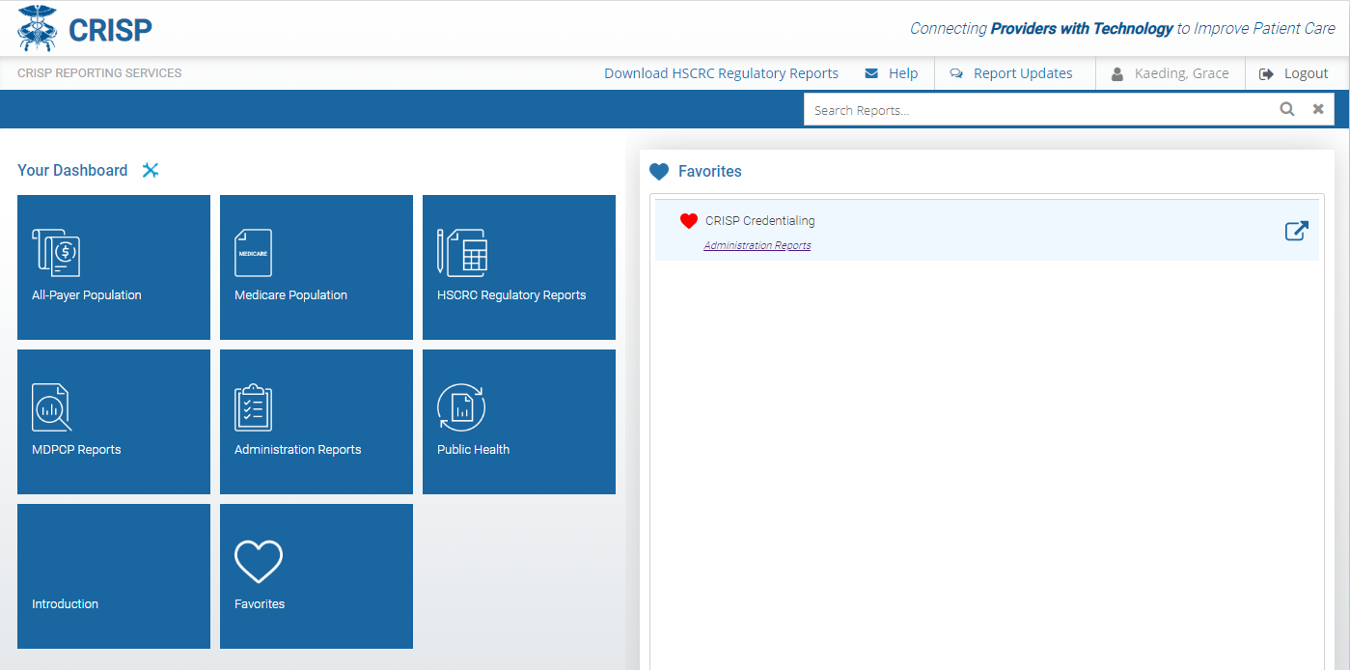
CRISP Credentialing = LogOnce
Click the wrench and spanner icon to view a full list of cards available to you.
Favorited Reports will appear here when you login.
The card titled ‘Administration Reports’ will take you to the Report Finder Page. ‘CRISP Credentialing’ will appear, which is the access point for the LogOnce credentialing system.

Slide 5
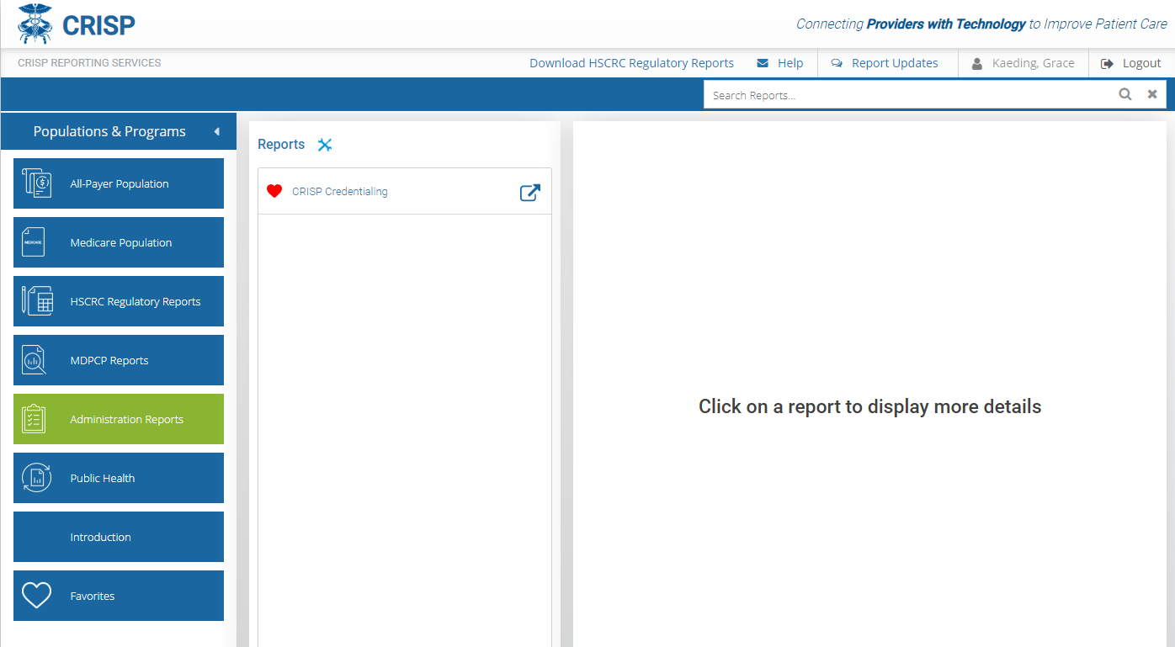
POC User Management Tools in LogOnce
CRISP Credentialing will appear in the second tier of reports. Click the Application Links icon to launch the LogOnce Application.
Click the heart icon to favorite a report. A red heart means the report has been favorited.

Slide 6
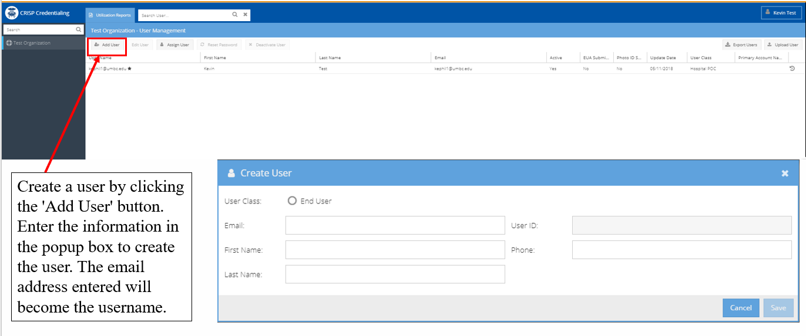
CRS Credentialing Workflow
Practice CRS POC will create user in their Organization

Slide 7
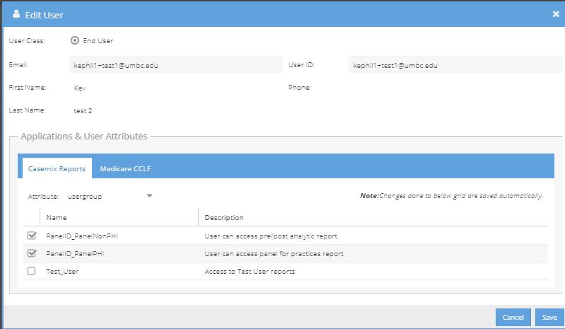
CRS Credentialing Workflow
Once a User is created, a POC will be able to assign report permissions to a user.
CRS POC will assign a user report roles
Under ‘Applications & User Attributes’ choose Attribute = usergroup. Next, select report permissions for the user. Tabs separate the groups of permissions by data source.
Click Save.
PracticeID_MDPCPPHI
User can access MDPCP reports.

Slide 8
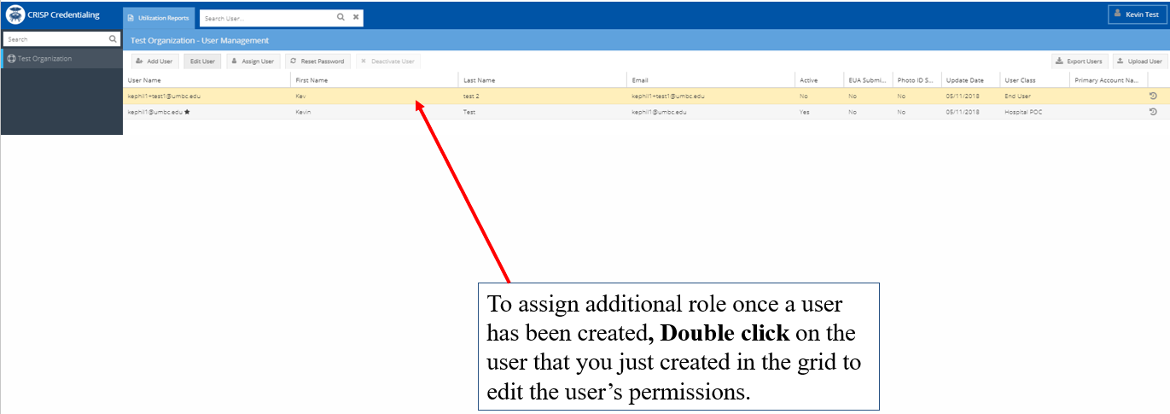
CRS Credentialing Workflow
CRS POC will assign a user report roles
  Note POCs can edit report permissions of a user at any time

Slide 9
Password Resets
There are 2 options for password resets:
POC may reset password within LogOnce
User may reset password on CRS Portal login screen at https://reports.crisphealth.org

Slide 10
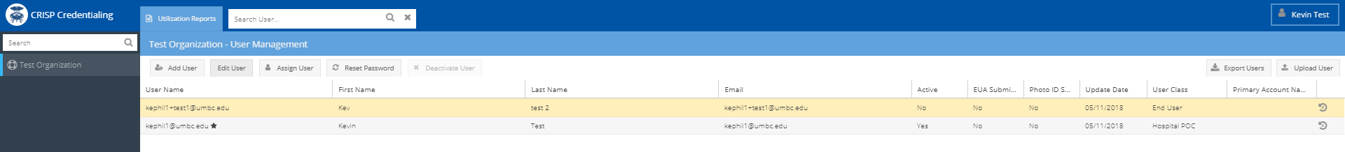
Password Resets – via LogOnce
To reset a user’s password, select the user and click the reset password button. The user will receive an email to reset their password.

Slide 11
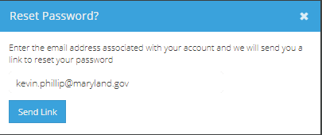
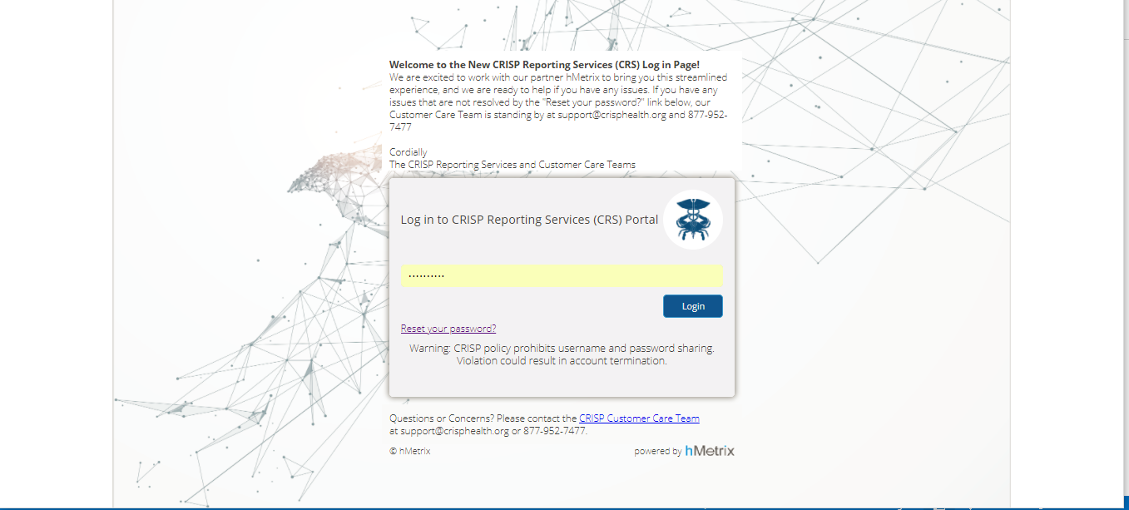
Password Resets – via https://reports.crisphealth.org
A user can reset their password on reports.crisphealth.org by clicking the reset password button. The user will receive a popup to send a link to the email address associated with their account.

Slide 12
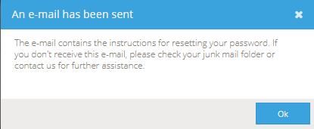
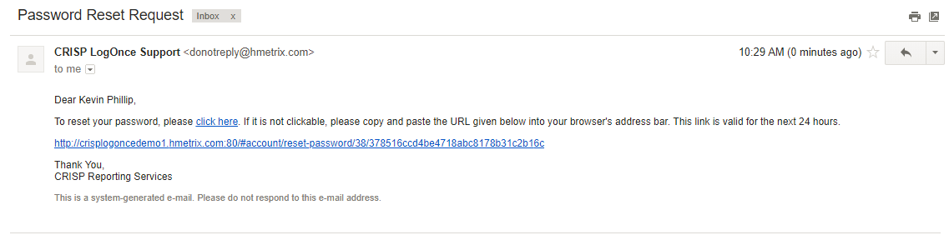
Password Resets – via https://reports.crisphealth.org
A user will receive a confirmation that an email has been sent. The email provides a link for the user to reset their password and an URL to that page.

Slide 13
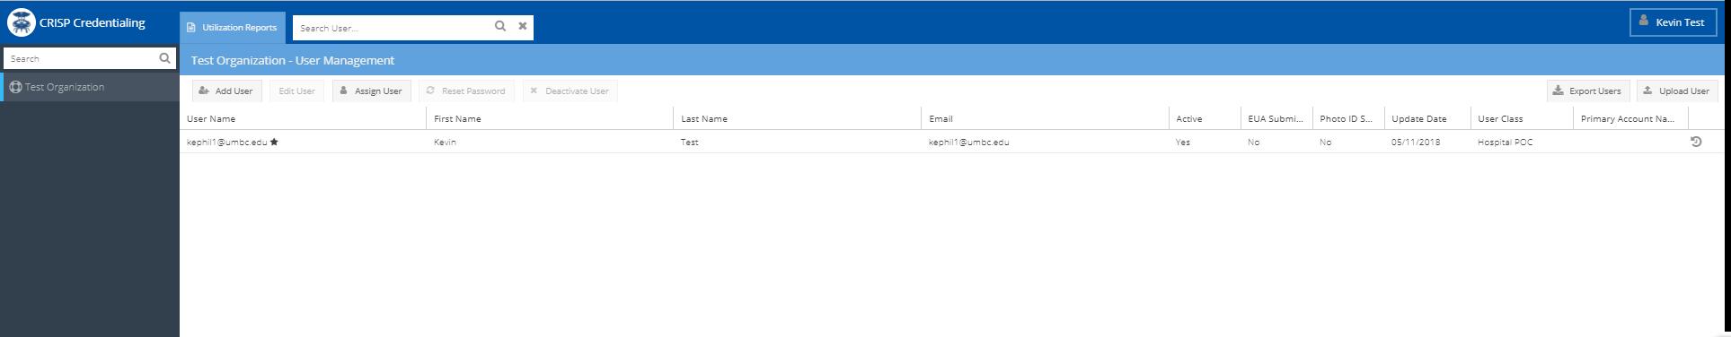
User Provisioning Log
You can view a user’s account history through the User
Provisioning Log by clicking the clock symbol on the right side of the user row. This log will display information about account activation, deactivation, report access grant, etc.

Slide 14
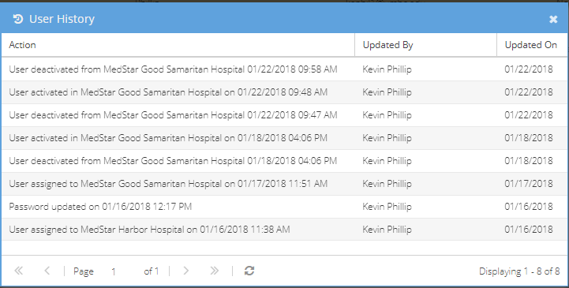
User Provisioning Log

Slide 15
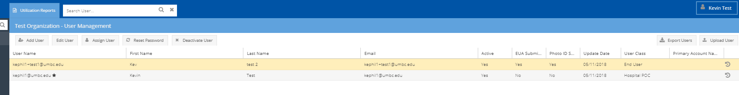
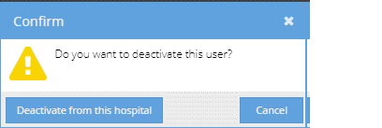
Deactivating a User
To deactivate a user, select the user and click the ‘Deactivate User’ button. A ‘Confirm’ box will popup asking for confirmation of deactivation.

Slide 16
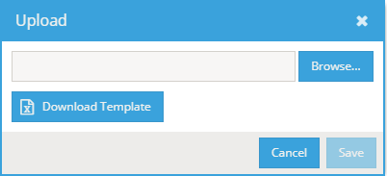
Bulk Uploading Users
To bulk upload users to a hospital, click the 'Upload User' button. Next, download the template and complete required data into the template. Save the file on your local computer (do not change the column headings and file extension). Then, upload your completed template using the 'Browse' button and click 'Save'.

Slide 17
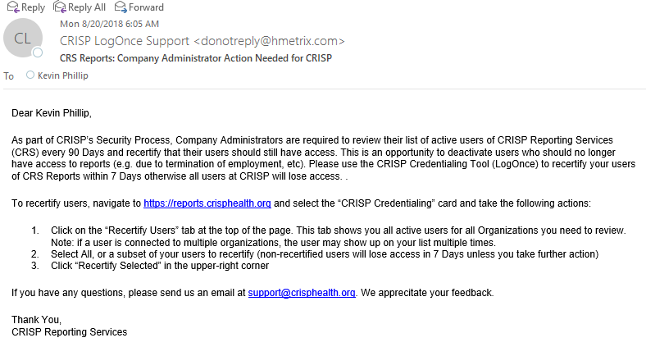
Recertify Users
POCs are required to recertify all active users in their organization every 90 days per CRISP security requirements.
All Users not recertified by the POC will be ‘locked out’ of the CRS Portal until recertification occurs – regardless of active status
POCs receive a email notification a week prior to this lock out

Slide 18
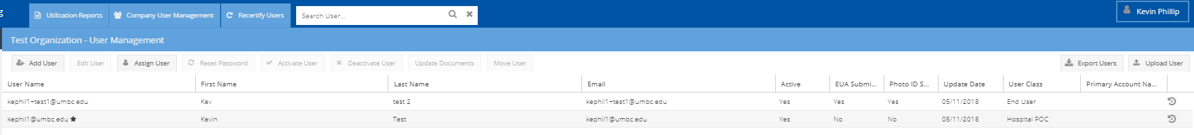
Recertify Users
Click on the “Recertify Users” tab at the top of the page
.
Notes:
Note: Known Bug Around Deactivating users

Slide 19
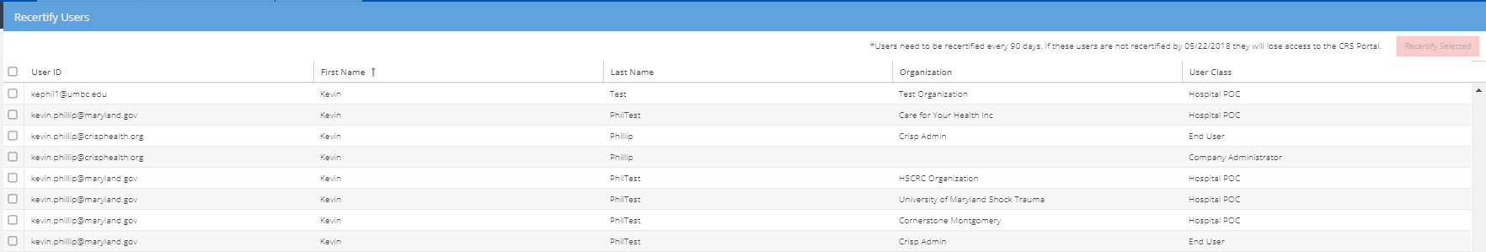
Recertify Users
This tab shows you all active users for all Organizations you need to review. Note: if a user is connected to multiple organizations, the user may show up on your list multiple times.

Slide 20
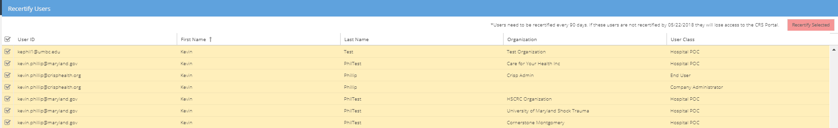
Recertify Users
Select All, or a subset of your users to recertify (non-recertified users will lose access unless you take further action)

Slide 21
Recertify Users
Click “Recertify Selected” in the upper-right corner

Slide 22
Changing a User’s Email
POCs and users cannot change their email address in the LogOnce system.
If a POC or user needs to change an email address in their LogOnce account, the user must be deactivated and a new user with the new email address must be created within the LogOnce system

Slide 23
CRISP Support Contact
Contact for LogOnce Questions
  support@crisphealth.org
  1-877-952-7477

