Slide 1
How to Optimize Cloud Purchasing for the Modern B2B Buyer
Notes:
competition

Slide 2
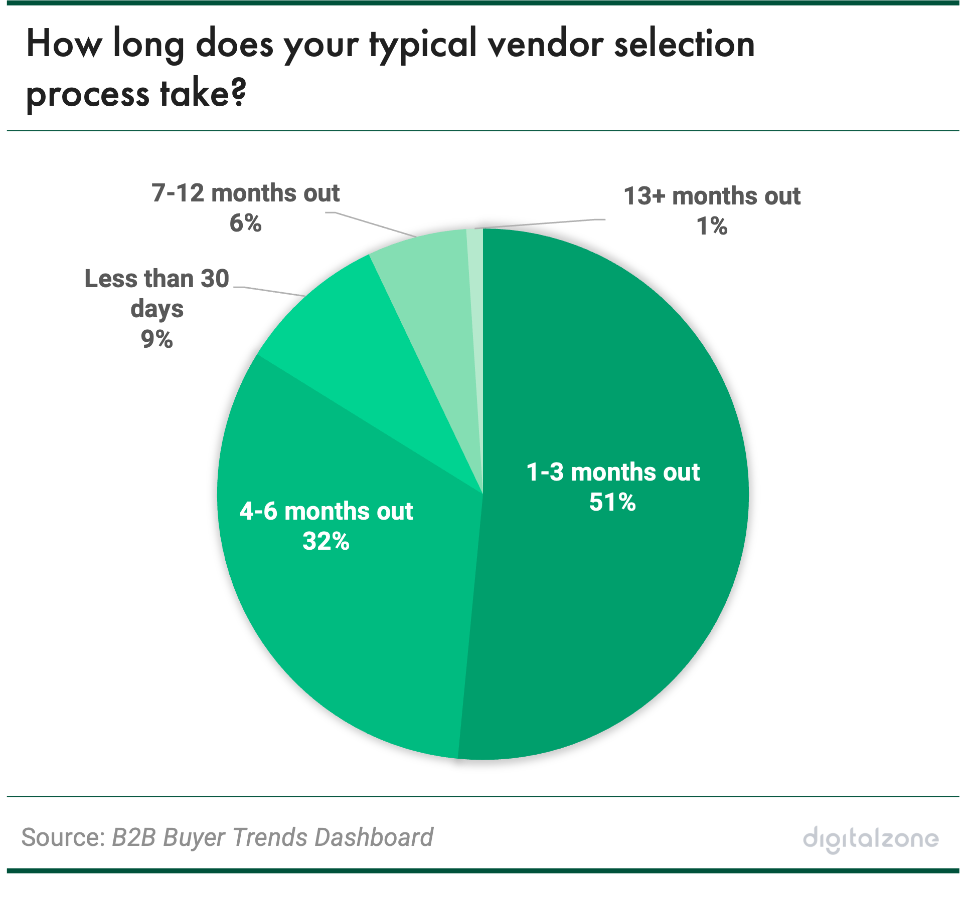

Slide 3
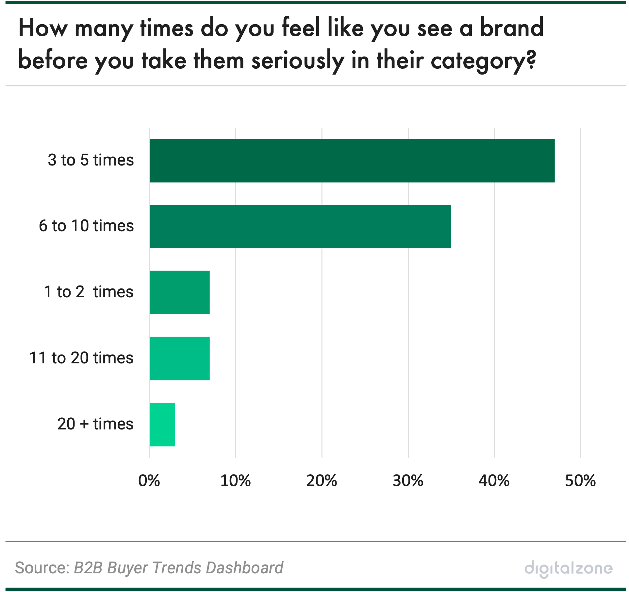

Slide 4
