Slide 1
Right to Education under Federal Law:
Supporting Afghan Newcomers
Dr. Supreet Anand, Office of English Language Acquisition
K. Sabrina Austin, Office of Special Education Programs
Carolyn Seugling, Office for Civil Rights
December 2021

Slide 2
AGENDA
Legal Obligations of Schools to English Learners
Resources from OCR/OELA
Legal Obligations to Students with Disabilities
Filing a Complaint with the Office for Civil Rights
Question and Answer

Slide 3
Disclaimer: We are providing an overview of the Federal framework. Please adhere to the state laws and guidance in your jurisdiction.

Slide 4
Rights of Students
All children in the United States have an equal right to enroll and participate in public elementary and secondary schools without regard to their or their parents’ or guardians’ immigration status.
Public schools must offer language assistance services to all students with limited English proficiency.
Public schools must communicate information about enrollment, classes, and other educational programs and activities in a language that all parents, guardians, and sponsors can understand.
“Confronting Discrimination Based on National Origin and Immigration Status” (August 2021)
https://www2.ed.gov/about/offices/list/ocr/docs/confronting-discrimination-national-origin-immigration-status
Notes:
These statements found in the Fact Sheet: Confronting Discrimination on National Origin and Immigrant Status, come from a long history of civil rights protections, cases and other federal laws as I will share in the next slide.
This fact sheet is available in Pashto, Dari and Arabic, among other languages.

Slide 5
Education Rights and Responsibilities
Civil Rights Requirements
Significant Case Law
ESEA and Standards
Executive Orders
Notes:
I have four areas that I want to discuss with you as we further consider these educational rights of students.

Slide 6
Civil Rights Requirements
Title VI of the Civil Rights Act of 1964
  No person in the United States shall, on the ground of race, color, or national origin, be excluded from participation in, be denied the benefits of, or be subjected to discrimination under any program or activity receiving Federal financial assistance.
Section 1703(f) of the EEOA
  No State shall deny equal educational opportunity to an individual on account of his or her race, color, sex, or national origin, by. . . the failure by an educational agency to take appropriate action to overcome language barriers that impede equal participation by its students in its instructional programs.
Notes:
Civil Rights Requirements
Title VI of the Civil Rights Act of 1964 Section 601: “No person in the United States shall, on the ground of race, color, or national origin, be excluded from participation in, be denied the benefits of, or be subjected to discrimination under any program or activity receiving Federal financial assistance.” 42 U.S.C. § 2000d to d-7.
As every public school receives federal funds in some way shape or form, they have the responsibility of applying the civil rights protection for English learners.
Many Afghani students will qualify as ELs.
Title VI’s prohibition on national origin discrimination requires SEAs and school districts to take “affirmative steps” to address language barriers so that EL students may participate meaningfully in schools’ educational programs. The Office for Civil Rights (OCR) at the U.S. Department of Education (ED) and the Civil Rights Division at the U.S. Department of Justice (DOJ) share authority for enforcing Title VI in the education context.
Section 1703(f) of the Equal Educational Opportunities Act of 1974 requires state educational agencies (SEAs) and school districts to take appropriate actions to overcome language barriers that impede English Learner (ELs) students from participating equally in state and district educational programs. 20 U.S.C. § 1703(f).
DOJ is responsible for enforcing the EEOA.
Title VI, the EEOA and other case law I will discuss in the next slide provide the “what” and the “why” of EL education – in other words, why are schools and districts required to do certain things, and what is the purpose of those requirements?

Slide 7
Significant Case Law
Lau v. Nichols: 1974 Supreme Court Case that found school systems must take “affirmative steps” to address language barriers so that EL students may participate meaningfully in schools’ educational programs.
Castañeda v. Pickard: Fifth Circuit case that specifies that an appropriate EL instructional program should be (1) based on sound theory, (2) implemented effectively, and (3) evaluated to determine effectiveness.
Notes:
Significant Case law explains how the court will interpret these laws- what sort of judgement we may expect in the same or similar circumstances.
Lau v. Nichols, 414 U.S. 563 (1974). Lau stated that where inability to speak and understand the English language excludes national origin-minority group children from effective participation in the educational program offered by a school district, Title VI requires that the district take affirmative steps to rectify the language deficiency to open its instructional program to these students. “Affirmative steps” has been interpreted as providing students with appropriate instructional support.
In determining whether a school district’s programs for EL students comply with the civil rights laws, ED and DOJ apply the standards established by the United States Court of Appeals for the Fifth Circuit in Castañeda v. Pickard, 648 F.2d 989 (5th Cir. 1981). Specifically, the Departments consider the following to determine whether an appropriate EL program has been selected and implemented: (1) The educational theory underlying the language assistance program is recognized as sound by some experts in the field or is considered a legitimate experimental strategy; (2) The program and practices used by the school system are reasonably calculated to implement effectively the educational theory adopted by the school; and (3) The program succeeds, after a legitimate trial, in producing results indicating that students’ language barriers are actually being overcome within a reasonable period of time.

Slide 8
ESEA and Standards
Language and content standards
Shifts in accountability
Notes:
NCLB and now ESSA- reauthorization of ESEA- has only strengthened requirements for ELs -accountability systems, parent engagements requirements or requirements pertaining to LIEPS
It’s important to remember that while states may have received certain waivers for some of the ESSA requirements and other procedures during the pandemic, the civil rights requirements under Title VI and EEOA for ELs cannot be waived and always remain in place.

Slide 9
Executive Orders
Biden Executive Order 13985
Advancing Racial Equity and Support for Underserved Communities Through the Federal Government. (January 2021)
Notes:
There are also the Executive orders that presidents sign. Most significant for our purposes is the recent one on equity.
As the Biden-Harris Administration has explained, the term “equity” means the consistent and systematic fair, just, and impartial treatment of all individuals, including individuals who belong to underserved communities that have been denied such treatment, such as Black, Latino, and Indigenous and Native American persons, Asian Americans and Pacific Islanders and other persons of color; members of religious minorities; lesbian, gay, bisexual, transgender, and queer (LGBTQ+) persons; persons with disabilities; persons who live in rural areas; and persons otherwise adversely affected by persistent poverty or inequality. Exec. Order No. 13985, 86 Fed. Reg. 7009, 7009 (Jan. 20, 2021).

Slide 10
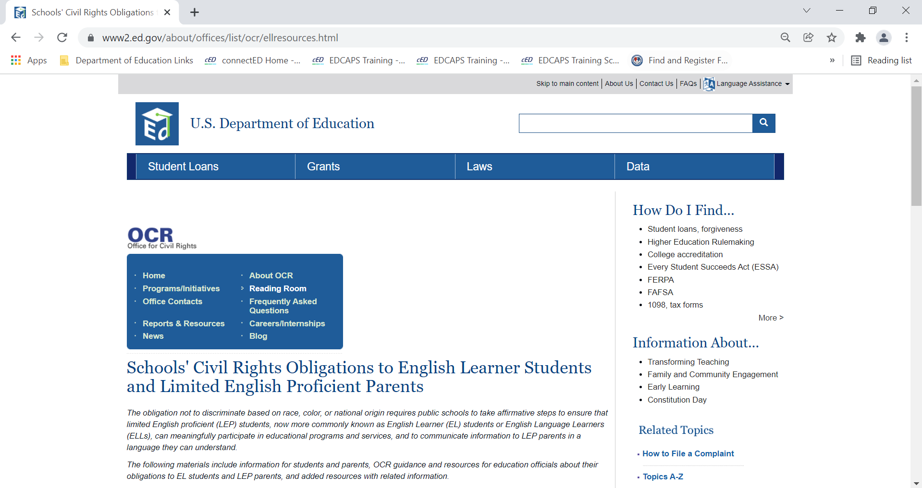
Resources from OCR
https://www2.ed.gov/about/offices/list/ocr/ellresources.html
Notes:
The Office for Civil Rights has numerous resources available on its website generally and on the page dedicated to Schools' Civil Rights Obligations to English Learner Students and Limited English Proficient Parents. I will highlight a few of these resources for you in the next slide.
On OCR’s website, you will also find information for filing a complaint which I will also cover briefly later. Some of the resources are available in Arabic, Dari, Pashto and Urdu.

Slide 11
Resources from OCR
Confronting Discrimination Based on National Origin and Immigration Status (August 2021)
This is a brief, joint communication from the U.S. Departments of Justice and Education. It was developed for families and educators. It states clearly that public school districts may not deny access to an education to any child based on immigration status. It is a violation of federal law for districts to prohibit or discourage children from enrolling in public schools because the children or their parents or guardians are not U.S. citizens or do not have immigration documentation.
Dear Colleague Letter – Department of Justice & Department of Education,
English Learner Students and Limited English Proficient Parents (January 2015)
This joint DOJ and ED DCL provides an outline of the legal obligations of SEAs and school districts to EL students and their families under the civil rights laws.
Notes:
Confronting Discrimination Based on National Origin and Immigration Status: This resource from OCR and DOJ provides examples and addresses students’ rights to be free from discrimination in school enrollment because of their immigration status or the immigration status of their parents or guardians. It also addresses the rights of students who are learning English, including the right to language assistance services. This fact sheet is available in Pashto, Dari and Arabic, among other languages.
Dear Colleague Letter – Department of Justice & Department of Education,
English Learner Students and Limited English Proficient Parents
This joint DOJ and ED DCL provides an outline of the legal obligations of SEAs and school districts to EL students and their families under the civil rights laws. This resource is available in Arabic, among other languages.

Slide 12
Resources from OCR
Dear Colleague Letter – Department of Justice & Department of Education
School Enrollment Procedures (May 2014)
This DCL describes the obligations of States and school districts under Federal law to provide all children with equal access to public education at the elementary and secondary level.
Fact Sheet: Information on the Rights of All Children to Enroll in School (May 2014)
This Fact Sheet contains information on the rights of all children to enroll in school.
Information on the Rights of All Children to Enroll in School: Questions and Answers for States, School Districts and Parents (May 2014)
These Questions and Answers are intended to assist states and school districts in meeting their legal obligations to ensure that their enrollment policies and practices at the elementary and secondary school levels do not discriminate on the basis of race, color, or national origin, and do not bar or discourage students’ enrollment in elementary and secondary school based on their or their parents’ actual or perceived immigration status.
Notes:
These following three resources have been jointly issued by ED and DOJ.
The joint ED and DOJ DCL, Guidance for School Districts to Ensure Equal Access for All Children to Public Schools Regardless of Immigration Status, describes the obligations of States and school districts under Federal law to provide all children with equal access to public education at the elementary and secondary level. The letter offers specific guidance to school districts to support their efforts to ensure that all students resident in a district can enroll in public elementary and secondary schools. The letter also highlights examples of information that districts may not use as a basis to deny school enrollment to a child. This resource is available in Arabic, among other languages.
This joint ED and DOJ fact sheet provide information on how states, districts, and schools can meet their responsibilities under Title VI and the Equal Educational Opportunities Act (EEOA) to ensure that English learners can participate meaningfully and equally in school, and that parents and guardians with limited English proficiency have meaningful access to district and school information. For more detail, see OCR’s and DOJ’s Dear Colleague Letter on English Learners and Limited English Proficient Parents. This resource is available in Arabic, among other languages.
The Questions and Answers are intended to assist states and school districts in meeting their legal obligations to ensure that their enrollment policies and practices at the elementary and secondary school levels do not discriminate on the basis of race, color, or national origin, and do not bar or discourage students’ enrollment in elementary and secondary school based on their or their parents’ actual or perceived immigration status. This resource is available in Arabic, among other languages.

Slide 13

Resources from OELA
The Newcomer Tool Kit provides:
Discussion of topics relevant to understanding, supporting, and engaging newcomer students and their families
Tools, strategies, and examples of classroom and schoolwide practices in action, along with chapter-specific professional learning activities for use in staff meetings or professional learning communities
Selected resources for further information and assistance,
most of which are available online at no cost.
https://www2.ed.gov/about/offices/list/oela/newcomers-toolkit/ncomertoolkit.pdf
Notes:
This is a resource for teachers and schools.

Slide 14
Legal Obligations for Students with Disabilities Under Section 504 and Title II of the ADA
Public school districts may not discriminate against any student on the basis of disability.
Public schools must offer regular or special education and related aids and services that are designed to meet the individual educational needs of students with disabilities as adequately as the needs of students without disabilities are met.
Public entities, like public schools, must offer reasonable accommodations and program modifications for students with disabilities.
“Parent and Educator Resource Guide to Section 504 in Public Elementary and Secondary Schools” (December 2016)
https://www2.ed.gov/about/offices/list/ocr/docs/504-resource-guide-201612.pdf
Notes:
These protections stem from two Federal civil rights laws: Section 504 of the Rehabilitation Act and Title II of the Americans with Disabilities Act.

Slide 15
Legal Obligations under IDEA
IDEA is a special education law that provides funding to states to make available a free appropriate public education (FAPE) to eligible children with disabilities.
IDEA requires states and districts to meet certain requirements.
Requirements of IDEA for school-age children (3-21) include:
  Identify, locate, and evaluate children with disabilities who need special education and related services
  This includes children who are experiencing homelessness or are wards of the State, highly mobile and migrant children, English learners, and more.
  Provide a FAPE to all eligible children through an individualized education program (IEP) that identifies special education and related services designed to meet their unique needs.
  In the case of a child with limited English proficiency, consider the language needs of the child as those needs relate to the child's IEP.
Notes:
Public schools must comply with the Individuals with Disabilities Education Act (IDEA).

Slide 16
Considerations Related to Disability
Evaluations under IDEA and the assessments involved must be conducted in a child’s native language.
Assessments and other evaluation materials must be selected and administered so as to not be discriminatory on a racial or cultural basis.
A child must not be found eligible under IDEA if the determinant factor is limited English proficiency; however, you cannot deny a child special education services due to their also receiving services as an English learner.
Notes:
Under Title VI, all vital documents, including a student’s IEP, must be accessible to LEP parents, but that does not necessarily mean that all vital documents must be translated for every language in the district. For example, a timely and complete oral interpretation or translated summary of a vital document might suffice in some circumstances. A district must, however, be prepared to provide timely and complete translated IEPs to provide meaningful access to the IEP and the parental rights that attach to it. This is because a parent needs meaningful access to the IEP not just during the IEP meeting, but also across school years to monitor the child’s progress and ensure that IEP services are provided.
https://sites.ed.gov/idea/files/policy_speced_guid_idea_memosdcltrs_iep-translation-06-14-2016.pdf

Slide 17
Parent Rights under IDEA
Parents have a right to request an evaluation at no cost.
Parents have a right to participate in meetings, including those with respect to the identification, evaluation, and placement of their child.
LEAs must take whatever action is necessary to ensure that the parent understands the proceedings of the IEP Team meeting, including arranging for an interpreter for parents whose native language is other than English.
Parents have a right to receive PWN and Procedural Safeguards in their native language unless not clearly feasible to do so.
Procedural safeguards include:
  Consent
  Reviewing records
  Receiving notice (of meetings and of decisions made at meetings)
  Request mediation or due process hearings if disagreements arise
  File State complaint to resolve disputes
Notes:
LEAs means “Local Educational Agencies.”

Slide 18
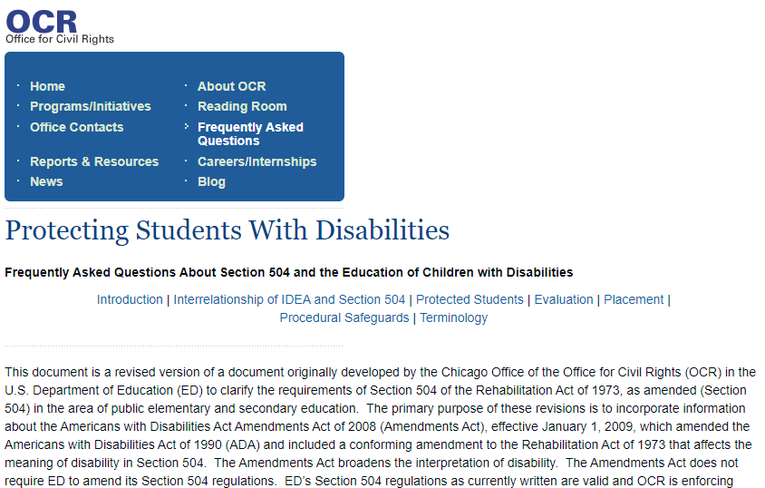
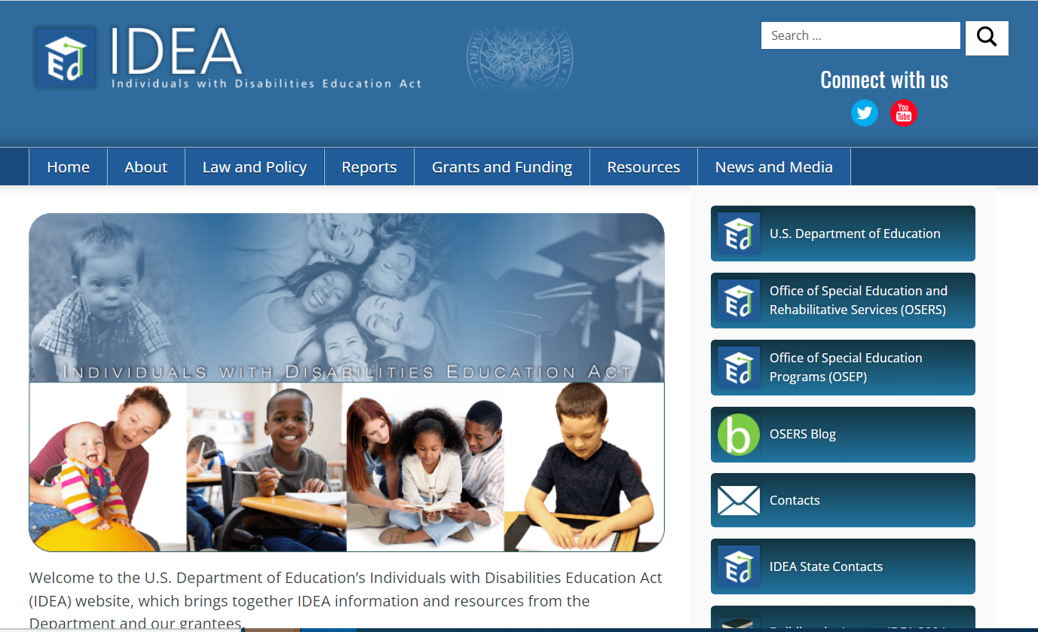
Resources for Schools/Providers
FAQ on Section 504
FAQs on Child Find under IDEA Part B & Part C

Slide 19

Resources for Parents/Families
Parent Centers in all 50 states:
https://www.parentcenterhub.org/

Slide 20
Filing a Civil Rights Complaint
Anyone who believes that an educational institution that receives federal financial assistance has discriminated against someone on the basis of race, color, national origin, sex, disability or age may file a complaint.
A complaint must be filed within 180 calendar days of the date of the alleged discrimination unless the time for filing is extended by the Office for Civil Rights for good cause.
Complaints can be filed online or via email, mail, or fax according to the instructions:
  https://www2.ed.gov/about/offices/list/ocr/docs/howto.pdf, https://www2.ed.gov/about/offices/list/ocr/docs/howto.html
Notes:
How to file a complaint, the complaint form and other information is available in Urdu and Arabic, among other languages. The online, electronic complaint assessment system is also available in Urdu and Arabic, among other languages.

Slide 21
Additional Resources
Starting School in the United States: A Guide for Newcomer Students' Families
This is a resource developed by the Regional Educational Laboratory (REL) Northwest. It provides answers to many questions newcomer families typically have about the U.S. school system. (July, 2020).
Welcoming, Registering, and Supporting Newcomer Students: A Toolkit for Educators of Immigrant and Refugee Students in Secondary Schools
This is another resource developed by the REL Northwest. It is intended to help educators and other stakeholders identify and use research-based practices, policies, and procedures for welcoming, registering, and supporting newcomer immigrant and refugee students who are attending secondary schools (grades 6–12) in the United States. It includes many practical examples. (February, 2021)
The Department has two webpages where we host other Fact Sheets, FAQs, and a variety of other resources (including many of those referenced above). While some of the materials have been archived, many have not. The first page is: Educational Resources for Immigrants, Refugees, Asylees and other New Americans. From this page, I encourage you to click on the “more…resources” links under each section to see additional information. The other page is: Educational Services for Immigrant Children and Those Recently Arrived to the United States.
Notes:
The REL Northwest Newcomer guide is available in Arabic.

Slide 22

Question and Answer

Slide 23
Thank You
Contact Information of Presenters:
Dr. Supreet Anand, Office of English Language Acquisition:
Supreet.Anand@ed.gov
K. Sabrina Austin, Office of Special Education Programs:
Kathryn.Austin@ed.gov
Carolyn Seugling, Office for Civil Rights:
Carolyn.Seugling@ed.gov
No official endorsement by the Department of any product, commodity, service, enterprise, curriculum, or program of instruction mentioned or referenced is intended or should be inferred. For the audience’s convenience, this PowerPoint contains information about and from outside organizations, including URLs. Inclusion of such information does not constitute the Department’s endorsement.

