Slide 1

Responding to Foreign National Minor Victims of Trafficking
U.S. Department of Health and Human Services
Office on Trafficking in Persons
Lauren Devine, Child Trafficking Prevention and Protection Coordinator

Slide 2
Training Overview
I : Office on Trafficking in Persons (OTIP)
II : Human Trafficking
III : Screening and Identification
IV : Reporting Process
V : Benefits and Services
VI : Case Trends

Slide 3
I : Office on Trafficking in Persons (OTIP)
Responding to Foreign National Minor Victims of Trafficking

Slide 4

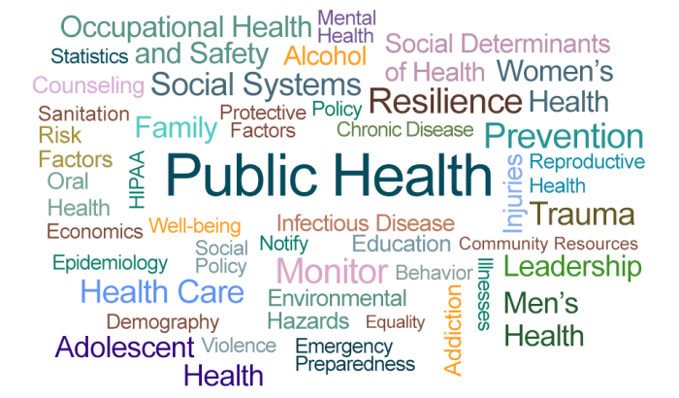
Office on Trafficking in Persons (OTIP)
Mission
To combat human trafficking by supporting and leading systems that prevent trafficking through public awareness and protect victims through identification and assistance, helping them rebuild their lives and become self-sufficient.

Slide 5
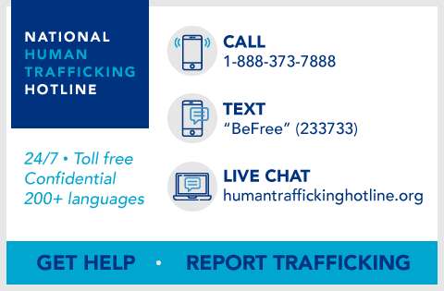


OTIP Major Functions
Protection
  Victim service and assistance activities, grant programs, Child Eligibility and Adult Certification programs, child victim coordination activities, and the National Human Trafficking Hotline
Prevention
  Training and technical assistance, survivor engagement, public awareness, regional coordination, and prevention education
Research and Policy
  Identification, coordination, and implementation of anti-trafficking research agenda, and supports program and policy development

Slide 6
II : Human Trafficking
Responding to Foreign National Minor Victims of Trafficking

Slide 7
What is Human Trafficking?
Human trafficking is a public health concern that impacts individuals, families, and communities across generations.
Labor Trafficking
Forced labor. Individuals are compelled to work or provide services through the use of force, fraud, or coercion.
Sex Trafficking
Commercial sex. Individuals are compelled to engage in commercial sex through the use of force, fraud, or coercion. When a person under 18 years old is compelled to perform a commercial sex act, it is a crime regardless of whether there is any force, fraud, or coercion.

Slide 8
Trafficking vs. Smuggling
Trafficking | Smuggling
Trafficking is a crime against a person. | Smuggling is a crime against a country.
Victims either do not consent to their situations or, if they initially consent, the situation shifts and they are made to engage in forced labor or commercial sex. | The transaction is typically mutual and ends upon arrival at predetermined destination.
Exploitation of victims to generate illicit profits for the traffickers. | Business arrangement between smuggler and person entering the country.
Trafficking does need to involve physical movement of a person (but must involve a person being subjected to forced labor or commercial sex). | Smuggling always involves transnational physical movement.
An individual being smuggled is at greater risk of experiencing trafficking.

Slide 9
Trafficking vs. Ransom
Trafficking | Ransom
Trafficking involves forced labor or commercial sex. | Ransom involves an individual being held against their will for the purpose of an organization or perpetrator receiving money.
Trafficking does not need to involve a person being held against their will. | Ransom typically involves the person being held against their will.
Includes forced labor or commercial sex to pay off debt or money owed to an individual or organization. | Ransom is paid directly to an individual or organization holding a person.
When a ransom payment for a child is met through a commercial sex act or the child is forced to work while held for ransom, then the child has likely experienced human trafficking.

Slide 10
Labor Trafficking vs. Labor Exploitation
Labor Exploitation
Paid less than promised
Withheld pay
No written earnings statement
  No meal breaks
  Hazardous work environment
  Lack of safe water or toilet
Movement to work controlled
  Individual lives at work site
Depriving or disorienting
Threats or use of violence
Demoralizing
Held against will
  Intimidation and control
  Sexual assault
  Use or threatened use of law
  Physical beatings
Labor Trafficking

Slide 11
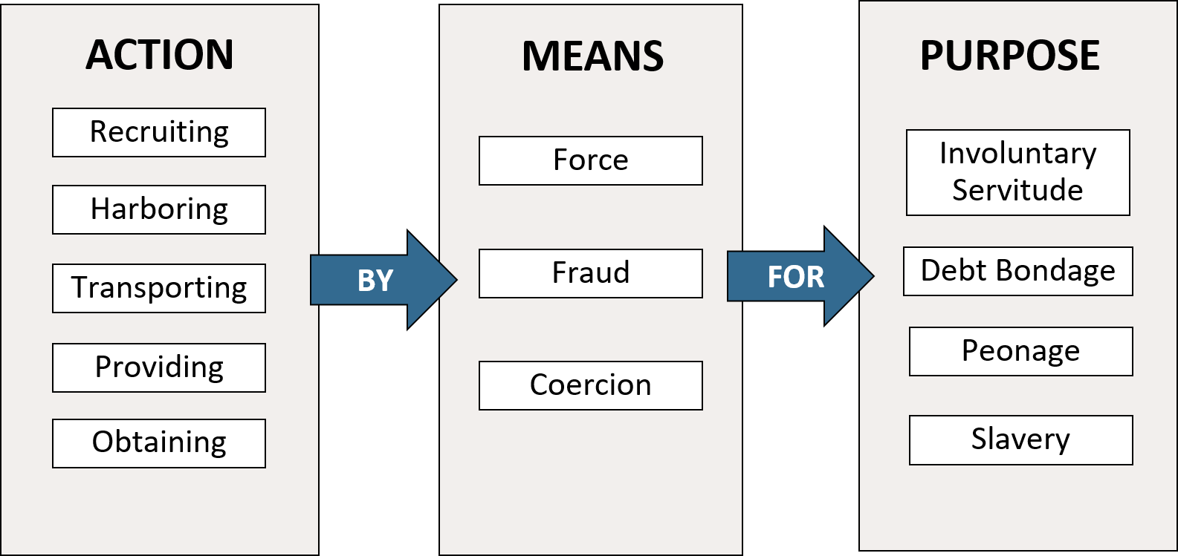
Labor Trafficking of Minors
The recruiting, harboring, transporting, providing, or obtaining of a child for labor or services through the use of force, fraud, or coercion for the purpose of subjection to involuntary servitude, peonage, debt bondage, or slavery.
(22 U.S.C. § 7102 (11))

Slide 12
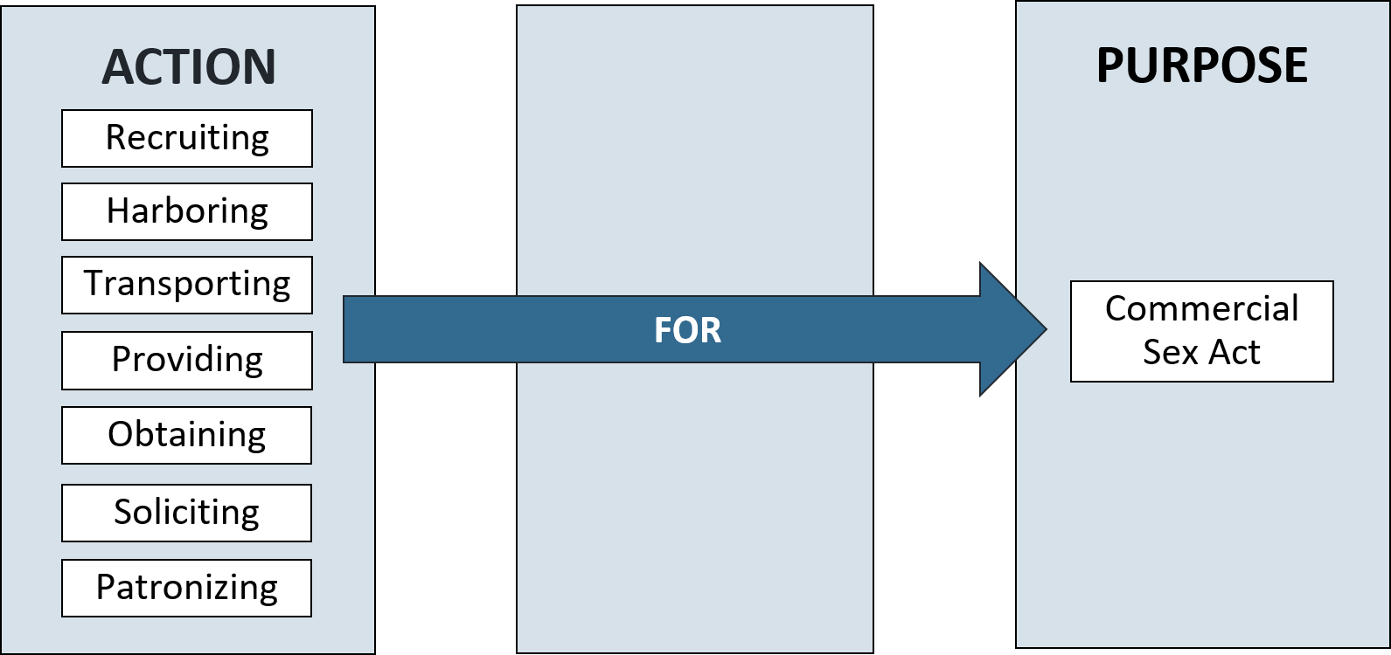
Sex
Trafficking of Minors
The recruiting, harboring, transporting, providing, obtaining, soliciting, or patronizing of a child for the purpose of engaging in a commercial sex act.
(22 U.S.C. § 7102 (12))

Slide 13
Sex
Trafficking of Minors
The “something of value” can include money, food, shelter, gifts, transportation, etc.
Offers of something of value for videos or images of a minor must include knowledge that the minor would be depicted or made to engage in a sexual act in the images or videos to be considered sex trafficking.
Sexual Act as defined in federal law, 18 U.S.C. § 2246.
Even if the sex act or exchange never occur, solicitation for a commercial sex act alone may be considered sex trafficking of a minor.

Slide 14
Recruitment of a child
Did the minor have a vulnerability that was then used against them for the purpose of exploitation? Did the child fit a specific profile? Were there grooming behaviors?
Harboring of a child
Was the child taken away from others (family, friends) or isolated? Was the child confined to a specific location? Were the child’s movements or communications monitored?
Transporting of a child
Was the child moved from one location to another for the purpose of being forced to work? Was the child provided with travel arrangements?
Provision of a child
Was the child given to another individual? Was the child given to a third-party employer?
Obtaining of a child
Was the child forcibly taken by an individual?
Soliciting of a child*
Was the child offered or promised money or something of value in exchange for a sex act?
Patronizing of a child*
Was any person offered or given money or something of value in relation to the child engaging in a sex act?
*Soliciting and patronizing are only for cases of sex trafficking.
Action
Sex & Labor Trafficking

Slide 15
Force
Physical. Sexual assaults, beatings, physical confinement, isolation.
Coercion
Psychological. Threats of serious harm or psychological manipulation, climate of fear, threatening the life and safety of a person or their family and friends, withholding legal documents, increasing or compounding debt that is impossible to pay off, witnessing harm to others, abuse or threatened abuse of the legal system.
Fraud
Deception. False promises about work and living conditions, use of fraudulent travel documents, fraudulent employment offers, withholding wages, changes in agreement or nature of relationship.
Children induced into commercial sex are victims of trafficking regardless of force, fraud, or coercion.
Means
Labor Trafficking

Slide 16
Involuntary Servitude
Forced labor. Any scheme, plan, or pattern intended to cause a person to believe that, if the person did not enter into or continue in such condition, that person or another person would suffer serious harm or physical restraint; or the abuse or threatened abuse of the legal process. This can also include “involuntary sexual servitude”.
Debt Bondage
Labor associated with a debt that increases or never decreases. The status or condition of a debtor arising from a pledge by the debtor of his or her personal services or of those of a person under his or her control as a security for debt, if the value of those services as reasonably assessed is not applied toward the liquidation of the debt or the length and nature of those services are not respectively limited and defined.
Peonage
Labor with threat of harm that is connected to a debt. A status or condition of involuntary servitude based on real or alleged indebtedness.
Slavery
Owned for the purpose of performing labor or services. The child was forced to perform labor or services with no pay or exchange of any goods and full purpose of day to day life becomes for the purpose of the labor or service. This can also include “sexual slavery”.
Commercial Sex Act
Sexual act in exchange for something of value. Any sex act on account of anything of value given to or received by any person.
Purpose
Sex & Labor Trafficking

Slide 17
Test your Knowledge (1)
A child is brought into the United States by a coyote. Once in the United States, the coyote demands more money from the child’s family and holds the child in a warehouse for three weeks until the child’s family sends additional money. While held, the child is told that if she attempts to leave, she will be killed.
A. Are there sex trafficking concerns, labor trafficking concerns, or no trafficking concerns?
B. What is the Action, the Means, and the Purpose?
C. If you cannot identify an Action, a Means, or a Purpose, what more questions would you ask?

Slide 18
Test your Knowledge (2)
While crossing the border, the child’s guide tells the child that she has to have sex with him in order to pay off her parents’ smuggling debt. The child agrees because she does not want to work when she gets to the United States to pay off the debt. The guide engages in sexual acts with her and tells her that her debt is now paid.
A. Are there sex trafficking concerns, labor trafficking concerns, or no trafficking concerns?
B. What is the Action, the Means, and the Purpose?
C. If you cannot identify an Action, a Means, or a Purpose, what more questions would you ask?

Slide 19
Test your Knowledge (3)
While waiting to cross the border, a 17-year-old boy is told by a stranger that he must carry drugs with him when he crosses into the United States. The stranger threatens to kill the boy if he does not carry the drugs. The child is apprehended after crossing the border and is found with drugs.
A. Are there sex trafficking concerns, labor trafficking concerns, or no trafficking concerns?
B. What is the Action, the Means, and the Purpose?
C. If you cannot identify an Action, a Means, or a Purpose, what more questions would you ask?

Slide 20
Test your Knowledge (4)
A child and her mother arrange the child’s journey to the United States.
The child’s mother puts up their land as collateral for the cost of her journey. The child is planning to work in the United States once she turns 18 years old and does not currently have a job set up for her. If the debt is not paid in three years her family will lose their land in Guatemala.
A. Are there sex trafficking concerns, labor trafficking concerns, or no trafficking concerns?
B. What is the Action, the Means, and the Purpose?
C. If you cannot identify an Action, a Means, or a Purpose, what more questions would you ask?

Slide 21
Common
Trends
Solicitation to engage in commercial sex
Cost of journey, shelter, food, etc. in exchange for sex
Forced to work on journey
Forced to work for caregiver
Held for ransom on journey and then forced to work
Smuggling concerns with debts and plans to work
Peonage and debt bondage to pay off debts for journey
Recruited to run away and then forced to work
Forced to engage in forced criminality
Involuntary sexual servitude and slavery
Intersection of labor trafficking and sex trafficking

Slide 22
III : Screening and Identification
Responding to Foreign National Minor Victims of Trafficking

Slide 23
Reasons for Underreporting
Why foreign national minors may not report:
Minor lacks awareness of victimization or thinks exploitation is “normal”
Minor experiencing complex trauma
Minor has been coached by the trafficker
Minor fears deportation or law enforcement
Minor distrusts screeners and authorities
Minor feels shame or guilt
Minor fears that trafficker will cause harm to them, their family, or their loved ones
Why screeners may not report:
Newly-hired worker lacks knowledge about human trafficking and case trends among unaccompanied children
Screener is busy and rushing the interview with the minor
Language or cultural barriers between minor and screener
Directions in policy guidance are outdated or unclear
Screener does not conduct the interview in a trauma-informed, victim-centered, or child-informed manner

Slide 24
Trauma-Informed and Victim Centered Screening
Use TED Questions.
Ask open-ended, non-leading questions.
Assess impact of child’s environmental factors and possible vulnerabilities with disclosure.
Consider effects of trauma on the child’s responses, consider cognitive abilities, and consider mental health.
Build felt safety and trust.
Seek to allow the minor to share a narrative rather than asking for specific details and trying to get every detail of the situation.
TED Questions
T – Tell me about.
E – Explain.
D – Describe.

Slide 25
IV : Reporting Process
Responding to Foreign National Minor Victims of Trafficking

Slide 26
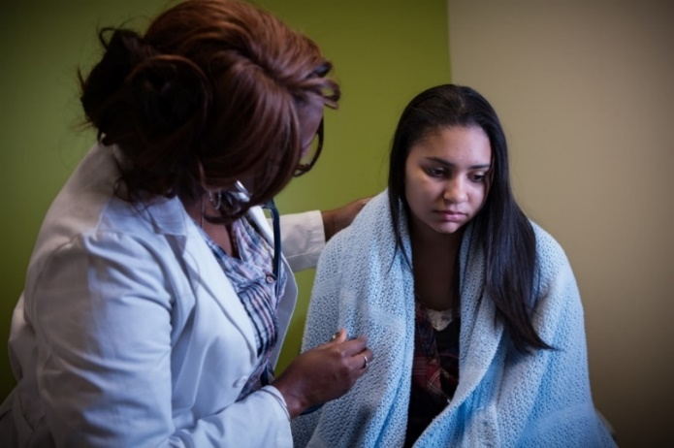
Reporting Requirements
Federal Reporting Requirements
“Not later than 24 hours after a federal, state, or local official discovers that a person who is under 18 years of age may be a victim of a severe form of trafficking in persons, the official shall notify HHS to facilitate the provision of interim assistance.” (Trafficking Victims Protection Act of 2000, as amended)
State and Local Child Welfare Reporting Requirements
Human trafficking is now included in the definition of child abuse. Therefore,
mandated reporters are now required to follow their state and local child
welfare reporting requirements and report trafficking accordingly.
(Justice for Victims of Trafficking Act of 2015)

Slide 27
Requirements to Report to OTIP
There are concerns of possible forced labor or commercial sex at any point in the minor’s life.
The minor is currently under the age of 18 and is currently located in the United States.
The minor is a non-U.S. citizen and non-lawful permanent resident.

Slide 28
Steps to Request Assistance from OTIP
1. Create an account in Shepherd, OTIP’s online case management system.
2. Submit a Request for Assistance to OTIP in Shepherd.
3. Check your emails and log back into your account for updates and to submit additional information to OTIP.

Slide 29
Child Eligibility Process
An individual has concerns that a foreign national minor may have experienced forced labor or commercial sex at any point in the minor’s life.
The OTIP Child Protection Team reviews the case, corresponds with the requester, and assesses whether the minor experienced trafficking in accordance with the TVPA of 2000, as amended.
If OTIP determines that the minor experienced trafficking, an Eligibility Letter is issued, and the child is referred to case management services.
The individual submits a Request for Assistance on the minor’s behalf in Shepherd, OTIP’s online case management system, within 24 hours of identifying the potential concerns.

Slide 30
Determination Types
Eligibility Letter
Request for Assistance indicates clear trafficking concerns or information gathered during period of Interim Assistance indicates clear trafficking concerns. Letter issued to the minor immediately or following the period of Interim Assistance that provides the minor the ability to apply for benefits and services to the same extent as a refugee. This letter does not expire.
Interim Assistance Letter
Request for Assistance indicates possible concerns of trafficking. Letter provides 90 to 120 days of benefits before a Denial or Eligibility Letter is issued.
Denial of Assistance
Request for Assistance did not indicate any possible concerns of trafficking. Internal denial response in Shepherd explaining why there was not enough information to provide Interim Assistance or Eligibility.
Denial of Eligibility Letter
Request for Assistance and additional information and consultation during Interim Assistance period do not indicate clear trafficking concerns. Letter issued to the minor after the period of Interim Assistance explaining that the minor is no longer eligible for assistance as a victim of trafficking.

Slide 31
V : Benefits and Services
Responding to Foreign National Minor Victims of Trafficking

Slide 32
Benefits
Monetary Assistance | Nutrition | Medical Services | Education | Employment | Housing | Multiple Needs Assistance
Refugee Cash Assistance | Supplemental Nutritional Assistance Program | Children’s Health Insurance Program | Title IV Federal Student Financial Aid | Job Corps | Public Housing Program | Refugee Social Services and Targeted Assistance
Supplemental Security Income (SSI) |  | Medicaid |  |  | Tenant-Based Vouchers | Unaccompanied Refugee Minors Foster Care Program
Temporary Assistance for Needy Families |  | Office of Refugee Resettlement Medical Screenings |  |  |  | Voluntary Agency Matching Grant Program
 |  | Refugee Medical Assistance

Slide 33
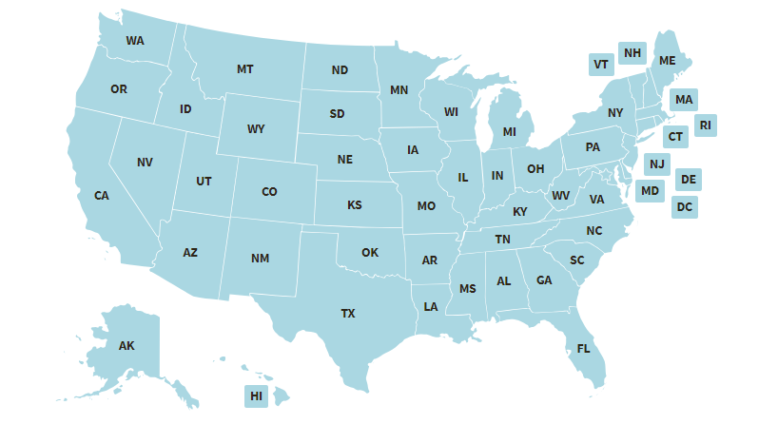
Case Management Services
Trafficking Victims Assistance Program (TVAP)
Trafficking-specific, comprehensive case management services and some out-of-pocket expenses for foreign national minors who have experienced human trafficking. Once connected to a social services organization, a case manager assists the child with accessing a range of supportive services:
Emergency needs
Housing, rent, utilities
Education
Transportation
Medical expenses
Mental health counseling
Food and clothing
Personal care items
Cell phone
Legal rights
Employment
Life skills training
Interpretation and translation
Financial support
U.S. Committee for Refugees and Immigrants
1-800-307-4712
TraffickingVictims@uscridc.org

Slide 34
VI : Case Trends
Responding to Foreign National Minor Victims of Trafficking

Slide 35
Eligibility Letters Issued FY 2001 to FY 2020

Slide 36
Type of Trafficking (FY20)

Slide 37
Gender (FY20)

Slide 38

Contact
Lauren Devine, Child Trafficking Prevention and Protection Coordinator
Email: Lauren.Devine@acf.hhs.gov
Phone: 202-205-5778
Child Eligibility Email: ChildTrafficking@acf.hhs.gov
Case Staffings Phone: 202-205-4582
Shepherd: https://shepherd.otip.acf.hhs.gov/
OTIP Website: acf.hhs.gov/otip

