Slide 1

COVID-19 Vaccine
Employee FAQs

Slide 2
OVERVIEW
Overview of the COVID-19 Vaccine
Plan for Vaccine Distribution to Staff

Slide 3
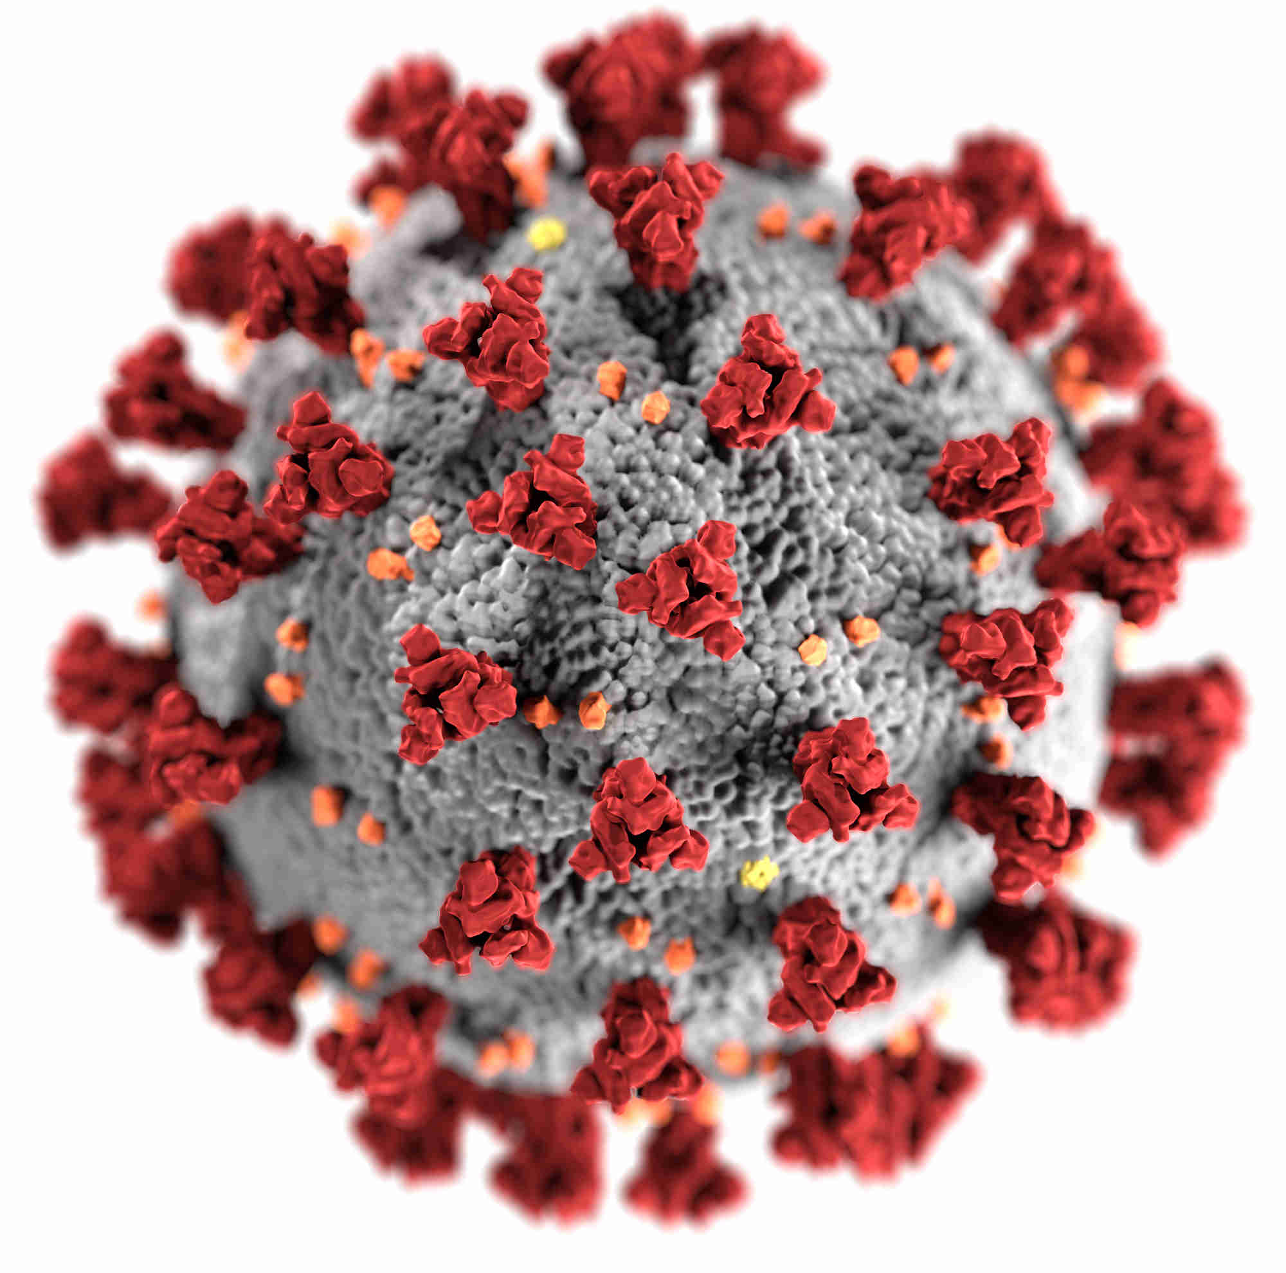
How does the vaccine work?

Slide 4
Two Kinds of Vaccines
Pfizer/BioNTech
Moderna
mRNA Vaccine
Two doses 21 days apart
Requires ultra-cold storage
mRNA Vaccine
Two doses 28 days apart
Requires freezer storage
The vaccines are 95% effective

Slide 5
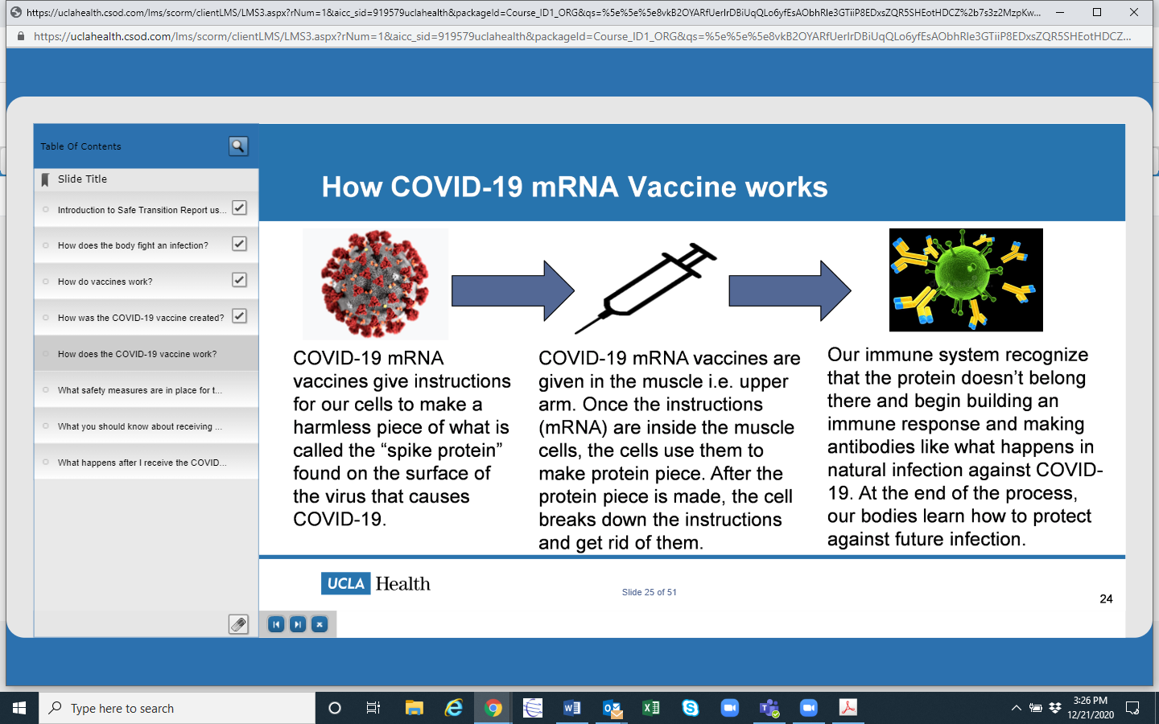

Slide 6
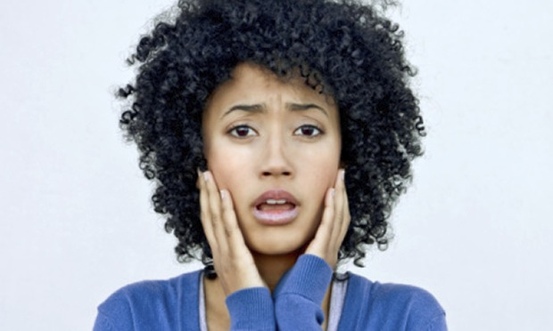
Is it safe?

Slide 7
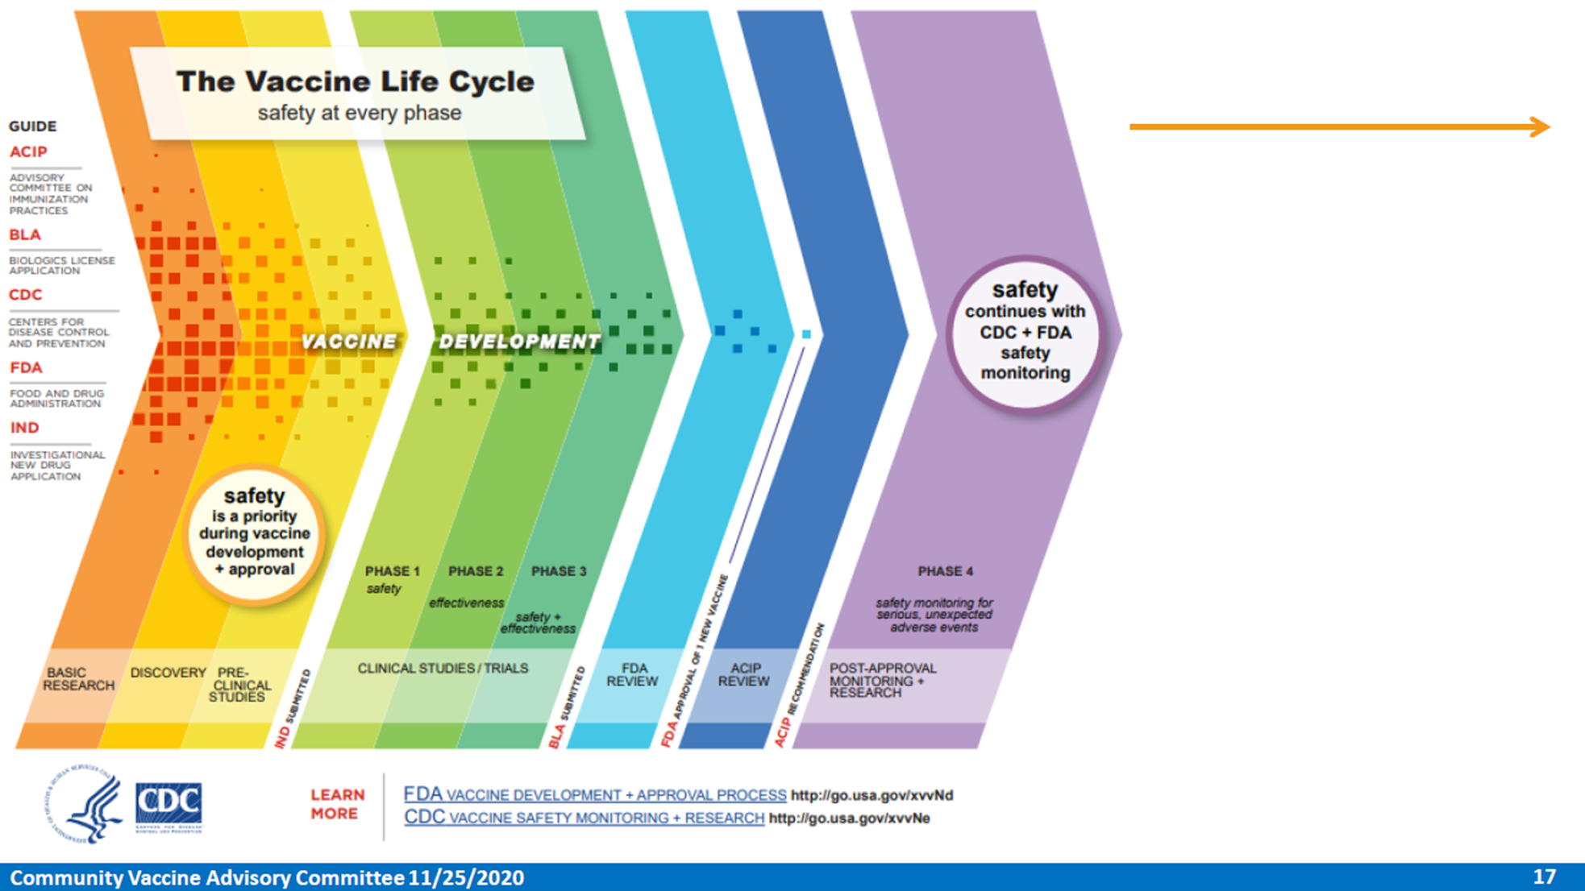

Slide 8
What are the side effects?
Expected Vaccine Reactions
mRNA Vaccines may have side effects, especially after the 2nd dose
Side effects include:
  Fever
  Headache
  Muscle aches
No significant safety concerns in vaccine trials
Side effects unlikely to appear after 8 weeks
The vaccine does not cause a positive test
You will be monitored for 15 minutes after receiving the vaccine to make sure you don’t develop serious side effects such as anaphylactic reaction.
Everybody receiving the vaccination are encouraged to register with v-safe https://www.cdc.gov/coronavirus/2019-ncov/vaccines/safety/vsafe.html

Slide 9

What happens after I get the vaccine?
After You Get the Vaccine
It is important that you continue to:
  Wear a mask
  Practice physical distancing
  Follow all other COVID-19 prevention precautions

Slide 10
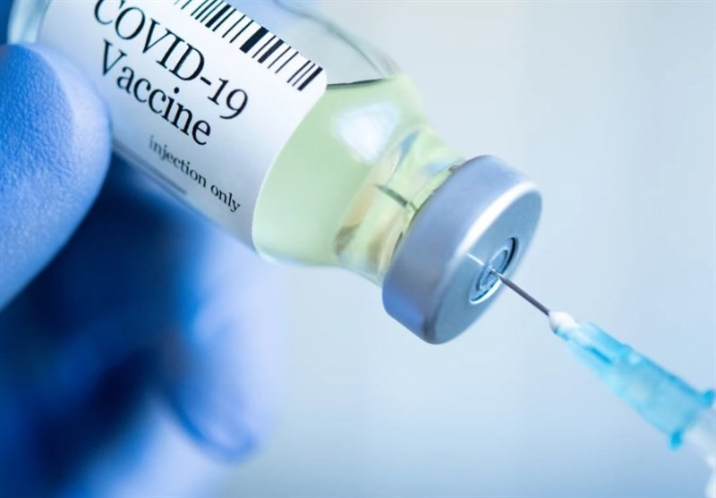
How do I get the vaccine?

Slide 11
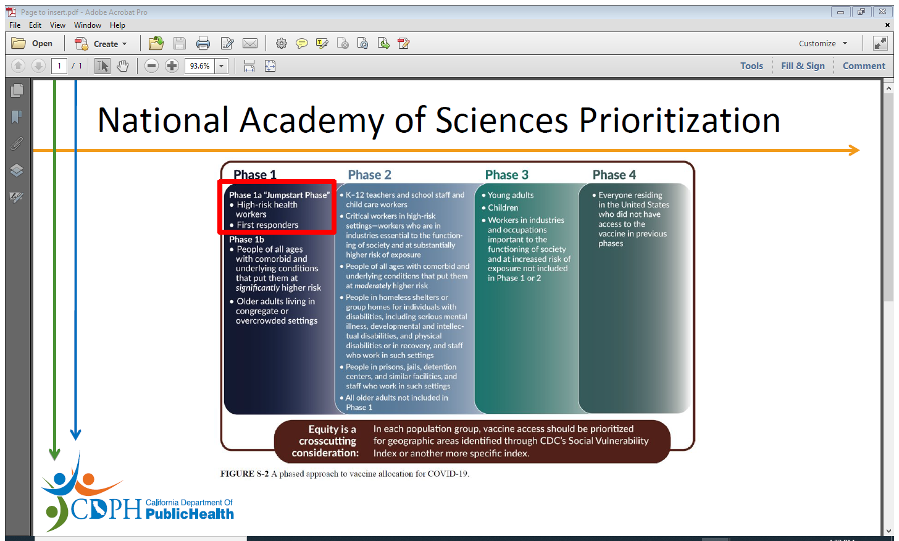

Slide 12
California Vaccine Distribution
Phase 1a: Health Care Workers
  Tier 1: Acute care, SNF, dialysis etc.
  Tier 2: Primary Care Clinics (including Community Health Centers), Home Health
  Tier 3: Labs, dental clinics, pharmacies

Slide 13
Staff Vaccine Distribution
Plan
To keep track of our vaccine numbers and to know how much to order, we need all staff members to please do one of the following:
1) If you already received COVID-19 Vaccine, either one or both doses, please send a copy to Human Resources at HR@tohelpeveryone.org or bring a copy to the office.
2) If you are Declining to be vaccinated, please sign the “Request for Waiver of COVID Vaccination Form” and return it to Human Resources at HR@tohelpeveryone.org or bring it to the office.
3) If you want the COVID-19 Vaccine and will wait until our clinic can provide it, please send an email to Betty, who will put you on the list to receive the vaccine once we have it available on-site.
4) If you are interested in receiving the COVID-19 Vaccine at one of our partner clinics as soon as Saturday, January 23rd, please email Betty bsalguero@tohelpeveryone.org as quickly as possible as spots are limited.

Slide 14
How long after the first dose can I receive the second dose and be protected?
Depending on which specific vaccine is used, the second dose will be administered after 21 days (Pfizer-BioNTech) or 28 days(Moderna). The first dose may offer about 50% protection, while the complete series offers up to 95% protection. It is important to receive both doses and continue masking/social distancing and to avoid mixing households even if you have received one or both doses.

Slide 15
Will this vaccine need to be repeated like the annual flu shot?
We do not yet know for how long the COVID-19 vaccines provide protection or if/when it will need to be repeated once the initial series is completed.

Slide 16
When do patients get the vaccine?

Slide 17
Patient Distribution
Timeline is not totally clear, but likely available to general public in
Spring or Summer

Slide 18
Message to Patients
COVID-19 Vaccines are not currently available to patients.
However, when vaccines are available, we will be providing them. This likely will be in the Spring.
When we have vaccines, we will begin sending out messages to patients on the portal and other places.

Slide 19
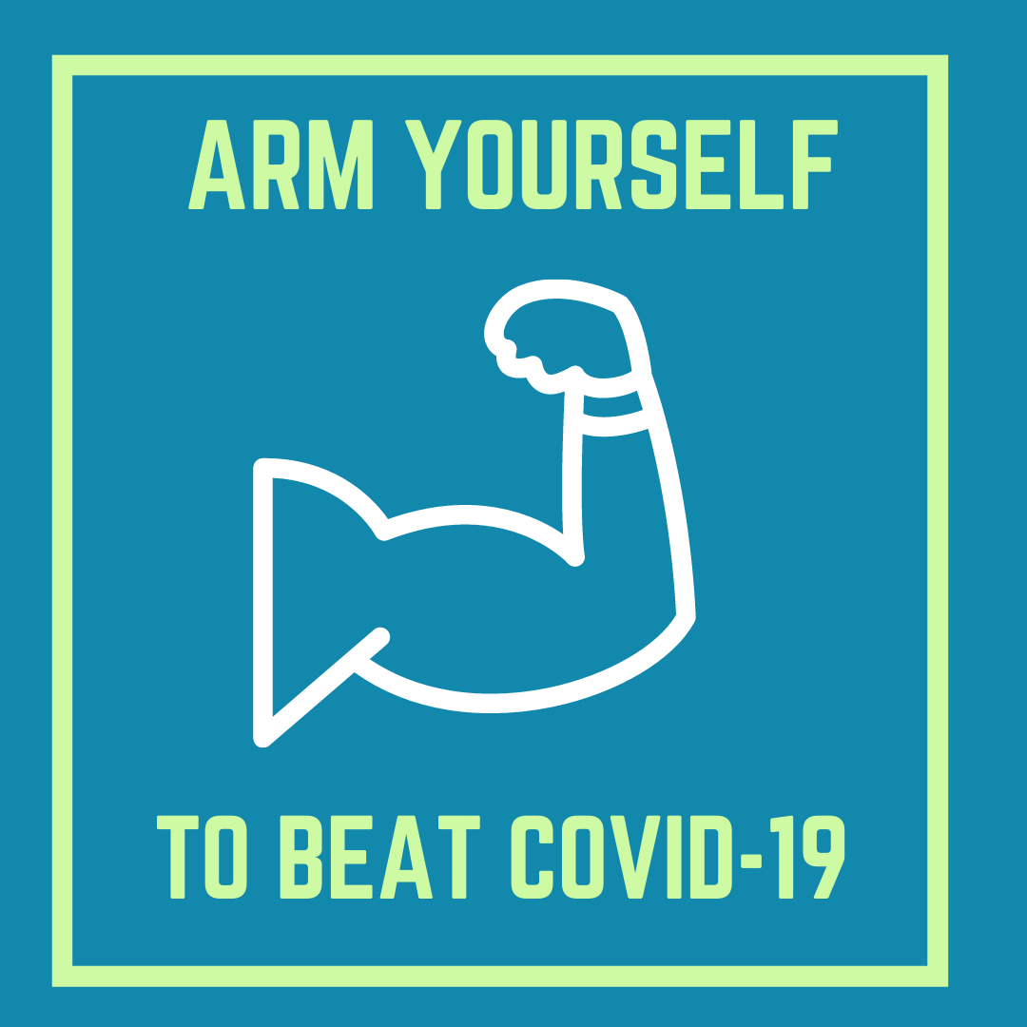
Derrick Butler, MD, MPH
Chief Medical Officer
dbutler@tohelpeveryone.org
(323) 730-1920, ext. 3061
#GetTheShot #PracticeGoodHealth #ThisIsOurShot

