Slide 1
New PWC Electric Rates/Riders
PWC Updates
City Council Work Session
August 1, 2022
Elaina L. Ball – CEO/GM

Slide 2
Electric Rates Summary
Key Drivers - Conservation, Economic Development, Customer Satisfaction
Base Rates
  PWC continues with the objective of maintaining current base rates through FY 2024
New Rates/Riders
  New rate design for Whole Home/Whole Small Business EV rates effective February 2023
  New Renewable Energy Buy Back rider effective February 2023
  New Economic Development rider effective September 2022
Updated Rates
  Changes in demand qualification and energy rate for Medium Power CP – (optional) September 2022, (required) September 2023
Services Regulations/Charges
  Fee reductions for Connections/Reconnections

Slide 3
New Rates
Residential Service - Whole Home (Electric Vehicles)
Single Phase Facility Charge | $30.00
Three Phase Facility Charge | $35.00
On-Peak Energy per kWh | $0.13270
Off-Peak Energy per kWh | $0.08473
Super Off-Peak Energy per kWh | $0.04810
Basic facility charge increase ($10), extension of Super Off- Peak energy period
Super off-peak is 9:00 PM to 5:00 AM
Target effective: February 2023

Slide 4
New Rates
Small Power Service - Whole Business (Electric Vehicles)
Single Phase Facility Charge | $45.00
Three Phase Facility Charge | $60.00
On-Peak Energy per kWh | $0.13742
Off-Peak Energy per kWh | $0.08935
Super Off-Peak Energy per kWh | $0.04810
Basic facility charge increase ($15), extension of Super Off-Peak energy period
Super Off-Peak is 9:00 PM to 5:00 AM
Target effective: February 2023

Slide 5
Customer Service Charges
Customer Service Charges | Current | Proposed
Initial Connection Fee | $22 | $20
Initial Connection Fee After Hours | $65 | $20
Reconnect Fee | $30 | $20
Reconnect Fee After Hours | $60 | $20
Disconnection Attempt Fee | $22 | Remove
Meter Testing Fee – Electric | $50 | $25
Meter Testing Fee – Water | $85 | $40
Reviewed internal effort and benchmarked utility practices

Slide 6
New Riders
Economic Development
Effective September 2022
Requirements
  New load: 1,000 kW
  Expansion: 750 kW
  FTE and/or capital investment requirements
  Minimum load factor: 40%
  Utility Purchase Agreement, repayment provisions
Energy Discount
  kWh percentage based
  Five-year declining annual credit

Slide 7
New Riders
Renewable Energy Buy Back
Effective February 2023
Requirements
  Residential and Small Power Service
  Follows applicable rate schedule
  10 kW or less Solar Generation Facility
Customer Credit
  Weighted average credit
  Calendar year based (0.06348 per kWh for CY 2022)
  Credit cannot exceed monthly energy charge
  No carry-forward of credit

Slide 8
Electric Vehicle Team
Fall 2021: Team formation and research
March 2022: Team presented recommendations to commission
June 2022: Implementation timeline created
June 2022 – present: Implementation in process

Slide 9
Implementation Overview
Recommendation | Projected Timeframe to Execute | Status | Notes
Add preliminary information to website | Q3 | In review with CCR | Quick link, written information, verified links to external sites, map
Add robust information to website | Q3/Q4 | In progress | Calculators, vehicle selector tool, residential chargers, incentive programs, vetted installation partners, vetted charging vendors
Physical collateral (pocket cards/pamphlets) | Q3/Q4
Add information to PWC phone app | Unknown |  | Future capability
Partner with city/county to install charging | Q3/Q4 | Planning phase | BlastPoint to assist
Partner with local businesses to facilitate charging installation | Q3/Q4 |  | BlastPoint to assist
Install charging on PWC property | Q4
Implement RES/Small Power TOU rates | Pending IT execution | Rates approved
Develop and publish Charging Equipment incentive program | Q4
Develop and publish DR monthly bill credit incentive program | Q4
Determine next steps for current CP stations | November | Researching options | Year to year contract expires 11/2022
Revisit team recommendations | Q1/Q2 2023

Slide 10
Team Recommendation
Recommend that PWC partner with the City of Fayetteville and Cumberland County to assist with charging installation
  Identify areas that would help facilitate adoption and add community value
    Downtown
    Municipal buildings
    Schools
  Consider donating four current charging stations

Slide 11
Team Recommendation
Partnership roles:
  PWC will help to identify areas of greatest community value for charging station installation
  PWC will assist in identifying and connecting city/county with potential charging vendors/services
  City/County will be responsible for selection and contract execution with vendors for ownership and payment of charging services
  PWC to assist with electric needs

Slide 12
Selecting Charging Vendor
Type of ownership/business model
  Each vendor has their own options for ownership and breakdown of profit sharing from charging costs
Model | Equipment Ownership | Operation | Profits from EV Charging | Other Information
Host Owned | Customer | Customer | Customer | Optional maintenance packages
Hybrid Owned | Vendor | Vendor | Split | Customer must provide installation site
Host Owned Hybrid | Customer | Vendor | Split | Customer must provide installation site
Vendor owned Turn Key | Vendor | Vendor | Vendor | Select high traffic areas only
Charging as a Service (CaaS) | Vendor | Vendor | Vendor | Flat monthly fee

Slide 13
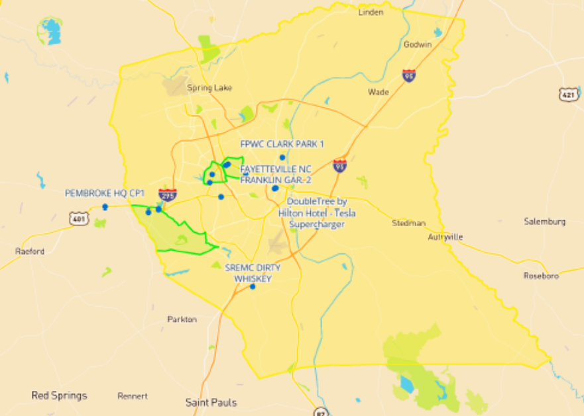
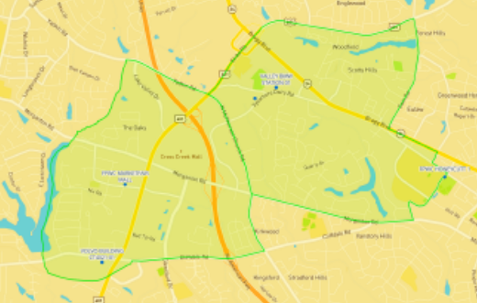

Identifying Charger Sites
Several areas in Fayetteville show a high propensity for EV adoption
BlastPoint can use machine learning/ algorithms to ID areas of value where charging can be installed to benefit the community

Slide 14
New PWC Electric Rates/Riders
PWC Updates
August 1, 2022
Elaina L. Ball – CEO/GM

