Slide 1

Annual State
of the
Catholic School Report 2025-2026
Rev. Nicholas Melo, Pastor
Mrs. Ann T. Sarpu, Principal
Mr. Thomas Shugrue, School Board Chair

Slide 2
School Board Members
Sarah Clark
Jordan Coe
Diane Edwards
Bernadette Foley
Thomas Shugrue
Travis Simpson
Aaron Soucy

Slide 3

School Mission
Corpus Christi School is a Catholic school rooted in the Gospel values of love and respect, where Jesus is present in the development of each child’s mind, body, and soul.
Corpus Christi School offers a safe, inclusive, and nurturing learning environment that develops the faith and character of each student.

Slide 4



Corpus Christi School . . . .
Nurtures strong Catholic virtues and moral values
Creates a challenging learning environment
Values each child’s unique ability and learning style
Respects students’ initiative
Inspires students to discover their talents
Empowers students to value and live their Catholic Faith
Enables students to be life-long learners & problem solvers

Slide 5

Accomplishments
Corpus Christi School is a Blue Ribbon School of Excellence, as designated by the U.S. Department of Education.
Corpus Christi School is accredited by the New England Association of Schools and Colleges and strives to provide a total program of academic excellence.
OUTSTANDING ACADEMICS ! !

Slide 6
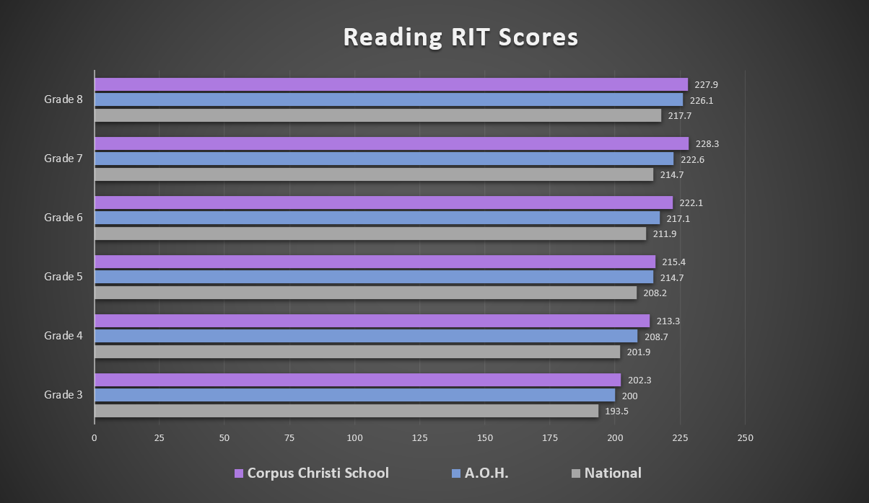
How We Measure Up: Reading
Corpus Christi School
outperformed other
schools within the
Archdiocese and the
Nation in Reading.

Slide 7
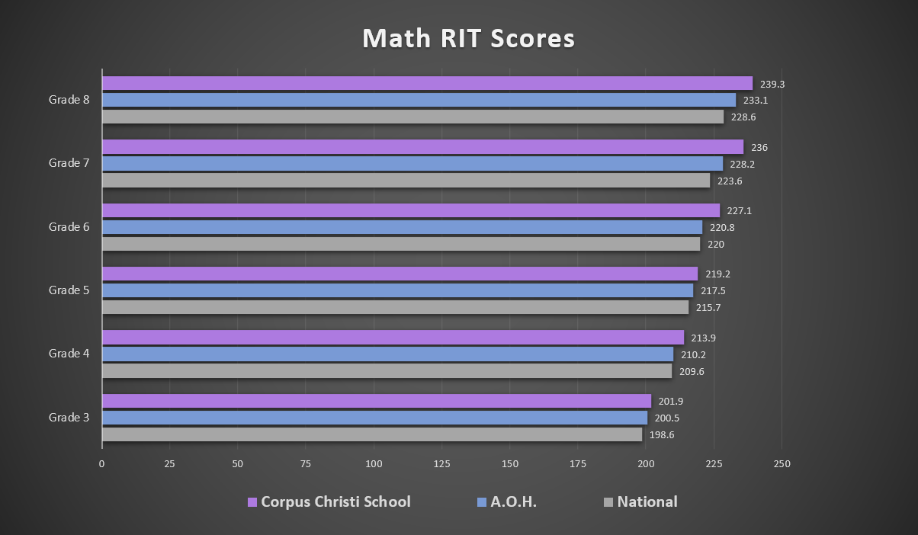
How We Measure Up: Math
Corpus Christi School
outperformed other
schools within the
Archdiocese and the
Nation in Math.

Slide 8
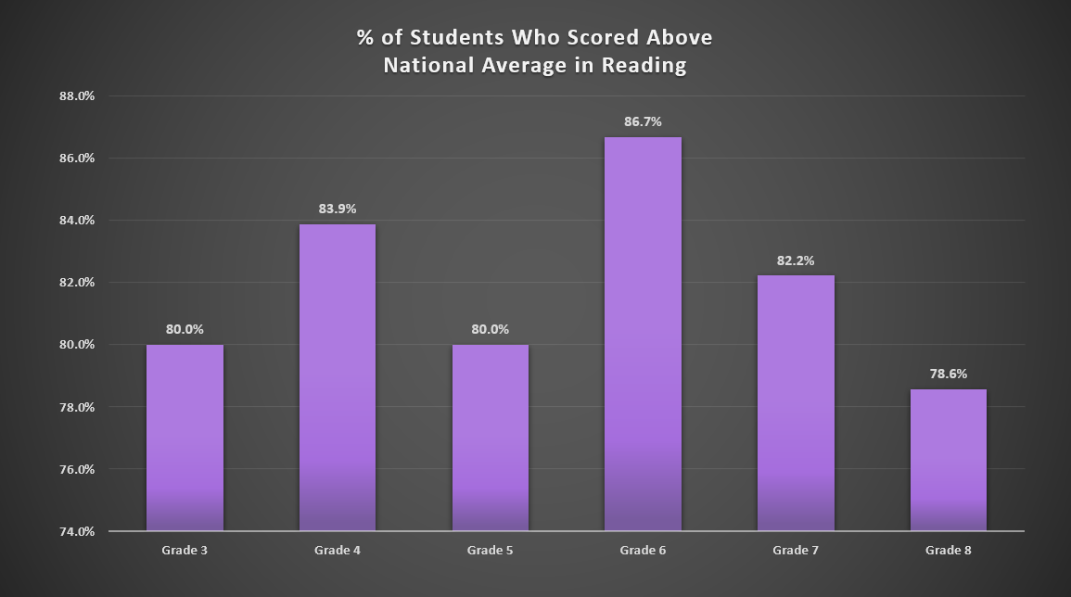
How We Measure Up: Reading

Slide 9
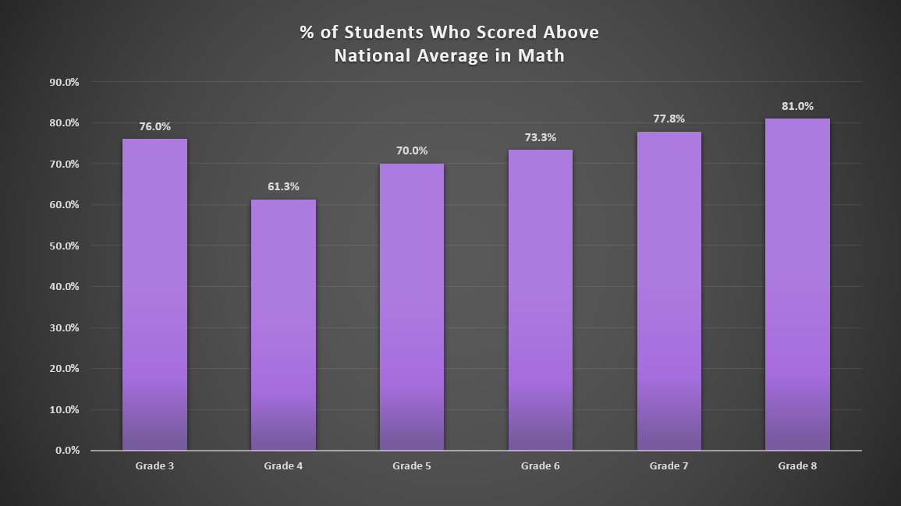
How We Measure Up: Math

Slide 10











Special Programming Offered
Chromebooks - - Google Classroom
GoGuardian: Internet Safety
Instrumental Music Instruction
Leveled Math
World Language
IXL Math Program & Lexia Core 5 Reading Program
Increased Coding opportunities:
100% participation in Hour of Code
Gospel Weekly
ViewSonic Boards in most classrooms!

Slide 11







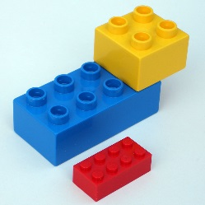
Opportunities for K-8 Students
Extra-Curricular Activities
LEGO Club
Chef’s Club
Band
Martial Arts Club
Robotics
Cheerleading Club
Futsal & Street Soccer
Basketball Training & Tactics
Drama Club
Exercise Club
Soccer
Basketball
Before/After Care Program
Summer Extension

Slide 12







Opportunities for Pre-K Students
Included in Big School Activities and Extra-Curricular Activities
Before/After School Program
Book Buddies
Field Trips
Summer Extension Program

Slide 13




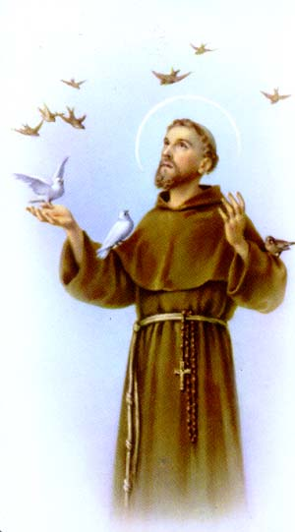
Spiritual Formation
Rosary Prayed
Monthly School Mass
Feast of Saint Francis of Assisi: Blessing of the Animals
Feast of Saint Nicholas
Advent Wreath Lighting Prayer Service
Stations of the Cross
May Crowning
Outreach Projects: Thanksgiving, Advent & Lent
Morning & Afternoon School Prayer, expressing Gratitude

Slide 14
Enrollment History
Year | Enrollment
2025-2026 | 416
2024-2025 | 412
2023-2024 | 360

Slide 15
City / Town Demographics Where Families Reside
Wethersfield 43% | East Haddam .5% | New Britain .7% | East Hartford 3.4%
Portland 2.4% | Newington 5.3% | Manchester .24% | Rocky Hill 6.7%
Colchester 1.2% | Old Saybrook .5% | Marlborough 2.1% | Vernon .2%
Windsor 1% | Glastonbury 9.1% | Middletown 4.6% | Coventry .4%
Cromwell 6.2% | Hartford 6.7% | Newington 5.3% | New Britain .7%

Slide 16
Initiatives to Increase Enrollment
Open Houses
Informative school website
Facebook: Live, Interactive Marketing
Instagram
Referral Program
Advertising in Church bulletins
Add/increase extra-curricular programs
Increase exposure in the community
Chamber of Commerce
Advertise our Accomplishments in local papers
Shadow days for prospective students
Tuition Assistance
YOU – Spread the GOOD NEWS

Slide 17
Successes Since Last Year
Assistant Principal: Mrs. Timko
The Honorable Edward Y O’Connell PreK
Security Upgrades for the PreK
New PreK Multisensory Curriculum: Learning Without Tears
New Stage Curtain
New cushions in the Library
Accreditation Process
Foundation Visit September 2025
Program Visit March 2026
Guidance Counselors 5 days/week
Enrichment Middle School Math
Varsity Boys Basketball Archdiocese of Hartford State Tournament Champions
JV Girls Basketball Archdiocese of Hartford State Tournament Champions
Varsity Soccer Final 4 Finalist
JV Soccer Final 4 Champions
Upgrades to student bathrooms: Auto flush
New drop ceilings, fire alarm, and lighting upgrades in the stairwells
Lighting upgrade and emergency lighting replacement 2nd floor hallway
Installed sensor lighting and LED retrofit in hallway
Repaired and serviced 14 building exhaust fans
Updated heating automation control

Slide 18
Exciting News for 2025 – 2026 And Beyond
Accreditation for NEASC
Replace flooring/carpeting in the school building
Replace gym floor
Bathroom upgrades

Slide 19
Tuition Amounts
Year | Tuition Amount
2025-2026 | $6,470 + $590 + $440
2024-2025 | $6,220 + $590 + $440
2023-2024 | $5,950 + $590 + $440

Slide 20
Financials
Archdiocese of Hartford Support | Dollar Amount
Archbishop’s Annual Appeal | $30,000

Slide 21
Financials
Actual Corpus Christi cost to educate your child $8,719.00
2025-26 CCS Tuition + FITS + Fundraising $7,500.00

Slide 22
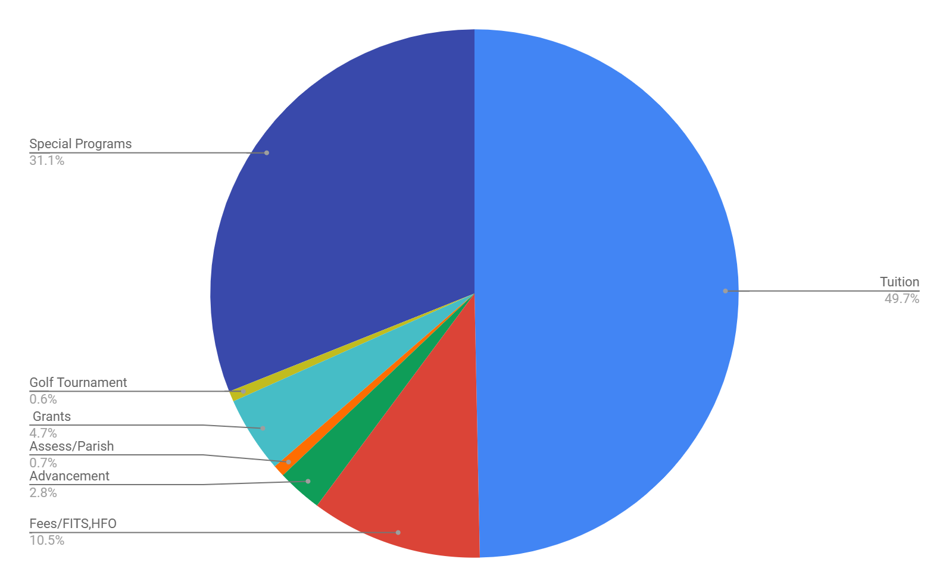
Sources of Income

Slide 23
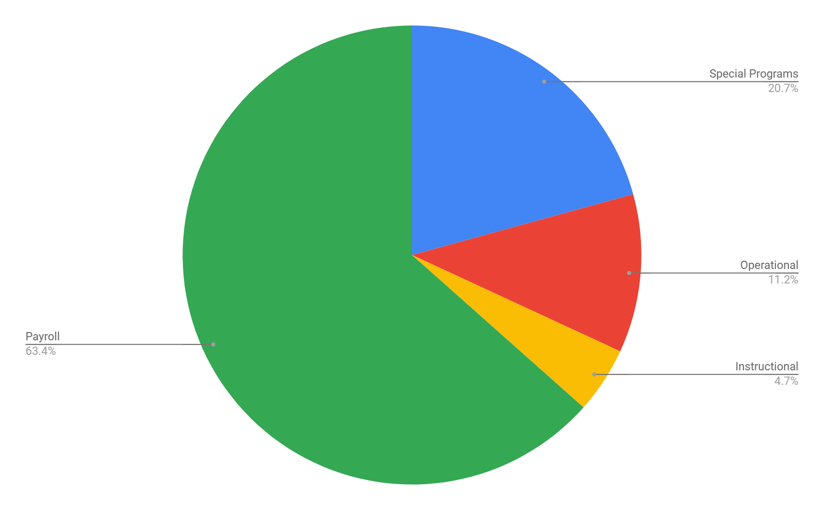
School Expenses

Slide 24



Initiatives to Increase Income
RECRUIT A STUDENT!!
Annual Appeal
Golf Tournament
Capital Campaigns
Assistance from other parishes

Slide 25

Kudos to US!!
Openly discuss our FAITH
Blue Ribbon Distinction: TOP 15% in the country in English & Mathematics
High Academic Expectations
NWEA scores: students outperforming peers in Archdiocese & Nationally
Over $152,000 awarded in Merit Scholarships to our graduating 8th graders
NURTURING & SAFE Environment

Slide 26
Celebrating Over
64 Years of
Catholic Education and Academic Excellence
THANK YOU !!

