Slide 1



Connect with your customers through text messaging and web chat

Slide 2
Agenda
Introduction to Precision Contact
Touch Points
Features and Key Benefits
Use Case scenarios
Reporting
Target Markets
Business Model
Summary
Live Demo

Slide 3

Precision Contact Service
Cloud-based service that allows companies to easily communicate with their customers through text messaging and web chat
Enable customers to contact you the way they want to
Exchange text messages and chat with customers using the Precision Contact mobile app…no matter where you are
Text enables your existing business phone numbers
Handle multiple conversations at the same time
Can be added to most telephony platforms

Slide 4






Precision Contact Touch Points
Expand how customers reach your business!
If your customers are . . .
they can reach you through. . .
. . . and your staff can respond . . .
Browsing
Your website
Precision
Contact
Cloud
With a mobile client
CPaaS
Your main business number or additional DID numbers
Texting
With a browser client
Notes:
(Talk thru the content on the slide)

Slide 5
Precision Contact Text Messaging
TEXT ENABLE YOUR EXISTING NUMBERS
Customers can text to your main business number, customer service number, or individual salespeople.
One text enabled-number creates a Text Group that can be shared by multiple employees or used as an individual text line.
Precision Contact’s iPhone and Android mobile apps let your employees text from their mobile device without giving out their personal phone numbers.
Your customers can reach you via text using numbers that they likely already have in their phone contacts.
All text messages are saved in the cloud allowing easy retrieval of past conversations.
Notes:
(Talk thru the content on the slide)

Slide 6



Precision Contact Text Messaging
USE CASES
Department/Group
Customers contact a service group (support, billing, sales) through a single number.
Employee Direct Line
Customers use the same phone number to call or text their salesman/agent/representative.
Customers
Precision Contact User
Precision Contact Users
Customers
Notes:
(Talk thru the content on the slide)

Slide 7

Precision Contact Web Chat
ADD CHAT TO YOUR WEBSITE
Precision Contact provides a plug-in module to add to your website that allows customers to initiate a chat with your sales support or technical support staff.
Customers visiting your website can click on a Chat button to request a chat conversation with your staff.
Customers are required to provide an e-mail address that can be used to follow up after the chat has ended
Any employees assigned to the Web Chat group can respond on their browser or using the Precision Contact mobile app
Business hours can be defined so that web chat is only available when you are
All chat conversations are archived for easy retrieval
Notes:
(Talk thru the content on the slide)

Slide 8
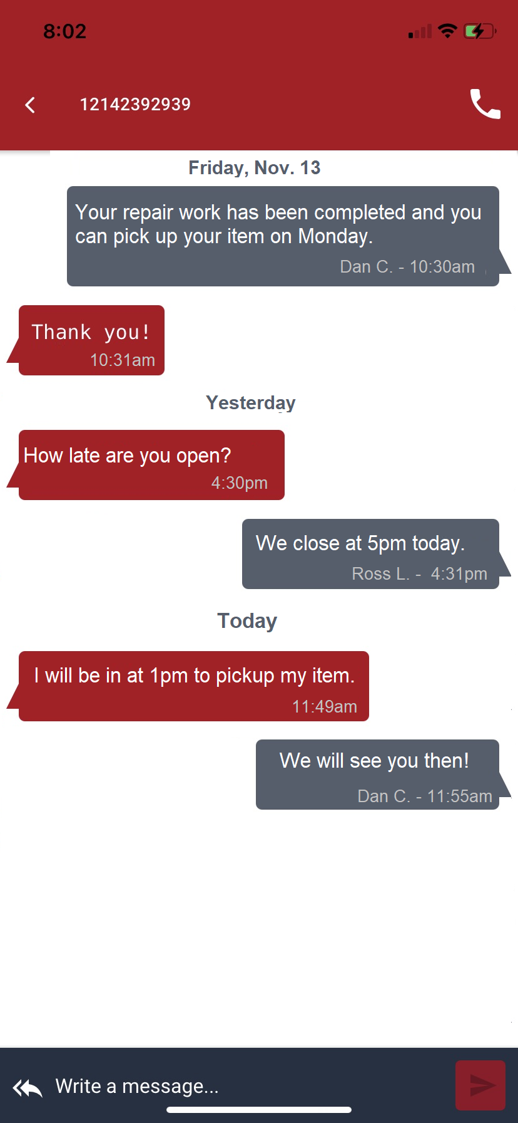
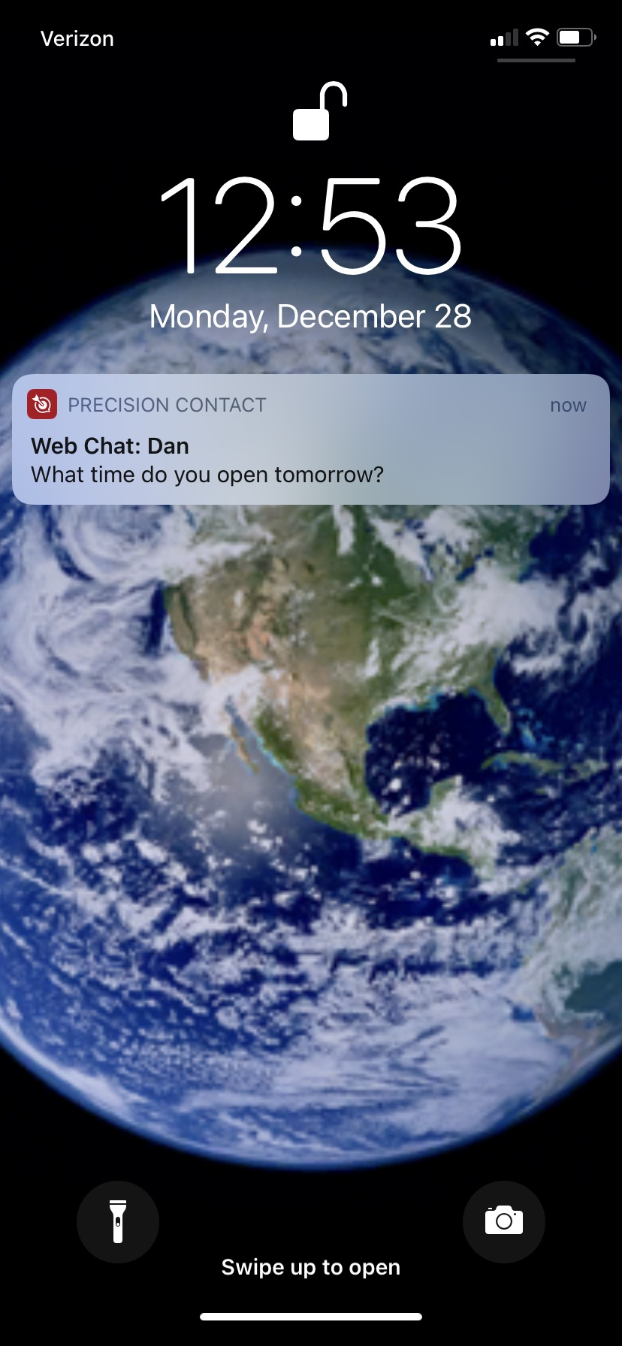
Precision Contact Mobile Application
RESPOND NO MATTER WHERE YOU ARE
Exchange messages using a familiar texting interface
Respond to web chats and text conversations using the same application
Receive notification alerts of new messages even when the application is not visible
Log in whenever you want to make yourself available to send and receive messages
Keeps your personal mobile number hidden, while still responding to customer messages
Notes:
(Talk thru the content on the slide)

Slide 9
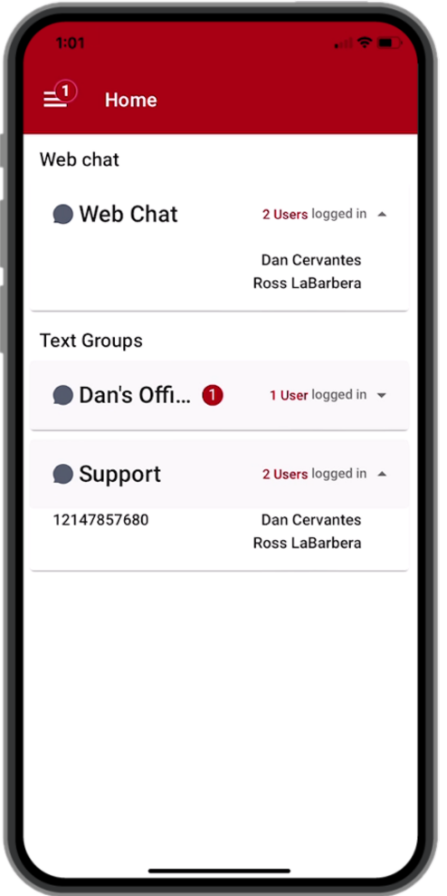
MOBILE APP – Home Page
Total Pending Message Count
Active User Count
Pending Count in queue
Personal Text Group
Active Users
Shared Text Group
Text Enabled Phone Number

Slide 10
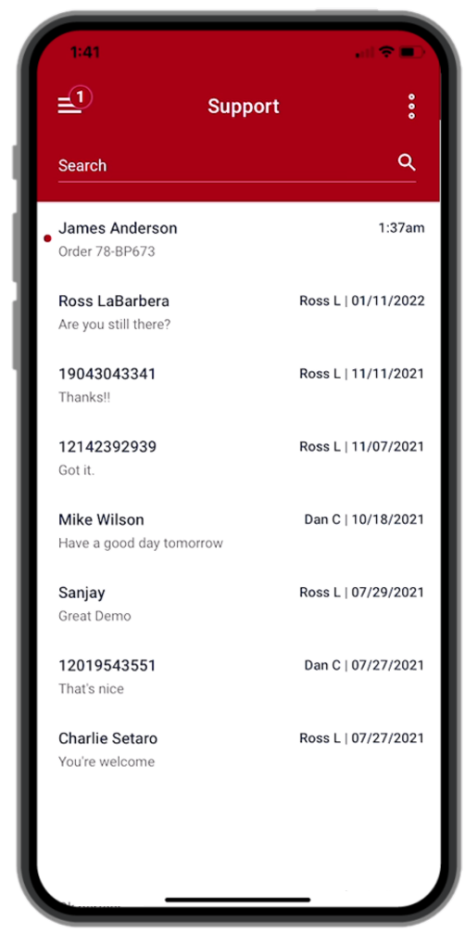
MOBILE APP – Conversation List
Time stamp for message arrival
Text Group Name
Tags conversation with name of last user to be active in the conversation
Red dot indicates a conversation with a pending message
Displays customer name or phone number
Shows snippet of most recent message

Slide 11
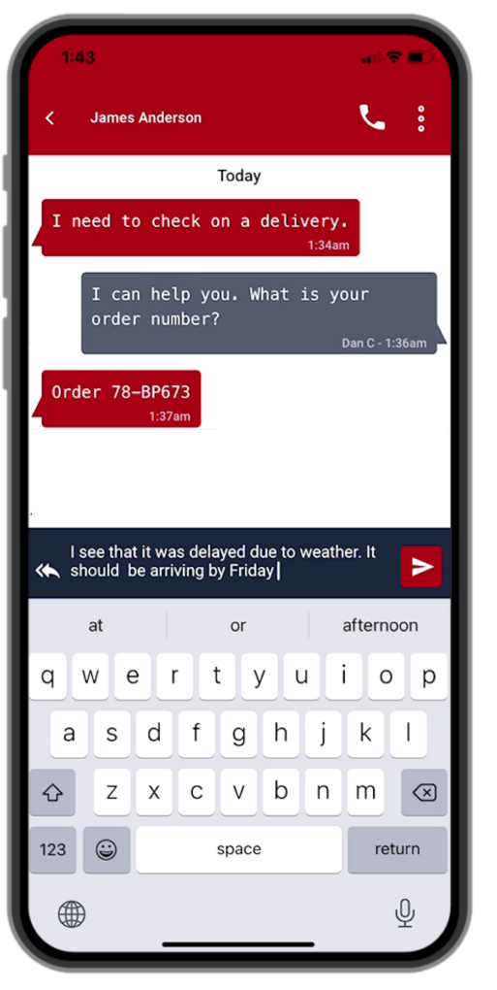
MOBILE APP – Conversation Detail
Initiates phone call to customer
Customer Name or Phone Number
Message Time Stamp
Conversation History
Identifies sender of each outbound message
Access pre-defined replies
Compose Outbound Message

Slide 12
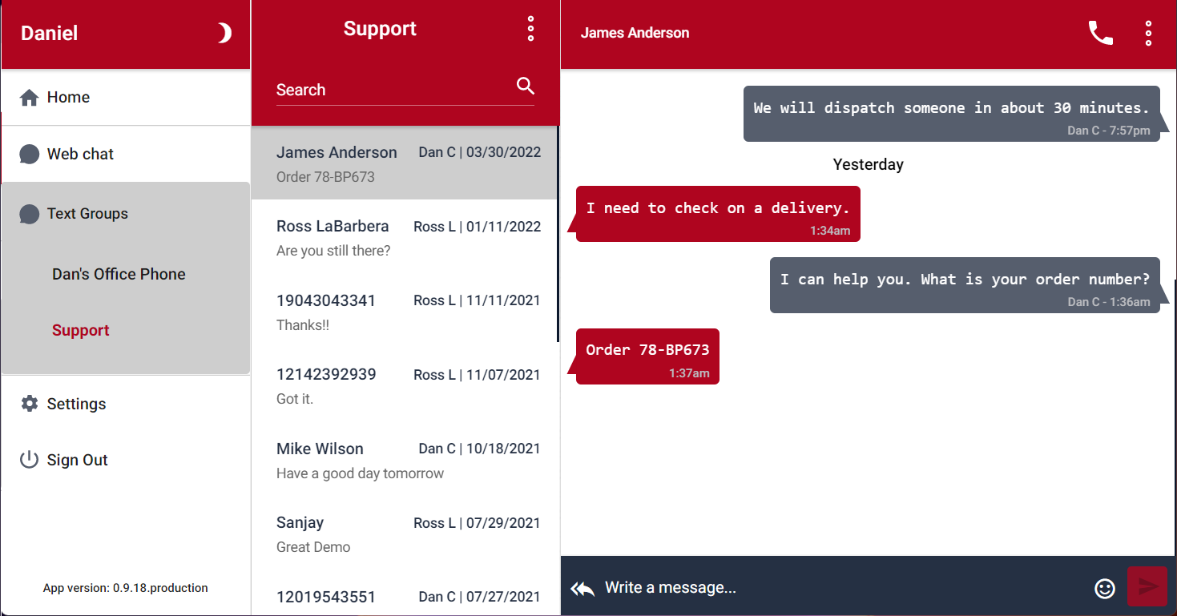
Browser Interface
Main Menu
Conversation List
Conversation Detail
Logging into Precision Contact through a PC browser provides a multi-panel display allowing the user to quickly switch between groups and conversations.

Slide 13
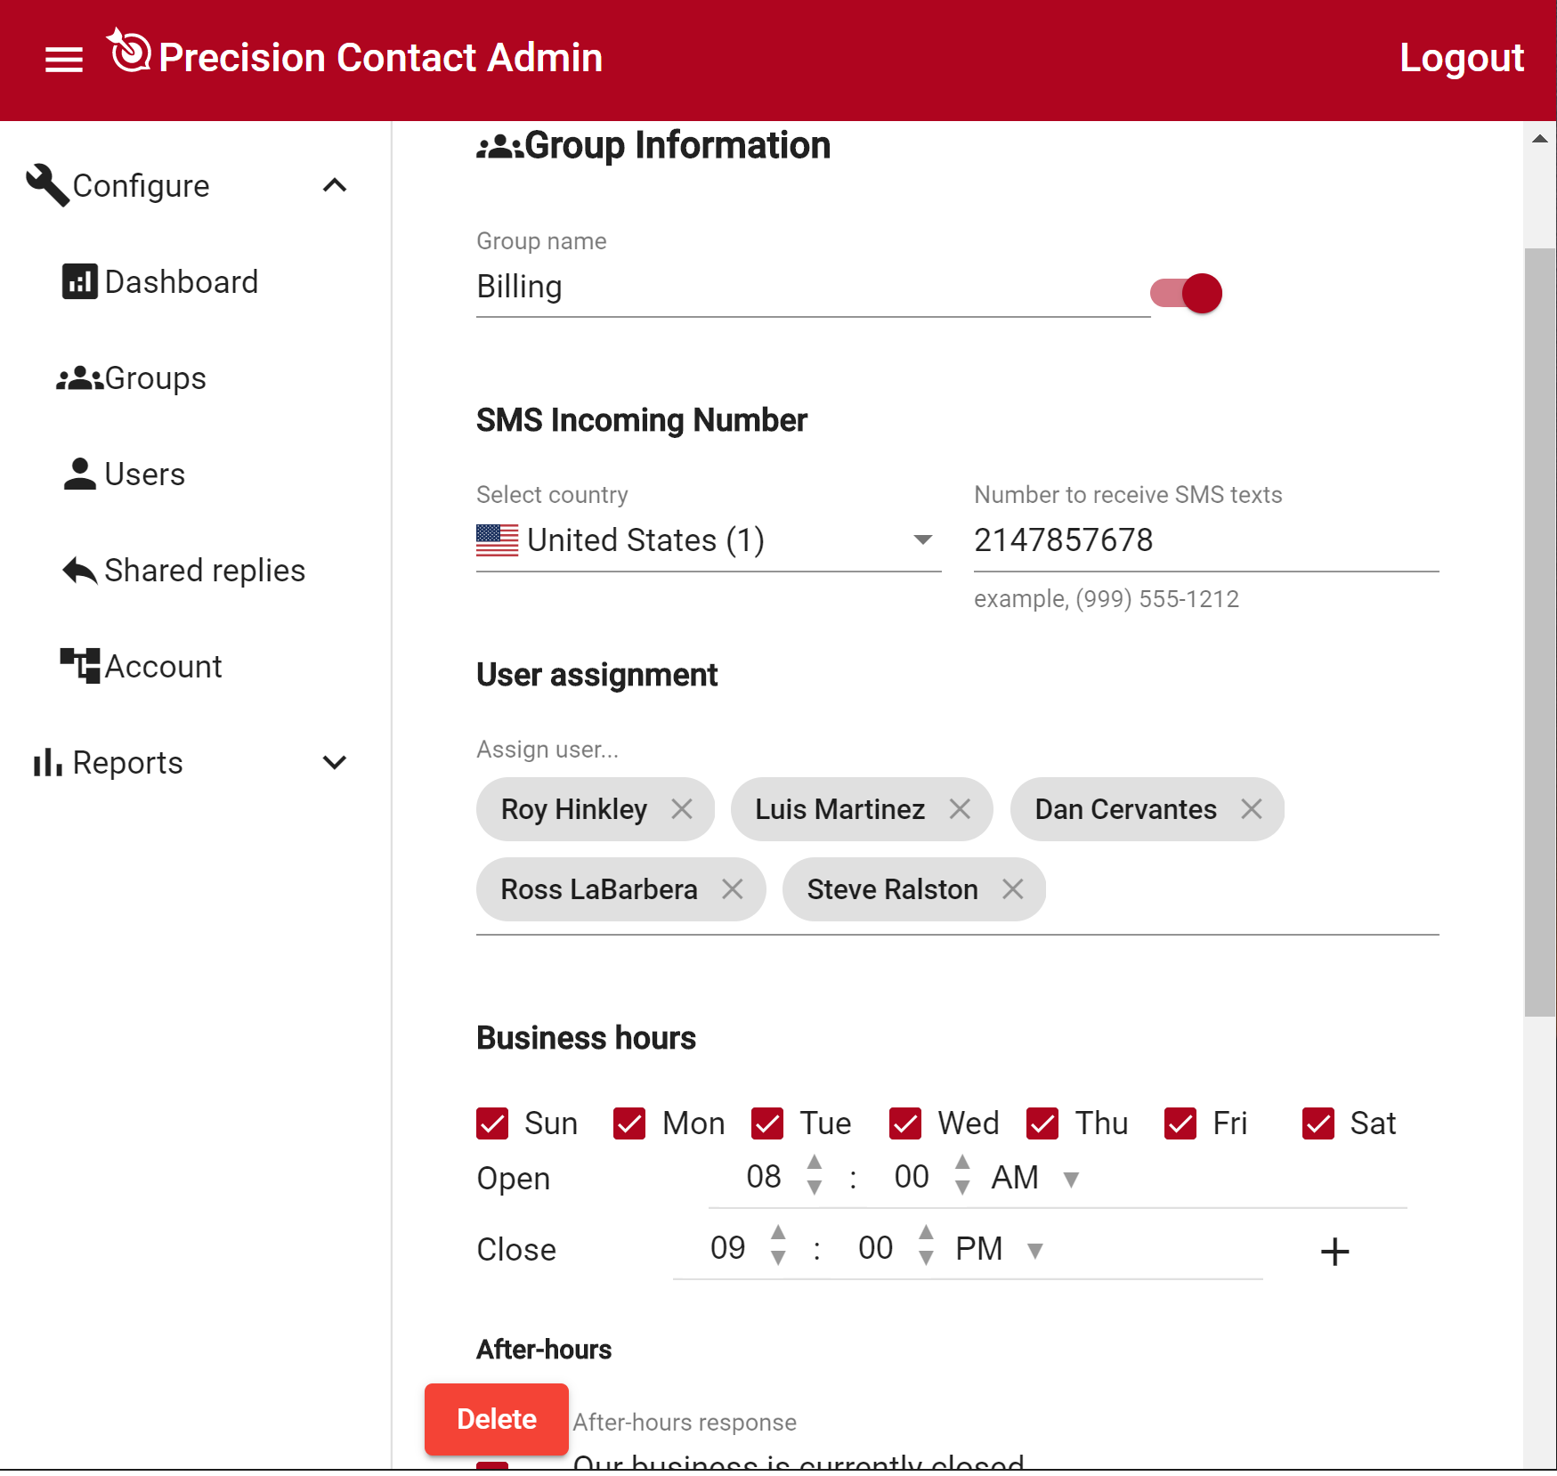
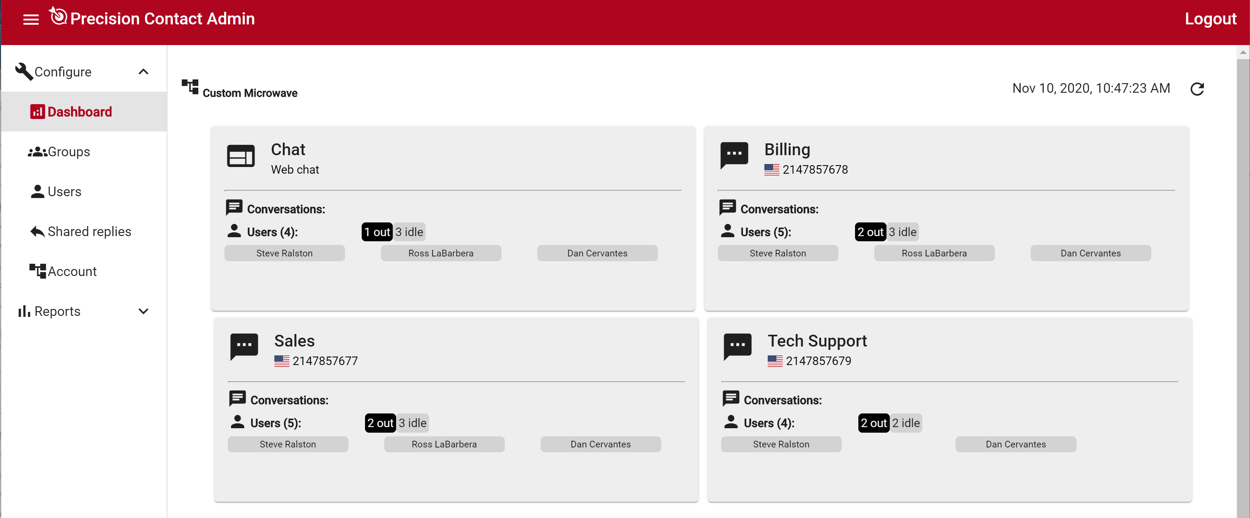

Precision Contact Administration
Web-based Administration utility
Define phone numbers to be text-enabled
Download web chat module to drop into website
Create user accounts for employees
Assign users to access specific text groups and web chat
Set hours of operation
Define automated replies to be sent
after hours
Create canned messages that can be
accessed by all users
Run reports to analyze message traffic
or examine details of specific
conversations

Slide 14
Precision Contact Reporting
ARCHIVE ALL TEXT/CHAT CONVERSATIONS
For Traffic Analysis
Identify when your customers are most active and adjust your staffing accordingly
For Storage Compliance
Access individual conversation details
Auto generate daily reports for each text group
Conversation history accessible for as long as an active subscription is maintained
No need to confiscate employee’s personal mobile-phone to access texting history
✓
✓
✓
✓
✓

Slide 15

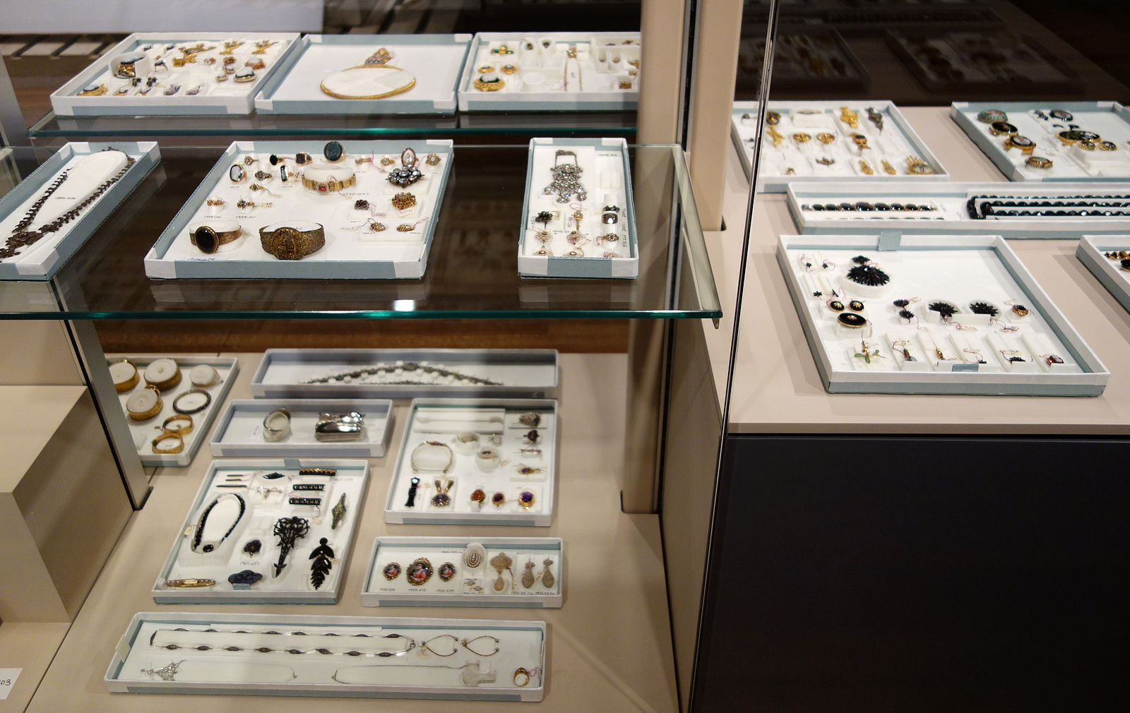

Precision Contact
TARGET MARKETS
Businesses with employees not tied to their desk
      Car Dealerships
      Real Estate
      Home Services
SMBs without a contact center
      Restaurants/Country Clubs
      Specialty Retail (Flower shops, Bakeries, Jewelers)
      Retail Services (Dry Cleaners, Tailors, Nail Salons)
Government offices that require archiving of conversations
Premise-based TDM systems that desire cloud-based features
Notes:
(Talk thru the content on the slide)

Slide 16
Precision Contact Business Model
Requirements |  | Precision Contact
Partner Model |  | Revenue Share
NEC Branded product |  | NO
Subscription |  | Monthly
Initial subscription |  | Monthly
Renewal |  | Automatic
Cancellation |  | No Contract
Subscription costs |  | Starter: $69.00 Add-on: Range $6.00-$36.00
Service Sell price |  | Set by the Partner
Hardware required |  | NO
Product available on-premises |  | YES
Legal | SI Appendix | YES
 | Reseller/Distribution
 |  | YES
GDPR compliant |  | YES
Notes:
Let’s talk about Revenue for you, the partner. Precision Contact is a Revenue Sharing model with month-to-month subscription with automatic renewal. One of the great benefits of selling the Precision Contact, is it offers partners a monthly recurring revenue stream after the sale. Which is guaranteed income. You can count on. Partners can set their own price. Tracking your MRR, can help provide a baseline to measure your growth and success. You can also use this revenue for forecasting and measuring your sales momentum.

Slide 17






Pricing Breakout for Precision Contact
1. If SI partner sell PC Starter(PROD4401) @ $69.00
Commission
Distributor
Monthly Payment
$69.00
Revenue Share
SI/Channel Partner
Customer
One Billing Application
(Notes all the UNIVERGE BLUE Cloud Services)
NEC Sales
Notes:
Within OneBill implementation is setup as a Revenue Share model. Similar to SWS and all UNIVERGE BLUE Cloud Services, Precision Contact is currently set up in a Revenue Share Model (NEC sets net price to channel partner, channel partner adds their mark up to arrive at end user price and upon collection of the end user price for services from the Customer each month, NEC pays the difference between NEC net price and the End User price (the partner’s mark-up) back to the partner as their monthly commission.

Slide 18
Pricing Breakout for Precision Contact
Mode | Part # | Name | Description | Subscription Price (SP Per Month)
Monthly Recurring Cost | PROD4401 | Precision Contact Starter | Provides 3 Users and 1 TEXT GROUP | $69.00
 | PROD4402 | Precision Contact Text Group | Addon of 1 TEXT GROUP. Provides “Unlimited messages per month”. Enables one Text (DID number) group and one additional user license. | $12.00
 | PROD4403 | Precision Contact User | Addon of 1 USER. Provides one mobile (or PC Browser) device with one additional user license. | $6.00
 | PROD4404 | Precision Contact Web Chat | Addon of 1 plug-module to a website that allows customers to initiate a chat. Only one Web Chat subscription is needed per site. | $36.00
Non- Recurring Cost | PROD4400 | Precision Contact Installation | The amount NEC Partner charges for initial services. This amount will be billed one time at the beginning of the first billing cycle. | NA
Note: Billing is setup as a monthly reoccurring as noted in the retail subscription cost.
Notes:
Here is the Pricing Breakout for Precision Contact and the monthly recurring revenue.
Our base package PROD4401 starts at $69.00 per month for 3 users and 1 texting DID group.
The addons are optional and are also offered monthly.
Standard Cost - Net Price to SI is 55.20 (Subscription Price (69.00 * .8))
Distributor Commission is 4.42 (Standard Cost (55.20 * 8%))
Revenue Share Model example on slide 3 shows monthly payment at 69.00
Revenue Share Model example on slide 4 shows monthly payment at 79.00.

Slide 19
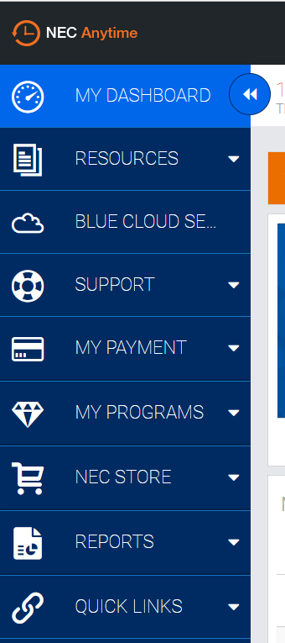
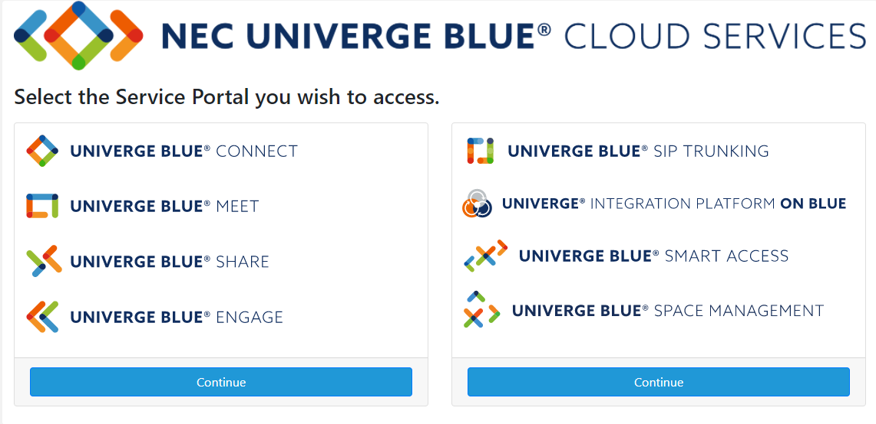
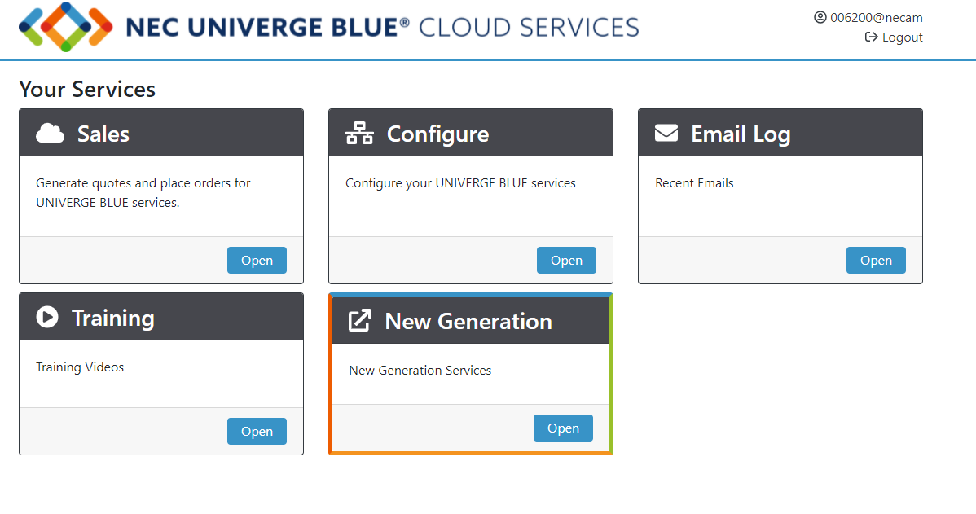
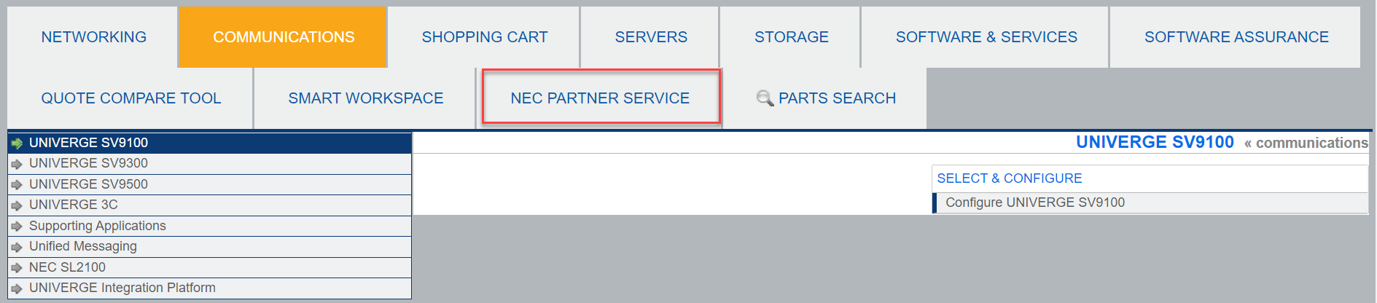

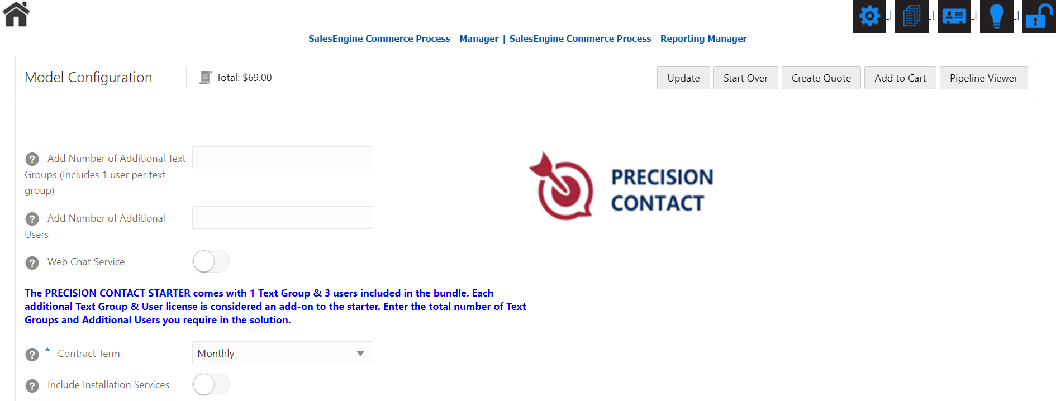
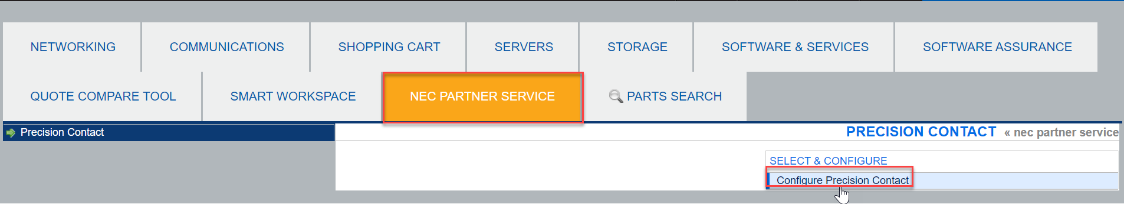
Quoting Process
Generating Quotes
New NEC Partner Services tab is valid for Precision Contact only.
Quick Link
Studio Access to Precision Contact
Configure Precision Contact
Configure Precision Contact
Notes:
SI creates a Anytime Studio quote
2. SI starts ordering on UBP on behalf of end user
3. Order is submitted to GOS
4. GOS sends contract to End User via Esign
5. Customer signs the contract[We assume Adobe/Docusign will send confirmation email]
6. BP then creates a location ID
7. GOS starts activation process
8. BP calls Red Phoenix services: if fails: [Email template name: PC_Order_Fail_Notification_Template[PC_Order_Fail_Notification_Template final ST.docx]
9. BP calls Red Phoenix services: if successful: [Email template name: PC_Order_Notification_Template[PC_Order_Notification_Template final ST.docx]
10. BP sends links to create OneBill account
11. GOS creates account on One Bill account.
12. BP sends welcome email, sends a link to create credentials TO Customer Standard welcome email [Standard email from BP]
13. Customer accesses the link (Assumed to be some link inside BP to create user) to create login credentials on BP - if they don't have an account on BP.
14. Customer gets a welcome email to access Precision Contact (production URL provided from RP) [Email Template name: PC_Service_Welcome_Template[[PC_Service_Available_Email_Template Welcome final ST.docx]
15. Customer logs in using that URL (single sign on), and be admitted into Precision Contact administrator for that location. [it is also assumed that the customer can access precision contact from their BP access using single sign on]

Slide 20


Sales and Marketing Support
Support Webpage
Brochure
Customer Presentation
Battle Card
Pricing
Terms of Use
Onboarding
Use Cases
Support
Notes:
Furthermore, we have the following Sales and Marketing collaterals available to help and assist with getting up to speed and gaining knowledge on the product to assists with sales. We also have On-boarding. All product information is listed in NEC anytime. Precision Contact follows the same process as other UNIVERGE BLUE CLOUD SERVICES. No Change and you can access your customer accounts with the same look and feel you’re use to. Website resources are available with product information, product documentation, and How to videos will be available in the future. There is no training certification required. QuickStart guide can be downloaded and provided for customers and partner trainings.

Slide 21



Summary
Text Messaging
  Enable existing phone numbers to send/receive text messages
  Let your customers contact you using the method they prefer
  Setup as a personal text number or available to a group of users
Web Chat
  Initiate chat sessions from your website
  Invites new customers to contact your business
  Uses the same application to respond as text messaging
Responsiveness
  Allows multiple employees to respond to incoming messages
  Adds new contacts to your customer database
  Easily follow-up on previous conversations
Mobility
  Respond to incoming messages from anywhere, anytime of the day.
  Switch between mobile client and PC browser interface
  Get new message alerts even when your phone is in sleep mode
Compliance
  Securely save all text and web chat conversations
  Review previous conversations without the need to access an employee’s phone
  Conversation history is available for as long as the customer has an active subscription

Slide 22
Live Demo / Questions & Discussion

Slide 23
THANK YOU!

