Slide 1


MEASLES
Island County Public Health
adapted from WA DOH

Slide 2
Public Health Hotline
360-678-2301
General team contact info
Email
PublicHealth@islandcountywa.gov
Personal contact info
Shannon FitzMaurice, RN
Public Health Nurse
Island County Public Health 360-929-0925
S.fitz@islandcountywa.gov
Megan Works, RN
Community and Family Health Manager Island County Public Health
360-914-0839
m.works@islandcountywa.gov

Slide 3
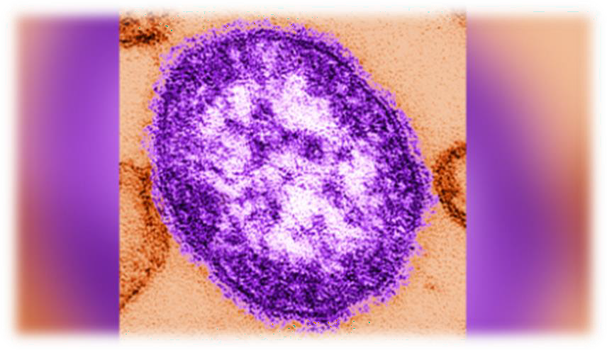
Measles
An acute, infective, viral disease
First described in the 7th century
Infection nearly universal during childhood in the
prevaccine era
First live-was licensed for use in the United States in 1963
2005 MMR was combined with varicella vaccine (MMRV)
2000 measles declared eliminated in the United States
Parts of the world where the population is not immunized,
outbreaks are still possible
Measles - StatPearls - NCBI Bookshelf (nih.gov)

Slide 4




Clinical Presentation Timeline
Incubation
period 11-12 days
Prodrome
2-4 days
Rash
5-6 days
Recovery

Slide 5
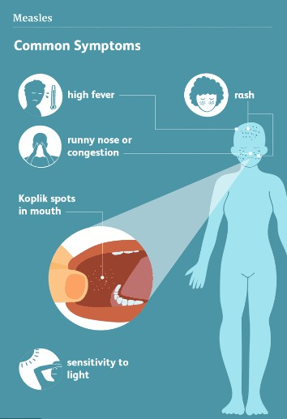
Prodromal Phase
High fever which increases in a stepwise fashion peaking as high as 103°F-105° F(39.4 °C – 40.5 °C)
Cough
Runny nose (coryza)
Red, watery eyes (conjunctivitis)
Tiny white spots inside the mouth (Koplik spots)
2 -3 days after symptoms begin

Slide 6
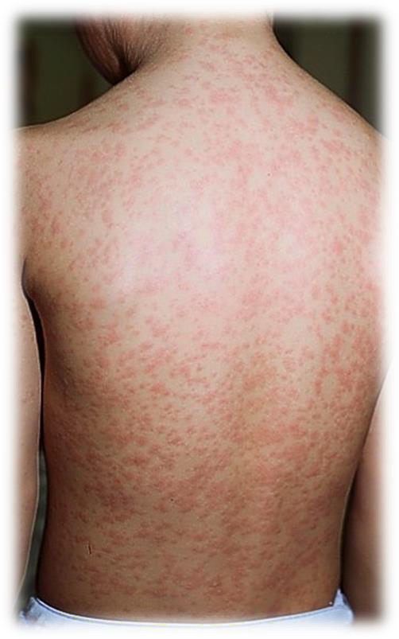
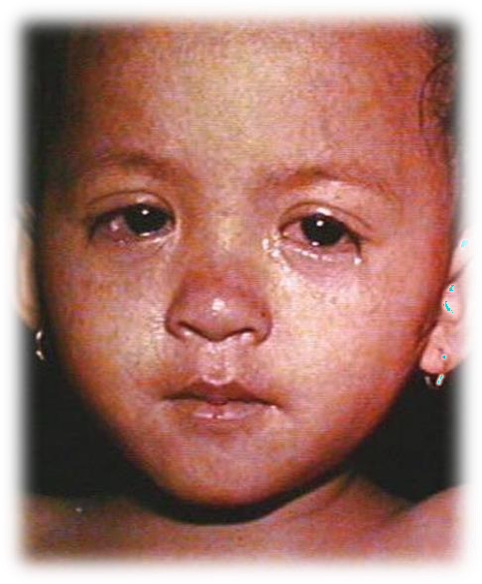
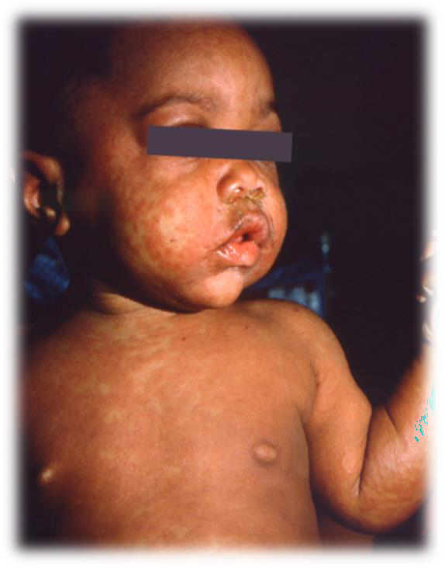
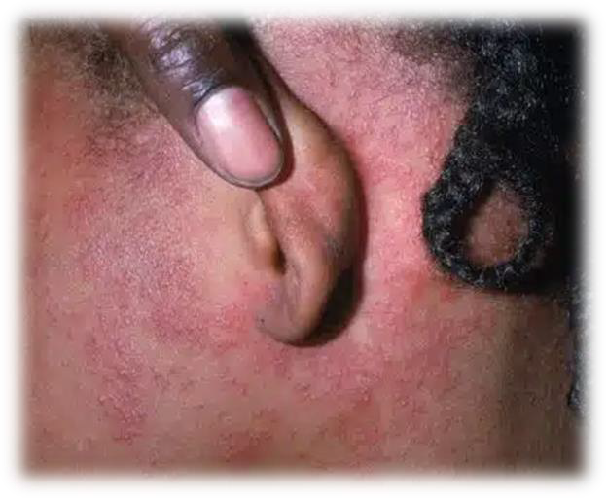
The Rash
2 to 4 days after symptoms begin (fever, cough, conjunctivitis) the rash appears
The rash usually begins as flat red spots at the hairline and spreads down the body
Fever may spike to more than 104°F

Slide 7
Complications
About 1 in 5 unvaccinated people in the U.S. who get measles is hospitalized
Children <5 years old are more likely to suffer from measles complications
Common complications include
Diarrhea and vomiting
Ear infection
Bronchitis or laryngitis
Pneumonia
Encephalitis
Pregnancy complications

Slide 8
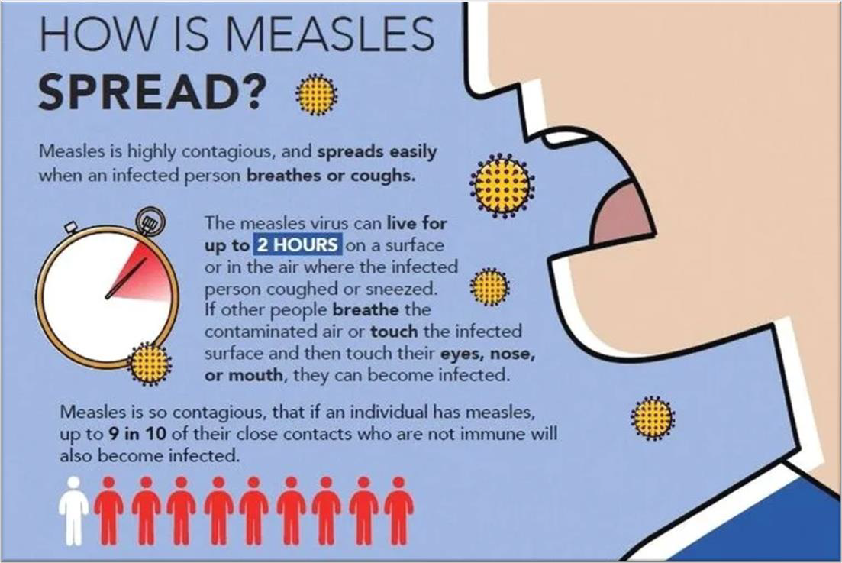
Transmission
Airborne transmission from an infected
person who breathes, coughs or sneezes
Can remain active and infectious for up to 2 hours in the air and on surfaces of indoor environment after infected person leaves the room
90% of the people close to an infected person who are not protected with MMR vaccine or N95 mask become infected.
Infected people are contagious from 4
days before to 4 days after the rash

Slide 9
Treatment
Post-exposure vaccination with MMR:
Within 72 hours of exposure may help provide protection or lessen severity
Immune Globulin (IG)
Within 6 days of exposure to prevent disease or make symptoms less severe for those who are at risk for serious complications
A few medications may be helpful (with licensed practitioner discussion)
Antipyretics (ex: tylenol, ibuprofen)
Vitamin A- this is only helpful with an active measles infection
Children with low levels of vitamin A are more likely to have a more severe case of
measles
There is no specific treatment for Measles.
It is a Vaccine Preventable Disease (VPD)

Slide 10
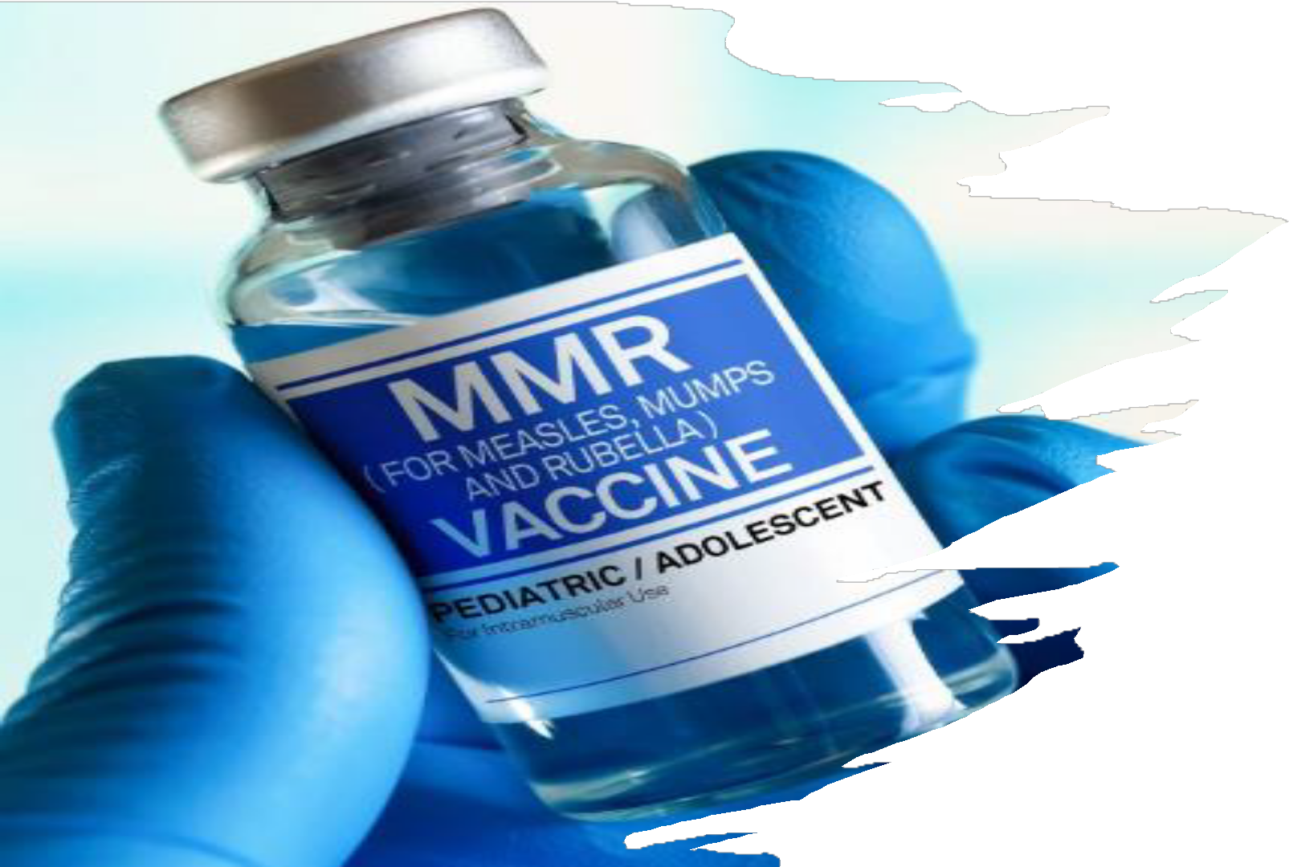
Two doses of MMR (measles-mumps- rubella) vaccine are 97% effective at protecting against measles
Vaccination is the best protection
Children need two doses of MMR vaccine: the first dose at age 12-15 months, and the second dose at age 4-6 years.
Babies ages 6-11 months should get an early dose if traveling internationally. They will still need two additional doses later.

Slide 11

A plane ride away
Measles is still common in many other
countries.
Unvaccinated travelers continue to get measles in other countries and bring it back into the United States.
Anyone who is not protected against measles is at risk of getting the disease. This includes infants who are too young to receive MMR

Slide 12
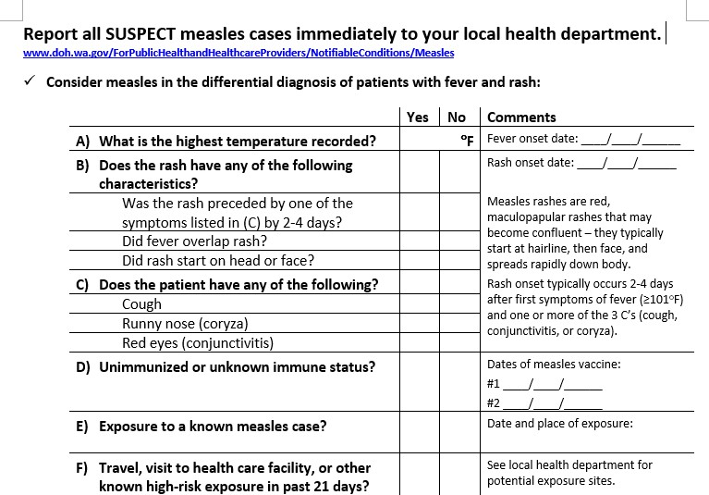
Measles Assessment
Measles Assessment Quicksheet for Providers

Slide 13
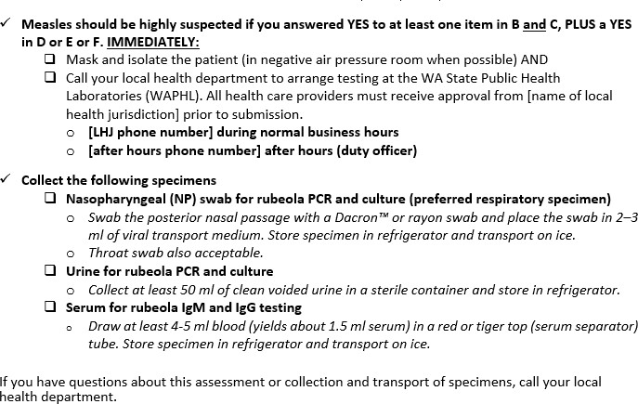
Measles Assessment
Measles Assessment Quicksheet for Providers (cont’d)

Slide 14
Measles Testing- for providers
PCR Specimens (NP swab and Urine) 
Days 0-5 from rash onset: collect NP swab for PCR
If rash is present, also collect a urine for PCR
Urine PCR test is most
sensitive between ≥72 hours and 10 days after rash onset
ICPH needs to be notified of any measles rule out testing
IgM and IgG Specimen (Serum)
IgM may be collected and sent for testing.
Please take an IgG
titer for Measles to verify immunity.
Molecular testing
(PCR) also needs to be done.

Slide 15
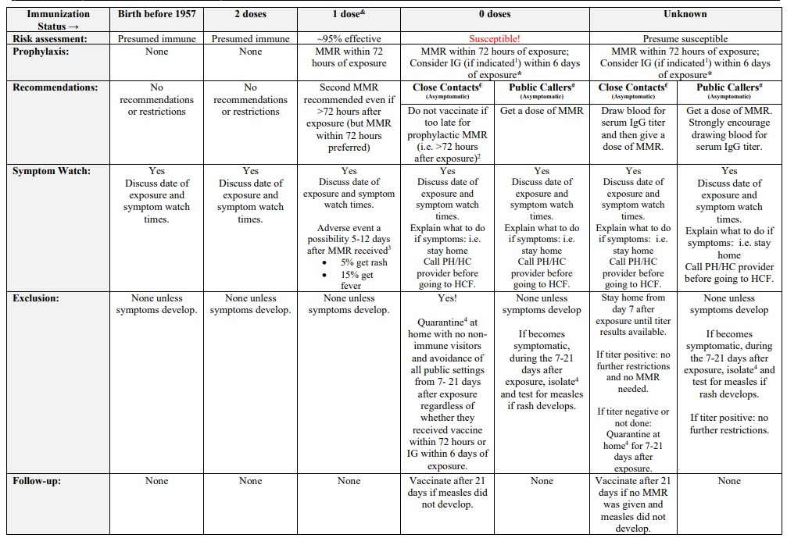

Slide 16
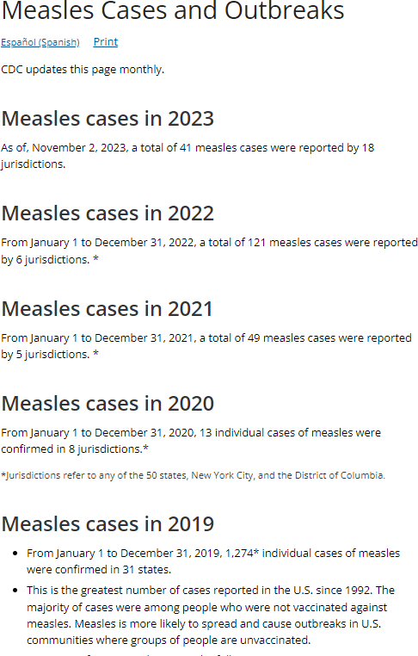
Measles in the US (CDC Data)
As of April 10 2025, a total of 712 confirmed* measles cases in: Alaska,
Arkansas, California, Colorado, Florida, Georgia, Hawaii, Indiana, Kansas, Kentucky, Maryland, Michigan, Minnesota, New Jersey, New Mexico, New York City, New York State, Ohio, Oklahoma, Pennsylvania, Rhode Island, Tennessee, Texas, Vermont, and Washington
There are 4 confirmed Measles cases in WA state in 2025 (King and Snohomish CO). They are linked to international travel in infants and exposure in unvaccinated adults.
Island County currently has 0 confirmed cases of Measles

Slide 17
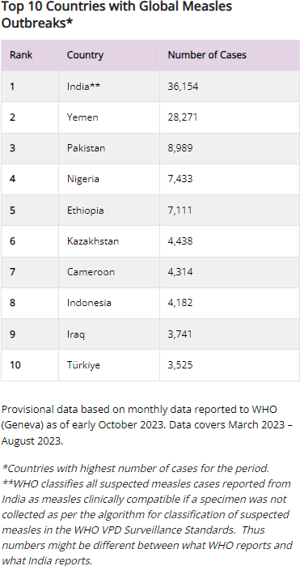
Global Measles and US
Vaccine Coverage Trends
Global Measles Outbreaks
Ongoing outbreak in India with 36,000+ cases
Both CDC and WA DOH data have shown decreases in pediatric vaccination uptake during COVID-19 – which includes MMR
*Please make sure your kids, students, and patients are up to date on MMR vaccines*

Slide 18

For all you do to protect and improve the health of those you serve!

Slide 19
Measles Resources
WA DOH Measles Guideline
WA DOH Measles Assessment Tool
WA PHL Measles Testing
CDC Pink Book – Measles
CDC Pink Book Series (webinar) – Measles, Mumps, Rubella
CDC – Measles for Public Health Professionals
CDC – Global Measles Outbreaks
ACIP – MMR Vaccination Recommendations
WHO – Measles Fact Sheet
Washington State Department of Health | 27

