Slide 1
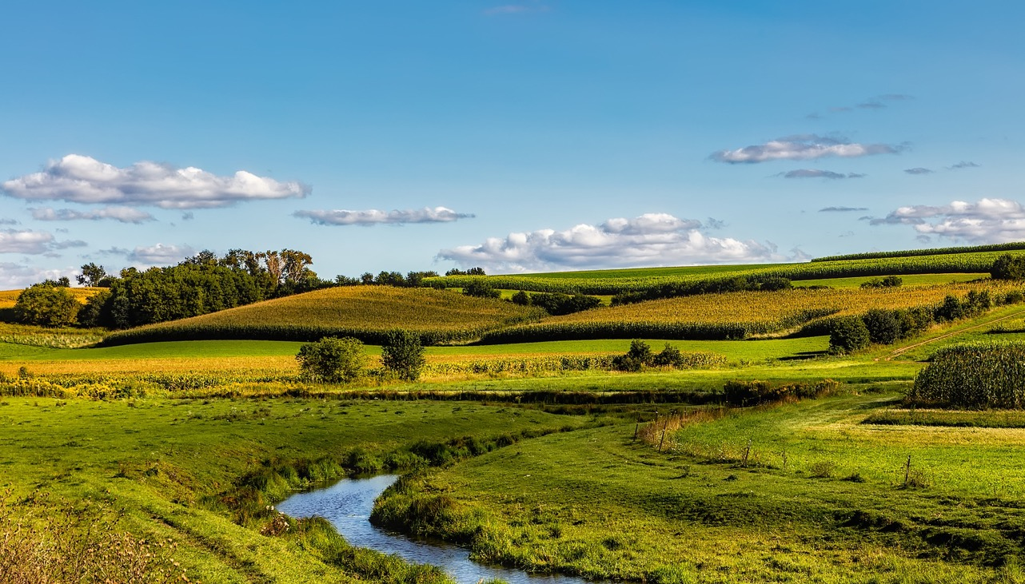



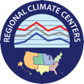
Drought Early Warning Update
June 18, 2020
Extreme Heat & Dry Conditions Forecasted to Persist
Potential Impacts in the Missouri River Basin & Midwest

Slide 2





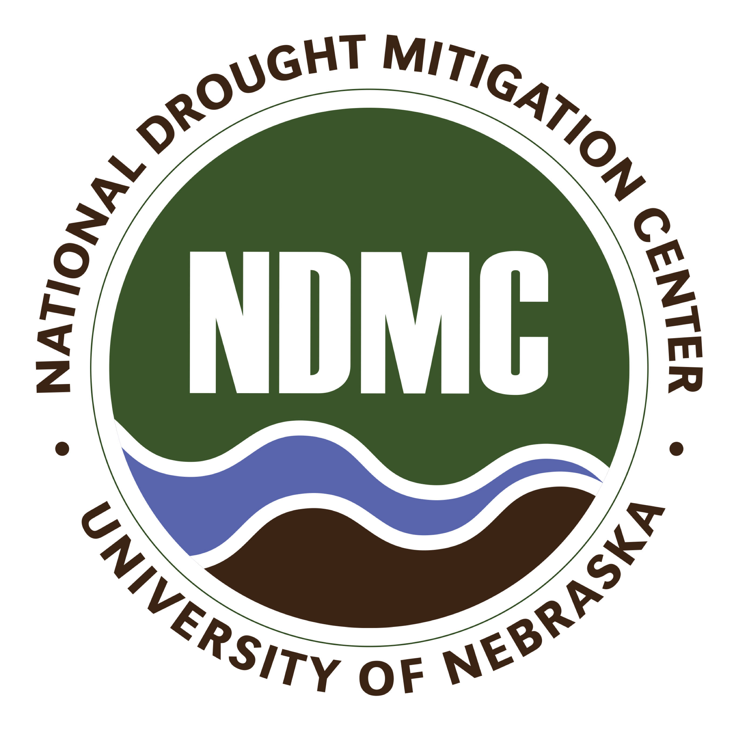

Background
Prepared By:
Molly Woloszyn & Britt Parker NOAA/National Integrated Drought Information System (NIDIS)
Dennis Todey USDA Midwest Climate Hub
Doug Kluck NOAA/National Centers for Environmental Information
Ray Wolf NOAA/National Weather Service
Natalie Umphlett High Plains Regional Climate Center
Mike Timlin Midwestern Regional Climate Center
This Drought Early Warning Update covers the following states in the North Central U.S.: Colorado, Illinois, Indiana, Iowa, Kansas, Kentucky, Michigan, Minnesota, Missouri, Montana, Nebraska, North Dakota, Ohio, South Dakota, Wisconsin, and Wyoming.
This is issued in partnership between the National Oceanic and Atmospheric Administration (NOAA) and the U.S. Department of Agriculture (USDA) to communicate a potential area of concern for drought expansion and/or development within the North Central U.S. based on recent conditions and the upcoming forecast.
NIDIS and its partners will issue future Drought Early Warning Updates as conditions evolve.

Slide 3
Key Points
Drought conditions have been recently deteriorating over areas of the North Central U.S. (Colorado, Kansas, Minnesota, Montana, North Dakota, South Dakota, Wyoming). Abnormally dry conditions have recently expanded as well.
A recent increase in atmospheric demand (i.e., crop water use) is starting to cause some stress on rangeland, grassland, and crops as soil moisture availability is decreasing.
Forecasts show the possibility for rainfall in some areas over the next week. However, it is not likely to be widespread. In addition, there is a greater chance for above-normal temperatures across much of the north central U.S. through the end of June into early July. Therefore, for those that do receive rainfall, hotter temperatures will likely continue to worsen conditions in some areas.

Slide 4
CURRENT CONDITIONS

Slide 5

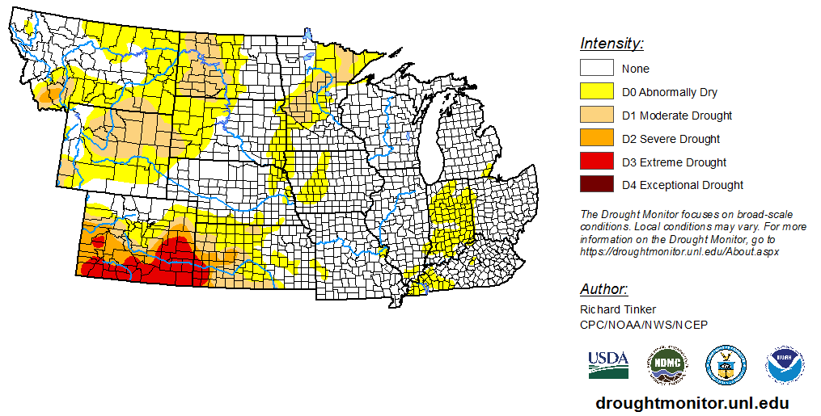
Current U.S. Drought Monitor Conditions
Severe (D2) to extreme (D3) drought persists across much of Colorado and western Kansas.
Moderate drought (D1) recently developed in portions of the Missouri River Basin and Midwest as well.
Abnormally dry conditions (D0) also expanded this past week by around 10% in the Midwest and 8% in the Great Plains.
For more information on the drought in southern Colorado visit https://climate.colostate.edu/~drought/. Also visit the Intermountain West DEWS page for more information on the upcoming July 9th webinar: https://www.drought.gov/drought/dews/intermountain-west
Current U.S. Drought Monitor Maps: https://droughtmonitor.unl.edu/

Slide 6
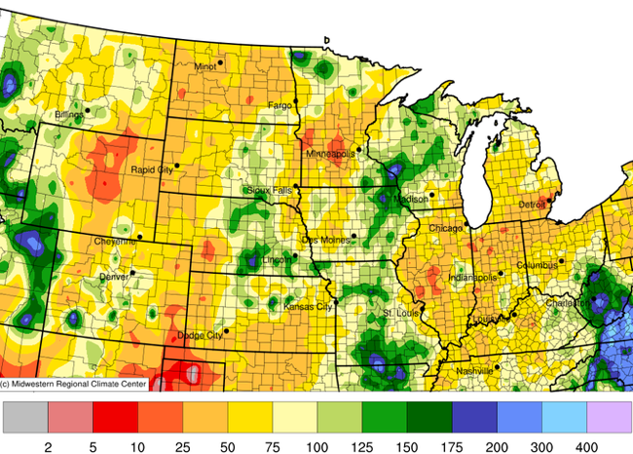
30-Day Precipitation
Percent of Normal Rainfall
May 20-June 18, 2020
Despite Tropical Depression Cristobal bringing significant rain to some areas in the Midwest, many areas in the North Central region remain below normal for the past 30 days. Some areas only received 10-25% of normal for this time of year.
Midwestern Regional Climate Center cli-MATE: https://mrcc.illinois.edu/CLIMATE/

Slide 7
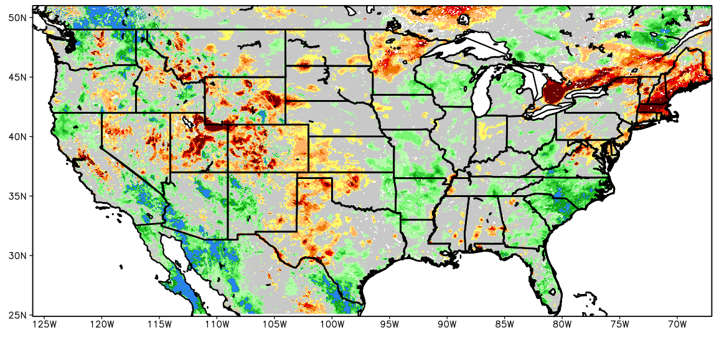
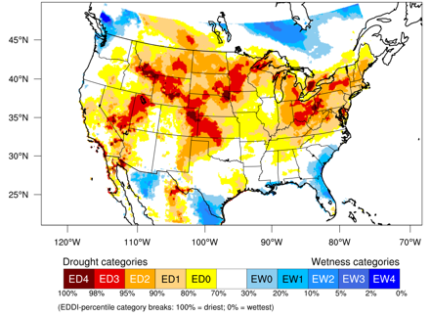
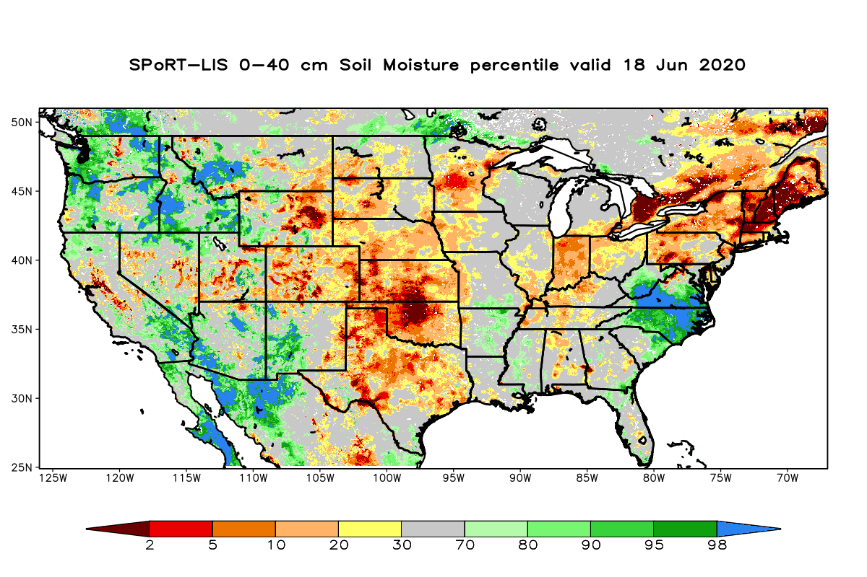


Additional Drought Indicators
Evaporative Drought Demand Index (EDDI)
2-Week EDDI for June 12, 2020
Soil Moisture Percentile
June 1, 2020
June 18, 2020
Increased heat, wind, low humidity and ample sun recently have greatly increased atmospheric demand, which is reflected by this 2-week EDDI map.
Soil moisture has decreased over broad areas of the Missouri River Basin and Midwest over the last couple of weeks. It is near- to below-normal in many areas.
Current Soil Moisture from NASA: https://weather.msfc.nasa.gov/sport/case_studies/lis_CONUS.html
EDDI Maps from NOAA ESRL: https://psl.noaa.gov/eddi/

Slide 8
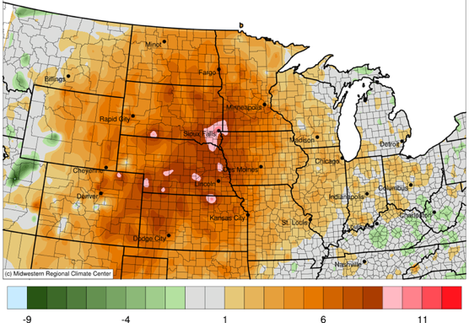
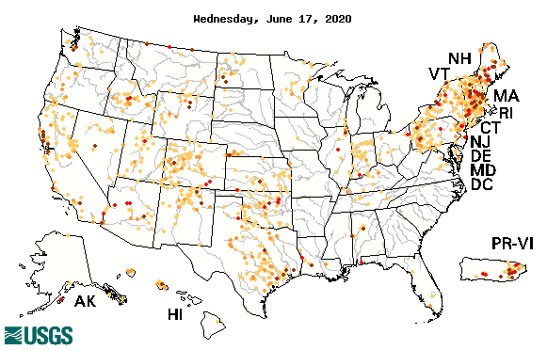

Additional Drought Indicators
Temperature Departure from Normal (°F)
June 1-18, 2020
USGS Streamflow
Below Normal 7-Day Average Streamflow
Temperatures during the first half of June were significantly above-normal for many areas.
Some areas have indication of hydrologic drought or below-normal streamflow, but it is not a widespread issue across the central U.S. currently.
Midwestern Regional Climate Center cli-MATE: https://mrcc.illinois.edu/CLIMATE/
Current USGS Streamflow: https://waterwatch.usgs.gov/index.php

Slide 9
OUTLOOK & IMPACTS

Slide 10
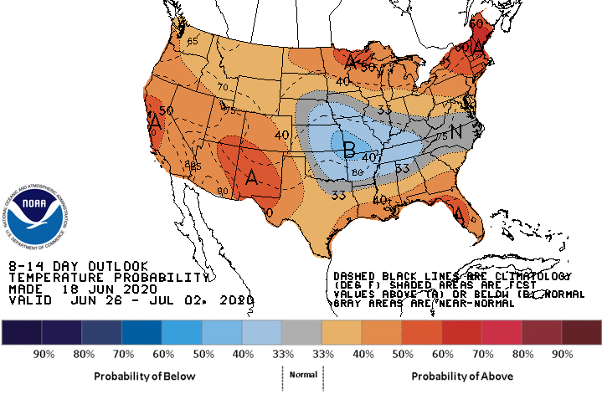
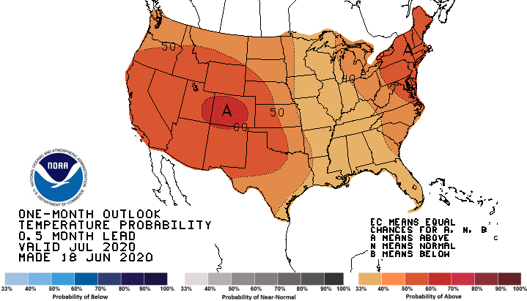
Temperature Outlooks
8-14 Day Outlook: Valid June 26-July 2, 2020
July 2020 Temperature Outlook
There is a greater chance for above-normal temperatures across much of the North Central U.S. over the period of June 26-July 2.
There is a chance for widespread above-normal temperatures into July as well, with most of the Great Plains having a greater than 40% chance.
Current CPC Outlooks: https://www.cpc.ncep.noaa.gov/

Slide 11
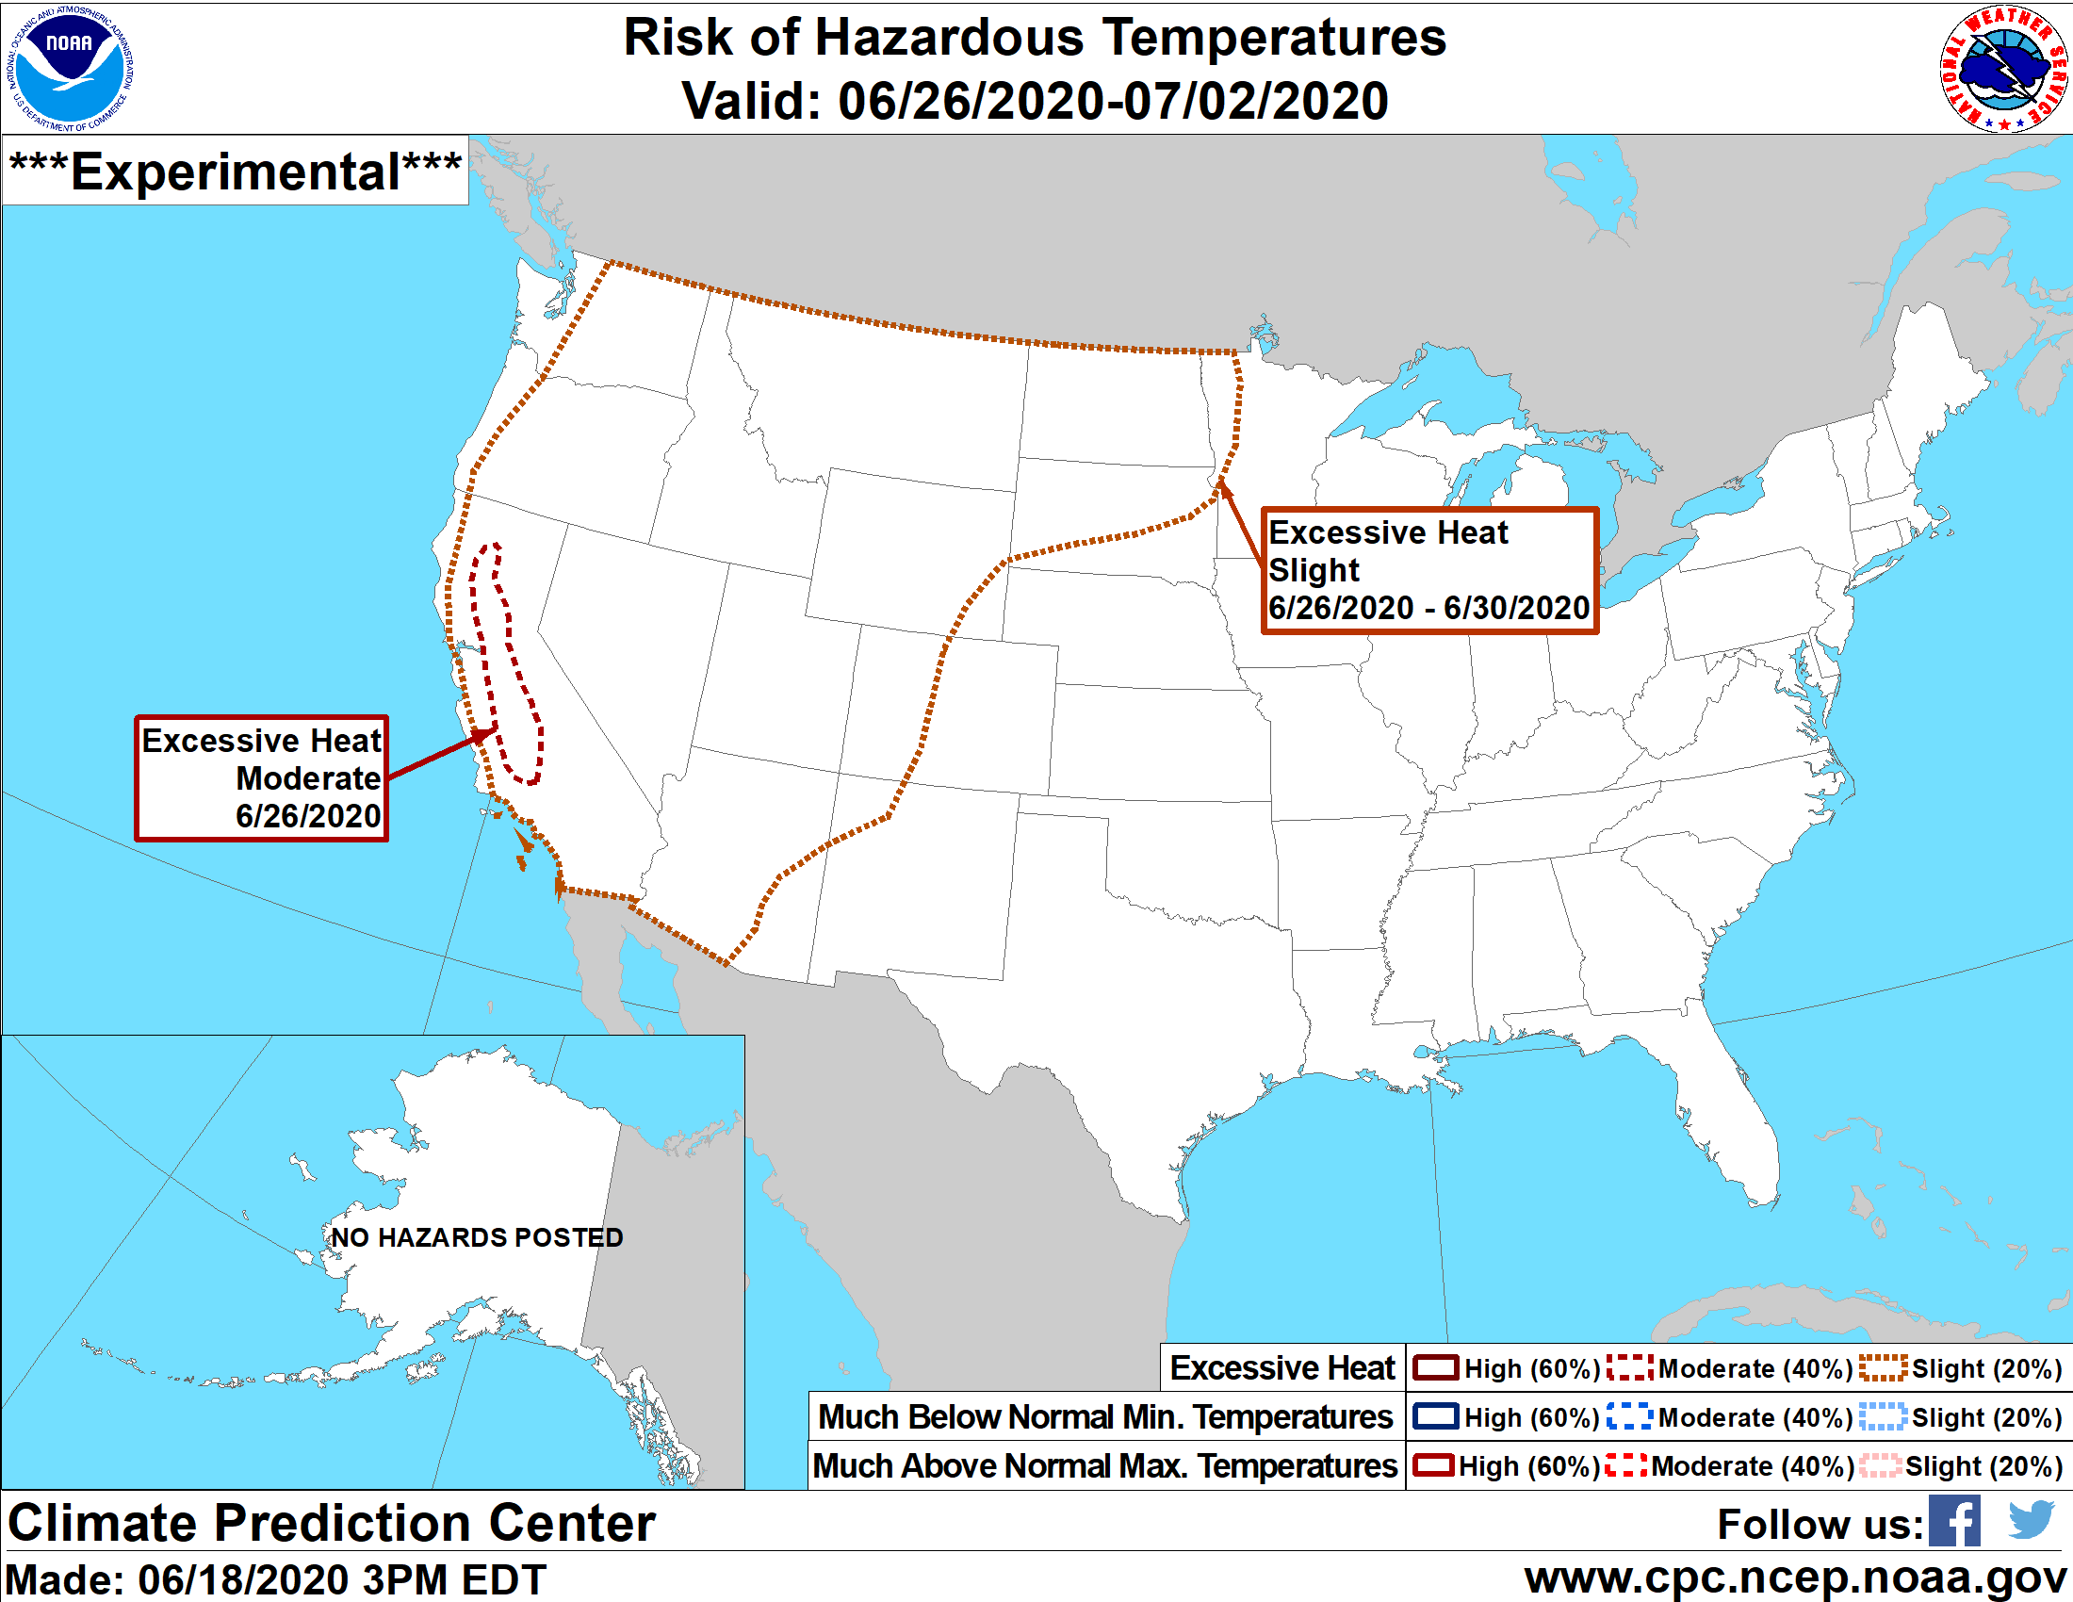
Risk of Hazardous Temperatures Valid June 26-July 2, 2020 Slight risk (20% chance) of excessive heat across much of the Great Plains. Daily high temperatures may exceed the 85th percentile.
Current NOAA CPC Hazards Outlook: https://www.cpc.ncep.noaa.gov/products/predictions/threats/threats.php

Slide 12
7-Day Precipitation Outlook
Forecasts show the possibility for decent rainfall in some areas over the next week. However, precipitation is not typically widespread this time of year.
Due to this, while some areas may receive some relief from rainfall, there will likely be areas that do not receive enough rainfall to help alleviate conditions.
In addition, for those areas that do receive rainfall, issues will likely still persist due to hot temperatures and therefore increased atmospheric demand.

Slide 13
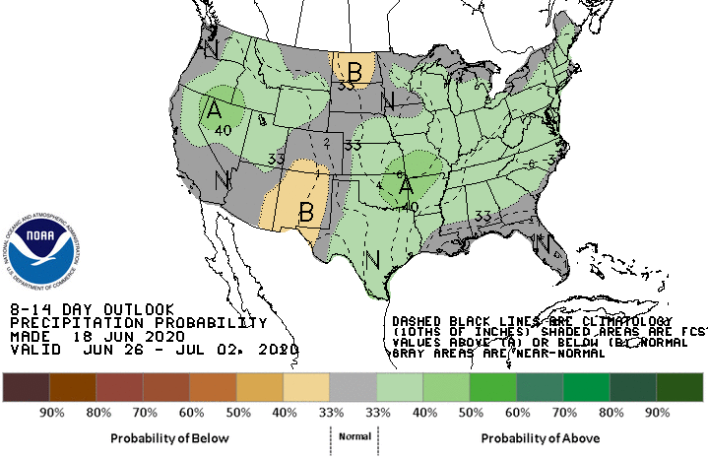
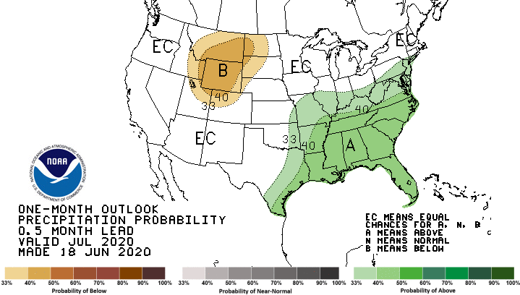
Precipitation Outlooks
8-14 Day Outlook: Valid June 26-July 2, 2020
July 2020 Precipitation Outlook
There is a greater chance for below-normal or near-normal precipitation in the Great Plains over the period of June 26-July 2.
Portions of the Missouri River Basin have greater chances for below-normal precipitation in July, while areas near the Ohio River Valley have greater chances for above-normal precipitation. Other areas have equal chances for above-, below-, or near-normal precipitation.
Current CPC Outlooks: https://www.cpc.ncep.noaa.gov/

Slide 14
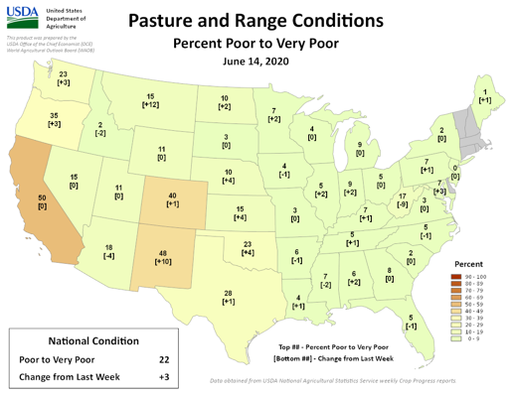
Agricultural Impacts
A recent increase in atmospheric demand (i.e., crop water use) is starting to cause some stress on crops and rangeland as soil moisture deficits are increasing.
Over the last couple of weeks, crop conditions have worsened according to USDA-NASS. The biggest impact will continue to be on rangeland and grassland. Crops are still early enough in growth stage to limit damage (except winter wheat).
Heat continuing into early July would start to harm corn reaching reproductive stages (i.e., tasseling).
Without timely and widespread precipitation, conditions will continue to deteriorate.
USDA-NASS Crop Progress Reports: https://usda.library.cornell.edu/concern/publications/8336h188j?locale=en

Slide 15
For More Information…
NIDIS and its partners will issue future Drought Early Warning Updates as conditions evolve.
More local information is available from the following resources:
Your state climatologist: https://stateclimate.org/state_programs/
Your local National Weather Service office: https://www.weather.gov/srh/nwsoffices
There are also upcoming webinars that will offer more information:
North Central U.S. Climate and Drought Summary & Outlook Webinars (offered monthly): https://register.gotowebinar.com/register/7528179497868100876
Archived webinars are available here: https://hprcc.unl.edu/webinars.php
July 9th – Colorado Drought Webinar from the Intermountain West Drought Early Warning System (DEWS): https://register.gotowebinar.com/register/3806410706977308171

