Slide 1
How to Build a Budget
1

Slide 2
The NYC Budget Process
2

Slide 3
The budget serves two complementary purposes
The budget presents City priorities and values
The budget dictates the funds City agencies can legally spend to provide services

Slide 4
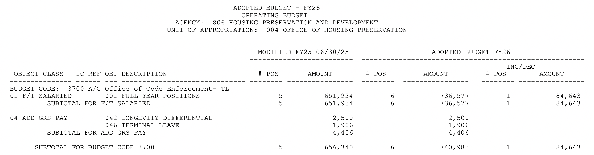
The budget is made up of units of appropriation and budget codes

Slide 5
NYC has an Operating Budget and a Capital Budget
The Operating Budget (or Expense Budget) reflects anticipated income and planned spending over a fiscal year
Personal Services (PS)
Other than Personal Services (OTPS)
The Capital Budget funds the construction, reconstruction, and acquisition of capital assets for projects that meet certain requirements

Slide 6


NYC releases four expense plans each year
Community Boards submit expense and capital priorities
City Council hosts budget hearings with all agencies, including the Office of Management and Budget (OMB)
Hearings are open to public comment
July
The Fiscal Year begins
November
Mayor submits the November Financial Plan Update
January/
February
Mayor presents the Preliminary Budget and Five-Year Financial Plan
April/
May
Mayor presents the Executive Budget
June
City Council votes on the Adopted Budget
Preliminary and executive capital plans are presented alongside the expense plans in January/February and April/May
However, the Capital Commitment Plan is not adopted until later in the fall, typically September

Slide 7
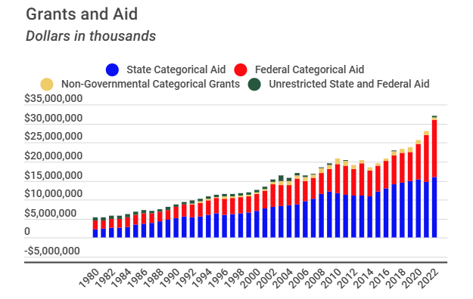
NYC's budget includes significant state and federal funds
The State Budget distributes resources across the State and sets priorities
The majority of State spending is local assistance, primarily Medicaid, health care, and school aid
The City and State have overlapping budget timelines
Source: Independent Budget Office Fiscal History: Citywide State and Federal Categorical Aid

Slide 8
NYC budget snapshot
FY26 Expense Budget balanced at $122.30B
Prelim FY27 Expense Budget balanced at $127.00B
FY26-30 Capital Plan totaling $113.00B

Slide 9
History of NYC's Budget Process
9

Slide 10
The fiscal crisis of the 1970s
Through the 1960s, the City ran annual current account deficits, funding payments in excess of revenues through borrowing
In late 1974, New York City had an outstanding debt of $10B, with $5B of that short-term debt. Interest rates had climbed from 4% in the late 1960s to 8%. In 1975, banks refused to issue new bonds, leaving the City in financial freefall
On October 17, 1975, the City was scheduled to pay $453M in debt payments. The City had only $34M on hand
The City was forced to cut essential services and seek support from the state and federal government

Slide 11
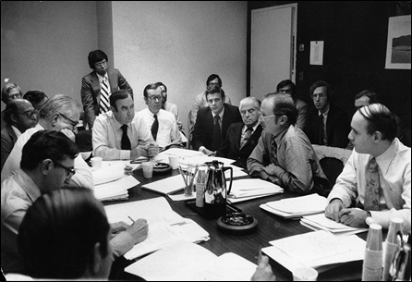
Aftermath of the fiscal crisis: GAAP and the creation of OMB
The Municipal Assistance Corporation was set up to sell bonds to finance City programs, and the Financial Control Board was created to review and approve City budgets
The NYS Financial Emergency Act in fall 1975 required the City to budget in accordance with Generally Accepted Accounting Principles (GAAP), including a formal requirement to balance the budget.
1981 was the first GAAP balanced budget requirement. The City has met this requirement each year to date – 47 years of GAAP balanced budgets
In 1976, the Office of Management and Budget was created to replace the Bureau of the Budget
The impacts were felt across the City: 69,600 public sector jobs were lost between 1975 and 1978
September, 1975: An Emergency Financial Control Board meeting in the office of Governor Hugh Carey (Meyer Liebowitz/The New York Times/Redux)

Slide 12
Mayor Mamdani's budget priorities & the FY27 budget
12

Slide 13
The Administration is committed to returning the City to firm financial footing while advancing the Affordability Agenda

Slide 14
Adams Left the Highest Budget Gaps in 12 Years
 | Budget Gaps |  |  | as a % of Revenue
 | Year 2 | Year 3 | Year 4 | Year 2 | Year 3 | Year 4
Last Bloomberg Plan Nov 2013 | - | -1,472 | -951 | 0.00% | -2.70% | -1.70%
Last de Blasio Plan Nov 2021 | -2,882 | -2,731 | -2,140 | -4.10% | -3.80% | -2.90%
Last Adams Plan Nov 2025 | -4,691 | -6,273 | -6,296 | -5.30% | -6.80% | -6.70%
Staggering Underbudgeting Made it Worse

Slide 15
FY27 Prelim Budget includes $7.54 Billion to Fill Cliffs Across Six Major Unbudgeted Needs

Slide 16
$6.67 Billion In Additional Unfunded Needs and Mandates Over FY6 and FY27 Alone
Includes
Health Insurance Stabilization Fund insolvency $911M in FY26, $1.1B in FY27
State class size law mandate $600M in FY27
Unbudgeted portion of the mandated 12% Health Insurance Plan $408M of Greater New York HIP rate increase (in FY26, $418M in FY27)
Early childhood education funding shortfall $300M in FY26, baselined at $380M in FY27
Supportive Housing Units $82 million in FY26 and baselined
State mandated Medicaid funding $57 million in FY26 and baselined
Unbudgeted Not for Profit vendor indirect costs $26 million in FY26, baselined at $71 million as of FY27 to support their growing administration costs
Federal and state mandated "Early Intervention” $74 million in FY26, $93 million in FY27

Slide 17
February 2026 Financial Plan City Funds - ($ in Millions)
 |  | FY 2026 | FY 2027 | FY 2028 | FY 2029 | FY 2030
Gap to be Closed - November 2025 Financial Plan |  | $- - - | ($4,691) | ($6,273) | ($6,296) | ($9,169)
Revenue Changes: |  | FY 2026 | FY 2027 | FY 2028 | FY 2029 | FY 2030
 | Tax Revenues | $2,447 | $4,140 | $2,951 | $2,245 | $5,055
 | State Action: Fiscal Impact of de-coupling from OBBBA | - - - | 723 | 1,010 | 520 | 317
 | State Action: Sales Tax Distressed Hospital Intercept | 150 | 150 | 113 | - - - | - - -
 | State Tax Programs | (3) | (64) | (71) | (78) | (82)
 | Unrestricted State Aid | 500 | - - - | - - - | - - - | - - -
 | Non-Tax Revenues | 56 | 25 | 5 | 5 | 5
 | Property Tax Increase | - - - | 3,700 | 3,601 | 3,707 | 3,814
 | Total Revenue Changes | $3,150 | $8,674 | $7,609 | $6,399 | $9,109
Expense Changes:
 | Agency Expense Changes | $6,610 | $7,405 | $7,895 | $7,907 | $8,043
 | Health Stabilization Fund Cost | 911 | 1,144 | 1,227 | 1,319 | 1,424
 | NYCE PPO Health Savings | (411) | (791) | (840) | (891) | (953)
 | State Actions: Article 6, Youth Programming and School Aid | (360) | (457) | (457) | (457) | (457)
 | Pension | 16 | (99) | 10 | 11 | (19)
 | Debt Service | (40) | 40 | 90 | 114 | 177
 | General Reserve | (1,150) | (1,100) | - - - | - - - | - - -
 | Retiree Health Benefits Trust Reserve | - - - | (229) | 229 | - - - | - - -
 | Rainy Day Fund | (980) | - - - | 980 | - - - | - - -
 | Capital Stabilization Fund | (250) | (250) | - - - | - - - | - - -
 | Labor Reserve Savings | (150) | (400) | - - - | - - - | - - -
 | Projected Agency Savings | (710) | (1,060) | (1,080) | (1,090) | (1,110)
 | OTPS Inflation Adjustment | - - - | (56) | (56) | (56) | (56)
 | Re-estimate of Prior Years' Expenses and Receivables | (500) | - - - | - - - | - - - | - - -
 | Total Expense Changes | $2,986 | $4,147 | $7,998 | $6,857 | $7,049
Gap to be Closed |  | $164 | ($164) | ($6,662) | ($6,754) | ($7,109)
FY 2026 Prepayment |  | ($164) | $164 | $- - - | $- - - | $- - -
Gap to be Closed - February 2026 Financial Plan |  | $- - - | $- - - | ($6,662) | ($6,754) | ($7,109)

Slide 18
Five Year Financial Plan Revenue And Expenditures All Funds - ($ in Millions)
REVENUES |  | FY 2026 | FY 2027 | FY 2028 | FY 2029 | FY 2030
Taxes
 | General Property Tax | $35,361 | $36,649 | $37,753 | $38,868 | $40,169
 | Other Taxes | 47,868 | 50,164 | 50,809 | 51,319 | 52,625
 | Tax Audit Revenue | 959 | 879 | 879 | 879 | 879
 | Tax Programs | 147 | 86 | 42 | (78) | (82)
 | Property Tax Increase | - - - | 3,700 | 3,601 | 3,707 | 3,814
 | Subtotal: Taxes | $84,335 | $91,478 | $93,084 | $94,695 | $97,405
Miscellaneous Revenues |  | 8,642 | 8,092 | 8,104 | 8,148 | 8,173
Unrestricted Intergovernmental Aid |  | 502 | - - - | - - - | - - - | - - -
Less: Intra-City Revenue |  | (2,275) | (1,946) | (1,938) | (1,931) | (1,929)
Disallowances Against Categorical Grants |  | (15) | (15) | (15) | (15) | (15)
 | Subtotal: City Funds | $91,189 | $97,609 | $99,235 | $100,897 | $103,634
Other Categorical Grants |  | 981 | 1,022 | 1,009 | 1,006 | 1,006
Inter-Fund Revenues |  | 808 | 800 | 801 | 804 | 804
Federal Categorical Grants |  | 8,889 | 7,260 | 7,179 | 7,155 | 7,165
State Categorical Grants |  | 20,503 | 20,310 | 20,709 | 20,341 | 20,415
 | Total Revenues | $122,370 | $127,001 | $128,933 | $130,203 | $133,024
EXPENDITURES
Personal Service
 | Salaries and Wages | $35,027 | $36,184 | $37,976 | $38,774 | $39,614
 | Pensions | 10,495 | 10,533 | 11,519 | 10,983 | 10,524
 | Fringe Benefits | 15,881 | 16,483 | 17,267 | 17,989 | 18,823
 | Retiree Health Benefits Trust | - - - | (229) | 229 | - - - | - - -
 | Subtotal: Personal Service | $61,403 | $62,971 | $66,991 | $67,746 | $68,961
Other Than Personal Service
 | Medical Assistance | $6,437 | $6,790 | $6,940 | $7,090 | $7,240
 | Public Assistance | 2,764 | 2,746 | 2,746 | 2,746 | 2,746
 | All Other | 50,017 | 47,050 | 47,863 | 48,323 | 49,385
 | Subtotal: Other Than Personal Service | $59,218 | $56,586 | $57,549 | $58,159 | $59,371
Debt Service ^{1,2} |  | 8,503 | 9,528 | 10,563 | 11,533 | 12,280
FY 2025 Budget Stabilization ¹ |  | (3,787) | - - - | - - - | - - - | - - -
FY 2026 Budget Stabilization ² |  | 238 | (238) | - - - | - - - | - - -
Capital Stabilization Reserve |  | - - - | - - - | 250 | 250 | 250
General Reserve |  | 50 | 100 | 1,200 | 1,200 | 1,200
Rainy Day Fund |  | (980) | - - - | 980 | - - - | - - -
Less: Intra-City Expenses |  | (2,275) | (1,946) | (1,938) | (1,931) | (1,929)
 | Total Expenditures | $122,370 | $127,001 | $135,595 | $136,957 | $140,133
Gap To Be Closed |  | $- - - | $- - - | ($6,662) | ($6,754) | ($7,109)
¹ Fiscal Year 2025 Budget Stabilization total $3.787 billion, including GO of $1.443 billion and TFA-FTS of $2.344 billion. ² Fiscal Year 2026 Budget Stabilization totals $238 million.

Slide 19
96% of the New Spending in this Plan Covered Unfunded Needs
Preliminary Budget New Spending
$14.0B

Slide 20
The City will generate recurring savings through targeted expense reductions
Per Executive Order 12, for the first time in City history, all agencies will have a Chief Savings Officer (CSO)
By March 20, CSO's will identify inefficiencies and redundancies to be eliminated through program consolidation, insourcing, and other means
Thereafter, every six months, they will issue a report with updated assessments and additional savings opportunities

Slide 21
The Case for Taxing the Rich
Increase personal income taxes on New Yorkers earning more than $1M and corporate taxes on the most profitable corporations
The cost of historic financial mismanagement should not fall on those who can least afford it

Slide 22
The Case for Ending the Drain
Recalibrate the City's fiscal relationship with the State
NYC contributes 54.5% of state revenue, but only receives 40.5% back
NYC's portion of NYS's GDP has grown by nearly 10% since 2010

Slide 23
Sources
Office of Management and Budget Publications, FY24-FY26
Kim Phillips-Fein, "Fear City"
Independent Budget Office, "Understanding New York City's Budget, A Guide"
Independent Budget Office, "A Guide to the Capital Budget"
Independent Budget Office, "Fiscal History: Citywide State and Federal Categorical Aid"
City Journal, "The Fading Lessons of New York’s Fiscal Crisis"

Slide 24
How to Build a Budget
24

