Slide 1
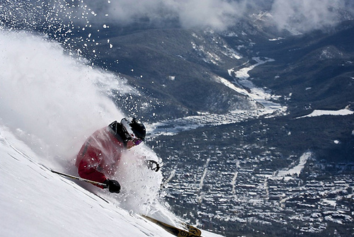
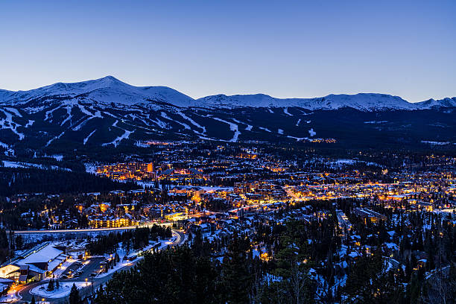
46th Annual Veterinary Orthopedic Society Annual Conference.
February 9 – 16, 2019
Breckenridge, CO

