Slide 1
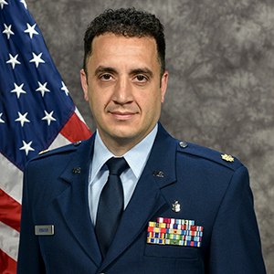
Dear All,
I am happy to introduce Dr. Omar Rokayak, assistant professor of surgery, who recently joined our Division of Acute Care Surgical Services (ACSS) in the Department of Surgery. Dr. Rokayak completed a general surgery residency at SUNY Stony Brook-Southampton Hospital in New York, and a surgical critical care fellowship at the University of Alabama, Birmingham. Prior to joining VCU, Dr. Rokayak served as assistant professor of surgery, in the Division of Trauma and Acute Care Surgery at the University of Alabama. Dr. Rokayak is a Major in United State Air Force (USAF) Reserve and previously served as a Major in USAF and Chief Medical Officer for Special Operations Surgical Teams (SOST) / Air Force Special Operations Command. He has significant experience in austere battlefield surgery and critical care with joint special operations commands, with extensive field deployments history to Afghanistan, Qatar, and Syria. He led the clinical organization, preparation, planning, and execution of SOST’s response to the largest mass casualty event of the Afghanistan war in the preceding decade. He received multiple humanitarian and military awards, including the 2022 Meritorious Service Medal, and the 2022 Air Force Longevity Service Award. Nationally, Dr. Rokayak, serves as the co-chair of membership committee of the ACS’s Excelsior Surgical Society. Apart from his acute care surgical responsibilities, Dr. Rokayak will serve as the VCU Health Medical Director of Military-Civilian Partnership. Dr. Rokayak is a great addition to the ACSS Division, the Department of Surgery, the VCU Trauma Center, and VCU Health. Please join me in welcoming Dr. Omar Rokayak and congratulating him on his new position.
My kind regards,
Michel B. Aboutanos, MD, MPH, FACS, NOTW
The Fletcher Emory Ammons Distinguished Professor in Surgery Chief, Division of Acute Care Surgical Service
Department of Surgery
Medical Director, VCU Trauma Center & Trauma System Network
Virginia Commonwealth University Health

