Slide 1
Utilizing Health & Welfare Alerts in Prevention of UI’s & MUI’s
David Nodge
Provider Series Training
11/7/2024

Slide 2

Objectives
Learn what Health and Welfare Alerts are
Learn how to receive Health and Welfare Alerts
Review of 2024 Health and Welfare Alerts
Learn how to apply Health and Welfare Alerts to aid in ensuring health and welfare in delivery of services and supports

Slide 3
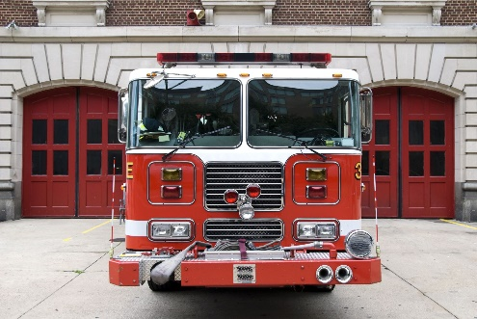
What are Health and Welfare Alerts
Health and Welfare Alerts
Created from MUI trends and patterns
Multiple MUI’s from a specific category or situation
Resulting in a critical incident
MUI
Purpose to alert ALL DD employees of trends and patterns

Slide 4

DODD Health & Welfare Alerts
OAC 5123-17-02 MUI RULE
Requires All DD employees to review Health and Welfare Alerts annually
https://dodd.ohio.gov/health-and-welfare/health-and-welfare-alerts/health-and-welfare-alerts
You can also subscribe to receive these alerts
Review previous alerts
Apply what you have learned to individuals served

Slide 5

2024 Health And Welfare Alerts Winter Safety
https://dodd.ohio.gov/health-and-welfare/health-and-welfare-alerts/Winter_Weather
Hazards of Winter Weather
Slip and fall Steps/Sidewalks/Streets/Vehicle Running Boards
Exposure Ensuring individuals are properly dressed
Mechanical Carbon monoxide Detectors/Furnace/Vehicle
Emergency Plan Power outage/Staffing Coverage/Program Closure
Policies/Procedures Not planning in a crisis/Space Heaters - Safety
Medical Conditions Diabetes/Seizure/Unsteady Gait/Poor Circulation
Emergency Contacts Who are your emergency contacts
How has this been communicated?

Slide 6
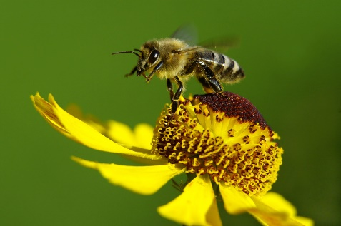
Summer Safety
https://dodd.ohio.gov/health-and-welfare/health-and-welfare-alerts/alert-summer-safety-2024
Addressing Summer Safety issues
Change in routines/activities/staffing patterns
Sunburn Medication/Activities/Clothing
Hot car deaths Leaving individuals in a car unattended
Water Safety Individuals drawn to water/elopement
Medications Are there any adverse effects
Increase Sensitivity to Sun/Heat
Activities Supervision/Exit Plan/Transportation
Contingency plans/Weather/Staffing/Cancellation/Epi Pen
Dehydration Increase fluids – Frequency
Heat Related Illness Train/Recognize/Prevent
Food Safety Lunches/Storage/Spoilage

Slide 7

Recognizing and Responding to Medical Emergencies
https://dodd.ohio.gov/health-and-welfare/health-and-welfare-alerts/Alert-recognizing-responding-to-medical-emergencies
What is a Medical Emergency
Changes in status from and individual’s baseline
Behaviors/Habits/Physical Conditions
What is “normal” for the individual
Eating
Drinking
Social Interactions
Bowel/Bladder Functions
Activity levels
Sleeping patterns
Where are these changes recorded?
Who is reviewing this information
What is being recorded
When did changes begin?
How long have the changes persisted? – Hours/Days/Weeks
How did the individual respond? Lethargic/Eating Patterns/Sleeping Patterns
Has severity of changed over time? Temperature/Communication of pain
Who is contacted in the event of
Onset of symptoms
Requirement of emergency services – Who is being called AFTER 911

Slide 8
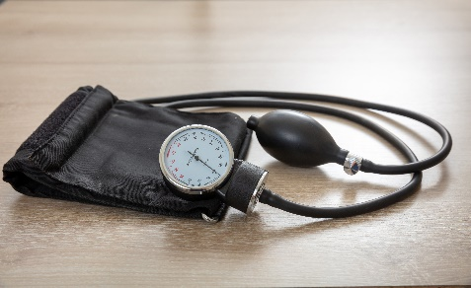
Recognizing and Responding to Medical Emergencies
Useful Information for 911 Dispatcher
Blood Pressure
If ability to do so
Breathing
Slow/Rapid/Shallow/None - CPR
Choking – First Aid Administered
Consciousness -Changes
Unresponsive/Loss of Consciousness – Call 911
Chest Pain
Get vital signs if possible Pulse/BP – Call 911
Falls
Head injury/Loss of Consciousness/Unable to get up/Severe Pain
Fracture/Dislocation/Uncontrolled bleeding
Heart Rate
Pulse/Rapid/Irregular Heart Rate

Slide 9
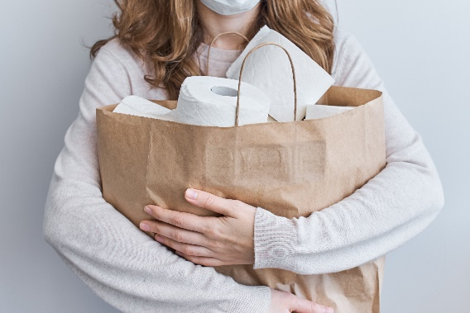

Recognizing and Responding to Medical Emergencies
Calling 911
Stay CALM
Location – Address
In the Community – Look for Address/Landmarks/Street Names/Highway Mile Marker
Name/Age of individual
Your Phone number
Nature of emergency
Details
Individual is in a wheelchair
Combative
Non-Verbal
Length of Seizure

Slide 10

Recognizing and Responding to Medical Emergencies
Waiting for first responders
Listen to instructions from dispatcher
Don’t hang up – Follow Dispatcher’s instructions
Continue performing First Aid/CPR
Remain calm on scene when first responders arrive
Continue to be a resource
Ask which hospital
Who will support individual in ED

Slide 11
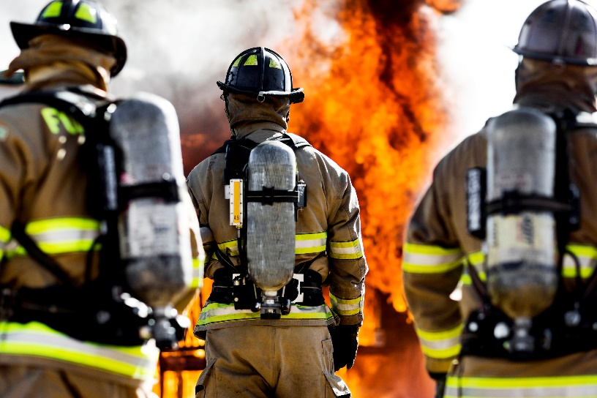
Burn Prevention
https://dodd.ohio.gov/health-and-welfare/health-and-welfare-alerts/Burn_prevention
Identifying Risk
Spills and Scalds
Drinking/Carrying Hot liquids
Sensory Impairments
Reduced sensation – High pain tolerances – Slow reaction
Cognitive Challenges
Inability to identify or react to dangers
Causes of burns
Fire
Hot Liquid
Steam
Unintended Causes
Electric Heating pad/blanket
Tub/Shower
Cooking accidents
Chemicals/Cleaners
Sun exposure
Have risks been identified and communicated?

Slide 12
Burn Prevention
Signs of burns
Blisters/Pain/Swelling/Reddening/White/Charred skin/Peeling
First Degree
Affects top layer of skin - Epidermis
Reddening – usually no blistering
Second Degree
Affects 2nd layer of skin Epidermis/Dermis
Pain/Redness/Swelling/Blistering
Third Degree
Affects All 3 layers of skin – Epidermis/Dermis/Fat
Appears black/white/red leathery appearance

Slide 13

Burn Prevention
Avoid Distractions
Address identified risks in OISP
Smokers
Policies
Safety awareness
Cooking
Not leaving stove unattended
Microwave use
Serving food
Bathing/Shower
Check Water temp prior to putting someone in a tub
Anti scald valves

Slide 14

Putting Health and Welfare Alerts to Work
Transitions
Identifying risk
Addressing risk
Planning
Unusual Incidents
Prevention Plans
Major Unusual Incidents
Prevention Plans
Developing Policy Procedure
Creating conversation/discussion/
Individuals served
DSP’s
DSP Trainings
Don’t Assume
Post and make accessible

Slide 15
All Health And Welfare Alerts
Dehydration
Choking Prevention
Constipation & Bowel Obstruction
Human Trafficking
Fall Prevention
Suicide Awareness & Prevention
Shunt Care
Prevention Abuse Awareness
COVID 19 Prevention
Drowning Prevention
Exploitation Prevention
Preventative Care
Pneumonia & Flu

Slide 16

Questions

Slide 17

Thank you!
David Nodge
MUI Community Liaison
Nodge.david@cuyahogabdd.org
www.cuyahogabdd.org

