Slide 1
How to Write a Plan of Correction (POC), and What To Expect During a Plan of Correction Verification (POC-V)
Ljiljana Bobinac-Provider Compliance Coordinator
Jasmine Perry-Provider Compliance Coordinator
Laura Snyder-Provider Compliance Coordinator
February 6, 2025

Slide 2
What To Expect After The Review
The Plan Of Correction (POC)
At the time of the exit conference, the reviewer has 10 calendars day to complete the report.
  If citations were issued, you will receive a “Citation Notification - DO NOT REPLY” email
  If no citations are issue, you will receive a “Compliance review- No citations letter” email
The provider must submit a plan of correction or appeal for each citation within 14 calendar days of the citation email.
Contact the reviewer if you are unable to see the citations in the portal.

Slide 3
Citation Notification - DO NOT REPLY
Example Letter
Compliance Review
Provider/Facility Name:
Provider/Facility #:
County: Cuyahoga
Review title/Date:
Dear Provider,
A Plan of Correction (POC) is required as a result of your recent compliance review. Please log in at dodd.ohio.gov, load the MyPortal, and click the review name to access the Compliance Summary report and enter a POC for each citation. The POC and/or appeal is due within 14 calendar days of this correspondence.
In your POC, please include the following information:
· Description of corrective action for each citation, including any system changes to prevent future occurrences; Implementation date of corrective action for each deficiency;
The reviewer will respond to your POC within 20 calendar days.
If you would like to appeal a citation, please check the appeal box for the citation and include the following:
· Reason for the appeal
· Submit/Upload supporting documentation to the reviewer via email/or the application
You will receive an appeal determination within 10 days of receipt.
If you have any questions, please contact the reviewer at (phone number) or by email at (email address)

Slide 4
POC Past Due Letter Notification
If a provider fails to enter and submit their POCs within 14 days. They will receive this notification.
The provider will receive notification at least weekly, with up to four attempts to get this completed.
Please note: If the provider is having problems with the provider portal, contact Antonleena via email antonleena.boykins@dodd.ohio.gov or via phone 614-902-4249.
Dear Provider,
This letter is to notify you that the Plan of Correction for the citations issued during your compliance review is overdue. As a provider, you are required to cooperate with compliance reviews in accordance with the Ohio Administrative Code.
Please follow this link
http://dodd.ohio.gov to access the Compliance Summary report and enter a POC for each citation.
If you are no longer interested in maintaining your certifications and/or facility license, please submit this in writing to DODD. The letter relinquishing your certifications and/or facility license should include your name, provider number and/or facility number and the effective date of your certification and/or facility license.
You can also or log into your DODD user account at,
https://portal.prodapps.dodd.ohio.gov , and select "Relinquish Certification"
If you have any questions, please contact the reviewer at phone number or email

Slide 5

A Plan of Correction For Each Citation MUST Include:
Description of corrective action for each citation, including any system changes to prevent future occurrences; (What is being corrected)
Implementation date of corrective action for each deficiency;
  (Date it will be corrected by)
How to prevent from happening in the future

Slide 6

A Plan of Correction CANNOT Include:
Identifying info about an individual:
  No names or initials ( use ID #s )
  No family/guardian names
  Nothing that would identify the individual in any way
  No names of staff ( use initials)

Slide 7
What If I Want to Appeal The Citation?
Enter your response as an appeal instead of a POC
Explain why you believe you are in compliance with the rule requirement
Submit documentation to support your appeal
Reviewers have 10 calendar days to respond to appeals
  If an appeal is approved, the citation will be removed
  If the appeal is disapproved, the provider submits a POC
  If the review was done by a county board/COG, the provider can appeal to DODD
Reviewers have 20 calendar days to approve or disapprove the POC
  If any POC is disapproved, the timelines start over

Slide 8
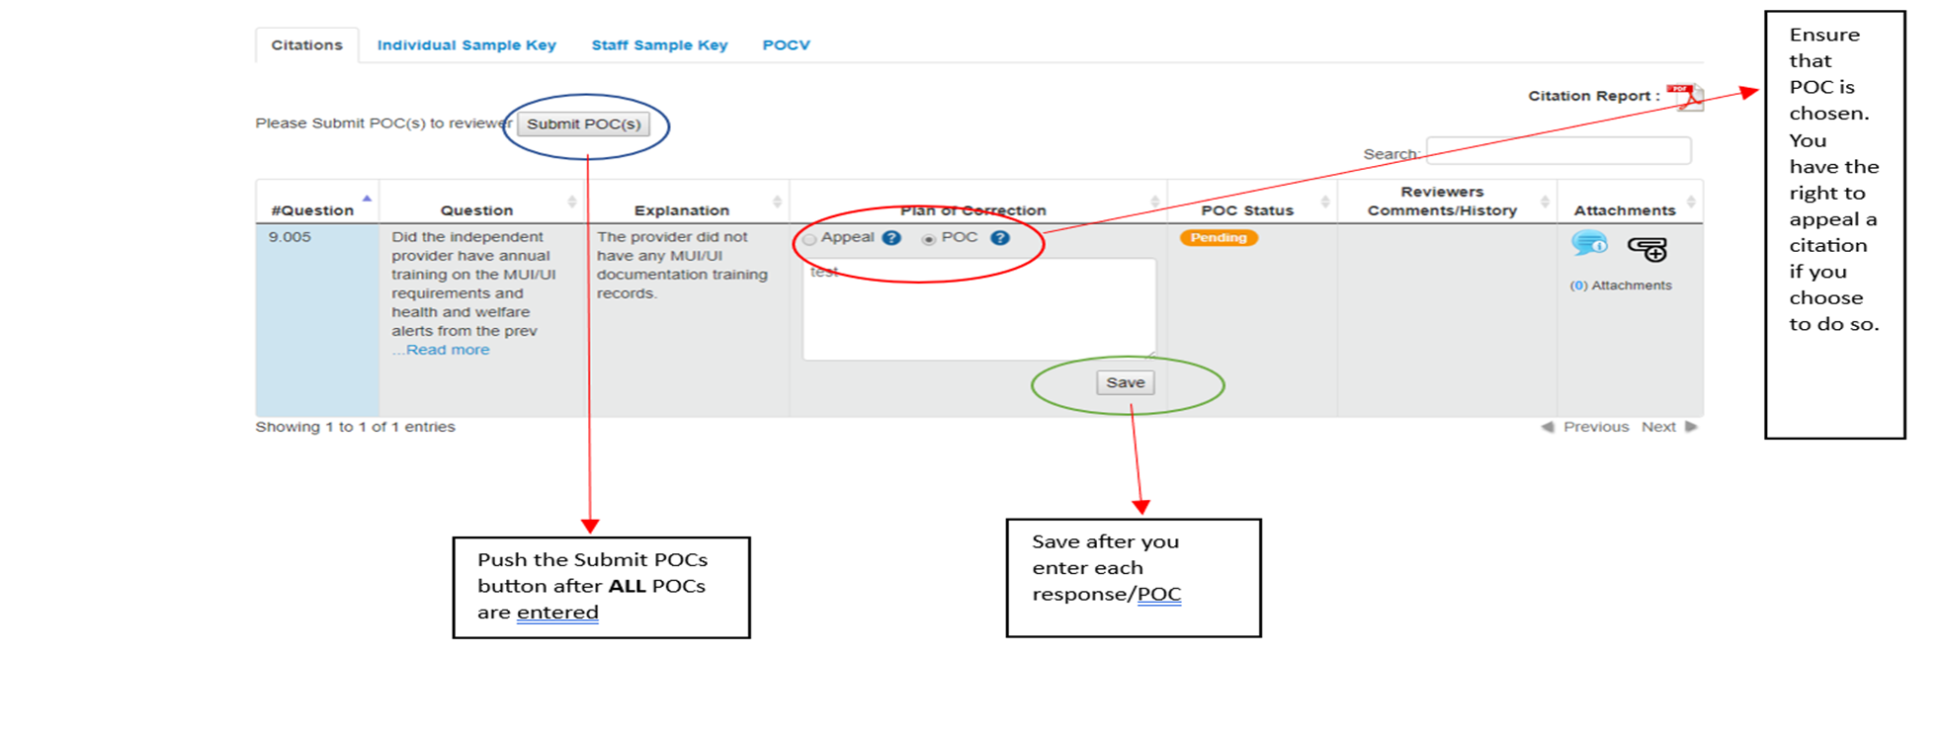
Plan Of Correction In RDS

Slide 9
POC Acceptance Email Received, Get Ready For POCV
If POC is accepted, email will be sent to you from The Office of Compliance
Date:
RE: Compliance Review
Provider’s name
Provider Contract #
County: Cuyahoga
Dear Provider’s name ,
Thank you for submitting a Plan of Correction (POC) for your recent compliance review. The POC satisfactorily addresses the citations issued during your compliance review and has been approved. The Reviewer will contact you to verify the implementation of your POC within the next 90 days.
If you have any questions, please contact me by email at reviewer’s email or by phone at reviewer’s phone number

Slide 10
Plan Of Correction Verification
Must Occur Within 90 days of the POC approval
May Occur Onsite or You May Be Asked to Submit Documents
It Might Take More Than One Try

Slide 11
Plan of Correction Verification (POC-V)
A Plan of Correction Verification (POC-V) is the last step of the review process.
Occurs within 90 days of POC approval.
The reviewer will need to see evidence that the provider has implemented their POC.

Slide 12
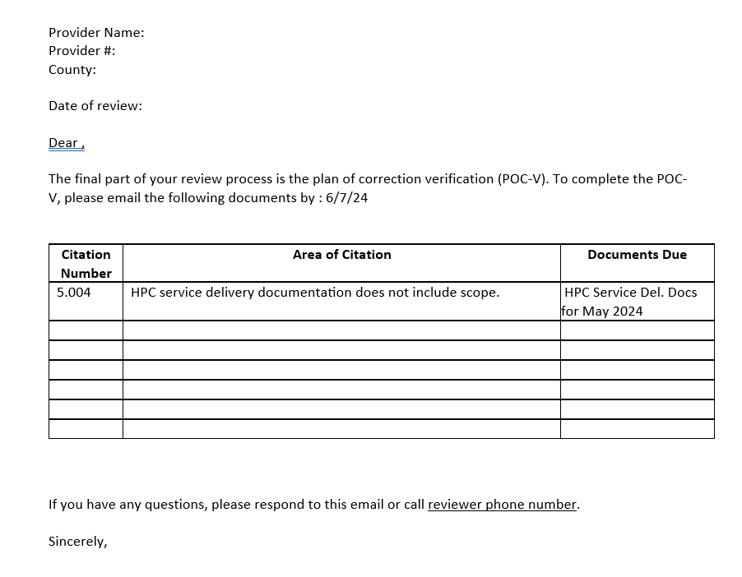
POC-V Document Request
After your POC is approved, you will receive a document request via email from the reviewer.
The documentation required for your POC-V will be listed.
There will be a due date for submitting the documentation to your reviewer.

Slide 13

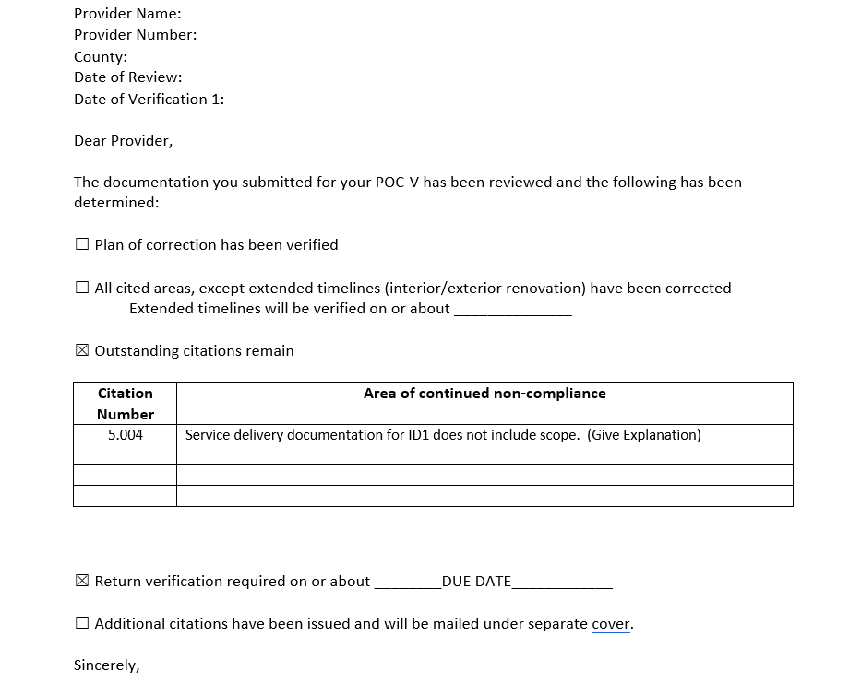
POC-Verification Not Accepted
After you submit the documentation required for the POC-V, you will receive a notification regarding the status.
If the POC-V is not accepted, you will be notified of the outstanding citations and provided with a new submission date.

Slide 14

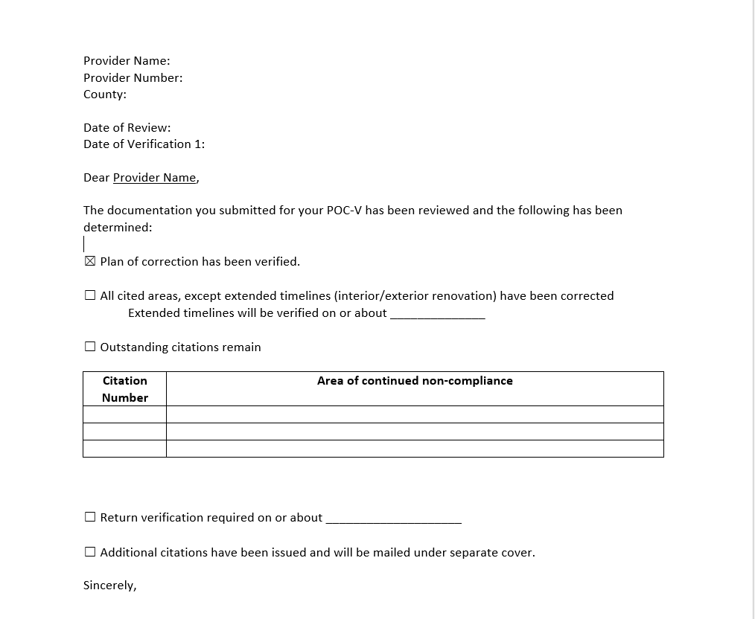
POC-Verification Accepted
If the POC-V is accepted, you will be notified that the review is complete.

Slide 15

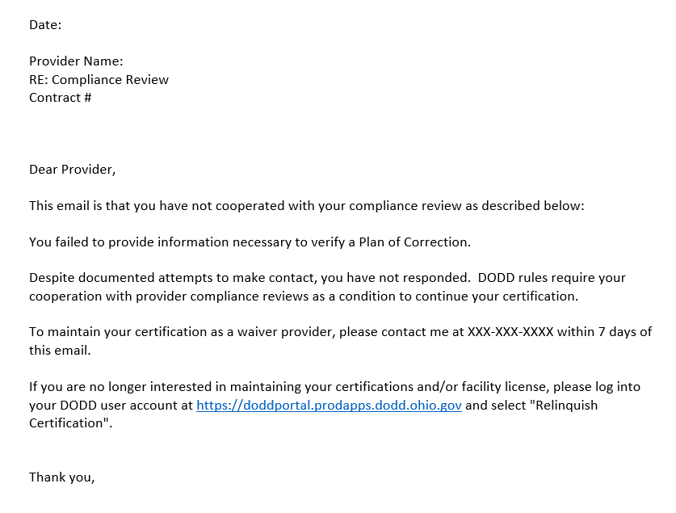
Your POC-V Is Past Due…
If you do not submit the documentation required for your POC-V by the required due date, it will start a non-responsive process.

Slide 16
Frequently Asked Questions
What happens if I get citations from my compliance review?
  You will need to write a plan of correction (POC) that identifies how and when the issue will be corrected and how to prevent it from happening in the future.
What next, after submitting POC?
  Once a POC is approved the reviewer will return to ensure the plan of correction has been implemented ( documentation sent via email or meet in person).
Are compliance reviews in person now?
  Yes.
I received citation for not having 8 hrs of annual training and I completed it before due date for POC? What should I do?
  Complete POC and upload training certificate with your POC response, and it will serve as your POC and POCV at the same time.
Notes:
Providers are required to submit a written appeal or a written POC. When citations are issued to the provider, typically the next step is for the provider to submit a plan of correction identifying how and when they will correct the issue and how they will prevent it from happening in future.
The provider will be notified via email with POCV due date and requirements. A review resulting in sixteen or more citations will be reviewed by Office of Compliance managers to determine if other action is needed.

Slide 17
Frequently Asked Questions
I entered my POC however everything looks gray to me? Did I do something wrong?
  You probably just saved your POC and forgot to hit “submit” button. Review your response and if you have all required elements, click submit.
What if I am late with my POC?
  If you are late, notification will be sent to you via email, and phone call. All attempts will be documented, and 777 process started.
  If I have questions during any phase of the review ( POC, POCV) am I allowed to contact the reviewer?
  Yes.
Immediate citation requires immediate POC. What does it mean?
  POC must be done immediately, before exit conference is completed. Examples; DSP med. certification expired, and DSP is still administering medication or DSP is administering medication but there is no record of High school diploma or GED. Or, provider did not evidence data base checks for employee. Or, FA/CPR is expired. Or, medication not stored properly…)
Notes:
Gray in RDS
. If this happens, the reviewer can see your response but cannot advance ( to reject or approve) to next step.
Late POC:
Monitor your email box to be aware of due dates. . If no POC submitted 7 days after final notification ( POC due dates exhausted) group manager will be alerted.

Slide 18
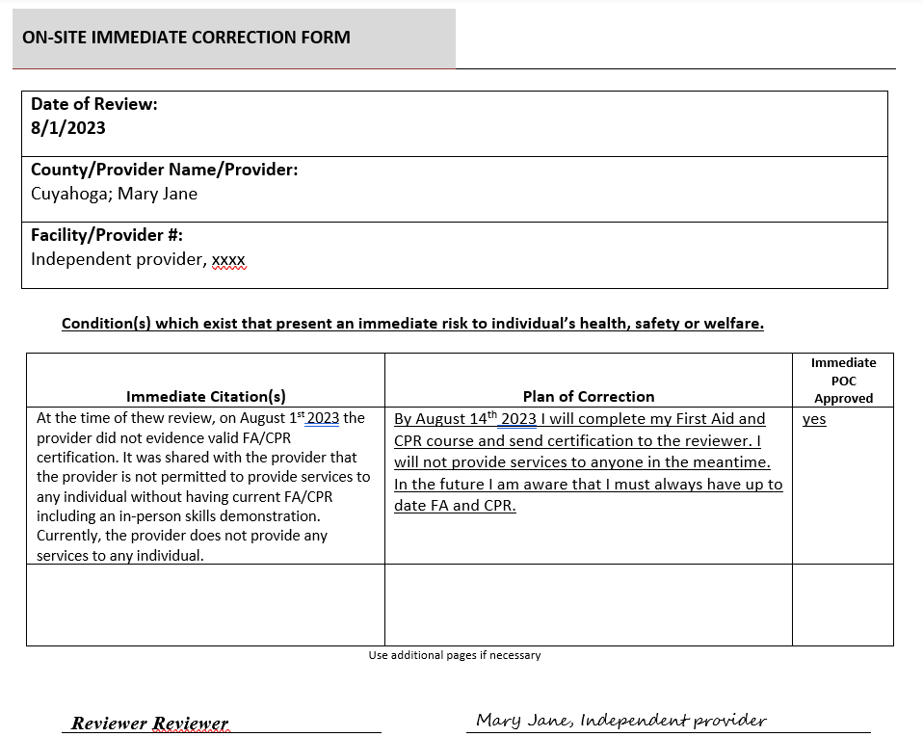
Immediate Citation Requires Immediate Plan of Correction
Immediate citation must be addressed immediately, and POC must be completed and accepted immediately. The provider will still need to complete POC in “my portal” after receiving citation notification from Office of Compliance.

Slide 19
Frequently Asked Questions
I received email that my POC is accepted? Am I done?
  No, you will receive new email from the reviewer with due date for POCV and requirements.
So, what is POC vs POCV?
  POC is your response to a citation, plan to fix the problem ( when, what and how you will prevent it from happening in future) and POCV is a verification that you implemented your POC/problem has been fixed.
What if I want to appeal some of my citations and for some to complete POC?
  You can do it. In that case, the reviewer must respond within 10 days to both ( appeal and POCs), including the manager’s response if the appeal is escalated.
How do I know why my POC is not accepted?
  The reviewer will enter a reason why POC was not accepted.

Slide 20
Frequently Asked Questions
What happens after my POC is disapproved?
  Process restarts again. You have 14 days to submit new POC, and reviewer 20 days to respond.
How many times I can submit POC?
  If not successful after three attempts, it will escalate to a Group Manager.
If I completed POC for immediate citation, do I still need to complete POC in My Portal?
  Yes, you do.
When POCV needs to be scheduled and completed?
  Within 90 days of POC approval. It can be onsite vs desk verification. It might take more than one try.

Slide 21
Which POC Is Acceptable #1
Is there evidence that the provider reviewed all unusual incidents as necessary but no less than monthly to ensure appropriate preventative measure have been implemented and trends and patterns identified and addressed? 5123-17-02
CITATION: At the time of the review, there is no evidence that the provider maintain a UI log for ID1 that contains the required elements, per rule.
POC
  A) Review and complete monthly UI logs starting this December, even if no incidents occurred, sign and date it. My plan includes to create a folder per month with the blank monthly Unusual incident forms to complete each month moving forward. Answer cut off. I will document in my calendar with a task to keep myself accountable for completing this form each month.
  B) Complete monthly UI logs, even if no incident happened. In the future, I will not forget to do it.

Slide 22
Which POC Is Acceptable #2
Beginning in 2022, did the provider annually complete: Two hours of training provided by the Department or by an entity using department-provided curriculum, Six hours of training on topics selected by the provider that are relevant to services provided and people served in the areas of components of quality care, positive behavior support, or health and safety?5123-2-09
CITATION: At the time of the review, the provider did not evidence that the provider completed annual training for independent provider for 2023, as required by the rule.
POC
  A) I will complete the Annual Training requirements online through the DODD My Learning . I will schedule and complete the appropriate training by December 31, 2024. To prevent future citation, I will set reminders and schedule online training answer cut off accordingly to ensure that the annual training will not be missed in the moving forward.
  B) I will complete my annual training as soon as possible. I will send you my certificate. I will do it every year.

Slide 23
Which POC Is Acceptable #3
Is there evidence that the provider conducted an in-depth review and analysis of MUI trends and patterns during the preceding calendar year, compiled an annual report containing required elements, and submitted it to the County Board for all programs in the county by the deadline?5123-17-02
CITATION: At the time of the review, there is no evidence that the provider completed and submitted annual MUI analysis and sent it to County Board by the deadline, for 2023
POC
  A) I was not aware that I need to complete this form, because there were no any MUI in last year. But I will do it as of now, complete the form and send it to County Board. I hope this is acceptable.
  B) I will complete the MUI report yearly and send it to County Board. I will keep email confirmation to ensure that I have sent this to the proper department. I will complete the required Annual Review by January 31 and send it to the County Board no answer cut off later than February 28, for the preceding year.

Slide 24
Which POC Is Acceptable #4
If the provider is responsible for providing Non-Medical Transportation in a modified vehicle or a vehicle equipped to transport five or more passengers, were the required vehicle inspections completed:
  Daily inspection prior to transporting each day, and
  Annual vehicle inspection by Ohio State Highway Patrol safety inspection unit or by a certified mechanic to determine vehicle is in good working condition? 5123-9-18
CITATION The provider was unable to evidence an annual vehicle inspection for year 2021 or thereafter for their Non-Medical Transportation vehicles with Ohio license plate #’s: “HAPPY PLACE xxx” and “HEY HEY”
POC
  A) Annual vehicle inspections will be completed for all NMT vehicles by 7/1/22. The Maintenance Director will be trained to ensure that annual inspections are completed going forward.
  B) Vehicle inspections will be done asap, and we will keep documentation as verification that it has been done.

Slide 25
Which POC Is Acceptable #5
If the provider is responsible for providing any type of transportation, do vehicles used to transport individuals appear safe?5123-2-09
CITATION: At the time of the review, the vehicle provider is using to transport individuals ID1 and ID2 ( Kia Sedona 2018, SDK2121) has a cracked windshield ( horizontal from one to another side).
POC
  A) Window estimates have been taken. Crack in windshield will be fixed by June 1, 2024.
  B) Windshield will be replaced by June 1, 2024 and moving forward I will ensure that as soon as I notice any damage on my car, I will take it to mechanic to get it fixed.

Slide 26
Which POC Is Acceptable #6
After being selected by an individual but prior to providing services, did the provider meet with a county board representative to discuss:
  Provider’s responsibilities
  Individual service plan, including what’s important to and for the individual
  Service documentation
  Billing for services
  5123-2-09
CITATION: At the time of the review, it was concluded that the provider did not provide written 30 days notification to the individual or CB/Support Administrator, before ending services for ID1, as required by the Rule.
POC
  A)Moving forward, I will provide written notification to the individual and all team members, as soon as decided that I will end services.
  B) Moving forward, I will provide 30 days written notification to the individual and team members no later than 30 days prior ending services.

Slide 27
TIPS
BE AWARE THAT COMPLIANCE REVIEW ( CITATIONS AND PROVIDER’S RESPONSE) IS PUBLIC DOCUMENT
BEFORE SUBMITTING RESPONSE CHECK YOUR GRAMMAR AND TYPOS
DO NOT INCLUDE UNNECESSARY INFORMATION ( ABOVE AND BEYOND)

Slide 28
RESOURCES
Compliance reviews of certified providers
  https://dodd.ohio.gov/forms-and-rules/rules-in-effect/5123-2-04
Provider Resources
  https://dodd.ohio.gov/compliance/Office+of+Compliance/Provider-Resources
Rules
  https://dodd.ohio.gov/forms-and-rules/rules-in-effect/administrative-rules-list

Slide 29
Thank You From Cuyahoga DD Provider Support
WE ARE HERE TO HELP!
How to contact us?
  Leave a detailed message with name, phone number, email address, and the reason for your call at 216-931-7474
  OR
  Email us at provider.support@cuyahogabdd.org

