Slide 1
Identifying Critical Observation

Slide 2
Contents
What is a critical observation
Signs of a crisis
Universal principles
General approach
Non-violent approach
Decompressing

Slide 3

Critical Observation
A critical observation is a necessary soft skill that allows a person the ability to see a problem before it can escalate to a crisis situation.
This Photo by Unknown Author is licensed under CC BY-SA

Slide 4

Signs of a crisis developing
Someone is Anxious.
Any “noticeable” change in the individual’s day-to-day behaviors.
Examples may include: pacing, excessive talking, rocking, wringing of hands, biting fingernails, tapping fingers, looking down at the ground.
Put on your “detective hat”. It is up to YOU, to be aware of changes.
Acting out behaviors seldom “come out of nowhere “.
Generally they start out as a “small” issue
This Photo by Unknown Author is licensed under CC BY-NC-ND

Slide 5

If the individual is experiencing continued
“small crisis struggles” these can often times compound and lead to a “large crisis”.
We want to be sure we are addressing those
“small crisis” with whomever is part of the support team in place, as well as the individual.

Slide 6

ACTIVITY-Line Up!
This Photo by Unknown Author is licensed under CC BY-NC

Slide 7
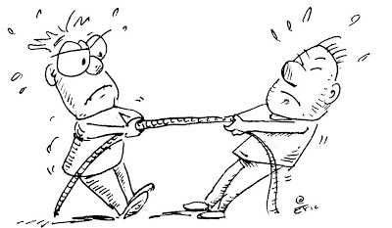
Signs of a crisis developing
Our Approach-Anxious Stage
When someone is Anxious, we have the opportunity to help them get through this without further incident.
Remain calm.
Do not become a contributing factor to escalate the situation.
Identify the trigger…what is the REAL issue.
Be re-assuring and supportive by validating their feelings
Do not get into a debate with the individual/ Avoid power struggles
Be aware of your body language (relaxed stance, open hands, uncrossed arms, hands at sides).
Be aware of your voice (Softer voice, slow down rhythm, non-sarcastic).
This Photo by Unknown Author is licensed under CC BY-SA-NC

Slide 8

Signs of a crisis developing
Someone is Defensive.
The individual begins to think/behave irrationally.
Examples may include: Challenging/refusing a request, walking away from you, raising their voice, yelling, making gestures that appear threatening, kicking over a chair.
Individual no longer hears your “words”.
Their focus is on your body language and your tone of voice.
They begin to go through physiological changes in which they are unaware
This Photo by Unknown Author is licensed under CC BY-NC-ND

Slide 9

Our body’s reaction to anger…

Slide 10

Signs of a crisis developing
Our Approach-Defensive Stage
When someone is Defensive, it is up to us to help them from physically acting out.
Remain calm. Our behaviors directly influence the individual.
Recognize that we cannot “make” someone behave appropriate.
Be firm, but empathic. Truly “hear” what the individual is saying.
Offer them appropriate situational choices.
Help them identify the outcomes for their choices. If possible, state the preferred choice at the beginning and end of your statement.
Let the individual know that you are there to support them.
Be non-judgmental.
Again, be aware and focus on your body language and your tone of voice.
This Photo by Unknown Author is licensed under CC BY-SA

Slide 11
This is not the time to create a “Teaching Moment” for the individual as this will likely escalate the situation.
Do not reiterate what the individual did wrong/what they could have done better/ what they should do/etc.
Offer a break – Change the environment – Take 5 minutes outside or in a different area i.e., break room.
Change job duty, if possible, to a preferred job duty especially if teaching a new job/skill which can cause anxiety/nervousness.
Let them know that it is OK – Take a deep breath and allow time for them to reset.
Follow up with the **employment support team or a supervisor to aid in facilitating the conversation. Make sure their contact info is handy.
(**IF, the individual’s placement was through an Employment Agency)
Revisit what upset the individual at another day/time . Problem solve what options they could use when……….
**If you feel that the individual is becoming a threat to self or others call 911.
This Photo by Unknown Author is licensed under CC BY-SA

Slide 12
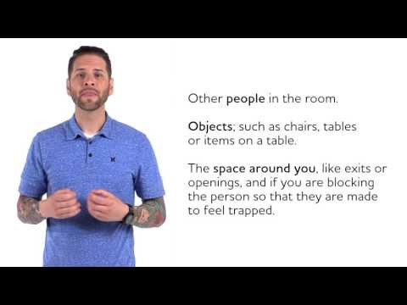
Let’s take a look…

Slide 13

Non-violent approach
We need to make sure that we continue to offer our best so we can keep those in our environment, and ourselves, safe and free from harm.
Should an individual become aggressive, there are some things you can do without putting hands on the individual to ensure everyone’s safety….
If they throw something at you, BLOCK the object with your notebook, bookbag, purse or your hand/forearm.
If they come after you, try to place an object between you and the individual such as a chair, a desk, a table.
Have an escape route planned. Often the individual will follow you out of the area which may help in calming them down, while removing bystanders.
If necessary, contact the local authorities.
This Photo by Unknown Author isl icensed under CC BY-NC

Slide 14
Let’s Review:
Be an empathic listener
Do NOT be judgmental.
Do NOT ignore the person or pretend to be paying attention.
Listen to what the person is really saying.
Re-state the message/ Clarify the message
Validate -- “I understand why…” (Not in agreement with…)
Try to establish rapport with the other person. (Ask then their name).
Invasion or encroachment of personal space tends to heighten or escalate anxiety.
** ( Note: Personal space is usually 1.5 to 3 feet )-- far enough away so you cannot be hit or kicked
Do NOT touch a hostile person -- they might interpret that as an aggressive action.
Always keep your hands visible -- you do not want the other person to misinterpret your physical actions.
Maintain a relaxed position, calm voice and be aware of your body language!

Slide 15
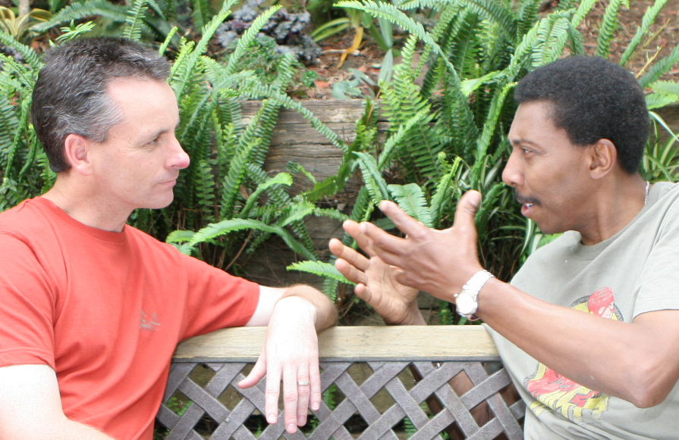
Show them you C.A.R.E.
(A General approach)
Calm- Remember to stay calm. How you react has a direct impact on how the individual will respond. The calmer you are, the better chance of helping the individual stay calm.
Aware- Be aware of their body language, as well as your immediate surroundings. Make sure you remove the individual from an audience, or the audience from the individual. Give them an escape route so they do not feel trapped.
Relaxed - Make sure you use non-threatening movements, gestures and language. Remember, you are trying to prevent becoming a part of the problem.
Empathic- Truly “LISTEN” to what is trying to be communicated. Be silent. Speak to them using their name. Allow for reflection and repeat back for clarification: “So what I am hearing you say is…”. Get them to agree on a possible resolution.
This Photo by Unknown Author is licensed under CC BY-NC

Slide 16
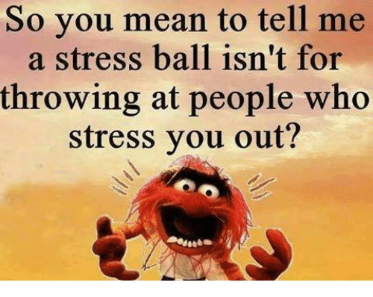

Slide 17

Decompressing
In order for us to be the best in handling a crisis situation, we must also learn to take care of ourselves. Often times, after an event occurs, we need to decompress. Simply put, we need to talk to someone on our team. This is an opportunity to grow by learning what we did that was helpful, and what we might need to improve upon.
One of the best things we can do in addition to talking with our team, is to do something for ourselves…get a hobby! Do something that helps you reduce the impact of stress from the event. Whether it is reading, listening to music, gardening, running, walking or biking….find something that YOU love to do and take time out of your day to help maintain your and physical health.
This Photo by Unknown Author is licensed under CC BY-ND

Slide 18
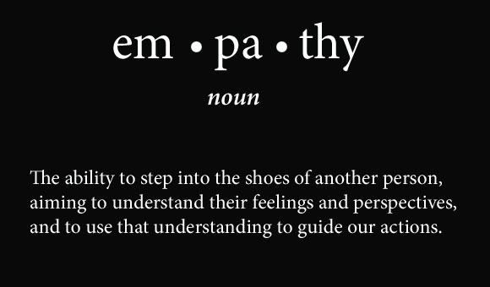
Final Thoughts
Everyone has a bad day every now and then. Our job is to make sure that we recognize when someone is becoming anxious so that we can help them. Offering a sense that someone actually cares, and is non-judgmental, focusing on the behavior and reassuring the individual that they are still valued, can make all the difference in the world.
Remembering our approach has a direct impact on the outcome is crucial. Think about a camp-fire…in order to make the fire grow, one must add logs to the fire. In order to put the fire out, one can remove the logs from the fire. Do you want to be a part of the problem or part of the solution?
This Photo by Unknown Author is licensed under CC BY-ND

Slide 19

QUESTIONS??
This Photo by Unknown Author is licensed under CC BY-SA

