Slide 1
UI Log Monthly Provider Requirements
&
MUI Annual Report Provider Requirements
David Nodge
MUI Community Liaison
Cuyahoga County Board of Developmental Disabilities
2/13/2025

Slide 2
Objectives
We will learn:
UI Log Requirements
  Purpose of Monthly UI Log
  Identifying trends and patterns
  Purpose of Annual MUI Log
  Completing MUI Annual Log
  Annual MUI Log analysis
  Due dates for completion

Slide 3
UI Log Requirements
Every independent and agency provider must maintain a log of Unusual Incidents or UIs.
Both independent and agency providers must review UI logs at least once per month to ensure appropriate preventive measures were implemented and to identify patterns or trends.
Reporting and tracking these incidents supports providers to understand trends and patterns to help ensure health and safety.

Slide 4



Purpose of UI log
UI Log provides a snapshot of an incident
  Review for trends and patterns
    3 similar incidents in a week (I.E. Trip/Fall)
    5 similar incidents in a month
  Second look at incidents to ensure the UI did not meet the level of MUI
    Call in MUI’s upon discovery when reviewing the UI Log
      State it was discovered upon review of the UI log when calling in the MUI
  Is prevention planning working
    Specific to the incident
    Great opportunity to review prevention plan with the team
      Do not use generic planning
        Continue to monitor/remind/instruct/document
  DSP’s have great insight into CCF’s
    Assist with prevention planning
    Debrief incidents with DSP’s and team

Slide 5
Purpose of UI Log
  Provides the opportunity to follow up with the prevention plan that was put in place
  Providers need to provide training on UI identifying/reporting - including cause and contributing factors
  If NO UIR’s for a month
    Complete a UI log for the month
    State No UI’s on the UI Log
    Sign and Date a UI Log

Slide 6
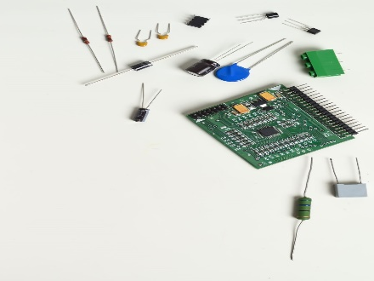
UI Log Components
Required elements – UI Log Components
  Provider Name/Location
  Month/Date/year of Review
  Who is reviewing/Title
  Individuals name –
    List Names in alphabetical order on the log to more easily identify trends and patterns
  Date/Time/Location of incident (Giant Eagle/Home Bathroom/Home front porch)
  Short description of incident (John tripped/fell getting off van)
  Immediate Actions (Checked for injuries/none noted)
  Cause and Contributing Factors (Driver was parked too far from curb)
  Prevention Planning (Driver will ensure he is parked appropriately prior to passengers exiting the vehicle and assist passengers from vehicle)
  Did the incident rise to the level of a MUI (Y/N) and if so document the Date/Time it was reported

Slide 7
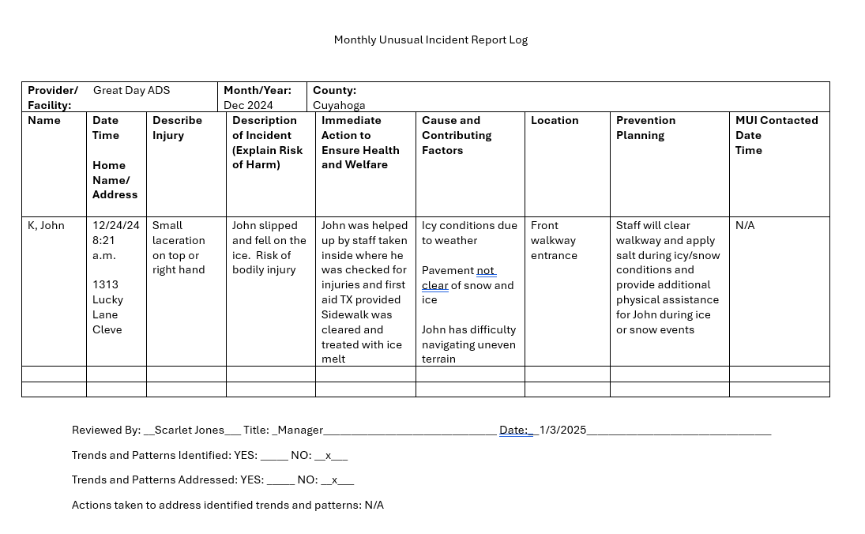

Slide 8
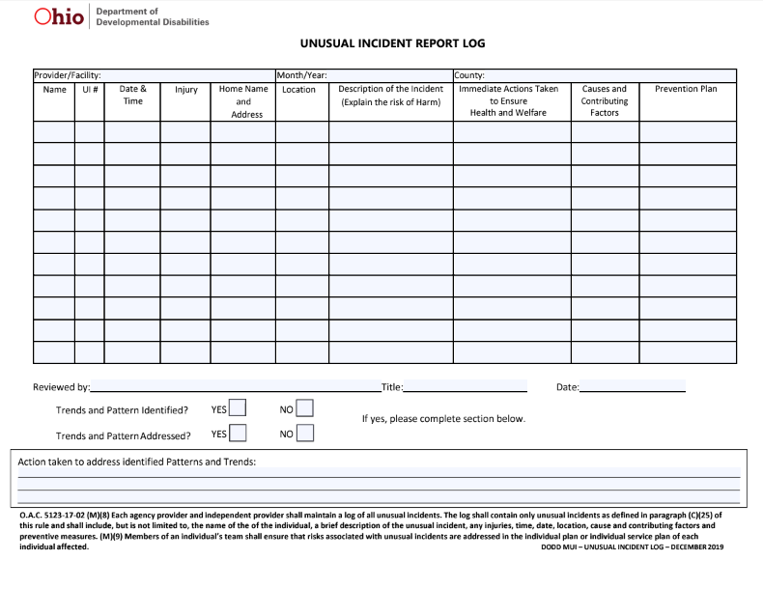

Slide 9
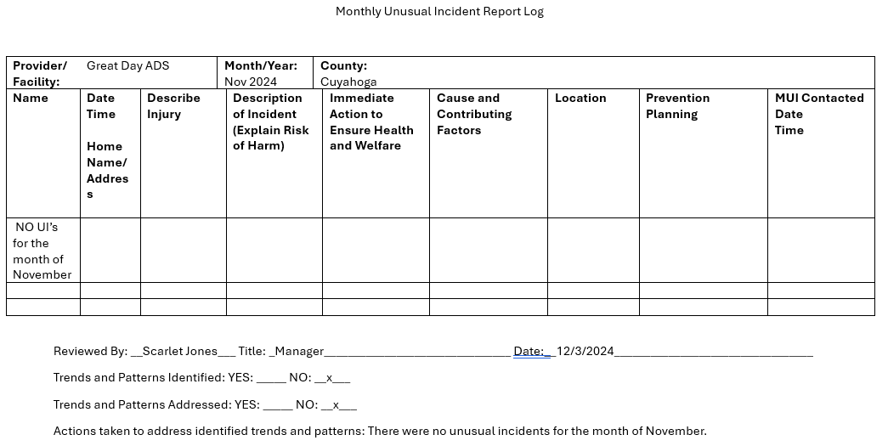
UI Log Requirements
UI Log is completed Monthly
  You must have 12 UI logs for each year (Or from the time you began providing services)
  Maintain copies of all your completed UI Logs
  If No UI’s for the month
    Complete a UI log for that month stating NO UI’s

Slide 10
Unusual Incident Log
PROVIDER NAME: ADS Day Services 1313 Lucky Lane Paradise Ohio MONTH/YEAR: July 2024
Consumer’s Full Name (PPI name, if applicable) | Incident Date & Time | Incident Location | Description of incident Include any injuries | Prevention Measures | Called MUI Hotline? Date
B, Davey | 7/22/24 1:40 pm | ADS Day Services Room 8 | Davey became upset after being redirected from touching a staff person’s hair. He screamed, swore, flipped his table, kicked the table and door, and spit. When asked what was wrong, he said “nothing.” Nurse assessed and asked if he was in pain. He said “my stomach.” His house manager was notified and she picked him up. | If Davey is experiencing dysregulation (Swearing/screaming/property destruction), ask him if something is physically bothering him have him evaluated by nurse/staff provide immediate appropriate comfort and care. Communicate physical complaints to residential staff for follow-up.
K, Michael | 7/17/24 Observed on arrival | Unknown – observed on arrival | Michael arrived with a bruise on his left arm. Cause of bruise unknown. Residential staff were not aware of the bruise. | Seating arrangement was reviewed. Michael was moved to the front seat. Van was checked for anything that may have caused an injury where Michael was seated (nothing Noted) Continue to monitor and report any injuries.
K, John | 7/19/24 11:37 am | ADS Day Services Lunchroom/ADS area | John left the lunch area early and was asked to return. When he left and was redirected again, he said “I’m going to f___ you up” and attempted to punch staff. Staff blocked the punch. He was assessed by the nurse no injuries were noted. | Staff will pay extra attention to any signs of agitation and engage John in a positive manner and attempt to meet needs prior to John escalating. Team will be meeting 7/25 to address increased agitation and aggression. Continue to monitor closely and redirect as needed.
K, John | 7/23/24 11:55 am | ADS Day Services Lunchroom | John was given coffee in the morning. He demanded coffee after lunch but there was none available. He threw a bin of forks and attempted to turn over a table. Staff verbally redirected him. He said he was leaving and attempted to exit, trying a number of doors. Staff placed john in a 2 person hold as he was about to exit the building onto a busy street. | Team will ensure coffee is available for John. Team will be meeting 7/25 to discuss increased agitation and aggression. Psych appointment scheduled in September. Continue to provide ongoing visual supervision and redirect as needed. | MUI Contacted 7/23/24 @ 2:00 p.m. for UBS
Z, Joanne | 7/9/24 12:35 pm | ADS Day Services ADS area | Joanne returned from lunch and sat in a rocker. She complained of pain in her chest and arm. Nurse assessed, applied oxygen, and called 911. Joanne was transported to Metro Hospital for evaluation. Taken to ER and released. | Continue to provide ongoing supervision and monitor Joanne’s physical condition and comfort to be able to respond effectively to any health concerns. Assessed Joanne’s diet as it was reported that she had Taco’s for lunch with extra hot sauce causing heartburn. Medical follow-up with PCP to discuss possible heartburn meds.

Slide 11
MUI Annual Reports
Purpose
  Review of MUI’s from the previous year
  Comparison of MUI’s over 3-year period
  Trends or Patterns Year
    Previous Year
    Current Year
    Individual trends and patterns
      I.E. Increase in UH’s due to new cancer diagnosis
  Analysis of data
    New Individuals Served/Major Changes i.e. Staffing
    Reasoning
  New prevention plan development

Slide 12
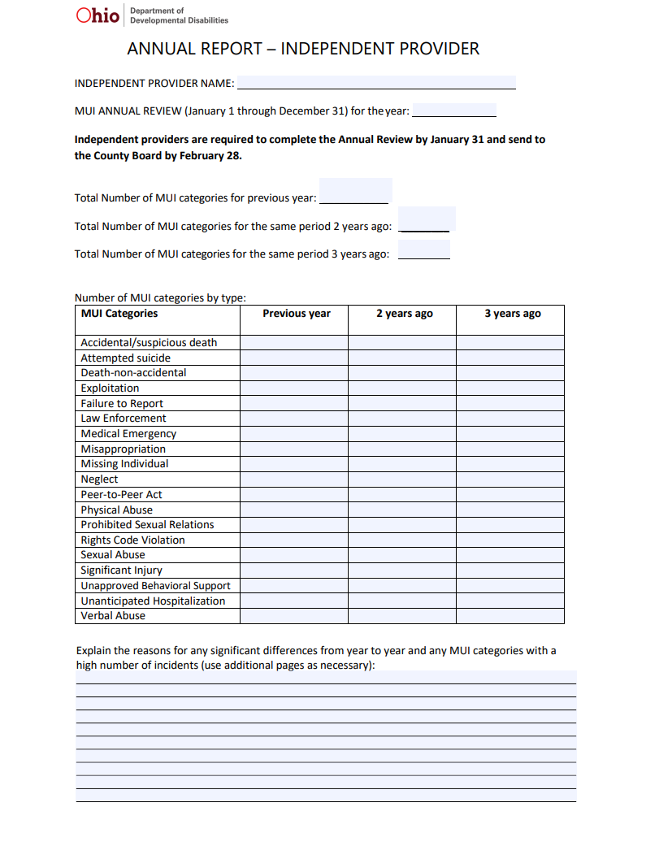
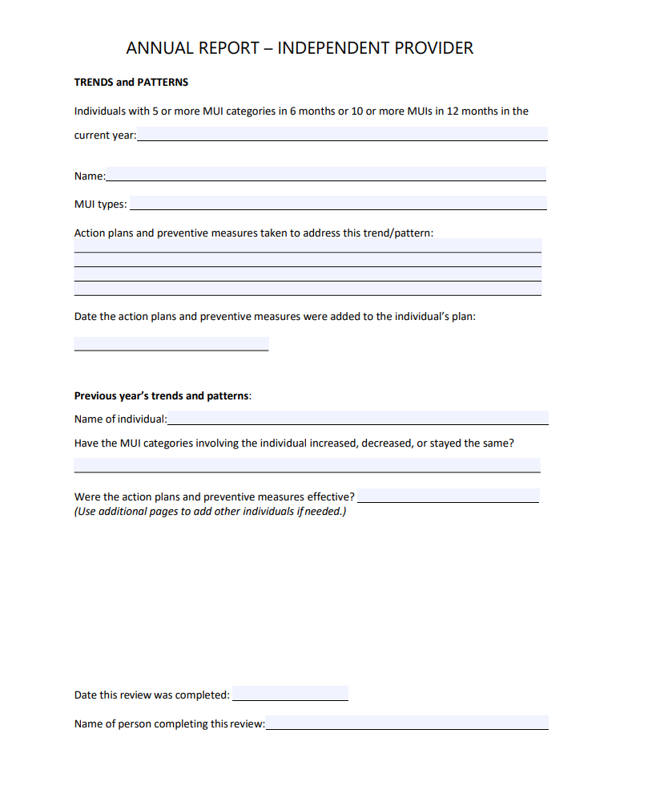
Independent Provider Annual Report Form

Slide 13
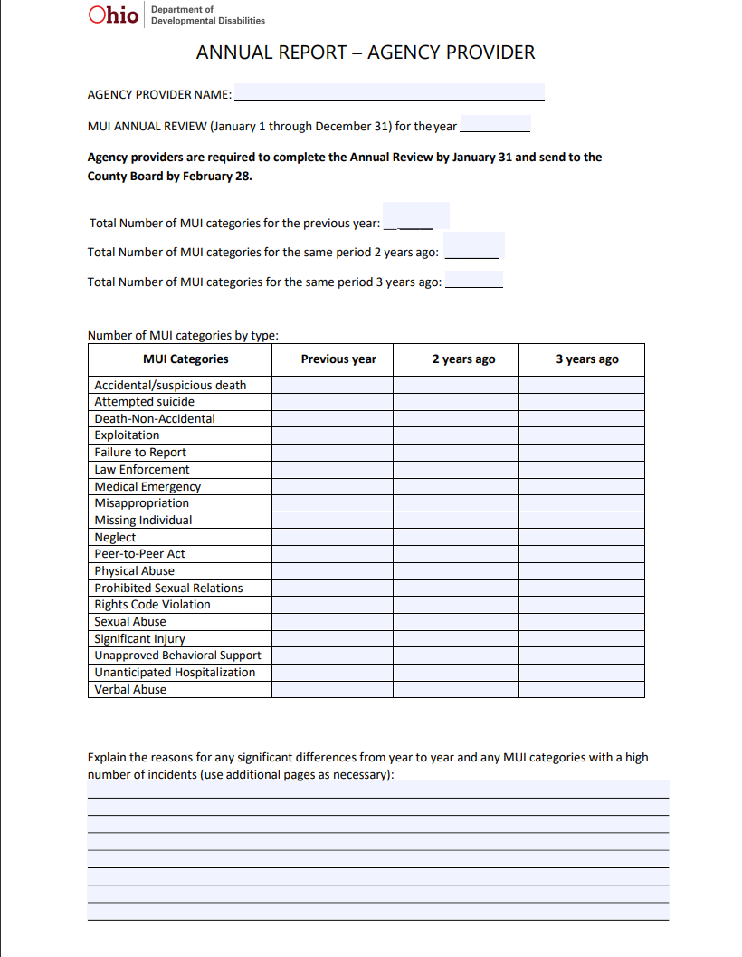
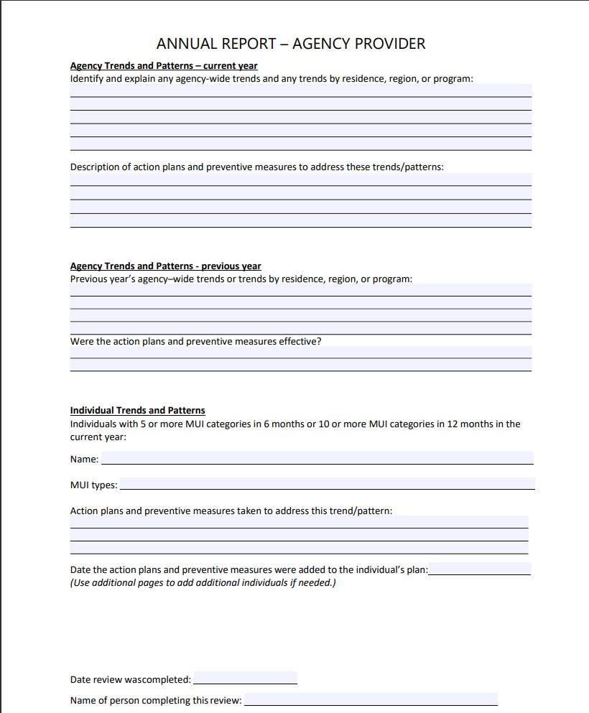
MUI Agency Provider Annual Report

Slide 14
MUI Annual Analysis Important Dates
Due Dates:
  Both Agency provider and Independent provider completes by January 31st
  Send Analysis to County Board by February 28th
  Maintain a copy for your records you will be asked for this as part of you provider review
  SEND COMPLETED REPORT TO: uir@cuyahogabdd.org

Slide 15
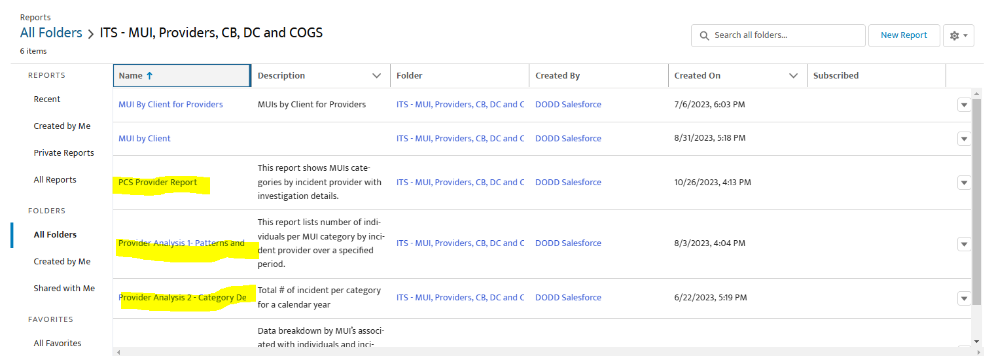
Provider Reports

Slide 16
OITMS External User Guide

Slide 17
Links
MUI Rule 5123-17-02
Agency Provider Annual Report Template
Agency Provider Tips for Annual Analysis of MUIs
Independent Provider Annual Report Template
Independent Provider Tips for Annual Analysis of MUIs
PCS Report Instructions https://www.youtube.com/watch?v=1RM5gUyWkMk
FOR OITMS Questions: 614-995-3810 or OhioITMS@dodd.ohio.gov

Slide 18
Additional Resources
https://cuyahogabdd.org/for-providers/major-unusual-incidents-mui/#
  This link will provide you access to:
  Forms:
  MUI Annual Report For Agencies
  MUI Annual Report for Independent Providers
  Monthly UI Log
  Incident Report Form
  Incident Witness Report Form
  Incident Administrative Report Form
Submit Forms to uir@cuyahogabdd.org

Slide 19

Thank you!
  David Nodge
  MUI Community Liaison
  nodge.david@cuyahogabdd.org
  www.cuyahogabdd.org

Slide 20
Q&A
Questions & Answers

