Slide 1
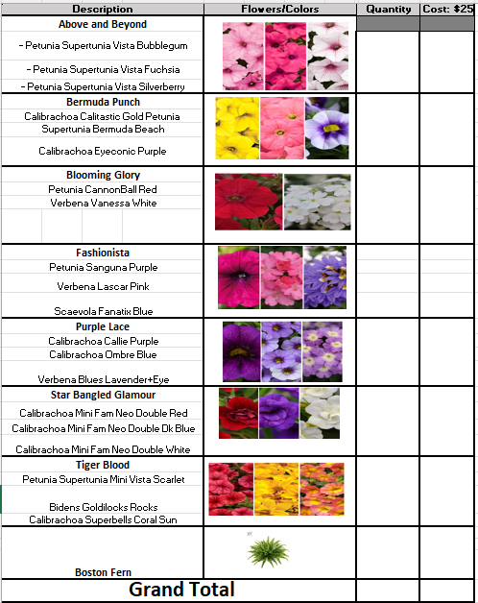
Support Guardian Angels Spring Flower Hanging Basket Sale
Benefiting: GA Boy Scout Troop 445 & The 8th Grade Class of 2026
13-inch Combo Hanging Basket for $25 each
Orders Due by : April 10 - Pick Up Friday May 1st 3 pm –7pm GA
Ordering Options
Online: https://bsa-guardian-angels-troop-445.square.site
Paper order and checks payable to Troop 445 - Turn into Parish or School Office by April 10
Name________________________________________________
Phone: _______________________________________________
Student/Scout Seller____________________________________

