Slide 1

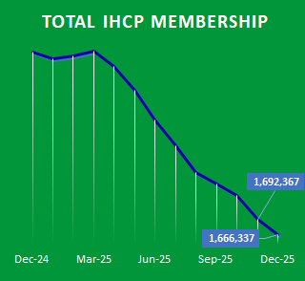
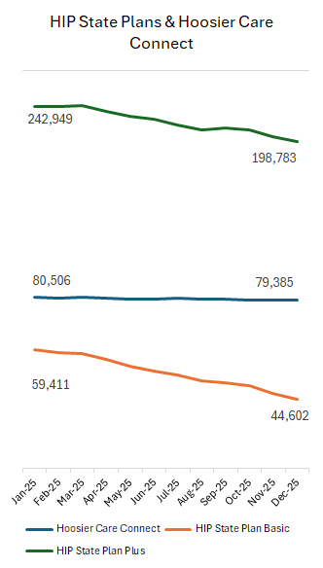
Indiana Health Coverage Programs
Enrollment Trend Highlights – December 2025
IHCP Program Membership:
Total Membership decreased in December. With 1,666,337 members, there were 26,030, or 1.54%, less members in December 2025 than in November 2025. Total Membership has fallen by over 304,000 since March 2025.
Category Membership:
All five major categories declined in December. HIP saw the steepest percentage drop, -2%, while HHW lost the most members, 12,458, followed closely by HIP, 12,318.
Insights:
The chart shows HIP State Plan Plus, HIP State Plan Basic, and Hoosier Care Connect membership from January 2025 through December 2025. HIP State Plans serve low-income parents and caretakers, while Hoosier Care Connect (HCC) coordinates care for aged, blind, and disabled members. Both HIP tiers saw significant declines. Plus membership dropped over 44,000 and Basic fell nearly 15,000. HCC remained stable, ending with 79,385 members, nearly matching its January level.
 | HHW | HIP | FFS | HCC | PWA
December | 647,794 | 602,488 | 221,538 | 79,385 | 115,132
1 mth. | -1.89% | -2.00% | -0.47% | -0.01% | -0.18%
6 mth. avg. | -4.06% | -5.37% | -3.62% | -0.31% | -0.91%
1 yr. ago | -15.10% | -20.43% | -12.16% | -1.47% | -1.56%
November | 660,252 | 614,806 | 222,584 | 79,391 | 115,334
1 mth. | -1.97% | -3.02% | -2.49% | 0.03% | -0.77%
6 mth. avg. | -4.01% | -5.64% | -4.72% | -0.42% | -1.01%
1 yr. ago | -13.28% | -18.51% | -11.52% | -1.17% | -1.10%
October | 673,531 | 633,931 | 228,262 | 79,367 | 116,231
1 mth. | -0.63% | -1.48% | -2.29% | -0.41% | -0.23%
6 mth. avg. | -4.21% | -5.09% | -3.78% | -0.55% | -0.42%
1 yr. ago | -11.56% | -16.35% | -10.23% | -0.73% | -0.83%
The values above reflect the percentage difference between the previous month, the six-month rolling average, and the same month last year, respectively.
Sources: Indiana Family and Social Services Administration, Enrollment Data. The expressed views and opinions are strictly those of Covering Kids & Families of Indiana and do not reflect the official position of the Indiana Family and Social Services Administration or other partners.

