Slide 1
Nebraska Rural Health Transformation Project March 4, 2026
Staci Hubert RP
Nebraska Enhanced Service Pharmacies
Shubert@cpesn.com 402.499.1878

Slide 2
Agenda
DHHS Update:
Pharmacy Opt-In Status
Pharmacy Recruiting
Pharmacy Education – UNMC update
Adherence App Update
Pharmacy Implementation Guide
Pharmacy comments and questions

Slide 3
DHHS CMS Update
**Still waiting on CMS to sign Nebraska’s revised application. Lee is expecting it to
Happen this week or next. When we get the final word, those pharmacies that have opted in
Will be able to start documenting the services in the statement of work.
**Staci update**so we will have to wait until this statement of work is approved as written, or
We will make the changes needed by CMS/NE DHHS and then sign the SOW. Once that is signed, THEN the opted in pharmacies can make those appointments for their targeted patient list.
Pharmacies next steps are 1) identify program champion (1 RPh, 1 Tech, 1 clerk/delivery person and 2) to contact eligible patients and let them know what will be offered and set up an appointment after the start date of the contract.

Slide 4
Pharmacy Opt-In Update
Alliance Community Pharmacy- Alliance
Bemis Drug – Kimball
**Benkelman Drug- Benkelman
Curtis Discount Pharmacy- Curtis
Dave’s Pharmacy – Hemingford
Dave’s Pharmacy – Alliance
**Fulmer Pharmacy - Holdrege
Gothenburg Discount Pharmacy – Gothenburg
**Hays Pharmacy – Alma
** Heart City Drug - Valentine
Mark’s Pharmacy- Cambridge
Stockmen’s Drug – Gordon
U-Save Pharmacy & Medical Supply – McCook
**U-Save Pharmacy – North Platte
**U-Save Pharmacy - Ogallala
**Westfield Pharmacy – North Platte
**Frontier - Broken Bow, Frontier - Cozad
** Need final authorization link to be sent by authorized person to CPESN** emails sent to all** on 3/4/2026

Slide 5
Pharmacy Opt-In Update
Service Requirements
Complete or update CLIA waiver (as applicable to point-of-care services)
Maintain readiness to conduct point-of-care tests for clinical monitoring
Access to eCare Plan software or JotForm for billing and documentation
Established workflow for med sync, monthly patient outreach, and packaging
Ability to provide delivery/mail services
Process for performing/documenting screenings (PHQ-9, SDOH, immunization, tobacco/alcohol/drug)
Capability to assist with app download and patient onboarding
Translation services access (internal or external)
Secure method for provider communication and referrals

Slide 6
Pharmacy Recruiting Update
Year 1 Pharmacies Qualify if they reside in eligible counties : Arthur, Banner, Blaine, Box Butte, Brown, Chase, Cherry, Cheyenne, Dawes, Dawson, Deuel, Dundy, Frontier, Furnas, Garden, Grant, Gosper, Harlan, Hayes, Hitchcock, Hooker, Keith, Keya Paha, Kimball, Lincoln, Logan, Loup, McPherson, Morrill, Perkins, Phelps, Red Willow, Rock, Scottsbluff, Sheridan, Sioux, Thomas
Year 2: Priority rural designated counties during Year 2 are Adams, Antelope, Boone, Boyd, Buffalo, Burt, Cedar, Colfax, Cuming, Dakota, Dixon, Franklin, Garfield, Greeley, Hall, Holt, Howard, Kearney, Knox, Madison, Merrick, Nance, Pierce, Platte, Sherman, Stanton, Thurston, Valley, Wayne, Webster, Wheeler counties
Year 3: priority counties include Butler, Cass, Clay, Dodge, Filmore, Gage, Hamilton, Jefferson, Johnson, Nemaha, Nuckolls, Otoe, Pawnee, Polk, Richardson, Saline, Saunders, Saunders, Seward, Thayer, Washington, York counties
Year 4: At the beginning of year 4 any community pharmacy enrolled in the chosen pharmacy network outside of Douglas, Sarpy or Lancaster Counties will be eligible to apply to join this pilot

Slide 7
Pharmacy Recruiting Update
Farrell’s Family Pharmacy – McCook yes
Safeway – 556 Scottsbluff yes
Safeway – 557 Ogallala yes
Safeway- 2555 Sidney yes
Nein Pharmacy – Bridgeport tbd
U-Save Pharmacy Lexington- tbd
Grant Pharmacy – Grant tbd met in person / owner concerned about time
Western Drug Co – Sidney visited but owner was out left messages
U-Save Pharmacy- Gering visited but owner was out- left message
Sidney regional Pharmacy- visited staff didn’t think they could do the statement of work
No HyVee’s in year 1
Haven’t heard from Walmart or Walgreens after informational meeting we had

Slide 8
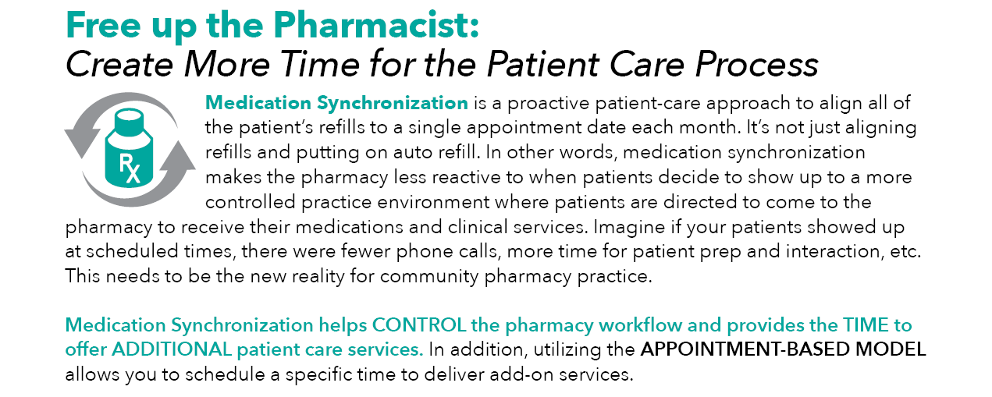
Identifying Program Champion

Slide 9
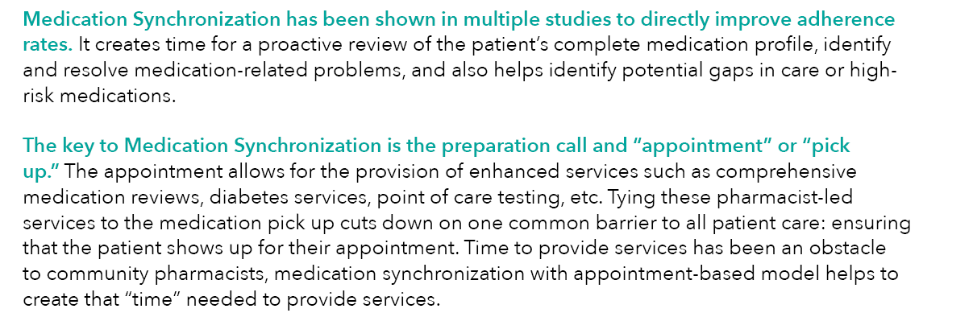
Identifying Program Champion

Slide 10
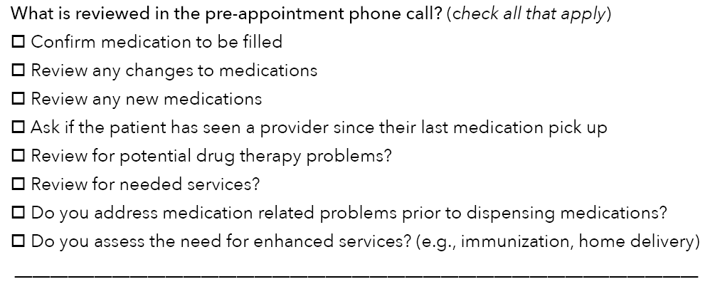
Identifying Program Champion

Slide 11
Identifying Eligible Patients
1- Move-It Folder from CPESN for SyncFit Targeted Patient List
2- Identify patients taking blood pressure medication, cholesterol medication, diabetes meds
3- EQuIPP PDC (Proportion of Days Covered
4- Liberty – Reporting Med Sync Dashboard that shows ave meds (descending) /month/ave visits/month right click Med Sync Enrolled in “not enrolled in med sync” goes back 90 days
5- Patients that call the pharmacy multiple times per month for medication refills
6- Delivery Patients

Slide 12
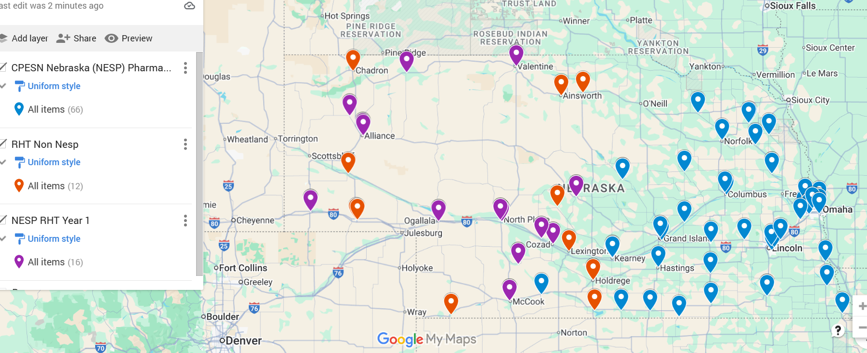
RHT Pharmacy Map Year 1
https://www.google.com/maps/d/u/0/edit?mid=1r2XQUAvn7OTMiQhm4KsdM_s44sSbtn4&usp=sharing

Slide 13
How can we succeed?
Pharmacies need to own this and ensure they are motivating patients and giving them the tools they need to make positive changes to improve their health
We need to help each other by sharing best practices and providing feedback to improve processes and patient care for the future
We need to document everything that occurs and share information with other health care providers and health plans to ensure continuity of care
We need to succeed and grow this program for the next 5 years

Slide 14
What does the future hold?
If we run with this and show value with data showing savings, I can push to have MCOs cover this for Medicaid patients after 5-year program ends.
With data showing savings I anticipate other plans will want these savings for their members
This may lead to further advancements in our profession
Rural pharmacies will continue serving your communities
AI and Mail order will never be able to connect with patients or be a pillar of the community like our rural community pharmacists.

Slide 15
Education- UNMC Update
Medication Adherence App
Tech Blood Pressure
RPH Blood Pressure
Monthly Medication Synchronization
Motivational Interview
Medication Reconciliation
ON TO PHASE 2!! Maternal Screening, SDOH Screening, Immunization Screening, PHASE 3!! Blood Pressure MGMT, Diabetes Management, Hyperlipidemia, HIV/STI Screening,
IF NEEDED: Mental Health/PQH9,
POCT

Slide 16
Adherence APP – Medisafe Update
QR CODE
EDUCATION
BILLING
FOLLOWUP MONTHS
SOW in process

Slide 17
Year 1- Adherence Billing Guide
Service | SNOMED CT Code | Rate | Frequency of Services Billed | Notes
Comprehensive Medication Reconciliation |  | $25 | 1 time only (Initial Consult after patient opts in and signs authorization) | Initial Motivational Interview with CMR
Med-Sync (with and without adherence packaging) |  | $40 | 1 time per month | 1 time per month (not during the same month as med sync + compliance packaging)
Medication Delivery |  | $10 | 1 time per month | 1 time per month
Adherence App downloaded and set up on patient smartphone |  | $20 | 1 time only | Download app and set up adherence reminders. Educate patient on recording monthly usage to pharmacy
Adherence App documentation recorded (if used 25 or more days) |  | $10 | 1 time per month if applicable | Receive and document/record patient aderhence app records for the month. Send ecare if patient used app 25 or more days.
Translation Service |  | $10/day | $10/day | Document and record translation services used for eligible patient

Slide 18
Maternal Care Billing Guide

Slide 19
Year 1 Maternal Care Expanded Services
2. Maternal Care Education for staff- free
Provide screening and education to expectant mothers
Initial - $150 care $10/month/care up to 6 months post partum
Follow-up - $10/month/care up to 6 months post partum.
Blood Pressure | Tobacco/alcohol/illicit drug use
Diabetes | Social determinants of health
Mental Health | HIV/Sexually Transmitted Disease Screening
Medications | Primary Care Referrals
Vitamin Supplementation | Insurance Communication of status
Vaccination Screenings

Slide 20
Implementation Guide
Waiting for the final approval of CMS for final draft
Will be sent to all Opt-In Eligible Pharmacies
Still connecting all of the links with final drafts (education) (patient forms) (pharmacy forms) (billing guidance)

Slide 21

Questions?
www.nebraskapharmacynetwork.com

