Slide 1

Re-charter training 2021
Glacier’s Edge Council

Slide 2
Charter Renewal – Getting Started
  Attend Your District Recharter Training & Kickoff in September or October
  Receive your Unit Recharter Packet via Email to Unit Leadership (CC & Unit Leader)

Slide 3
Charter Renewal – Steps
  Step 1 Attend your District Recharter Kickoff/Training & Receive Access Code (Digital Packet)
  Step 2 By 10/26 Register Online & Complete Online Steps 1 & 2
  Step 3 By 11/16 Inventory your Members & Collect Fees
  Step 4 By 11/23 Complete Online Steps 3-5: Update the Unit Roster & Submit to Council
  Step 5 By 12/2 Obtain Signatures & Collect Missing Items
  Step 6 Turn-in Paperwork

Slide 4
Availability and Due Date
Log On – October 1, 2020
  Log on for Internet Recharter 3-months prior to
  renewal date, January 1, 2021
DUE DATE – SUBMIT BY EARLY DECEMBER
  ALL units… ALL recharter documentation
  LATE Charters… (Expire 12/31)
  NO Grace Period, NO Insurance, NO Advancement
District Recharter Turn-in Dates at Madison Office
  November 17th
  November 24th
  December 2nd

Slide 5
Just Like Last Year…
ALL Adults must be Current with Youth Protection Training
Any New Adults must have Background Check Authorizations and Returning Leaders must be Current
  3% Admin Fee Online Internet Recharter payment. Suggest paying Council directly with check or unit account.

Slide 6
New This Year…
  Council Program Fees - $66 for all Youth, Except Exploring, which is $5 per Youth
  Program Fee for Adult Leaders is $29
  No Program Fees for Scoutreach Units
  Share Council Updated Membership Fee Structure Piece

Slide 7
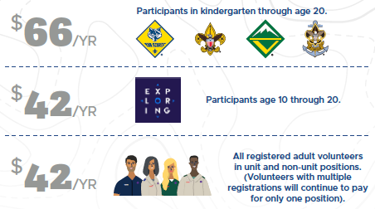
New This Year…

Slide 8
New This Year…

Slide 9
New This Year…

Slide 10
Be Prepared… Do This First
Identify Key Personnel
  Identify & Train Unit Recharter Processor
  Identify Unit Commissioner
  Identify District Professional
Review Internet Rechartering Tutorial; scouting.org/commissioners/internet-rechartering/

Slide 11
Be Prepared
Member Manager and Training Manager; my.scouting.org
    Tutorials for My Dashboard, Training Manager, Member Manager, and more​
    Member Manager
      Inventory all members and adult positions
      Print youth & adult roster and membership cards​
    Training Manager
      Review & update leader training records including YPT and Job Specific
      Take Youth Protection Training and Job Specific Training

Slide 12
Be Prepared
Complete membership inventory of all youth & adults. Identify dropped members, continuing members, and new members.
Determine changes to key unit leadership. Identify replacements and/or additions.
Determine leadership positions for ALL adults.
Collect Applications for all NEW youth & adult members.

Slide 13
Be Prepared
Collect Background Disclosures for all NEW adult members.
*Background Disclosure Forms
  Criminal background check only. No consumer/credit check.
  Signature form must be included with recharter or received prior at Council Service Center.
  Adults WILL NOT be registered without the signed form.

Slide 14
Be Prepared
Confirm ALL Adults have current Youth Protection Training (YPT).
Encourage ALL Leaders are FULLY trained for their registered position.
Collect training verification for ALL new Leaders.

Slide 15
Do Your Best… The Process
Unit receives Access Code
Go to the Council website and select Internet Rechartering
Immediately Log into Internet Recharter and review roster
Collect the current fee for every registered youth & adult (See 2021 Fees)
  Collect Cash/Checks

Slide 16
Do Your Best
Electronic Authorization
  Available for the COR
  No signatures required if this option is chosen
3% Admin Fee Online Internet Recharter payment.
Suggest paying Council directly with check or unit account.
Print recharter paperwork
If needed, Obtain signatures of Unit Leader & Executive Officer on applications/charter paperwork
Turn-in charter paperwork
    (member applications, background authorizations, training verifications, correct fees or unit account authorization)

Slide 17
2021 Fees
  12 Months
    Unit Liability Insurance Fee--$75 (unit charter fee)
    Boys’ Life Magazine--$12 (Optional)
  NO Fee for Lion/Tiger Cub Adult Partners
  NO Fee for ‘Multiple’ Position Registrations
 | National Fee | Council Fee | New-Member Fee | Total Fee (12-months)
Scout - New | $66 | $66 | $25 | $157
Scout - Returning | $66 | $66 | - | $132
Explorer New or Return | $42 | $5 | - | $47
Adult - ALL | $42 | $29 | - | $71

Slide 18
Required Unit Membership
Executive Officer / Institutional Head (IH) can be any position in the unit (but must pay the registration fee for that position)
Chartered Organization Representative (COR) can also be the Committee Chair (CC) or a Committee Member (MC)
All other leader positions…one person - one job

Slide 19

Required Unit Membership
Cub Scouts
  Institutional Head (IH) - No Application or Fee
  Charter Organization Representative (CR)
  Committee Chair (CC)
  Cubmaster (CM)
  At Least Two (2) Committee Members (MC)
      or 1-MC and 1-Pack Trainer (PT) or 1-New Member Coord (NM)
  At Least One (1) Den Leader (LL, TL, DL, WL)
  At Least Five (5) Youth Members
  Must Have One (1) Lion/Tiger Adult Partner for every Lion/Tiger Cub

Slide 20
Required Unit Membership
Cub Scouts
Lion/Tiger Adult Partners
No fee or application required
They may register in another leader position with fee, application, background, YPT.
If the Adult Partner’s physical address is different from the Youth.
  Adult Application is Required
  Youth Protection Training is Required
  No Fee is charged

Slide 21



Required Unit Membership
Troops, Crews, & Sea Scouts
  Institutional Head (IH) - No Application or Fee
  Charter Organization Representative (CR)
  Committee Chair (CC)
  Scoutmaster (SM), Crew Advisor (NL) or Sea Scout Skipper (SK)
  At Least Two (2) Committee Members (MC)
      or 1-MC and 1-New Member Coord (NM)
  Minimum of Five (5) Youth Members

Slide 22
IMPORTANT !!!
Scouts / Sea Scouts & Venturers Age 18-20
Considered a youth for program purposes
  HOWEVER
All Sea Scouts and Venturers age 18-20 must complete:
  Adult Application
  Youth Protection Training
  Undergo a Background Check and Include Disclosure Form
Position Code
  Troops - Unit Participant (UP) – only for those with an Eagle Extension
  Crew - Venturing Participant (VP)

Slide 23
Information Input
(online recharter will allow…but when synced with other systems, things get screwed up)
No spaces in last names (DeCarlo not De Carlo)
No apostrophes (OBrien not O’Brien)
No initials for first names
Use an initial for a middle name, no period after initial.
Prefixes are Dr., Rev.
Suffixes are Jr., III, etc.
No need to enter Mr. or Mrs.

Slide 24

Information Input
Change wrong contact information (Address, phone number, etc.)
Change grades if wrong, BUT don’t “update” to the next year’s grade.
This happens automatically by BSA

Slide 25
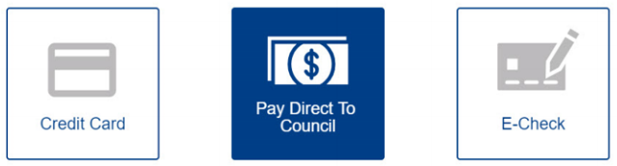
Internet Rechartering
Electronic Options
Electronic Authorization
  Available for the COR
  No signatures required if this option is chosen
Electronic Internet Recharter Payment
Suggest paying Council directly with check or unit account.

Slide 26
Internet Rechartering
Use this year’s access code
Log in as First-Time User
  https://www.glaciersedge.org/
  Under “RESOURCES” tab
  Select “Internet Rechartering”
Supported browsers
  Firefox, Chrome (Best), IE 10 & 11, Edge
  MAC Computers not supported

Slide 27
Internet Rechartering
Load Council information from ScoutNet
  OR
  Upload file from PackMaster
  TroopMaster
  Scoutbook
Update roster
  Update information
  Renew Current Members
  Add adult members
  Add youth members
  Update member data
  Update positions
  Ensure non-members are removed at re-charter

Slide 28
Internet Rechartering
Update member fees
  Assign “Multiple” status
  Sign up members for Boys’ Life
Survey: Why Scouts are not re-chartering
After double checking everything, click SUBMIT information to council
PRINT paperwork and turn-in hardcopy

Slide 29
Internet Rechatering
Obtain signatures
  Paper
    Charter Organization’s Executive Officer (IH), and
    Unit Leader
  OR – elect to use electronic authorization
    Charter Organization’s Representative (COR)
Note: “Submit to Council” on Internet = NOT COMPLETED
Paperwork
  Printed Recharter, New Applications, Background Auth, Fees
  Take to your District Recharter Meeting
  OR – take to the Council Service Center
Fees - Suggest paying directly with check or unit account.
  Paid at your District Recharter Meeting
  OR – at the Council Service Center

Slide 30
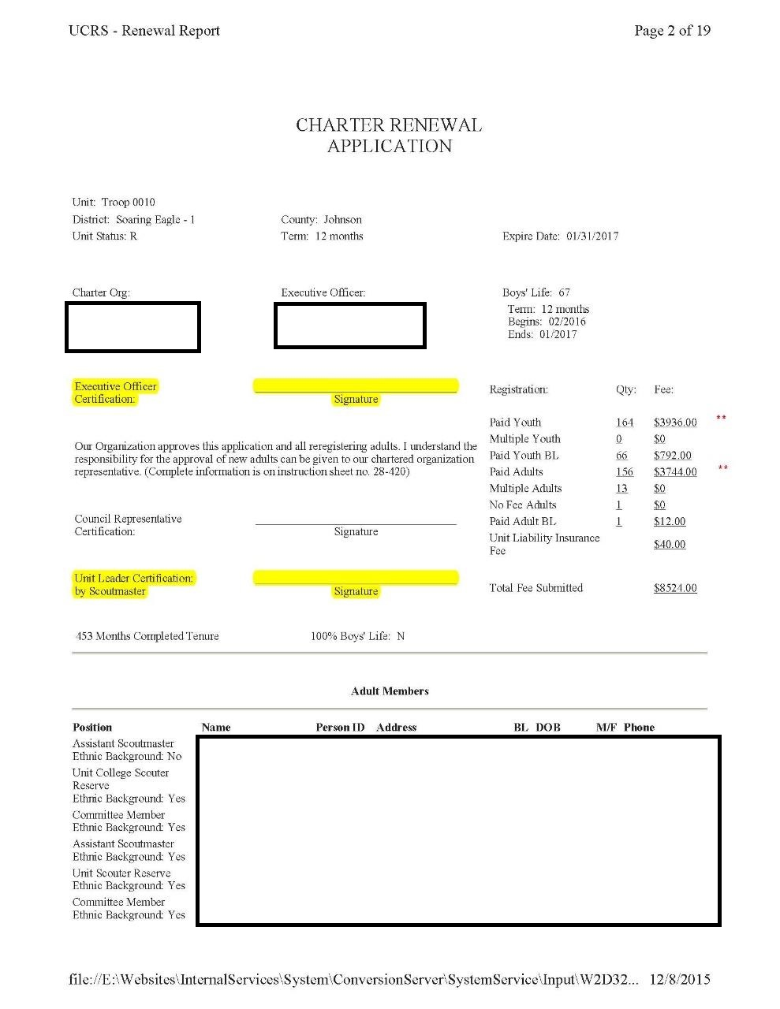
Charter Renewal Application
If the Executive Officer has changed, cross this out and write in correct information
Requires Signatures from:
  Executive Officer (IH)
  Unit Leader
    Cubmaster
    Scoutmaster
    Crew Advisor

Slide 31
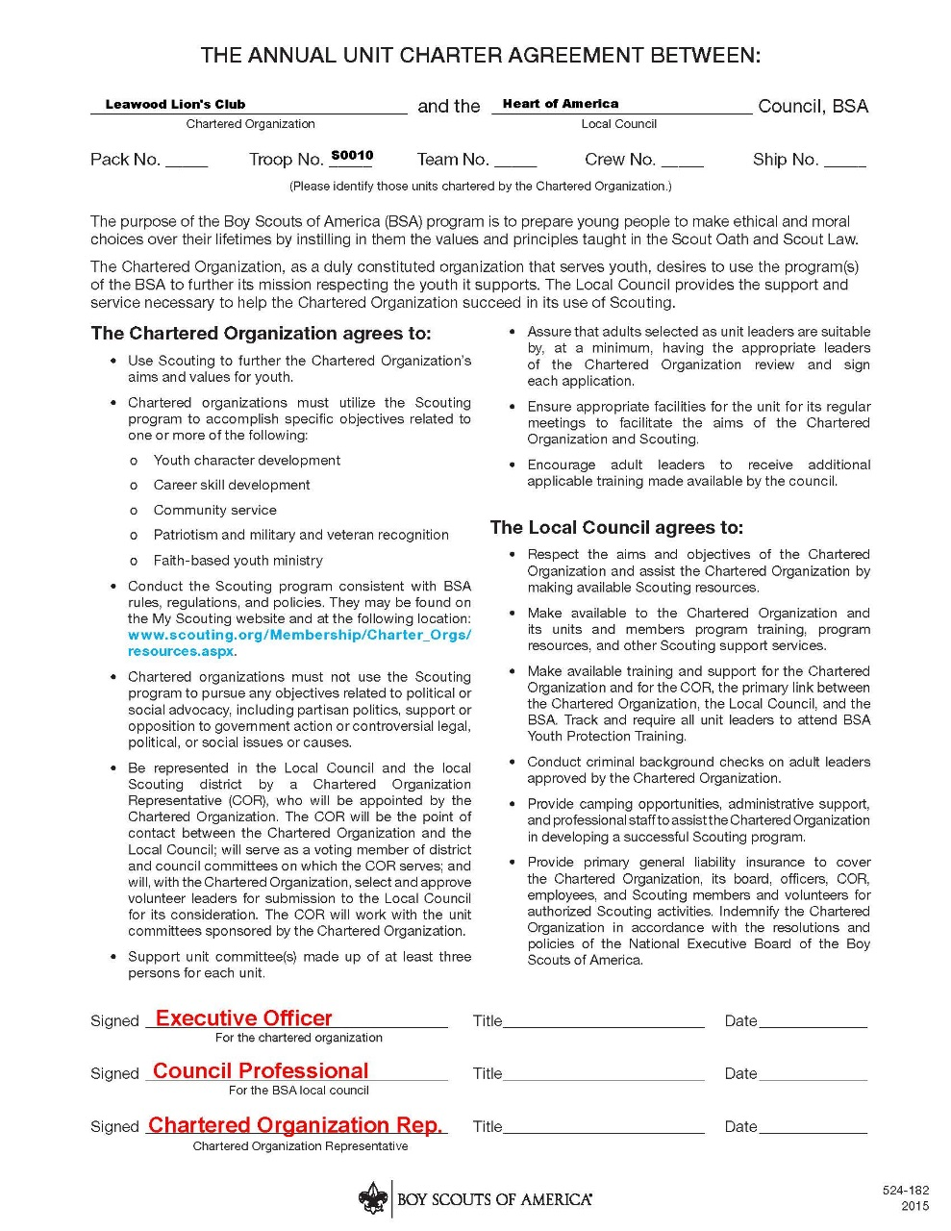
Annual Charter Agreement
Requires Signatures from:
  Executive Officer (IH)
  Charter Organization Rep. (COR)

Slide 32
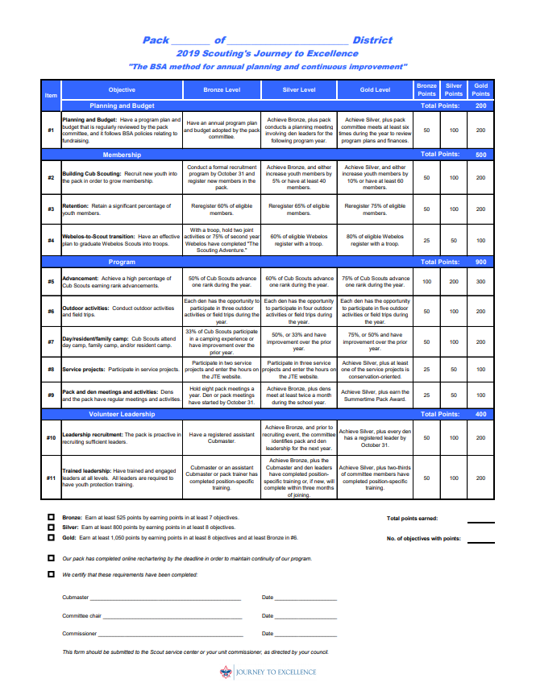
Journey to Excellence
Complete Journey to Excellence form
  Qualified for Bronze, Silver, or Gold ?
Log your Service Hours
  (Link on JTE site at www.Scouting.org )
Unit Leader
Committee Chair
Unit Commissioner

Slide 33
Additional Recharter Training
  https://www.scouting.org/commissioners/internet-rechartering/
  2019 Internet Charter Renewal Tutorial for Packs, Troops and Crews V10
  FAQ’S AND HOW TO’S – Charter Certificate Printing
  FAQ’S AND HOW TO’S – Membership Card Printing

Slide 34

Questions?

