Slide 1
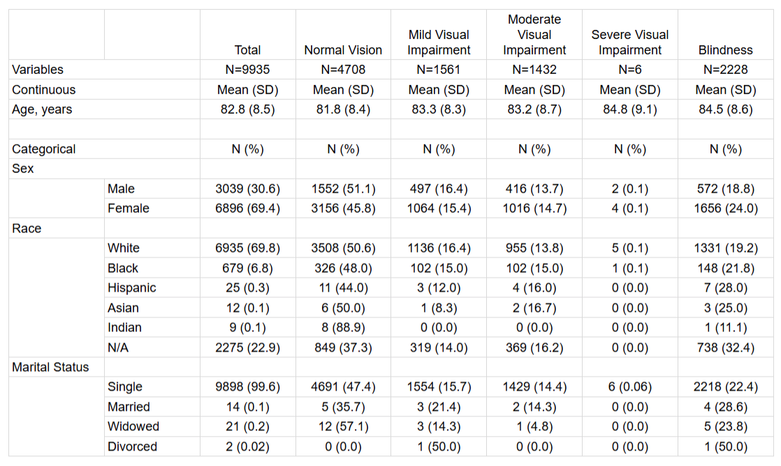
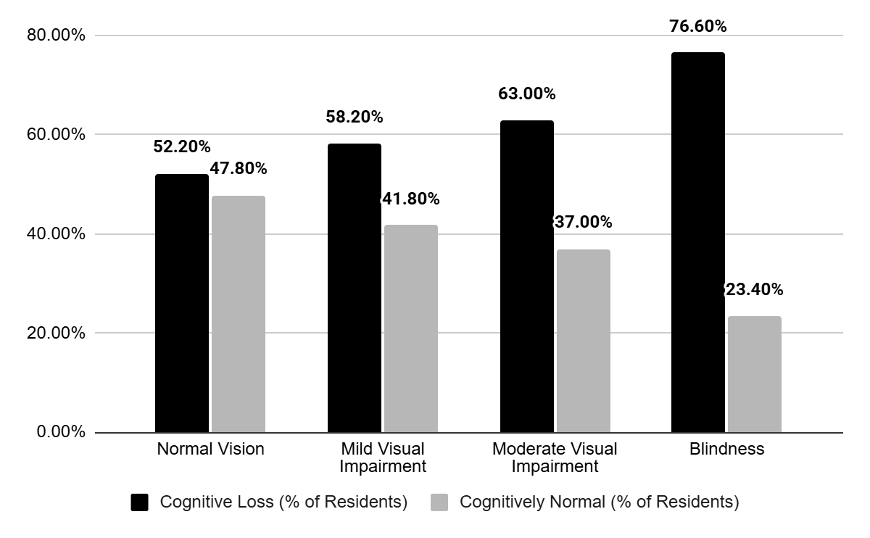

The Association Between Vision Loss, Co-morbidities, and Cognitive Loss Among Residents in Skilled Care Facilities
William A. Monaco, O.D., Ph.D., M.S.Ed.; Khary Walker; Avery Moriyasu; Hongdao Meng, M.D., M.P.H, Ph.D.; Mohammad Al Olaimat, Ph.D., M.S.
Introduction
Vision loss and cognitive loss are highly prevalent among older adults and represent growing public health concerns, particularly in the medically complex U.S. nursing home population. Prior studies have consistently suggested an association between sensory loss and cognitive loss, with worse visual acuity linked to reduced cognitive performance and increased dementia risk. However, many existing studies rely on cognitive assessments such as the MMSE or DSST, both of which require intact vision and may confound the relationship between visual and cognitive function.
Additionally, most prior work has focused on community-dwelling populations. Therefore, research for nursing home residents who suffer a greater baseline risk remain understudied. This study addresses these gaps by using standardized clinical visual acuity measurements concurrently with a vision independent clinically derived definition of cognitive loss. We aim to evaluate the association between visual acuity and cognitive loss and quantify how cognitive loss prevalence varies across worsening levels of vision loss in this high-risk population.
Table 1
Demographic Data Among Different Vision Statuses
Figure 2
Cognitive Status Among Different Vision Statuses
Note. A chart showing the breakdown of age, sex, race, and marital status of the data among the five vision categories
Note. A chart comparing % of Residents with and without cognitive loss among the four categories of vision.
Discussion
This study identifies a significant association between worsening visual acuity and increased likelihood of cognitive loss among nursing home residents, with evidence of a dose-response relationship. These findings are consistent with prior research in community-based populations and extend this relationship to a more complex and medically vulnerable population.
Several mechanisms may explain this association. Vision loss may contribute to neurodegenerative changes, as reduced sensory input has been linked to decreased brain volume in regions associated with cognition. Additionally, visual impairment can lead to social isolation and depression, both of which are known to contribute to cognitive decline. Finally, the increased cognitive load necessary to compensate for impaired vision may divert resources away from memory and executive function.
A key strength of this study is the use of clinically measured visual acuity and a novel LLM-assisted method for extracting cognitive indicators. However, the cross-sectional design limits causal inference and future longitudinal studies are needed to clarify directionality.
Methodology
We conducted a cross-sectional analysis of data from the Western North Carolina Nursing Home Study, restricting the sample to residents aged ≥65 years with baseline visits (n = 9,935).
Visual acuity values were standardized, converted to logMAR, and categorized into normal vision, mild visual impairment, moderate visual impairment, and blindness. Cognitive status was determined using a rule-based model based upon diagnoses and medications associated with cognitive impairment.
A Large Language Model (LLM) was used to extract and normalize clinical conditions from free-text medical records, improving consistency in classification. Residents were categorized as cognitively normal or having cognitive loss. Descriptive and regression analyses were then performed to evaluate associations between visual acuity and cognitive status.
Conclusion
Among U.S. nursing home residents, vision loss and cognitive loss are frequent coexisting conditions and appear to be closely linked. This study demonstrates that poorer visual acuity is associated with progressively higher odds of cognitive loss, suggesting that vision loss may serve as an important marker of cognitive vulnerability.
Importantly, many causes of vision loss in older adults such as refractive error and cataracts are treatable. This raises the possibility that improving visual function could represent a modifiable pathway to help reduce the risk or progression of cognitive loss. Given the high burden of both conditions in nursing home populations, routine vision screening and timely intervention may have meaningful clinical and public health implications.
Future research should focus on longitudinal analyses to determine whether treating vision impairment can directly influence cognitive outcomes and delay the onset of dementia.
Results
Analysis of 9,935 nursing home residents revealed that 60.3% suffered cognitive loss, highlighting the substantial levels of cognitive loss in this population. A clear gradient was observed across visual acuity categories, with increasing prevalence of cognitive loss as vision worsened. Specifically, cognitive loss was present in 52.2% of residents with normal vision, rising to 58.2% in mild visual impairment, increasing further to 63.0% in moderate visual impairment, and finally peaking at 76.6% among those with blindness.
In adjusted models, mild visual impairment was associated with higher odds of cognitive impairment (OR 1.197, CI 95% [1.064, 1.347]), representing a 19.7% increase in odds of cognitive loss compared to individuals with normal vision. Moderate visual impairment was associated with even higher odds of cognitive impairment (OR 1.483, CI 95% [1.310, 1.679]). Blindness was associated with the highest odds of cognitive impairment (OR 2.705, CI 95% [2.410, 3.036]).
Regression analyses further supported this pattern, demonstrating a dose-response relationship between worsening vision and cognitive loss. Compared to individuals with normal vision, those with mild visual impairment, moderate visual impairment, and blindness had progressively higher odds of cognitive loss. These findings suggest a strong and graded association between visual acuity and cognitive status.
References
Acknowledgment: The authors extend special thanks to Dr. Rebecca Wartman for providing these clinical data.

