Slide 1
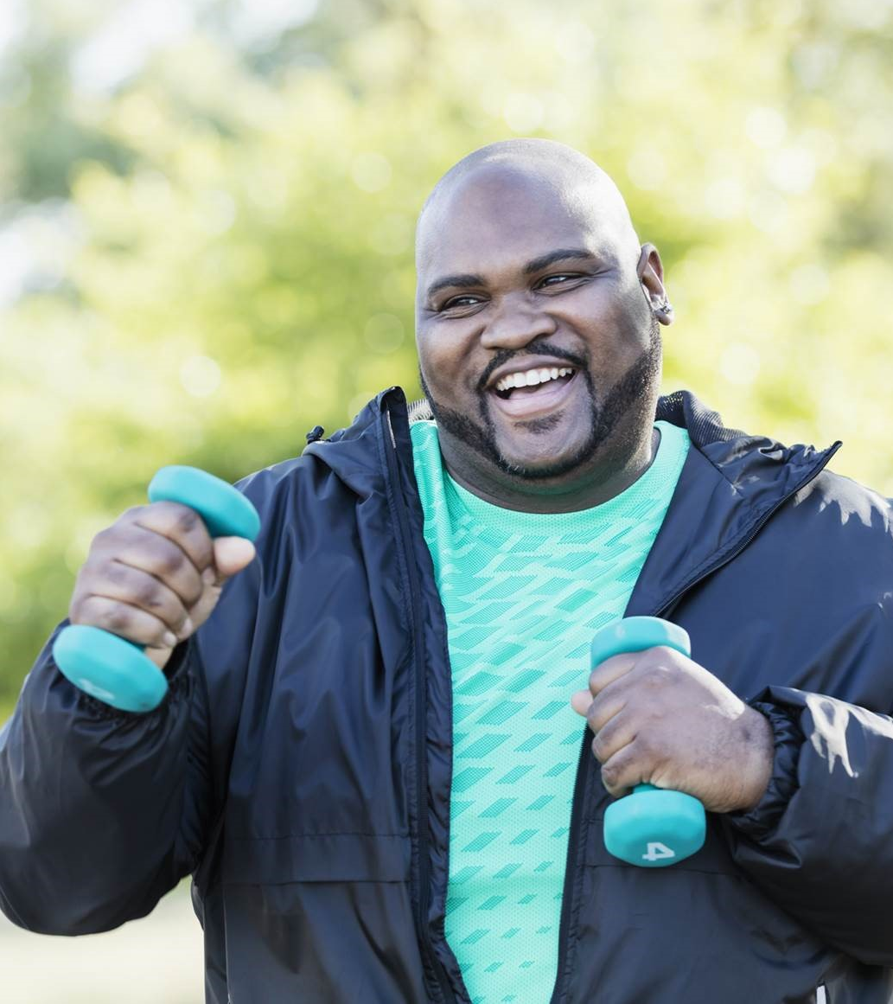
Exercise Essentials
Your Guide to Getting and Staying Active
Presented by your
Employee Assistance Program (EAP)

Slide 2
Seminar goals
Review the recommended guidelines for physical activity
Learn about the three main types of exercise
Explore strategies for getting started and sustaining momentum
Know the benefits of the Employee Assistance Program (EAP)
2

Slide 3



Types of exercise
Strength training
Increases lean
muscle mass
Improves balance
Weight management
Aerobic
Improves body’s ability to meet demands
Burns body fat
Reduces risk of
chronic conditions
Stretching
Improves flexibility, range of motion
Reduces pain and risk
of injury
(Harvard Health Publishing, 2023)

Slide 4


Anatomy of a workout
The Physical Activity Guidelines define physical activity with a few key components:
How hard a person works to
do the activity (e.g., energy required, weight lifted)
Intensity
Safety reminders
How long a person does an activity in one session
(e.g., minutes, repetitions)
“Start low and go slow”
Prioritize safety
Consult with your doctor
Duration
How often a person does the activity (e.g., days/week)
Frequency

Slide 5


Strength training: The basics
Start small and gradually build strength
Should target all major muscle groups
Consider equipment investment
Don’t neglect rest days
Optional equipment:
Household objects
Resistance bands
Free weights (barbells, dumbbells)
Medicine balls
Gliders/sliders
Kettle bells
Weight machines
Suspension
training straps
Guidelines recommend:
Moderate or greater intensity strength-training exercises 2-3 days a week.

Slide 6

Aerobic exercise: The basics
Examples:
Swimming
Rowing
Walking
Jogging
High-intensity interval training (HIIT)
Kickboxing
Cycling
Zumba/dance
Jump rope
Trampoline
…and much more!
Include elements you enjoy
Try mini workouts
Keep it fresh to avoid boredom
Expand your idea of “active”
Guidelines recommend:
150-300 minutes per week of moderately intense activity or…
75-150 minutes per week of vigorously intense activity

Slide 7
Flexibility and stretching: The basics
Examples:
Dynamic stretches
Static stretches
Yoga
Tai chi
Pilates
Foam rollers
Stretch/
resistance bands
Warm up muscles with dynamic stretches and movements
Use static stretches to cool down
Incorporate into normally sedentary or inactive tasks
Experts recommend:
Aim to do stretching exercises
2-3 times per week. Even 5-10 minutes of stretching has benefits.

Slide 8

Getting started: Make a plan
Know your “why”
Visualize your desired outcome
Set small, achievable goals
Outline the how, when, and where
Be mindful to select days, times, activities, and locations that make exercise convenient, not a burden on your time, schedule, or motivation.

Slide 9

Getting started:
Overcoming initial obstacles
Start small with habit stacking
Add to downtime activities
Give yourself “nudges”
Focus on the first step
Remember, small “bursts” of activity during the day “count” towards your total exercise minutes.

Slide 10

Sustaining momentum
Make it a social activity
Track your progress
Set intentions, not tasks
Tap into the power of positive self-talk
Believe you can do it! Give yourself credit for what you can do. See how you can continue making good choices today, tomorrow, and in the days to come.

Slide 11
Benefits of the EAP
Household benefit, prepaid by your employer
Confidential, available 24 hours a day, 7 days a week
Face-to-face or virtual counseling sessions
Unlimited clinical telephonic support
Digital platforms with secure text and video sessions
Home life referrals, such as elder care, child care
Financial and legal services*
Benefits vary by employer. Please check with your
HR representative for your specific EAP benefits.
*Employment-related legal issues are not covered.

Slide 12
References
Clear, J. (n.d.) How to build new habits by taking advantage of old ones. https://jamesclear.com/habit-stacking
Cleveland Clinic. (2024, August 29). Dynamic vs. static stretching: Is one better? https://health.clevelandclinic.org/dynamic-stretching-vs-static-stretching
Harvard Health Publishing. (2025, January 9). The ideal stretching routine. https://www.health.harvard.edu/staying-healthy/the-ideal-stretching-routine
Harvard Health Publishing (2023, August 8). The 4 most important types of exercise. https://www.health.harvard.edu/exercise-and-fitness/the-4-most-important-types-of-exercise
Mayo Clinic. (2026, January 21). Weight training: Do's and don'ts of proper technique. https://www.mayoclinic.org/healthy-lifestyle/fitness/in-depth/weight-training/art-20045842
United States Centers for Disease Control & Prevention (CDC). (2025, December 4) Benefits of physical activity. https://www.cdc.gov/physical-activity-basics/benefits/
United States Department of Health & Human Services (HHS). (2019). Physical activity guidelines for Americans 2nd edition. https://odphp.health.gov/sites/default/files/2019-09/Physical_Activity_Guidelines_2nd_edition.pdf

Slide 13
Thank you

