Slide 1
GSPC Thriving Congregations
Members:
Rebekah Abel Lamar, John Browning, Casi Callaway, Mary Herndon Nordmann,
William Peebles, Buzzy Riis, Nicole Riis, Bo Perry,
Notes:
Rebekah intro and say the prayers

Slide 2
What is “Thriving Congregations”
Black Mountain School of Theology & Montreat
Lilly Endowment Grant
Help congregations thrive by
Strengthening ministries that help people deepen their relationships with God,
Enhance connections with each other, and
Contribute to the flourishing of their communities and the world.
Committee Goal has been to determine who we are and where we are
Notes:
Casi

Slide 3
Why Thriving Now?
Where have we been as a Church?
Review the Timeline in the Fellowship Hall
Add Items you see missing
Note how much our church as done over just the last 50 years.
Where does God want GSPC to go?
This is a working Church –historically working for our downtown community
If we can imagine it, we can do it.
Big dreams for a thriving church comes through a thriving community
God is calling us to serve and to Bloom Where We are Planted
Notes:
Mary Herndon – “If we can imagine it, we can do it.”

Slide 4
What Have We Done To Date?
Research & Data Collection
One on One Conversations
House Meetings
Community Leaders
Analysis:
Cross Comparison of Notes
Reporting
Minutes for Mission
May 5 Lunch Discussion
Evaluation – The big Next Step
Your involvement –
Where do you feel called to join?
Notes:
William
Note – Reporting is what we’re doing here today and the several times we’ve done minutes for mission, etc.
Evaluation is your role next. As the rest of the team presents our findings, you’ll be the judge of success by signing up to get involved in a committee.

Slide 5
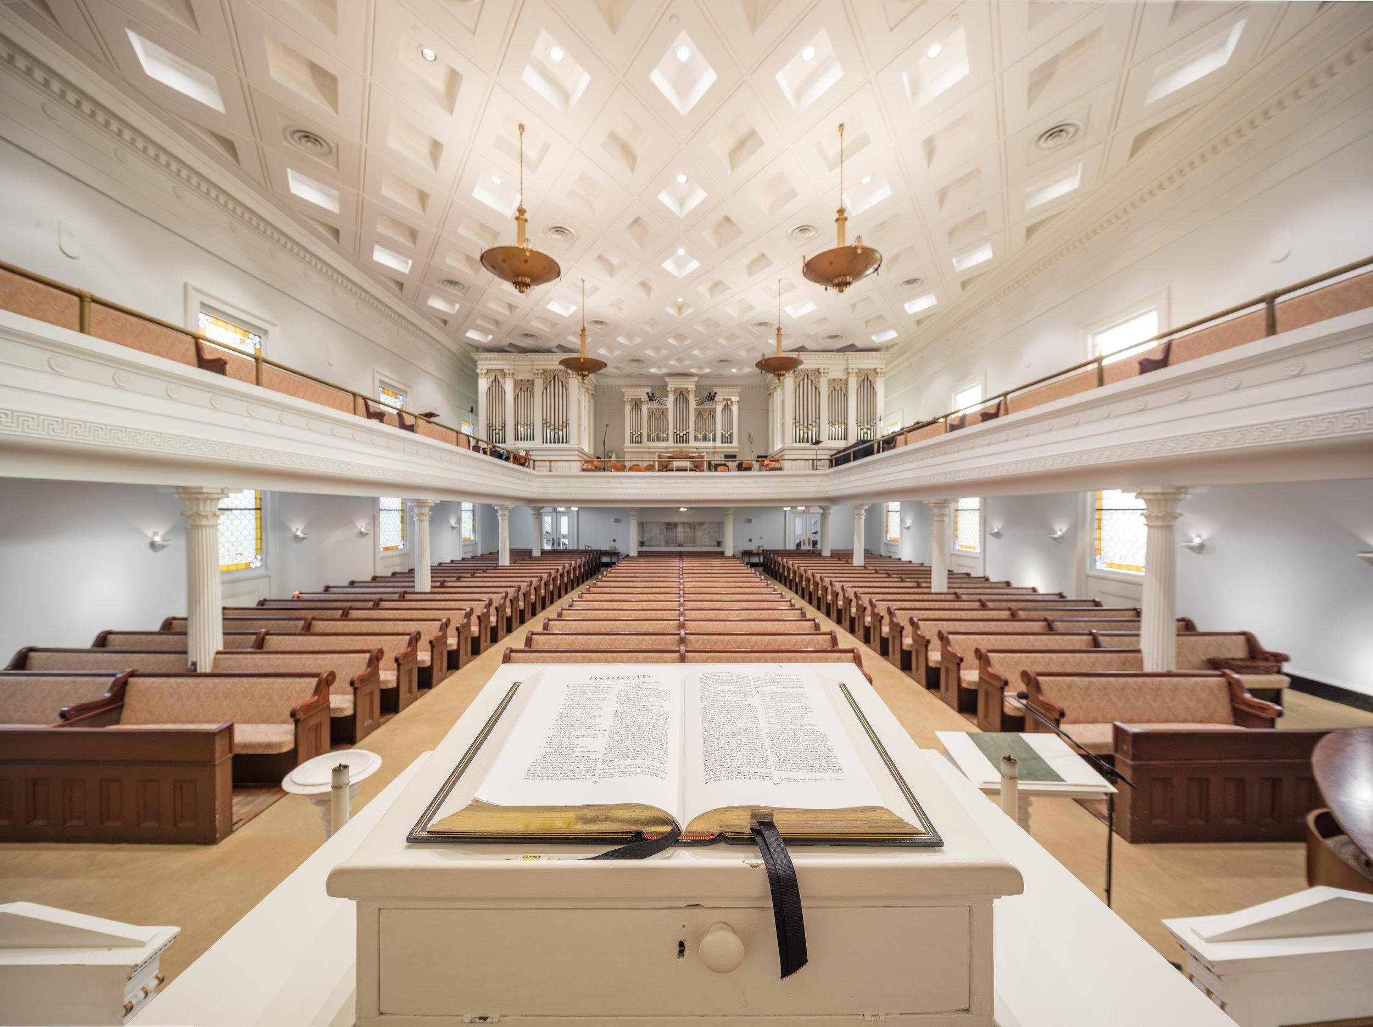
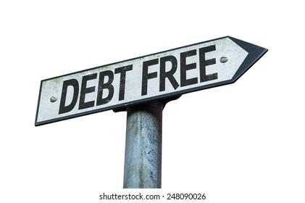
Defining our Assets – Its More than a Building
Amazing Pastoral Care
Proud History in Old City
Commercial Grade Kitchen
Bible Based Preaching
Debt Free Financials
Multipurpose Fellowship / Dining Hall
Mission Focused History
Parking Lot that Pays for Itself
ADA Compliant – Safe Spaces
Guesnard House –
“Off Site” Functions & Education
Endowed Funds and Estate / Trust Support
High Quality Sanctuary Space
Members Who Care
Beautiful Music and Worship
Members are Known Leaders in Community
Dedicated Families

Slide 6
Defining our Community - GSPC In the Heart of the Action

Slide 7
In listening, We Identified 3 Main Topic Areas and a list of ideas in each
Children & Youth
Improve the connection and opportunities for children & youth
Connect volunteer programs for summer activities
Work to combine our children and youth to support a summer volunteer program
Parent education & training
Connections among Church Family
Monthly lunches after church
Address isolation – learn who needs help and who is able to help
Quarterly Field trip
Quarterly Martelle Parties
Plug in New Members
Cook Offs – Chili, etc.
Notes:
Buzzy

Slide 8
Continued: In listening, We Identified 3 Main Topic Areas and a list of ideas in each
Connecting to Our Community & External Mission
Lack of affordable housing
Mental health
Food Insecurity
Backpack programs - food & educational materials for children over the summer
Expand Meals on Wheels
Take on an area/block to understand the needs; build relationship with a small area
Single Moms
Art Walk
Guesnard House
Counselor – bridge between the church and the community
Notes:
Buzzy

Slide 9
Continued: In listening to the Community outside the church, our 3 Topic Areas were confirmed with additional actions
Third-Party Community Connections
Fuse Project
Mobile Police Department
Youth Violence Prevention Coordinator
Faith In Action
Support Fuse Projects’ Purpose Built Community
Early Childhood Center for 3-5 year old children – opening in the fall?
Tutoring
Events at childhood center
Focus on summer only – to start
Care and concern for Immigrants
Notes:
Buzzy

Slide 10
With Big Picture Topic Areas, GSPC Got Going. Here’s what’s already happening:
Children and Youth – the study
Tara Bulger Children’s program review & plan
Connections among church family:
Supper Clubs, Parties, Bible Studies, Lunch & Learns, Book Study
Connecting to Our Community
Downtown Police Precinct – Mardi Gras
Water Fountain
2 Pastors & A Rabbi
Notes:
Buzzy

Slide 11
What we need from you – Committee Engagement
Children and Youth in the Downtown Community
Connections among Church Family
Connecting to our Community-Meals on Wheels
Responsibility:
Sign up for one of the above listed committees
Committees will meet monthly for 2-3 months and then quarterly
Task 1 – Vet the best ideas in each category to see what stands out as most doable, within budget, with support through action/ volunteers
Task 2 – Get started to see what sticks
Notes:
Bo Perry

Slide 12
Specific Ideas within Children and Youth in the Downtown Community
Support for elementary/pre-K programs inside downtown loop
Reading to students
Partnering with parents of students
Summer meal “backpack” support for students during summer vacation
Explore causes/prevention of factors leading to youth violence in these areas
Explore development/offering in GSPC facility of parenting counseling and related resources
Chair:
Members: Bo Perry
Notes:
Bo Perry

Slide 13
Specific Ideas within Connections among Church Family
Survey needs and assets
Fellowship committee
New Member Committee/greeters
Chair: Mary Herndon Nordmann,
Members: Casi Callaway
Notes:
Mary Herndon - (Casi-Backup) “I am waiting for someone to include me TO: I am intentionally including someone else”

Slide 14
Specific Ideas within Connecting to our Community- Meals on Wheels
Expansion – More routes and/or More engagement with those we serve
Help around their houses
Invite folks to church
Chair:
Members: Nicole Riis, William Peebles

Slide 15
God is Calling Us to Serve
We can change from waiting for someone to include me to intentionally including others.
Be Reminded of our assets, Focus on our successes.
We can do more than we are trusting that we can do – it only takes one person and one idea.
Remember what we used to do so we can decide what we want to do next.
If we can imagine it, we can do it.

Slide 16
Questions?
Notes:
Nicole

