Slide 1


Marine Corps League
Southern Division
Marine Corps League Newsletters

Slide 2
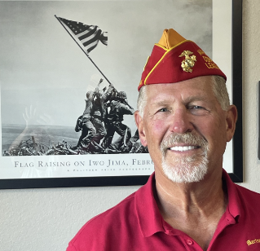
Marine Corps League
Facilitator: Keith Wiesman
  Public Affairs Officer (“PAO”) - Schwab Detachment #857
  Public Affairs Officer & Web Sergeant - Department of Oklahoma
  PR Team Member - Southern Division
  PR Committee Videographer - National

Slide 3
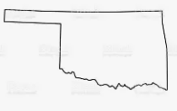
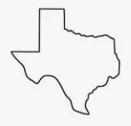
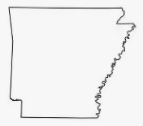
Marine Corps League
  I currently live in Broken Arrow, Oklahoma
  (12th best place to live in the US. according to U.S. News & World Report)
  I am a Native Texan (born in Gainesville)
  (less than 100 miles west of Paris, TX)
  I have relatives in Arkansas

Slide 4
Marine Corps League Newsletter
The 5 Ws
  Who
  What
  Where
  When
  Why
Plus the all-important: How

Slide 5
Marine Corps League Newsletter
Who creates a Marine Corps League Newsletter?
Anyone in the Marine Corps League with a computer and internet access can create a Newsletter!
Detachment Level
Department Level
Division Level

Slide 6
Marine Corps League Newsletter
What is a Marine Corps League Newsletter and What should it include?
An information and marketing tool designed to
Promote the Marine Corps, the Marine Corps League, and our way of life
Share information on MCL activities
Recruit new Members
Almost always an email to be cost-effective

Slide 7
Marine Corps League Newsletter
Include:
‘Eye-Catching’ subject line
Header that includes your Division/Department/Detachment logo
Marine Corps League content that includes calls-to-action, and is easy to navigate
Articles on patriotic holiday events
Marine Corps historical articles

Slide 8
Marine Corps League Newsletter
Include (cont.)
Recruiting information
Highlight new Members
Photos (lots of photos) and video
Links to websites and social media
Information on Conventions and Conferences
Newsletter Editor’s contact info

Slide 9
Marine Corps League Newsletter
Where should the Newsletter be sent?
Members and Associate Members
Member Prospects
Birthday Ball Attendees
Local Government Agencies
Media Contacts
Local Active or Reserve Military Units

Slide 10
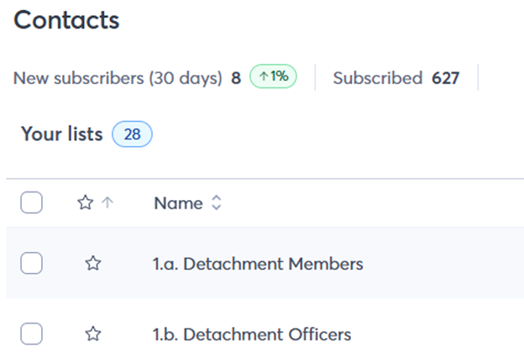
Marine Corps League Newsletter
Where: a Schwab Detachment Example

Slide 11
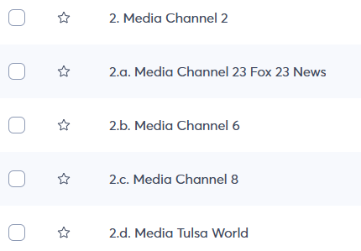
Marine Corps League Newsletter
Schwab Detachment Example (cont.)

Slide 12
Marine Corps League Newsletter
When should a Newsletter be sent?
The frequency can vary depending on the level of activity
Weekly
Bi-Weekly
Monthly (most common)
Bi-Monthly
Quarterly

Slide 13
Marine Corps League Newsletter
Why does my Division, Detachment or Department need a Newsletter?
Direct Access to your MCL Members and Member Prospect’s inbox
Build Trust and Credibility by sharing valuable USMC & MCL content
Engagement that encourages responses & actions
Promote the League to recruit and keep the MCL top-of-mind
Build Long-term Relationships that help increase MCL Member retention

Slide 14
Marine Corps League Newsletter
How is a Newsletter created?
Gather content
MCL Members
Other relevant Newsletters
Example: VA Department of Veteran Affairs
https://public.govdelivery.com/accounts/USVA/subscriber/new
MCL Units
Social Media and Websites

Slide 15
Marine Corps League Newsletter
How is a Newsletter created?
Choose an email newsletter software platform.
Templates. Email templates make it easy to create and share
Automation. You can set welcome emails, event follow-ups, and more
Formatting. The software formats emails sent to fit smartphones, tablets, and other devices.
Create your Newsletter on a word document
Reporting. Shows opens, clicks, bounces, and emails that unsubcribe
Manageable for small Detachments

Slide 16


Newsletter
  2 Provider examples are:

Slide 17
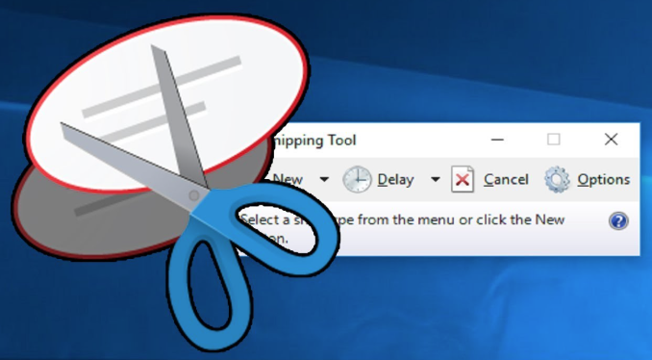
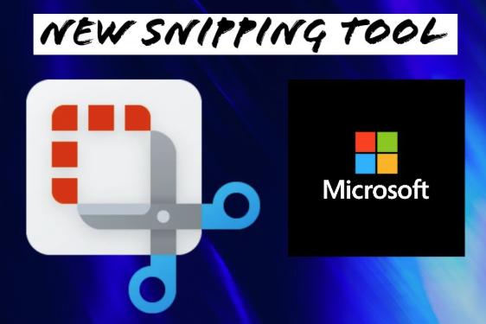
Marine Corps League Newsletter
Snipping Tool
  Microsoft Windows 10 (left) and Windows 11 (right)

Slide 18
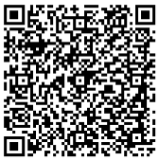
Marine Corps League Newsletter
Cost Example
  Constant Contact – Marine Corps League pricing based on number of contacts and number of emails sent
    Lite: $10 per month
    Standard: $28 per month
    Premium: $64 per month

Slide 19

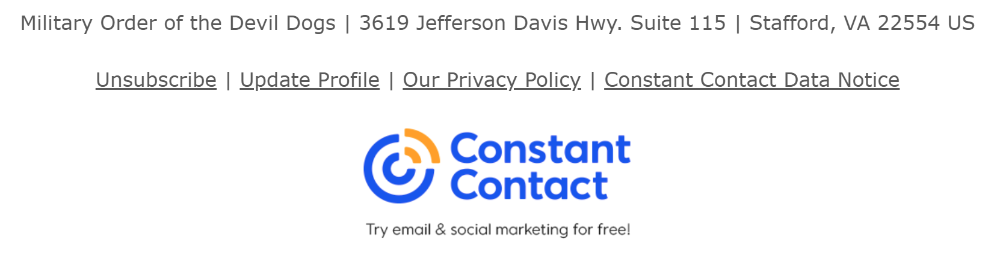
Marine Corps League Newsletter
Look Who Else Uses Constant Contact:

Slide 20
Marine Corps League Newsletter
https://myemail.constantcontact.com/April-2026-Schwab-Detachment-Newsletter.html?soid=1133865907884&aid=dKj4-m8HHmY
April draft of the Oklahoma Schwab Detachment Newsletter to be sent using Constant Contact software.

Slide 21
Marine Corps League Newsletter
https://www.canva.com/design/DAHCc2fHfuQ/KqhB3UoQ9lOGJ0bPum73OA/view?utm_content=DAHCc2fHfuQ&utm_campaign=designshare&utm_medium=link2&utm_source=uniquelinks&utlId=h3eb0a58818
March edition of the Oklahoma Sooner Detachment Newsletter
aka the sooner sitrep
created by Jake ‘Doc’ Strong using Canva software.

Slide 22
Marine Corps League Newsletter
https://myemail.constantcontact.com/01-Apr-2026-Department-of-Oklahoma-Newsletter.html?soid=1142243394925&aid=YIqiRqEt_iA
April draft edition of the Department of Oklahoma Newsletter created on Constant Contact software.

Slide 23
2026 MCL Newsletter Competition
2026-National-Newsletter-Competition-SOP.pdf
MCL National Newsletter
  Chairman: Walt Benson
  Phone: (203) 768-8435
  Email: walt.benson5@gmail.com
  Email Competition entries to: mclnewsletter@gmail.com (08 Jun – 30 Jun)
  Judging Criteria can be found in the MCL Library: https://www.mcleaguelibrary.org/wp-content/uploads/2025/03/2025-judging-criteria.pdf

Slide 24
Facilitator Contact Info
  Keith Wiesman
  Emails:
  pao@mclok.org
  kwiesman@outlook.com
  Phone:
  (918) 924-6766

Slide 25
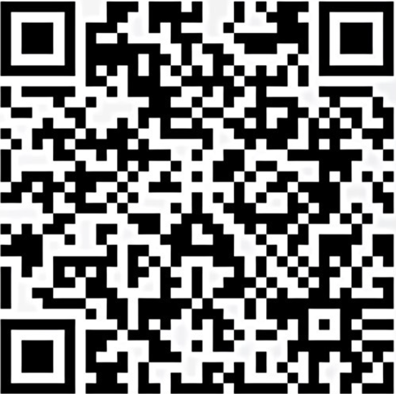
Marine Corps League
National PR Committee

