Slide 1

DMV Faith in Action
Webinar Series 2022
TEEN DATING VIOLENCE AWARENESS MONTH
February 8, 2022

Slide 2
Today’s Agenda
12:00 PM Opening Welcome
12:05 PM About the Washington DOH - POWAB
12:10 PM About the Virginia Partners in Prayer and Prevention
12:15 PM Goals and Objectives for Today and Introduction of the Main Presenters
12:20 PM TurnAround, Inc.
12: 50 PM Prince George’s County Department of Family Services
12:10 PM Q & A
12:25 PM Resource Sharing and Closure

Slide 3



Welcome
Regina Jefferson, POWAB DOH/HAHSTA Chair and the Coordinator for Faith Initiative, DC DOH
Carmi Washington Flood, Chief, Office of Faith Based and Community Partnerships, MDH
Veronica Cosby, Partners in Prayer and Prevention Coordinator, Office of Health Equity, VDH

Slide 4
Goals and Objectives for Today
Goal: Build the capacity of faith and ministry leaders to engage their congregations and communities to discuss and address the concerns of teen dating violence.
Objectives: by the end of this presentation participants will be able to -
Discuss strategies to present the issue of teen dating violence
List ways faith communities can develop safe spaces for discussion and personal sharing
Describe program activities that can be established and/or supported to facilitate healthy dating
Summarize how faith leaders can educate and heighten the awareness of young people about dating violence
Identify at least three available services and /or resources targeting teen dating violence

Slide 5
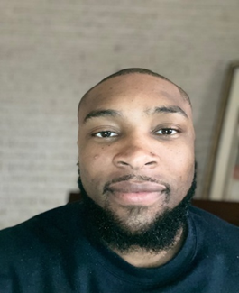
Rev. Darryl Kemp BA, MDiv
Darryl Kemp holds a Bachelor’s in Psychology from Howard University and a Master of Divinity from Virginia Union University.
Darryl is also a member of Phi Beta Sigma Fraternity Inc. and brings with him an appetite of culture for service and service for humanity.
Even though a young professional, he is a seasoned professional - - From serving as an Army chaplain to serving in a Counselor Manager role for various organizations, to being a graduate of multiple fellowships (Ronald E. McNair & Princeton Theological Seminary: Black Theology & Leadership Institute), and also working with survivors of domestic violence and sexual assault while serving as a chaplain in the Army.
Darryl believes that serving others is the best way to embody our role as human beings, it exudes selflessness, empathy, and love.

Slide 6
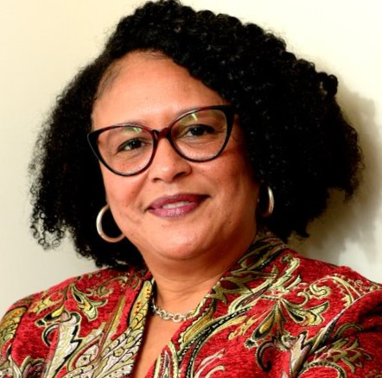
Jackie Rhone, BS, MA
Jacqueline Rhone is currently an Associate Director in the Department of Family Services in the Domestic Violence and Human Trafficking Division. The division is responsible to provide the coordination of access to services to victims of domestic violence and human trafficking in Prince George’s County.
Jacqueline has over 30 years’ experience in Administrative Management. She has a Bachelor of Science in Business Administration and a Master of Arts in Administrative Management. She recently received the Certified Public Manager’s (CPM) designation from George Washington University and the Metropolitan Washington Council of Governments.
Jacqueline is the 2016 Gladys Noon Spellman, Public Service Award recipient. Appointed in 2016 by Governor Hogan to the Neshante and Chloe Davis Domestic Violence Prevention Task Force. She currently serves on the Maryland Domestic Violence Fatality Review State Implementation Team (MD-DVFRSIT).

Slide 7
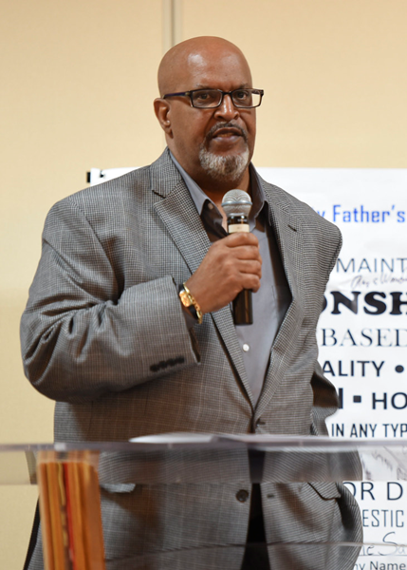
Elio M. Wade
BS
Elio M. Wade is the Program Coordinator for Prince George’s County Government, Department of Family Services, Domestic Violence/ Human Trafficking Division located in Camp Springs, Maryland.
Serving as a strong community advocate working with men and male youth to realize their role within the community and in relationships, he’s played an integral part in successfully developing programs to help males understand the dynamics of healthy relationships.
Graduating with a Bachelors of Science Degree in Criminal Justice from Point Park University, Elio has been instrumental in developing the batters Intervention (BIP) as well as the Fatherhood and Parenting program in the Allegheny County Jail (ACJ) in Pittsburgh, PA. he also played a key role in starting the father day Initiative program both in Western PA and now here in Prince George’s County Maryland.
Elio has traveled to a number of colleges ( Penn State, Drexel and Temple Universities) doing Domestic Violence workshops. He has provided 20 years of professional experience in this field with plenty of success that not only includes accomplishments for advocating for healthy relationships.
Elio has served as a board member for the ITT school of Business where he received a Committee Service award for his work with youth. In 2016, he was awarded the presidential citation Award for his outstanding Community Leadership.

Slide 8
Presenter Contact Information
Darryl R. Kemp, M.Div
Community Engagement Coordinator
Turnaround Inc.
dkemp@turnaroundinc.org
Jackie Rhone, MBA
Prince George's County - Department of Family Services
Domestic Violence and Human Trafficking Division
JMRhone@co.pg.md.us
Elio M. Wade
Prince George's County - Department of Family Services
Domestic Violence and Human Trafficking Division
EMWade@co.pg.md.us

Slide 9
Health Department Contact Info
Regina Jefferson, POWAB DOH/HAHSTA Chair and the Coordinator for Faith Initiative, DC DOH regina.jefferson@dc.gov
Carmi Washington Flood, Chief, Office of Faith Based and Community Partnerships, MDH carmi.washington-flood@maryland.gov
Veronica Cosby, Partners in Prayer and Prevention Coordinator, Office of Health Equity, VDH veronica.cosby@vdh.virginia.gov

Slide 10
Recording Link
Topic: DMV Faith in Action CY2022 Webinar Series
Start Time: Feb 8, 2022 11:39 AM
Meeting Recording:
https://us06web.zoom.us/rec/share/bS8ITLCjvtI8MhAejHYuGU34eM9yZqzLc8zOHw6RCwMSU4DWr-48M-N3HUn9QG-V.Dq91u9BgLFkuEYvk

