Slide 1


Health Care Needs Home Care
Home Support Is A Health Priority
Healthcareneedshomecare.ca

Slide 2

We urge government to provide:
UNIVERSAL FREE ACCESS TO HOME SUPPORT
To allow all seniors’ to age in place with dignity, in their communities, and in their homes to reduce demand on the health care system.
Healthcareneedshomecare.ca

Slide 3


By the numbers…
Rapid growth of BC seniors' population from 1,000,000 today to more than 1,500,000 by 2040.
500,000 (66%) of seniors in BC today are living on less than $34,000 annually.
250,000 Seniors in BC today live on less than $22,000 per year.
300,000 Seniors in BC receive the Guaranteed Income Supplement.
Wait time of 290 Days for LTC admission.
Many Seniors required to pay over $9,000 annually to receive minimal home support.
Healthcareneedshomecare.ca

Slide 4
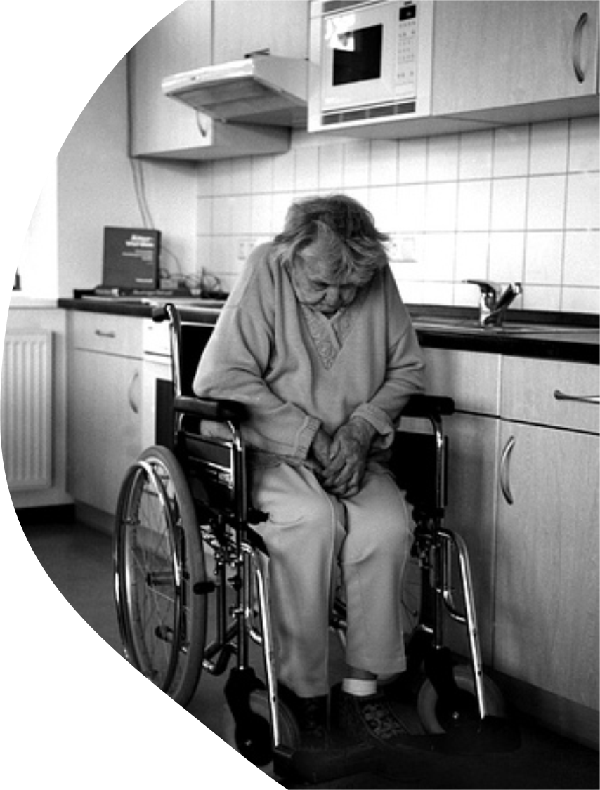
Quality of life is lost at a cost!
When seniors can’t afford home support
the consequences are serious:
More ER room visits
More hospitalizations
Premature entry to LTC
Greater strain on family caregivers
Healthcareneedshomecare.ca

Slide 5

What is Home Support?
Gary and Eileen Record’s Story
Ladysmith, BC
Purpose: Helps seniors or people with physical or mental health challenges maintain independence and stay in their own homes longer.
What is it? Non-medical, daily living assistance.
Eileen is doing everything she can to keep her husband Gary at home as his dementia progresses. She manages his care, his meals, and his safety — often with little outside help.
They earn just a little too much to get free home support and too little to afford private care.
Eileen is exhausted but determined to keep Gary in the home they’ve shared for over forty years — the place where their memories still live, even as his begin to fade.
Their story can be found at www.jsalliance.org/advocacy/
Who Provides It: Private-pay, subsidized or sliding-scale home support workers, community health aides, personal support workers, volunteer, friends, family.
Examples of Services:
  Help with bathing, dressing, toileting and grooming.
  Meal preparation, light housekeeping, laundry and feeding.
  Medication reminders.
  Transfers in/out of bed/chairs.
  Companionship
Healthcareneedshomecare.ca

Slide 6
Why Home Support is right for YOU?
Publicly funded home health care services allow Seniors to stay in their homes longer.
Better Health Outcomes
Protects
Cost Savings
Improved quality of life and health status for seniors
Mental Health and well-being for Seniors
Savings to government and for individuals
Increased Independence
Reduced Hospitalizations
Benefits
Fewer unnecessary emergency and ALC (Alternative Level of Care beds) admissions
For seniors, families, services, and the health care system
Preservation of dignity and autonomy
Healthcareneedshomecare.ca

Slide 7

Why Universal Free Home Support?
90% of Seniors prefer to age-in place at home with available supports.
Annual cost of government funded Long-Term care beds is >$80,000 per year.
Alternative Level of Care (ALC) beds cost over $1,000 per day to house patients, often unnecessarily.
Average seniors stay in ALC beds is 24 daysat $1,000 / day = $24,000 vs. $1200 for 24 days home support.
Hospitalized seniors waiting in alternative level care (ALC) beds costs the health care system between $500 to $800 million a year in BC.
Jurisdictions that provide free home support have better outcomes, lower long-term care admissions, lower overall health care costs.
Healthcareneedshomecare.ca

Slide 8

It Saves The System Money, too!
Home support doesn’t just help seniors….
The current co-payment model is outdated and inequitable.
It penalizes seniors on fixed incomes.
It penalizes seniors that are most at-risk and vulnerable.
It shifts costs to the most expensive parts of the health system — costs that home support would have prevented.
Healthcareneedshomecare.ca

Slide 9
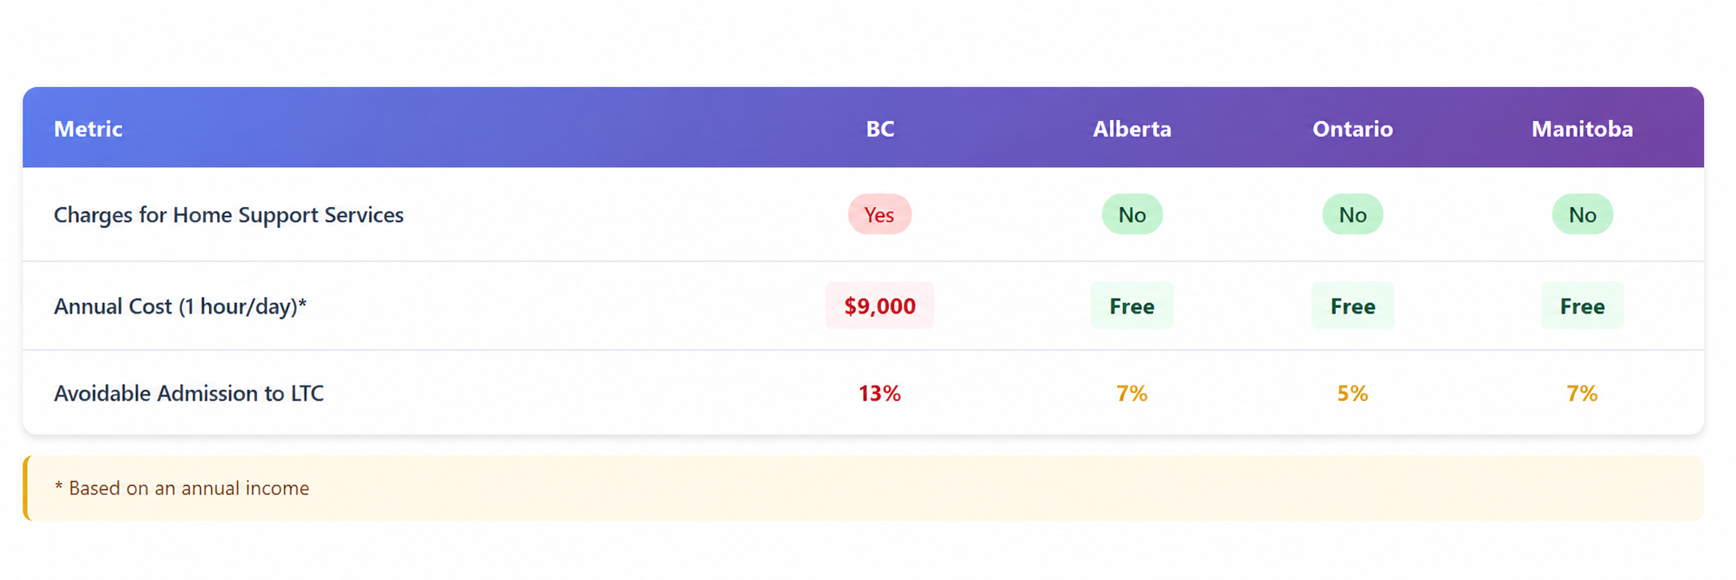
Home Support Services Comparison
BC pays for the hospital bed after the fall while other provinces invest earlier so the fall is less likely to happen.
BC still largely treats home support as a supplemental social service whereas Ontario, Alberta, and Manitoba treat it as core healthcare infrastructure.
BC Admission rate to LTC with no prior home support : 61%
Key Findings: BC has both the highest rate of avoidable admissions to LTC (13%) and 61% of admissions occurring without any prior home support services.
Healthcareneedshomecare.ca

Slide 10
LTC Bed Deficit Reduction Benefit
Impact of Expanded Home Care on Future Long-Term Care Bed Deficits in BC · Projected to 2035/36
Aggressive home care expansion reduces the projected LTC bed deficit by 8,391 beds — from 16,858 to just 8,467.
Diversion scenarios modelled at 12.5%, 15%, and 17% of projected LTC-eligible individuals redirected to home care. | Baseline deficit: 16,858 beds with no diversion.
Healthcareneedshomecare.ca

Slide 11
Capital Cost Savings vs. No Home Care Diversion
At $1,000,000 per bed · Projected bed deficits by 2035/36
Scenario | Beds Required | Capital Cost | Savings vs. No Diversion
No home-care diversion | 16,858 | $16.86B | —
Conservative (12.5% diversion) | 10,688 | $10.69B | $6.17B saved
Moderate (15% diversion) | 9,454 | $9.45B | $7.41B saved
Aggressive (17% diversion) | 8,467 | $8.47B | $8.39B saved
Aggressive home care expansion could free up $8.39 billion in LTC capital — before accounting for operating cost savings, reduced hospitalizations, and avoided staffing pressures.
Estimated using $1,000,000 capital cost per new LTC bed. | Does not include operating costs, staffing, or hospital overflow pressures.
Healthcareneedshomecare.ca

Slide 12
Making the Case for Universal Free Home Support
Reductions in unnecessary early admissions to long-term care.
BC has highest costs in Canada for home support services not covered by province.
Low-middle income seniors are disproportionately impacted by home support costs.
Ontario, Alberta, and others are providing Universal Free Home Support for all seniors.
Costly to build LTC beds at over $1,000,000 per bed. Too far behind to EVER catch up to needs.
Seniors are the largest voting block in the province, with the highest voting turnout. Older Adults will be ¼ of the BC population by 2035.
Healthcareneedshomecare.ca

Slide 13

No one should be forced into long-term care simply because they cannot afford to stay home.
Healthcareneedshomecare.ca

Slide 14
Act Now!
Send A Letter To Your MLA…
British Columbia's seniors deserve to age at home — with dignity, independence, and without financial hardship.
​It's time to eliminate home support co-payments.
Use the Health Care Needs Home Care Email Your MLA Today button at healthcareneedshomecare.ca to contact your MLA directly.
It takes less than two minutes to let them know this is a health care priority for you.
​
Healthcareneedshomecare.ca

Slide 15

Act Now!
Share Your Story…
Have you or someone you love been affected by limited access to home support as a result of government mandated co-payments? Personal stories are powerful.
Act Now!
Spread The Word…
Share this campaign with your networks and help us reach more British Columbians who want to make an impact in improving seniors' care.
Healthcareneedshomecare.ca
info@healthcareneedshomecare.ca
Healthcareneedshomecare.ca

Slide 16









Help us help BC Seniors
Healthcareneedshomecare.ca

