Slide 1




Slide 2
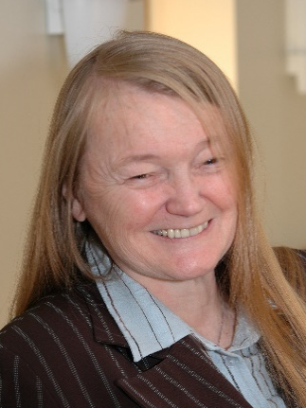

Dr. Fuleihan Lecture Speaker: Dr Suzanne Lacasse
Dr. Suzanne Lacasse was born in Noranda, Québec. She earned her Bachelor of Arts degree from the University of Montréal and completed her civil engineering degrees at École Polytechnique de Montréal and the Massachusetts Institute of Technology (MIT). After serving for 15 years on the faculty of MIT’s Department of Civil and Environmental Engineering, she joined the Norwegian Geotechnical Institute (NGI) in 1982.
During the summers of 1977 and 1978, Dr. Lacasse worked for Ardaman & Associates under the supervision of Drs. Anwar Wissa and Nadim F. Fuleihan. She became Managing Director of NGI in 1991, a position she held until 2012, and currently serves as an Expert Adviser at the institute.
Dr. Lacasse has published over 400 papers and delivered many prestigious lectures, including the Terzaghi Lecture, Rankine Lecture, Carrillo Lecture, Lumb Lecture, Jennings Lecture, and the Terzaghi Oration. In her honor, the International Society for Soil Mechanics and Geotechnical Engineering (ISSMGE) established the Suzanne Lacasse Lecture on Risk and Reliability in Geotechnical Engineering.
She has received five honorary doctorates from universities in Scotland, Norway, and Canada, and is an elected member of the National Academies of Engineering in the United States, Canada, Norway, and France. Dr. Lacasse is also an Honorary Professor at Tongji University, Jiaotong University, and Zhejiang University in China. She has been appointed Officer of the Order of Canada and Knight of the Order of the Falcon in Iceland.
Title: Risk-informed decision-making for improved safety
Abstract: The 1st Dr. Nadim F. Fuleihan Lecture presents a framework to help stakeholders make sound, risk-informed decisions to improve the safety of civil engineering structures such as slopes, dams and offshore installations. Risk-informed decision-making (RIDM) involves: (1) Gathering available information, including field and laboratory data, analyses and reliability of observations; (2) Estimating hazards, potential failure modes, and consequences; (3) Developing a risk picture using qualitative or quantitative diagrams and comparing results with international guidelines; (4) Assessing overall risk levels, identifying key safety factors, and determining needed controls; (5) Managing risk through informed decisions on tolerability, control measures and communication, and (6) Periodically reassessing risk as conditions evolve. The RIDM framework quantifies uncertainties, reduces risk, and supports decisions. Examples from practice, including case studies on landslides, hydropower dams, and foundation projects, illustrate the approach and show how mitigation measures can reduce computed risk. The lecture concludes with key lessons from case studies and recommends broader adoption of the risk-informed approach in practice.

Slide 3
Program at a Glance (Tentative)
5:00 to 5:45 pm – Registration, Student Poster Sessions (10+ UCF Graduate Student Posters), and Social Hour
5:45 to 6:30 pm – Dinner
6:30 to 6:45 pm – Opening Remarks
6:45 to 7:00 pm – UCF Student Research Presentations (Edgar Correa Prada and Martha Santos)
7:00 to 7:30 pm – UCF Faculty Research Presentation (Dr. Luis Arboleda, Associate Professor, University of Central Florida, title: Unified Prediction of Ground Response to Pile Driving and Compaction Vibrations).
7:30 to 7:45 pm – Recognition of Dr. Fuleihan’s Contributions and Introduction of the Dr. Fuleihan Lecture Speaker
7:45 to 8:45 pm – Fuleihan Lecture: Dr Suzanne Lacasse, Risk-informed Decision-making for Improved Safety.
8:45 – 9:00 pm – Final Remarks
9:00 pm – Adjourn
Note: 1.5 Professional development hours (PDHs) will be provided for participants.
Sponsorship Level
Sponsor Level | Donation | No. of Seats | Program & Slides | On-site Signage | Mention from Podium | Reserved Seating
Individual | $75 | 1 | - | - | - | -
Donor | $200 | 1 | Listed Name | - | - | -
Silver | $500 | 2 | Small Logo | - | - | -
Gold | $750 | 3 | Medium Logo | - | Yes | -
Platinum | $1000 | 4 | Large Logo | Yes | Yes | Yes
Diamond | $2000 | 6 | Large Logo | Yes | Yes | Yes
Bar Sponsor | $1000 | 4 | Large Logo | Yes | Yes | Yes

