Slide 1
C.A.R.E.
Club Member Retention Program
Notes:
Hello my fellow optimists. My name is ______________________ and I am _________________________________. (Provide some details about you that are relevant to the training.
I am a member of the 2023-2024 Optimist International Membership Engagement Committee.
I am the Chair of the _____________ District Membership Engagement Committee.
I am a longtime optimist, having served youth in my community for over 20 years!
**If you have co-presenters you would introduce them now, or have them introduce themselves as well.
Today, I am very excited to talk to you all about an exciting new program that some excellent Optimist International Leaders have developed to help our clubs retain our most important resource - our members.
This is about how we CARE for our clubs.

Slide 2
Objectives
Club Membership
What does a retention program look like?
C.A.R.E. - What this stands for
The 4 Steps of a C.A.R.E. Retention Program
Notes:
We have 4 objectives for our discussion today.
We want to discuss Club Membership and how our clubs are evolving.
We’ll review what a good retention Program looks like in order to help our clubs sustain, and grow. Many clubs and members experience some difficulty in adding new members, so retention is as important as every to ensure we have strong, vibrant clubs that can serve our communities today, and for many years into the future.
The Acronym C. A. R. E. is the cornerstone of this new Retention Program that all clubs should take advantage of at least one each year. After the presentation today, you’ll understand what each of the letters in C A R E represents and how we can apply them to our clubs to make them more resilient.
Finally we’ll go through the 4 easy steps of the CARE program, and how your club can easily run this program at an annual General Member Meeting, Celebration night, Anniversary, or membership event. The program is the same no matter when your club schedules it, but you have some abilities to fine tune the specifics to meet your event and clubs needs.

Slide 3

Club Membership
Existing Members
New Members
Leaving Members
Notes:
There are 3 things we need to consider when we think about the membership growth with our Optimist Clubs, and the Optimist International Organization.
It’s exciting when we get new members into our clubs! They bring in new energy, new ideas, and new perspectives on the events we currently do to bring out the best in our communities. When we think of growing our membership and being able to serve more youth, this is where much of our attention goes - Bringing in new members. Historically too, that’s how we’ve maintained the membership levels in our clubs.
Ask Question - What are some ways that you promote new membership into your clubs. Take 3-4 answers and allow for small discussion before moving on.
Another big component to the membership within our clubs is our existing members. These members are the ones who volunteer for the events we do, serve our clubs as Club Administration and Board of Directors, serve as leaders within our districts, and leaders within Optimist International. Many of these members stay in our clubs year over year, and we hope that any new member becomes a lifelong optimist bringing out the best in youth, the communities they serve, and of course, themselves.
Ask Question - What are some reasons why people stay members of our clubs? Take 3-4 answers and allow for small discussion before moving on.
Sadly, there is a third component that has a huge effect on the membership in our clubs. That is members that leave.
Ask Question - What are some reasons why members leave our clubs? Take 3-4 answers and allow for small discussion before moving on.
The CARE Program is going to combine all three of these different types of members into a program that will help us continue the legacy of service our optimist clubs provide. What we’re looking at in terms of membership retention is those members that are on the verge of leaving, not those that have already broken up with the club, and completely moved on. There is still time for many of our members who’ve lost that connection and are on the verge of leaving the club due to “lack of interest”. It’s not that these people are no longer interested in serving youth, making their community a better place, or improving themselves - its lack of interest in being a member. We need to find out why - in order to remind them why they joined, and make sure our clubs are still fitting their needs.
We use the New Optimist Welcome (N.O.W.) program to bring members in. This is great for adding membership to our roster.
One of the primary reasons members stay within their club membership roots itself down to relationships, how we make them feel and how well we serve their personal WIIFM (What’s In It For Me).
Most clubs make some kind of conscientious effort to bring members into their clubs. Yet we continue to see a decline in membership.

Slide 4

Notes:
Ask Question - What is happening in this picture? Take 3-4 answers and allow for small discussion before moving on.
We’re looking for 2 answers - 1 is that this is a new optimist welcoming a member into the club with a smile. 2 is that we are gladly holding the door open for our existing members to leave.
Sample Responses -
Yes - this is a new member being welcomed into our clubs with a smile as we open the door for them
Yes - we also show our members the door with a smile. What is this? Who do we do that?
When our new members bring up ideas, as we telling them that their idea is crazy? We tried that Car show 25 year ago, and it didn’t work - you’re crazy to think we could do it again..
As leaders in our clubs who want to make them better and retain our members, we need to think about these two different people that look the same, but are doing something very different. Kind of like the Angel and Devil on our shoulders - are we welcoming members into our clubs, or welcoming members out?
Whenever your club is faced with making a decision ro a challenge, think - Are we welcoming in, or welcoming out?
Optimists are really good at holding the door open.
The question is: are we holding it open to make it easy to enter? Or easy to exit?
We can add all the members in the world, but if we aren’t also running a program to retain our members, we will continue to watch our membership roll like a roller-coaster. What program do we use to KEEP our members?
The Importance of Retention:
I want to read you a quote taken from an article I've read that was written by Brent Willis in his article titled "Why Do Members Lose Interest in Organizations?"
“Active membership is the lifeblood of any organization. It does not matter if the organization’s purpose is business, social, political, advocacy or selling balloons. Without active members, the organization will die a natural death.”

Slide 5
C.C.A.R.E. Program
C Celebrate
A Address
R Recognize
E Excel
A structured program for clubs to reward and celebrate accomplishments while resolving any issues and strengthening membership.
Notes:
Membership is THE key component to our organization and the individual communities we serve.
Without active members our clubs run the risk of fading out.
To prevent the loss of membership, its ideal that clubs do a yearly “check in” using this 4-step program to keep membership happy, healthy and engaged.
C-Celebrate, A- Address, R-Recognize and E- Excel.
This structured program is designed to reward and celebrate clubs' accomplishments while also resolving any issues pertaining to member loss, works towards strengthening clubs and individual membership needs, allowing everyone to feel they have a voice as well as an influence and clubs' direction and future.

Slide 6

Celebrate
Celebrate the accomplishments of the club, fellow membership and the impact made in the community.
Notes:
This 4-step program begins with C- Celebrate.
Host an annual event where you Celebrate your clubs' accomplishments and the impact you have made in the community you serve.
Establish a committee of members to help plan this event.
Send out Invites to all club members and buy a CAKE.
Also remember- No Response is a response. If a member doesn’t RSVP to the celebration, call them and invite them personally, find out why they aren’t active and provide them a way to get involved.
This is a PARTY! ‘and Party without Cake is just a meeting”.
Try to make sure no one feels left out and the whole Optimist Club Family is there.
Your hard work and community participation is worth celebrating.

Slide 7

Address
Address responses in an open, non-confrontational way from a survey provided to the membership.
Notes:
The second step is A- Address.
Prior to the Celebration party, send out a member survey, you can send it out along with the invitations.
Members can answer these questions anonymously (questions for the survey will be provided later in this presentation)
The survey will provide a way for members to be heard without judgement or bias, a way for them to give their honest feedback.
Address the answers in a non confrontational way and in an open manner at the celebration party. Make a list of improvements, any issues members are having (an example may be- meeting days or times don’t work for them). Find out why members are not active or are perhaps considering resigning from the club.
This provides the opportunity to be heard and members feel like an important part of the Optimist Family while providing a way to address any issues and move past any problems, thus building a stronger team and a happier, healthier club.

Slide 8

Recognize
Create an opportunity to recognize members for their accomplishments, exceptional work and effort given throughout the year.
Notes:
Our 3rd step is R- Recognize.
Recognize any issues, areas for improvement and ways to strengthen membership.
Then create an opportunity to recognize members for their accomplishments, exceptional work and effort given throughout the year.
Reward a few members for a job well done, provide a “Optimist of the year” award , a “member appreciation” award or a “Strength of Optimism” award.
This moves the focus away from any negative feelings towards a more lighthearted optimistic future.

Slide 9


Excel
Plan to move forward and Excel together as a stronger club.
Notes:
The fourth and final step to the CARE Program is E-Excel.
The membership has celebrated the clubs' accomplishments, feedback has been collected, addressed and members have been recognized, you can finally plan to move forward and excel as a stronger club
When you work cohesively, people feel they are being heard, their work is appreciated and their Optimist family is having a good time, you will be exceptional and EXCEL at what you put your efforts into.

Slide 10




Organizing a Care Program
Select The Facilitator
Plan the Event
Member Review
Follow the Agenda
Notes:
How does a club organize a CARE program and get it off the ground a running?
It is very crucial that if the club's going to do a CARE program that they do not have it run by a committee of one. It has got to be a committee!! You'll understand why when we start talking about the facilitator, because the number one thing that this committee is going to do is to select the facilitator. On the next slide we will see who that facilitator is and who they are not.
Once the committee has the facilitator selected the committee is going to start to plan the event. The committee is going to reach out to the club members that there is going to be a Member Review conducted and the committee will outline who the club members should expect to receive the review from and who they will be returning it to. This process is to ensure that the club members and club leadership is not going to know who said what or have any of the information provided by the member review. This will get rid of “behind the scenes talk” that we know would not be encouraged by the Optimist Creed. That's why it's so important that the facilitator be selected by a committee and not just one individual.
The club is then going to host its event and be sure to follow the agenda so that the desired outcome of the CARE program is achieved….which we all know is having that slice of cake.

Slide 11
Select The Facilitator
An Optimist, from outside the club
Strong communication skills
Respected by the members of the club
Notes:
For the CARE program we want to offer an unbiased opportunity to the membership so they can bring forth concerns and issues they may be having. Clearly if they are having a problem with the leadership in the club or to make an example more obvious, the President, then bringing their issue to the President may not be a productive option. This is where we bring in an outside person to play the role of Facilitator for the event.
Who should the facilitator be, you might be asking.
The facilitator first and foremost must be an optimist member but they cannot be a member of that particular club that is running the CARE program. We don’t want the facilitator to be a member of the club because we are trying to take a club and resolve any issues that it might be having and it sometimes can be hard to do when someone from the club is involved in the resolution.
We also want to have a facilitator that has strong communication skills as sometimes they're going to have to communicate some less than fun aspects of being an Optimist and they're going to have to do it in a way that doesn't make members want to leave out the door.
They also need to be someone who's respected by the members of the club because if the club dislikes this Optimist that's not going to go well either and if the club has no idea who this Optimist is there's no built up trust. The facilitator has got to be respected by a majority of the members of the club and can offer guidance for any issues that may be arising.
Don’t let finding a facilitator be a barrier to a club conducting a CARE program. Someone like a Past Governor, past Lt Governor, committees that work with members are great options. Maybe someone whose career might be working daily with conflict resolution such as a teacher, peace officer, lawyer, or another field. Pretty much, we are looking for someone who is good at conflict resolution because that's basically what they're doing with a bit of celebration and cake.
We want to reiterate that once the facilitator is chosen they work as a team with your club ahead of time to get this information and not just showing up the night of the event. The facilitator is key to a successfully CARE program.

Slide 12
Plan the Event
Set Date/Time/Place
Theme?
Budget (Cake!)
Invitations
Notes:
Now the committee is going to plan the event! Make sure there is a small budget and one that supports cake because we have to have cake. The committee is going to select a date, time and place. The end of the Optimist year might be your best option but not a must.
Never lose sight of this being a Celebration. Perhaps the committee wants a theme for the event. If a club always holds a CARE program in September when they change leadership, maybe the theme is New Year’s. Maybe they can do a fall theme. If a theme is important to the club or those members on the committee go all out with it and if it is not an integral part then we don’t need a theme. Every party doesn’t need a theme, it can just be celebrating us as Optimists.
Maybe the club can have a full dinner or just appetizers like drinks with crackers and cheese. But, we do need cake. How many of us have been invited to an event and you're on the fence about it and then someone says “there is going to be cake”and then you agree to go. Plus, we all know that when we’re at a function that has cake, we will regard that function as a celebration.
Finally, we have to get members to attend. We recommend a three-prong approach to the invitations. Well four prong if you want to talk about it at a meeting which we highly recommend.
Prong 1:
Mention it at a club meeting.
Prong 2:
Then we're going to send an email out to all the members inviting them and we're going to give them a deadline to RSVP. We don’t just want to mention it at a meeting and assume everyone's excited and they're coming and they remember so we're going to continue with our four prong approach.
Prong 3:
When three to seven days go by whoever hasn't rsvp'd those are going to be your hot targets and those are going to be folks that you are going to send an in the mail invitation.
Prong 4:
Let's say you've got 30 people in a club and 10 of them rsvp'd from the email so that's 20 that you're sending a in the mail invitation to and then you wait another seven eight days because USPS can take a while and some of our districts are larger. Then we start doing phone calls or texts to the remainder of the people who still have an RSVP because what we want to do is get everybody excited, get everybody invited and we'll make sure everyone knows they are invited and has an opportunity to consider coming and we know just talking at a meeting or just sending an email doesn't cut it

Slide 13
Member Review
4 Questions
Responses sent to the Facilitator, NOT the club
Notes:
Now you have your date, your Facilitator, your theme and you have the cake ordered. Working on getting invitations out to every member of your club. Again, do your best to make everyone feel wanted and welcome to attend even if you haven’t seen them around for a while. There could very well be a reason they haven’t been around which you can do something about, and this is that opportunity to possibly right any wrongs.
In addition to the invitation the club's CARE program committee is going to tell the membership that the facilitator is going to be sending a document to all of the members of the club and it is going to contain four questions. The members will answer the four questions anonymously and send them back to the facilitator. Nothing will be connected back to the club member unless the member does not want to remain anonymous. It is very critical that the club members hear this more than once to emphasize the process…..the four questions are coming from the facilitator and the responses will go back to the facilitator. No member from the club itself is involved in any of this part of the process or information gained.

Slide 14

Questions for your Members
What do you feel went well with the Club this year?
What do you feel the Club needs to work on?
What makes you happy to be a Member of your Optimist Club?
Do you have a new idea for the Club as a Community Service Project/Youth Activity/Fundraiser? Describe?
Notes:
And here's the four questions that the facilitator is going to be asking.
What do you feel went well with the Club this year? – what makes you happy – this tells us our strengths as a club.
What do you feel the Club needs to work on? – this tells us our weaknesses
What makes you happy to be a Member of your Optimist Club?
Do you have a new idea for the Club as a Community Service Project/Youth Activity/Fundraiser? Describe? – tells us what direction our clubs should go towards, but no pressure to bring it up. It also allows members to introduce a new idea or one they have introduced in the past and not have to stand up in front of the group if they don’t want to. It also allows someone else to bring up the idea who is not tied to the club directly.
From these questions the Club can find out what their members have enjoyed, where they need to improve, what they have been doing well and get new or newly inspired ideas for future events. The questions are structured perfectly so that we're not just having a session, it's not just sending pages of complaints, we're talking about what makes us happy to be an optimist. We want to stick with these four questions so that we make the program as pure as possible and we don’t morph into something different.
REMEMBER! All the responses are returned to the Facilitator not any member of the Club and ALL members need to be made aware that their responses can be anonymous. They also need to know that their response will be going to an outside party. So, at the bottom of the survey there is a spot for this information of who to return it to and a deadline. The Facilitator will need time to read and find a way to address anything. If something very sensitive or serious is brought forth on this form the Facilitator might find it more productive to address the issue with an individual privately then to call anyone out in the middle of the event. The Facilitator might also find it effective to take a complaint or bad communication (as an example) and prepare a 15-minute workshop type address for the event that everyone would benefit from better communication skills.
This is why it is so important that the selected and invited Facilitator be someone who the Club respects and can trust will deal with anything that arises from the answer with the best of intentions for the Club’s health.

Slide 15
Follow the Agenda
Year in Review
Opportunities for Improvement
Appreciation
Cake!
Notes:
Keeping to this order helps with the flow of the event. Since you plan to possibly address any issues during this event you need to work with the emotions this could create. The facilitator is going to be the lead in the meeting and start by welcoming the members and then bring up the individual leading “The Year in Review”.
The “Year in Review” starts the program out with a happy Optimist tone. Make this an opportunity to either have a member of the club make a presentation of how the year went or maybe you have someone who could put together a great slide show for everyone to see pictures and remember the events over the last year.
The facilitator will then take the lead again with their pre-planned way to address any issues brought forth in the Annual Reviews they received. This is an opportunity to show your members that their concerns whether big or small matter and are being heard. For example, if one is the issues that was brought up that “you don't get the agenda for the meeting until you're getting into the car to go to the meeting so i've talked to your Club leadership and they are committed to sending agendas out Sunday nights so you can expect to see those in in your inbox by Monday morning when you connect for the day.”Facilitators will be trained on this, and will be able to take care of this step. Once the nitty gritty has been dealt with you can get back to the celebrating part of the event.
What better way to bring smiles back to the faces of the attendees than step three which is to show some appreciation. At this time, the President or maybe the Board of Directors will have chosen a few awards to present to different members and the facilitator will turn it over to them. Maybe your Club already has an annual award or awards it presents each year. Use this event to highlight and recognize your members.
The facilitator will then thank everyone for attending and for their impact on the community. The facilitator is more of a natural part of the event without pretending to be excited about things they have no idea have happened in the club.
And, the final step! CAKE!
A party without cake is only a meeting, make this a celebration. Time to celebrate, reflect and socialize with your fellow members.

Slide 16

APPRECIATION
Contagious Optimism
…was just as enthusiastic about the success of others as they were about their own
Notes:
Sample recognition
Create some sample awards as resources

Slide 17

APPRECIATION
Cheerful
Countenance
…wore a cheerful countenance at all times and gave every living creature they met a smile
Notes:
Sample recognition

Slide 18
APPRECIATION
Friendship
…made everyone feel that there was something in them
Notes:
Sample recognition

Slide 19
APPRECIATION
Strength
of
Optimism
… exemplified the Optimist Creed
Notes:
This may also be known as an Optimist of the Year award.

Slide 20
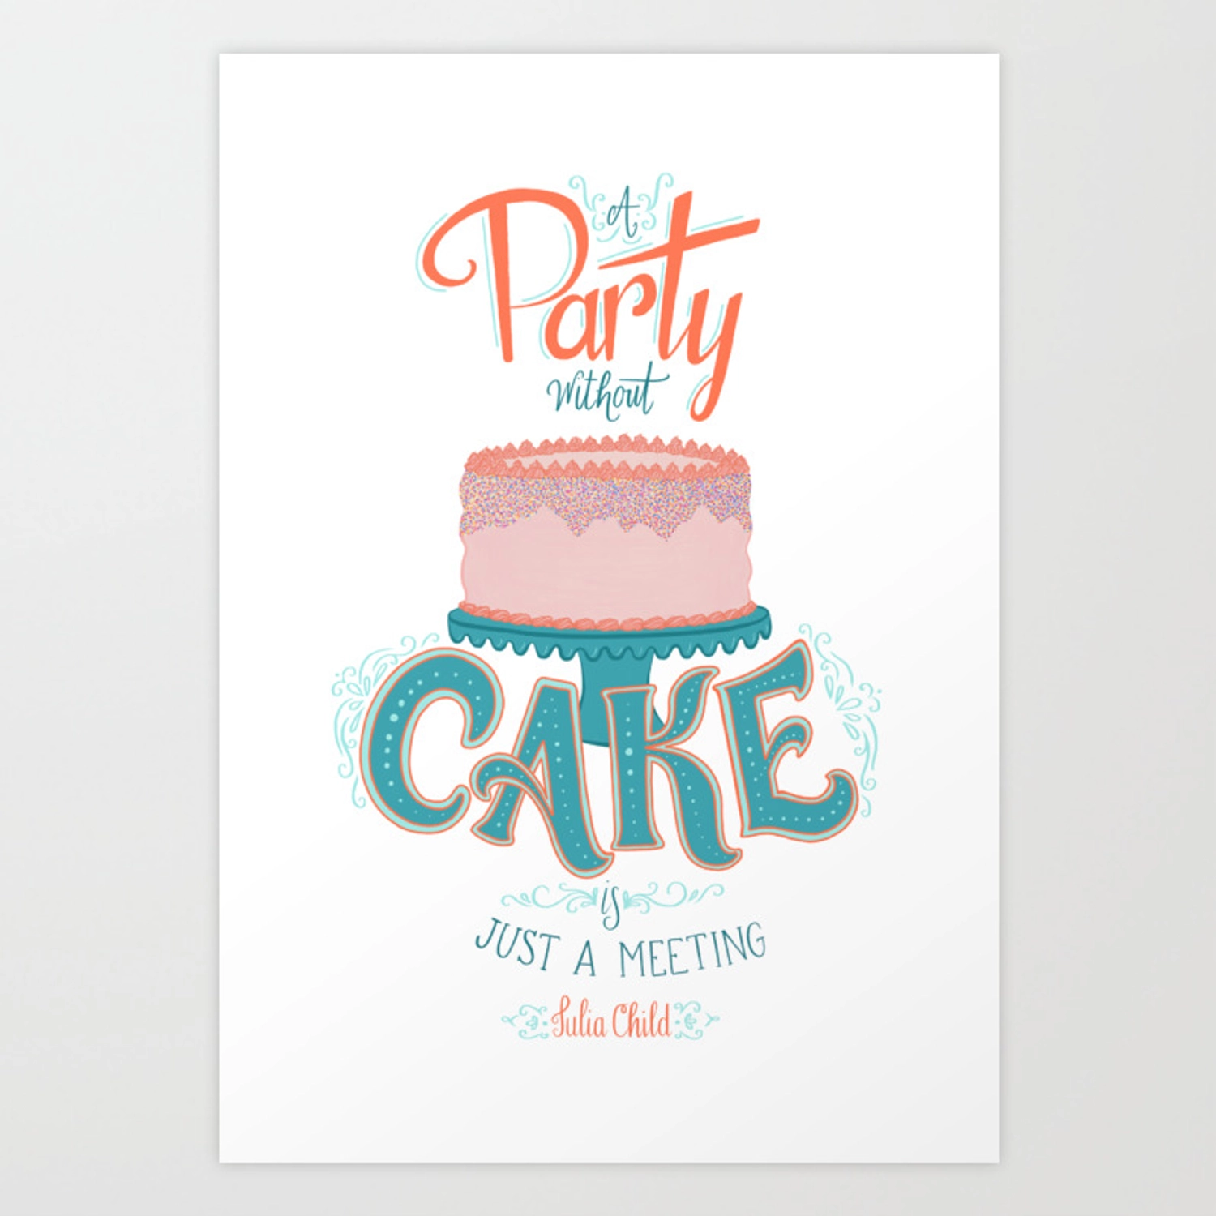

Slide 21
C.A.R.E. Benefits
Members feel appreciated
Issues are addressed and given direction for resolution
A stronger sense of team is fostered
Membership is retained with stronger members
Productivity is elevated
The community witnesses a harmonious happy group of individuals
Members set an example to the youth in their community
Notes:
If we address members’ concerns in a productive fashion, we should be able to retain more of our members. We will discover that we aren’t offering opportunities enough or that we bicker too much or what ever the concern may be. But by asking and addressing and resolving issues we can make our Club’s healthier and stronger.
We open our front door to welcome new members in with our N.O.W. program but without a C.A.R.E. program we’re just leaving the back door wide open to let them right back out.

Slide 22
C
Celebrate
A
Address
R
Recognize
E
Excel

