Slide 1
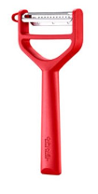
SHOW SPECIAL – January 2 – January 31, 2023
5% off $500-$999 orders and 10% off >$1000 orders
1 free T-Duo case pack (6pcs) for every Opinel order over $500.
Submit your $500.00 or more order prior to show or bring your order to
the show – that order will get Net 90 days!!!!!
Opinel price increase effective 2/1/2023 – Great time to stock up!!
Opening Order: $250 Free Freight over $500. Must order min. case pack where applies Minimum Reorder: $150 Minimum. Free Freight over $500. Must order min. case pack where applies Terms: Net 60 day dating for credit approved stores.
Purchase Orders Amandine Robinson Main: (773) 754-3275
Email: sales@opinel-usa.com

