Slide 1

MASTERCARD OPEN FINANCE — CASH FLOW AND PAYMENT RISK INSIGHTS FOR SMALL BUSINESS LENDING
Mastercard Open Finance covers 95% of U.S. deposit accounts. Two products built specifically for small-business credit decisioning, both refreshable on an ongoing basis to support origination and continuous loan monitoring.
Cash Flow Analytics
Payment Risk Insights
24 MONTHS
100,000+
of categorized small-business operating-account activity
small-business accounts powering the ML risk score
WHAT YOU SEE
PAYMENT RISK SCORE (1–100)
• Categorized transaction detail — Mastercard's small-business categorization
• Credit / debit transaction streams with net cash flow
• Annual revenue assessment from deposit activity
• Average and current account balances with trending
• NSF Summary — a key indicator of financial distress
• Identification of transactions to other lenders (existing debt)
• Account Owner verification (fraud reduction)
Probability of NSF, overdraft, or missed recurring payment in the next 3 months — based on the business's financial history
LOW 0–25
MEDIUM 26–50
MED-HIGH 51–75
HIGH 76–100
SUPPORTING ATTRIBUTES (per month, 24-month history)
• Average income, deposit volume + income-confidence
• Withdrawal volume; NSF counts and aggregate $
• Recurring loan, insurance, and tax payment amounts
Replaces the manual tax-return process: operating cash flow + estimated revenue + all loan payments running through the account = a current proxy DSC ratio that isn't 6–18 months lagged.
Both reports refresh on an ongoing basis — driving credit decisions at origination and continuous loan monitoring through the life of the loan.

Slide 2
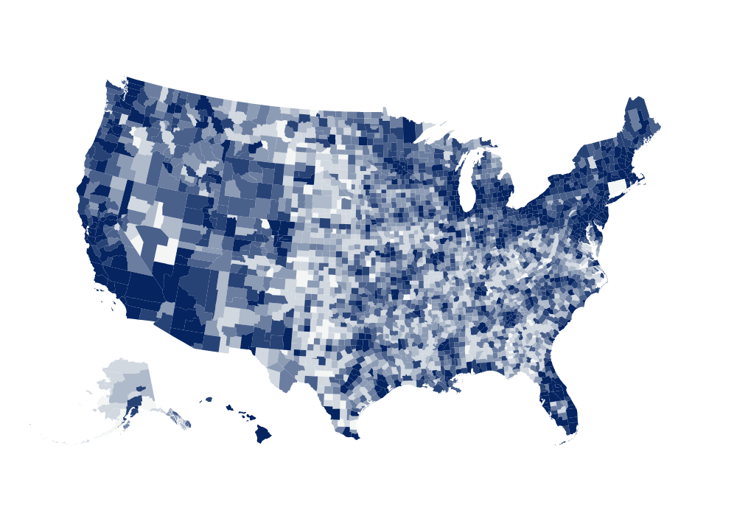
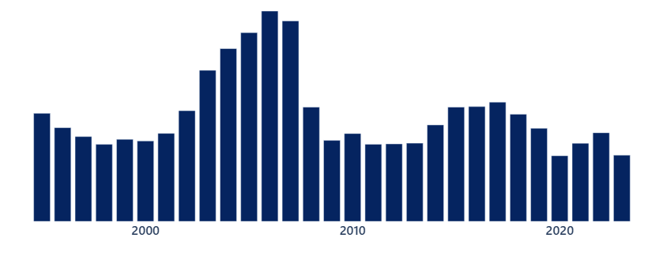
3 decades of small business lending data drives A better AI-powered Risk Forecast
Millions of loans covering >99% of Industries
30 years of data covering multiple economic cycles including the Dotcom Bust, Great Recession and Covid
Data from all 50 States and over 3,200 Counties
50% of all US Banks represented

Slide 3
Historical Under $500K 7(a) Losses for
Top 20 Industry Sectors
Rank | Industry | Annualized Default Rate | LGD | Annualized Loss Rate
1 | 722 Food Services and Drinking Places | 5.4% | 63% | 3.4%
2 | 541 Professional, Scientific, and Technical Services | 4.4% | 76% | 3.3%
3 | 621 Ambulatory Health Care Services | 2.5% | 66% | 1.7%
4 | 238 Specialty Trade Contractors | 4.8% | 74% | 3.6%
5 | 812 Personal and Laundry Services | 4.6% | 74% | 3.4%
6 | 811 Repair and Maintenance | 4.3% | 69% | 3.0%
7 | 445 Food and Beverage Retailers | 4.8% | 70% | 3.4%
8 | 561 Administrative and Support Services | 5.2% | 76% | 4.0%
9 | 423 Merchant Wholesalers, Durable Goods | 5.7% | 75% | 4.3%
10 | 459 Sporting Goods, Hobby, Musical Instrument, Book, and Miscellaneous Retailers | 5.8% | 71% | 4.2%
11 | 713 Amusement, Gambling, and Recreation Industries | 4.9% | 63% | 3.1%
12 | 484 Truck Transportation | 5.4% | 72% | 3.9%
13 | 236 Construction of Buildings | 6.2% | 79% | 4.9%
14 | 424 Merchant Wholesalers, Nondurable Goods | 6.4% | 77% | 4.9%
15 | 332 Fabricated Metal Product Manufacturing | 3.5% | 57% | 2.0%
16 | 624 Social Assistance | 3.8% | 66% | 2.5%
17 | 457 Gasoline Stations and Fuel Dealers | 4.1% | 62% | 2.6%
18 | 449 Furniture, Home Furnishings, Electronics, and Appliance Retailers | 6.9% | 75% | 5.2%
19 | 441 Motor Vehicle and Parts Dealers | 5.3% | 72% | 3.8%
20 | 458 Clothing, Clothing Accessories, Shoe, and Jewelry Retailers | 7.1% | 77% | 5.5%
3

