Slide 1


Slide 2
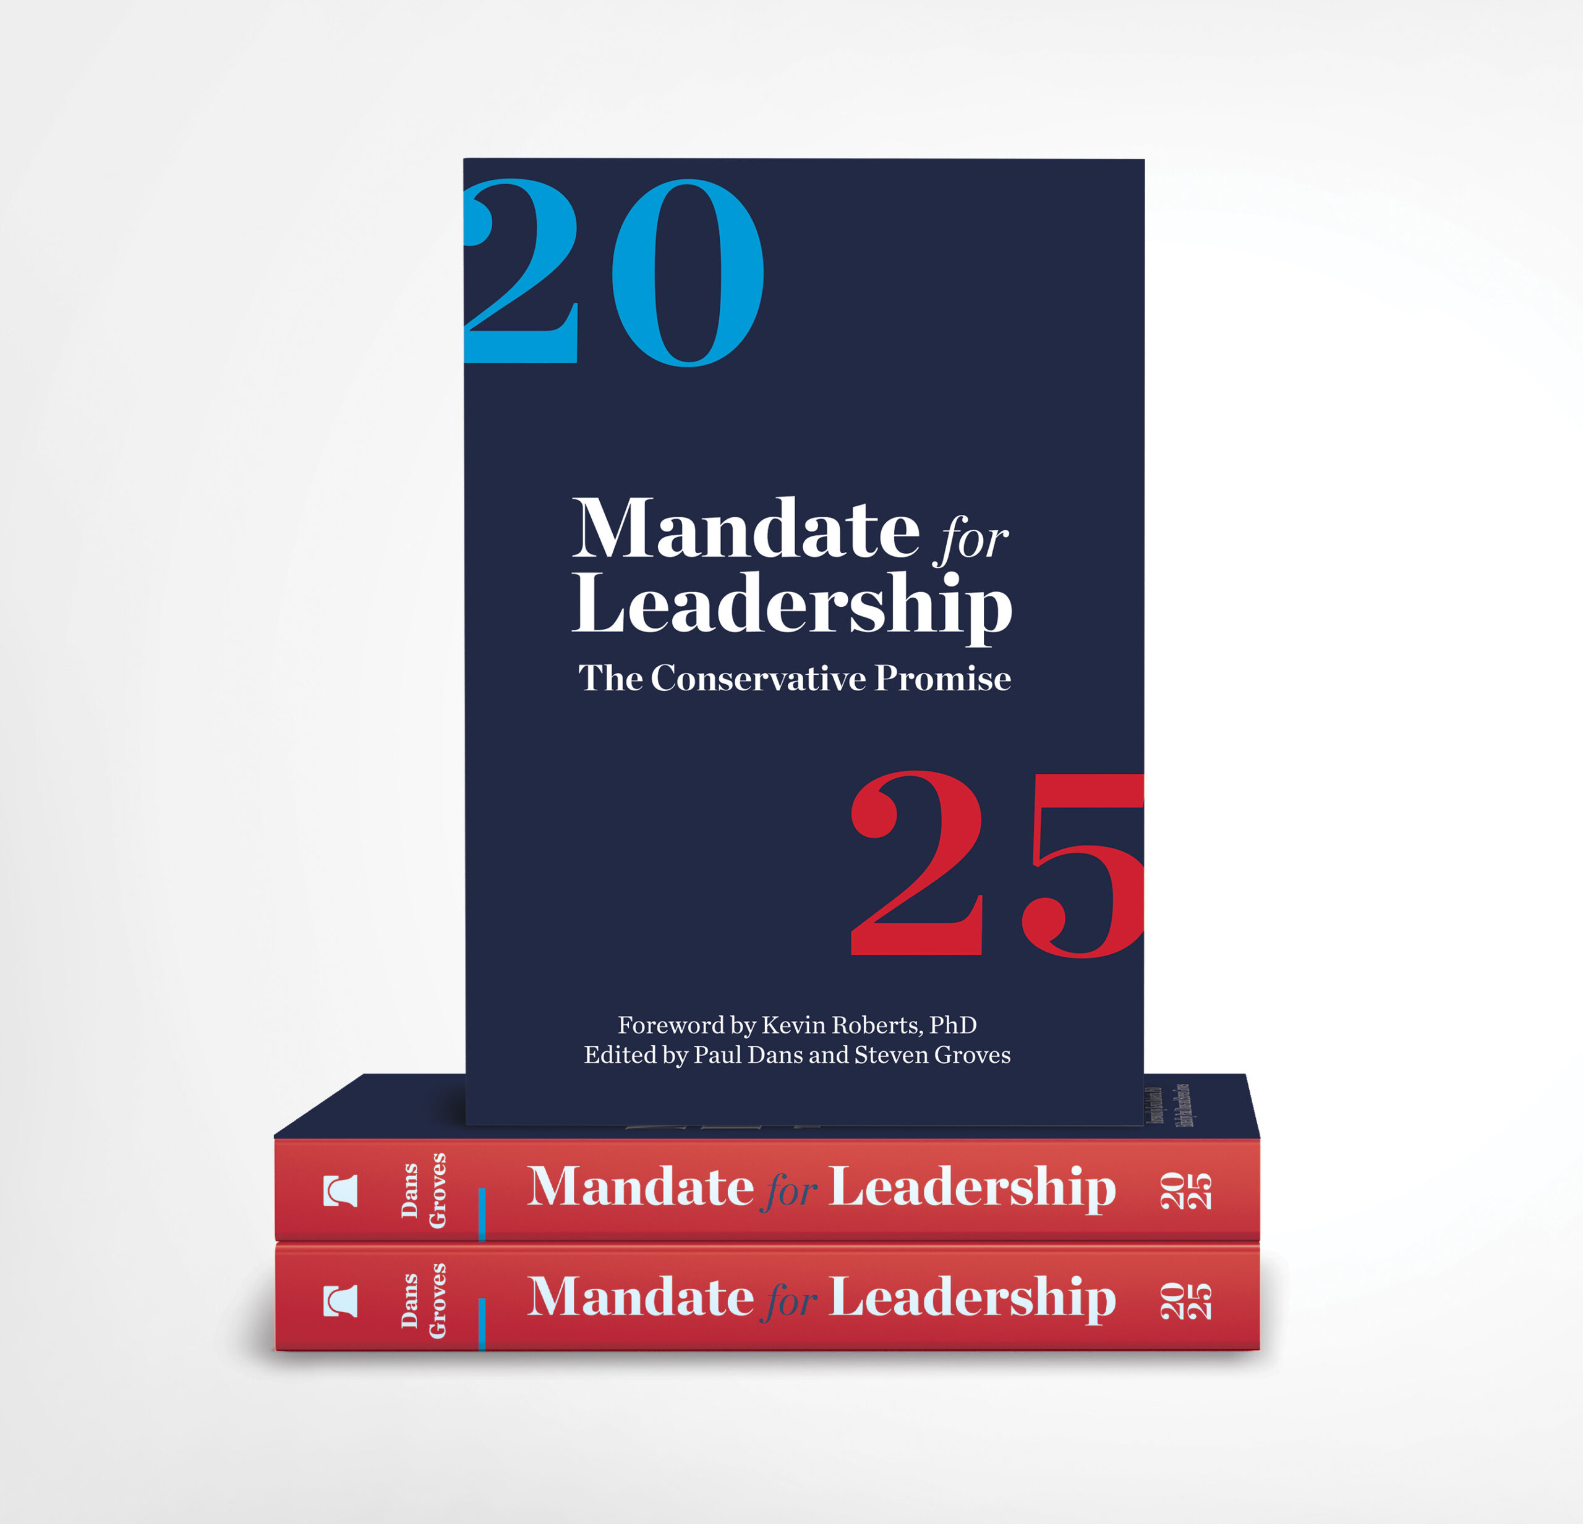
WHAT IS PROJECT 2025?
A compilation of radical policy proposals and presidential transition project launched by the Heritage Foundation.
These policies threaten basic freedoms, punish the most vulnerable, dismantle the structure of our federal government, and attack religious freedom and the separation of church and state.
Project 2025 stands in direct opposition to the United Church of Christ’s values and work.
Unfortunately, the Trump Administration and Congress is aligning with this document as they implement their 2025 policy agenda

Slide 3
PROJECT 2025
> 100
> $10,000,000
> 900
The number of organizations, led by The Heritage Foundation, who authored it.
The amount spent by The Heritage Foundation to create it.
The number of pages in the central policy playbook, “Mandate for Leadership”

Slide 4
ISSUES
IMMIGRATION & REFUGEE ISSUES
ENVIRONMENTAL JUSTICE
FOREIGN POLICY
EDUCATION
LGBTQ+ RIGHTS
ECONOMIC JUSTICE
HEALTHCARE
RACIAL JUSTICE
REPRODUCTIVE RIGHTS

Slide 5
IMMIGRATION & REFUGEE ISSUES
Project 2025 Directives | Trump Administration’s Actions | UCC Values and What We’re Doing
Deploy National Guard and active-duty personnel to border Curtail refugee admissions Raise the standard of “credible fear” for asylum Reinstate “Remain in Mexico” Authorize state and local law enforcement to enforce immigration law Removal of the sensitive locations guidance Mass deportation and detention of undocumented immigrants | Deployed the National Guard and the military to the border Ended the US Refugee Resettlement program Ended the processing of asylum applications for those at the border Reinstated “Remain in Mexico” Authorize state and law enforcement to enforce immigration law Removal of the sensitive locations guidance Mass deportation and detention of undocumented immigrants | Solidarity in the struggle for dignity and human rights for immigrants, asylum seekers and refugees regardless of their immigration status Call for humanitarian protection for migrants seeking safety and a pathway to citizenship Called to welcome and love immigrants as our neighbors. Email nandersen

Slide 6
ENVIRONMENTAL JUSTICE
Project 2025 Directives | Trump Administration’s Actions | UCC Values
Shred regulations to curb greenhouse gas pollution from cars, oil and gas wells, and power plants Dismantle almost every clean energy program in the federal government Disband NOAA, cutting off access to updated weather and climate data Expand offshore oil and national gas drilling on public lands and destroy the “endangerment finding” Withdraw from Paris Climate Agreement | Cut EPA staff by 65%, including thousands of National Park and Forest staffs, all inter-agency work on reducing emissions ceased Lee Zeldin prioritizing ending the “endangerment finding” Paused the disbursement of funds for clean energy programs, and ended EV subsidy Interior Secretary’s orders make public lands ground zero for drilling & mining Withdraw from Paris Climate Agreement Staff cuts and dismantling of NOAA | Prioritize addressing the climate crisis Focus on becoming carbon neutral by 2040 Prioritize environmental justice initiatives to help marginalized groups

Slide 7
FOREIGN POLICY
Project 2025 Directives | Trump Administration’s Actions | UCC Values
Refocus the State Department’s mission to ensure the interests of Americans are given priority Address countries’ failure to accept deportees by imposing sanctions Criticized World Health Organization Withdraw from global organizations that “undermine U.S. interests” Dismantle USAID | Directed Secretary of State to put the agency’s operations in line with an America first foreign policy Trade standoff with Colombia over whether it would accept deported migrants Took the US out of the World Health Organization Removed the US from UNHRC, ended support for UNRWA, and review the U.S.’s involvement in UNESCO Cut budget and staff at USAID | As a Just Peace Church, the United Church of Christ is committed to working towards peace with justice at home and around the world. We believe that God calls us to love our neighbor by hearing and responding to the needs of others (providing food, shelter, water, etc.) and caring for all of God’s creation. We believe that only by communicating and working together can we bring about God’s kin-dom on Earth.

Slide 8
EDUCATION
Project 2025 Directives | Trump Administration and Congress’s Actions | UCC Values
Eliminate the Head Start program Defund the federal school meal program Defund the individuals with disabilities in education act Phase out Title I funding for low-income school districts. Abolish sex education and “critical race theory” in schools. Redistribute federal funding to private schools | Freezing federal funding has triggered Head Start program closures Congress is currently considering a reconciliation bill where the federal school meal program is on the chopping block Expand school choice (i.e. public funding for private schools). Abolished critical race theory in schools | As a people called to love our neighbors as ourselves, we are called to protect and improve public schooling as a matter of justice. The UCC also believes that public schooling should include comprehensive sexual education, reflected in its commitment to the implementation of the Our Whole Lives curriculum.

Slide 9
LGBTQ+ RIGHTS
Project 2025 Directives | Trump Administration’s Actions | UCC Values
Defunds trans healthcare and creates huge barriers to transgender youth in transition Proposes lenience towards business owners and hospitals seeking to refuse service to LGBTQ+ families. End data collection on gender identity and interagency work on gender and sexuality Issue guidance that defines “gender/sex” as a fixed biological fact | Prohibits the provision of gender-affirming care to trans youth by federal facilities Prohibits trans people to be members of the military Ends federal discrimination protections for trans people Prohibits the creation of government identification documents that indicate a gender other than what is assigned at birth Ends CDC’s data collection on gender identity and all agency work on gender and sexual identity Issues guidance that defines “gender/sex” as a fixed fact | Support and advocacy for LGBTQ+ rights Supported human rights related to sexual orientation and gender identity in 1979 Affirmed the human dignity of transgender and non-binary persons in 2023 Attempts to oppress any person violates the UCC's commitment toward a just world for all.

Slide 10
ECONOMIC JUSTICE
Project 2025 Directives | Trump Administration and Congress’s Actions | UCC Values
Ban all public employee unions and allow employers to terminate its union agreements mid contract Allow states to disregard the national minimum wage Creates a 15% and 30% tax rate, placing the financial burden on middle income earners. Cuts to taxes on the wealthy’s investment income. Cut the corporate tax rate to 18 percent. | Made it more difficult for unions to gain official recognition Allows employees to be required to sit through anti-union rallies during the workday Congress’s tax plan is moving forward, which would include cuts to taxes on the wealthy’s investment income as well as other priorities | Pursue a just economy – through progressive taxation, guaranteed health care, labor protections and solidarity, affordable housing, and the establishment of reparations Collective thriving comes with ensuring all are robustly paid and protected at work and given ample rest from labor. We must equitably steward our money and share resources in service of meeting human need and rights.

Slide 11
HEALTHCARE
Project 2025 Directives | Trump Administration and Congress’s Actions | UCC Values
Imposes work requirements to be eligible for Medicaid and suggests time limits on how long people can be on Medicaid Increases drug prices for Medicare Part D and rescinds the ability for Medicare to negotiate drug prices Proposes addressing the opioid overdose crisis through increased sentencing and closing the U.S. border. | Passed a House Budget Resolution this week that proposes $880 billion of cuts to the Medicaid program Rescission of a Biden administration initiative that had directed the health secretary to explore ways of lowering pharmaceutical costs within Medicare. | The United Church of Christ has advocated for health care as a human right and priority for all people for more than 40 years All should have access to affordable, safe, and high-quality healthcare. We must heal—not criminalize—the sick, including those struggling with substance abuse.

Slide 12
RACIAL JUSTICE
Project 2025 Directives | Trump Administration’s Actions | UCC Values
Abolish DEI programs and initiatives across the federal government Dismantle symbols of “identity politics” Prosecute schools, institutions and private companies that continue implementing DEI initiatives | Abolish DEI programs and initiatives across the federal government Prohibit the flying of “Black Lives Matter” or rainbow flags at US embassies Directed the DOJ to use its full prosecutorial powers to prosecute schools, institutions and private companies that continue implementing DEI initiatives | In 2003, the UCC adopted a resolution to be an Anti-Racist Church. Committed to “examine both historic and contemporary forms of racism and its effects.” The UCC voted to mandate DEI training for authorized ministers

Slide 13
REPRODUCTIVE RIGHTS
Project 2025 Directives | Trump Administration’s Actions | UCC Values
Defund Planned Parenthood Criminalize traveling for abortions and abortions by mail Puts at risk insurance coverage of contraception. | Stopped all agency efforts to protect patient and provider privacy and security Rescinded the right for military servicemembers to use leave to travel for abortion care (not provided by the military health system) Prohibits international NGOs that receive U.S. government funding from using their own money to provide information, referrals, or services for legal abortion | Since 1971, the United Church of Christ has supported the right of each person to follow their personal religious and moral convictions regarding the completion or termination of a pregnancy In 2023, the UCC proclaimed abortion as healthcare, forced birth an act of violence, and called for systemic measures to increase access to the full spectrum of reproductive healthcare

Slide 14
FIGHTING PROJECT 2025
Empowering Congress to lead in holding this Administration accountable and to fight Project 2025 legislation
  Action Alerts
  Call campaigns
  Meetings with Members of Congress
  Letters and Vote Recommendations
Direct Action
  Witness Wednesdays

Slide 15
WAYS TO BE INVOLVED
Join the Justice and Peace Action Network (JPANet)
Take Action in our Action Center
Commit to acts of witness and resistance!
If your church wants to join in organizing and advocacy efforts on the issues we’ve mentioned above, check out our newsletter archive for opportunities to get involved!
Follow our work and how you can get involved at ucc.org/First100Days
Stay up to date by following us on Facebook and Instagram @JusticeAndWitnessMinistries and Twitter @justice_ucc

