Slide 1


Harrisburg BIC
Finance Update
July 2025

Slide 3
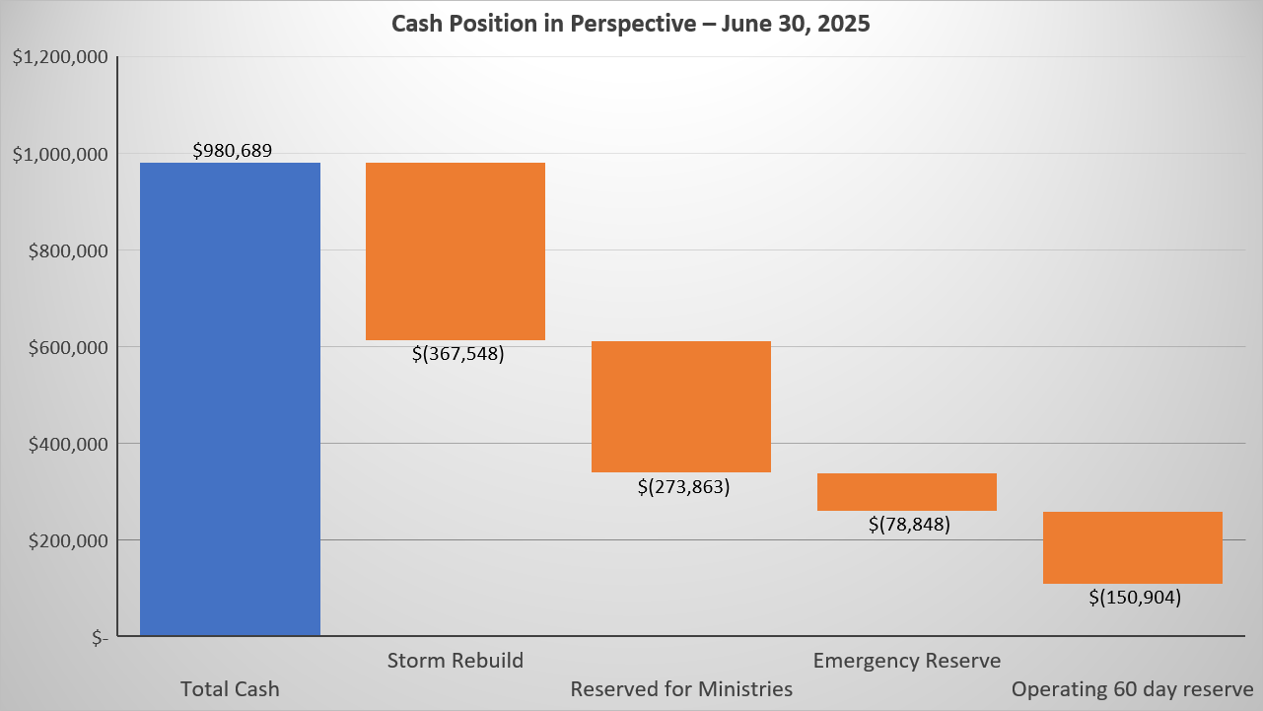
$109,525 Available for Improvements

