Slide 1
MEDICARE / HEALTHCARE CHANGES IN 2020 AND 2021 AFFECTING ONCOLOGY
MOASC
Via
Webinar
January 22, 2020

Slide 2
HEALTHCARE IS CHANGING
Newer treatments more complicated
More methods, drugs, devices, diagnoses
Physicians need new non-medical training
  Understand EMR and related documentation
  Understand insurance contracts
  Be cognizant of HIPAA, PII, other legal rules
  Work cooperatively with hospitals, non physician practitioners and other healthcare workers
Office practice more complicated
  Record keeping, chart keeping & documentation
  Employment / employee matters, HR matters
  Changes in healthcare laws and regulations

Slide 3
DOCUMENTING REASONABLE & NECESSARY: NOT CHANGING
Only the actual physician who is treating the patient knows what is reasonable and necessary for that patient being evaluated and treated.
The only way a Noridian reviewer can determine if something is (was) reasonable and necessary on a claim is to review the complete documentation submitted

Slide 4

LOOKING AT EMR CLAIMS
EMR Must be up to date for each visit—not cloned
Be Reasonable and Necessary for each visit and each service now and in the future
Review of systems: must be coherent & Decision Making Most Important
  Helpful if explained / listed / or documented in chart
  Important to list changes in care or diagnoses since last visit
  Lab review helps decision making
  Excess verbiage on some EMR still does not give extra value, nor unnecessary E&M points. Services must be reasonable and necessary
EMRs take time to learn---by doctor or scribe, and some doctors are uncomfortable with electronic records and the time it takes to fill them out
Get me outta here

Slide 5
MED LIST 86 YEAR OLD PATIENT
1. Accu-Chek Aviva Plus In Vitro Strip; check sugar ac TID and HS
2. Accu-Chek Aviva Plus w/Device Kit; USE AS DIRECTED
3. Accu-Chek Aviva STRP; USE 1 STRIP DAILY
4. Accu-Chek FastClix Lancets; TAKE 1 TABLET BY MOUTH ONCE DAILY
5. Accu-Chek Multiclix Lancets; use once daily
6. Acetaminophen ER 650 MG Oral Tablet Extended Release; TAKE 1 TABLET 4 TIMES
DAILY AS NEEDED
7. Acetaminophen-Codeine #3 300-30 MG Oral Tablet; TAKE 1 TABLET 3 TIMES DAILY AS
NEEDED FOR PAIN
8. Advair Diskus 100-50 MCG/DOSE Inhalation Aerosol Powder Breath Activated; INHALE 1
PUFFS EVERY 12 HOURS
9. Albuterol Sulfate 0.63 MG/3ML Inhalation Nebulization Solution; INHALE 1 UNIT DOSE 4
TIMES DAILY PRN
10. Aspirin 81 MG TABS; TAKE 1 TABLET DAILY
11. Atenolol 25 MG Oral Tablet; Take 1 tablet by mouth twice a day
12. Benzonatate 100 MG Oral Capsule; TAKE 1 CAPSULE 3 TIMES DAILY AS NEEDED
13. Calcium TABS; TAKE 1 TABLET DAILY AS DIRECTED
14. Centrum Silver Oral Tablet
15. Clobetasol Propionate 0.05 % External Ointment; Apply to AA (hands and fingers) BID x 2
wks prn
16. Diclofenac Sodium 1 % Transdermal Gel; apply 4 grams to LOWER EXTREMITIES four
times a day . DO NOT APPLY MORE THAN 16 GRAMS TO ANY ONE AFFECTED
JOINT
17. Estradiol 0.1 MG/GM Vaginal Cream; INSERT 1 APPLICATORFUL INTRAVAGINALLY AT
BEDTIME NIGHTLY
18. Fluconazole 150 MG Oral Tablet; TAKE 1 TABLET 1 TIME ONLY
19. Fluocinonide 0.05 % External Cream; APPLY 2 TIMES A DAY ON RASH HANDS,
ELBOWS, AND KNEES NOT TO FACE
20. Fluocinonide 0.05 % External Ointment; APPLY TO AFFECTED AREAS ( EXTREMITIES )
BID X 2 WKS, PRN
21. Fluticasone Propionate 50 MCG/ACT Nasal Suspension; USE 2 SPRAYS IN EACH
NOSTRIL ONCE DAILY
22. Glucosamine Chondroitin Complx Oral Capsule; TAKE 1 TABLET DAILY
23. hydroCHLOROthiazide 50 MG Oral Tablet; TAKE 1 TABLET BY MOUTH ONCE DAILY
24. Januvia 25 MG Oral Tablet; TAKE 1 TABLET BY MOUTH ONCE DAILY
25. Levalbuterol HCl - 0.63 MG/3ML Inhalation Nebulization Solution; USE 1 UNIT DOSE
EVERY 4-6 HOURS AS NEEDED FOR WHEEZING
26. Mometasone Furoate 0.1 % External Ointment; APPLY SPARINGLY TO AFFECTED AREA
Wait!!! There is more

Slide 6
MED LIST 86 YEAR OLD PATIENT
27. Mupirocin 2 % External Ointment; APPLY THIN FILM TO AFFECTED AREA 3 TIMES DAILY
28. Naproxen 375 MG Oral Tablet; Take 1 tablet by mouth twice a day
29. Ocean Nasal Spray 0.65 % Nasal Solution; USE 2 SPRAYS IN EACH NOSTRIL TWICE DAILY
30. Pennsaid 2 % Transdermal Solution; apply 2x day
31. Potassium Chloride Crys ER 20 MEQ Oral Tablet Extended Release; TAKE 1 TABLET BY MOUTH ONCE DAILY
32. ProAir HFA 108 (90 Base) MCG/ACT Inhalation Aerosol Solution; INHALE 2 PUFFS EVERY 4 HOURS AS NEEDED
33. Vitamin D (Ergocalciferol) 50000 UNIT Oral Capsule; take 1 capsule weekly
34. Voltaren 1 % Transdermal Gel; apply 1 inch to affected joint twice daily
Only 34 meds for this 86 year old patient listed, but let us look more closely and the medicine supply…

Slide 7
MED LIST 86 YEAR OLD PATIENT
1. Accu-Chek Aviva Plus In Vitro Strip; check sugar ac TID and HS
2. Accu-Chek Aviva Plus w/Device Kit; USE AS DIRECTED
3. Accu-Chek Aviva STRP; USE 1 STRIP DAILY
4. Accu-Chek FastClix Lancets; TAKE 1 TABLET BY MOUTH ONCE DAILY…OOPS!!
5. Accu-Chek Multiclix Lancets; use once daily…….
8. Advair Diskus 100-50 MCG/DOSE Inhalation Aerosol Powder Breath Activated; INHALE 1 PUFFS EVERY 12 HOURS
9. Albuterol Sulfate 0.63 MG/3ML Inhalation Nebulization Solution; INHALE 1 UNIT DOSE 4 TIMES DAILY PRN
32. ProAir HFA 108 (90 Base) MCG/ACT Inhalation Aerosol Solution; INHALE 2 PUFFS EVERY 4 HOURS AS NEEDED

Slide 8
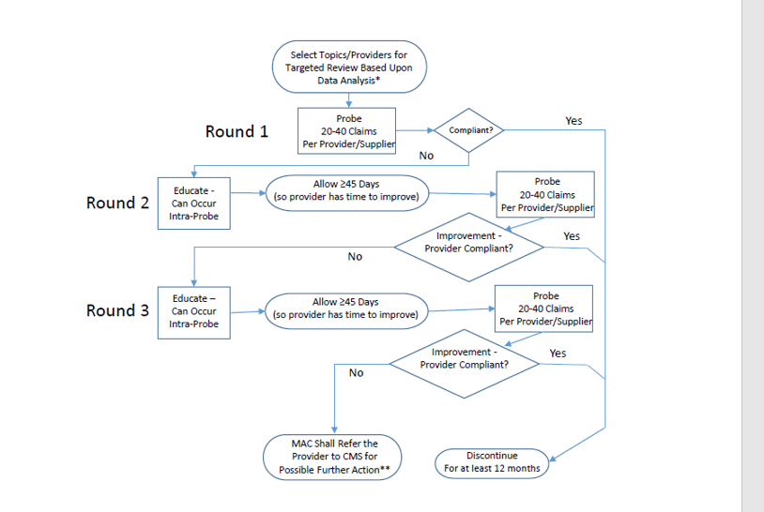
TARGETED PROBE
AND EDUCATION (TPE)

Slide 9
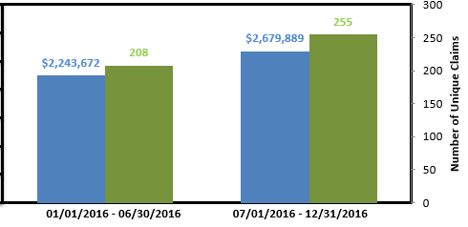
Your facility was selected for review based on data analysis. A trending graph is provided below comparing your facility’s six month billing data to previous six month billing data for XXXXX It indicates an increased utilization of this code as compared to your previous utilization data.
Reason for review of Part B Claims:
You have been identified in the top 10% of dollars paid for code XXXXX when compared with peers billing the same code. A prepayment review has been initiated to probe a sample of your claims billed with the following CPT codes: XXXXX

Slide 10
SUMMARY OF TPE
Hospital or physician selected on basis of data collected by Noridian
Prepay charts requested for up to 3 rounds
  Requested charts must be returned to Noridian within 45 days
  Results sent to you after review
  If no improvement in 3 rounds, action may be taken---including extrapolation and referral to Recovery Auditor Contractor
Education offered after each round
  Summary of data reviewed with reasons for any denials
  One on one review, including possible Webinar
  Other presentations on topics when they occur

Slide 11
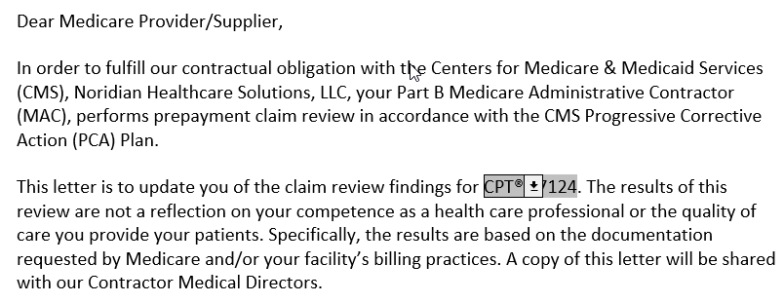
TARGETED PROBE AND EDUCATE SUMMARY LETTER

Slide 12
RECENT PART B CLINICAL REVIEWS AFFECTING ONCOLOGY
High Level E&M (99214-99215; 99223-99233)
Intensive Care Codes (99291-99292)
IMRT, SBRT, CXR,
Selected Laboratory Tests, CBC, TSH, Biomarkers
Denosumab (Prolia, Xgeva) and Rituximab (Rituxin)
Other Selected Biologic Drugs (Keytruda, Remicade, etc)
Off Label Drug Uses (esp chemotherapy and biologics)
Prolonged E&M or Psychology (99354) Codes
CT of head and brain (70540), CT Abd & Pelvis, PET scans
11042 - Debridement, Subcutaneous Tissue (1st 20 cm)
80053 Comprehensive Metabolic Panel frequency
82306 Vitamin D; 25 hydroxy, including fraction(s), if performed
Molecular Diagnostic / Genetic, Genomic Testing
Some are office reviews, others are for physician inpatient services or lab services…..

Slide 13
FIGHTING BACK: RESPONDING TO ANY REQUEST FOR RECORDS
Have a set office process for dealing with all ADRs (Additional Record Requests)
Have one individual responsible for sending all records as part of the set office process
  Experienced office person, or clinical person, or both
Have a check off sheet that involves
  Legibility (can add typed / printed addendum)
  Correct name, date, physician listed in request
  Signature (signature sheet or attestation if needed)
  Correct address to send records
  Timeliness of records being sent
Know how and where to get hospital records
Send by certified mail (or equivalent)

Slide 14

APPEALS PROCESS
Initial Determination from Noridian ($1)
Redetermination from Noridian ($1)-120 days/file
Qualified Independent Contractor (QIC) ($1)-180 days/file
Administrative Law Judge (ALJ) ($170)-60 days/file
Department Appeals Board (DAB) ($170)-60 days/file
Federal Court ($1760)-60 days/file

Slide 15
USING MEDICATIONS OFF LABEL
If FDA approves a drug, Medicare almost always approves its labeled indications
If a drug is approved for any indication, physicians can legally use it for any other indication but
  Medicare may not reimburse for using that drug
  Many drugs used for cancer are very expensive and have significant side effects and risks
  Off label includes doses or frequencies above or below FDA approval
Medicare only approves services that are reasonable and necessary
  Thus any off-label use of medications must have significant support in peer reviewed literature
  Must also evidence from specialty societies and or technical guidelines, i.e., evidence based medicine

Slide 16
SIX SETS OF LEVELS OF EVIDENCE COMMONLY USED
United States Preventive Services Task Force (USPSTF)
Grading of Recommendations, Assessment, Development and Evaluations (GRADE) Working Group
National Comprehensive Cancer Network (NCCN) Categories of Evidence and Consensus (Level 2A and Above)
NEATS, from National Academy of Sciences for clinical guidelines
ECRI Trust (https://guidelines.ecri.org)
Cochrane Database Reviews

Slide 17
PATIENT RELATIONSHIP CATEGORIES FOR MACRA / MIPS
CMS will be considering the utility of patient relationship categories and codes to improve the attribution of resources to clinicians in developing measures of cost, as required by the Medicare Access and CHIP Reauthorization Act (MACRA) Pub. L. No. 114-10
Section 101(f) of MACRA requires that we post the operational list of patient relationship categories and codes by April 2017 and that the codes be included by clinicians on all Medicare claims, as determined appropriate by the Secretary, beginning ………… (soon)

Slide 18
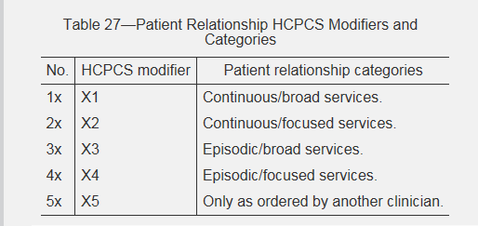
FEDERAL REGISTER 11/15/2017 Page 53233

Slide 19
CMS Patient Relationship Categories and Codes
1. Continuous/broad: This category could include clinicians who provide principal care for a patient, where there is no planned endpoint of the relationship. Care in this category is comprehensive, dealing with the entire scope of patient problems, either directly or in a care coordination role. (X1)
  Examples include: Primary care, specialists providing comprehensive care to patients in addition to specialty care, etc.
2. Continuous/focused: This category could include a specialist whose expertise is needed for the ongoing management of a chronic disease or a condition that needs to be managed and followed for a long time. (X2)
  Examples include: A rheumatologist taking care of a patient’s rheumatoid arthritis longitudinally but not providing general primary care services.
3. Episodic/broad: This category could include clinicians that have broad responsibility for the comprehensive needs of the patients, but only during a defined period and circumstance, such as a hospitalization. (X3)
  Examples include: A hospitalist providing comprehensive and general care to a patient while admitted to the hospital.

Slide 20
CMS Patient Relationship Categories and Codes
4. Episodic/focused: This category could include a specialist focused on particular types of time-limited treatment. The patient has a problem, acute or chronic, that will be treated with surgery, radiation, or some other type of generally time-limited intervention. (X4)
  Examples include, but are not limited to: An orthopedic surgeon performing a knee replacement and seeing the patient through the postoperative period.
5. Only as ordered by another clinician: This category could include a clinician who furnishes care to the patient only as ordered by another clinician. This relationship may not be adequately captured by the alternative categories suggested above and may need to be a separate option for clinicians who are only providing care ordered by other clinicians. (X5)
  Examples include, but are not limited to: A radiologist interpreting an imaging study ordered by another clinician.

Slide 21
VOLUNTARY REPORTING PERIOD
As of January 1, 2018, Medicare Part B Merit-based Incentive Payment System (MIPS)-eligible clinicians may report patient relationships on Medicare claims using the PRC codes. While this will be mandatory in the future, reporting of the PRC codes is voluntary during this initial period of implementation.
CMS advises clinicians to participate in this voluntary reporting period to gain familiarity with the categories and experience submitting codes. CMS will review data on the use and submission of the codes to consider their potential future in cost measure attribution methodology in the Quality Payment Program.
Reporting of these modifiers will be mandatory in the near future and CMS advises clinicians to participate during the voluntary reporting period to ease transition. Uncertain when they will be required

Slide 22
NATIONAL / LOCAL COVERAGE DETERMINATIONS ARE CHANGING
NCDs Created by CMS or under CMS control
  Usually have open/transparent process
  Presented at MEDCAC open meetings at CMS that anyone can attend and comment
  Written notice and comment always allowed
  Must be followed by administrative law judges
In future, MACs may initiate codes and edits---to speed up NCD effectuation and use
  CMS will ultimately review and confirm
  Reconsiderations always possible
  Process subject to change as science changes

Slide 23
NCDs AFFECTING ONCOLOGY
Alpha-fetoprotein
Anti-Cancer Chemotherapy for Colorectal Cancer
Bone (Mineral) Density Studies
Breast Reconstruction Following Mastectomy
Carcinoembryonic Antigen
Colorectal Cancer Screening Tests
FDG PET for All Other Cancer Indications Not Previously Specified (Replaced with Section 220.6.17)
FDG PET for Brain, Cervical, Ovarian, Pancreatic, Small Cell Lung, and Testicular Cancers (Replaced with Section 220.6.17)
FDG PET for Breast Cancer (Replaced with Section 220.6.17)
FDG PET for Colorectal Cancer (Replaced with Section 220.6.17)
FDG PET for Esophageal Cancer (Replaced with Section 220.6.17)
Prostate Cancer Screening Tests
Prostate Specific Antigen

Slide 24
NCDs AFFECTING ONCOLOGY
FDG PET for Head and Neck Cancers (Replaced with Section 220.6.17)
FDG PET for Lung Cancer (Replaced with Section 220.6.17)
FDG PET for Lymphoma (Replaced with Section 220.6.17)
FDG PET for Melanoma (Replaced with Section 220.6.17)
FDG PET for Soft Tissue Sarcoma (Replaced with Section 220.6.17)
FDG PET for Thyroid Cancer (Replaced with Section 220.6.17)
Granulocyte Transfusions
Human Tumor Stem Cell Drug Sensitivity Assays
Hyperthermia for Treatment of Cancer
Magnetic Resonance Imaging
Percutaneous Image-Guided Breast Biopsy
Positron Emission Tomography (FDG) for Oncologic Conditions
Positron Emission Tomography (NaF-18) to Identify Bone Metastasis of Cancer
Positron Emission Tomography (PET) Scans

Slide 25
NCD AFFECTING ONCOLOGY
Prostate Cancer Screening Tests
Prostate Specific Antigen
Stem Cell Transplantation (Formerly 110.8.1)
Therapeutic Embolization
Tumor Antigen by Immunoassay - CA 125
Tumor Antigen by Immunoassay - CA 15-3/CA 27.29
Tumor Antigen by Immunoassay - CA 19-9

Slide 26
LOCAL COVERAGE DETERMINATIONS
Local Coverage Determination (LCD) More Transparent
  Rationale must be given for any new coverage changes
  Literature explained in policy---increased number journals
  Sent to CMS 21 days prior to publication---medical input accepted
Contractor Advisory Committee: will be changing
  CACs will be for evidentiary discussion with topic experts
  Open meetings after evidentiary CACs & with all changes
  May have combination of live meetings and / or webinars
  Must be open to public and industry for more transparency
  National or Local Coverage Determinations explained in detail on Noridian website and CMS website—we tell you how to code
Changes will still be possible for LCDs
  Individual Considerations for patients with specific situations
  Reconsiderations of local policy possible with submission of appropriate peer reviewed literature or society white papers
  We value your opinions, but when asking for changes, SHOW US THE DATA…in God we trust, everyone else needs data

Slide 27
LCDs AFFECTING ONCOLOGY
Chest X-Ray Policy
Intensity Modulated Radiation Therapy (IMRT)
In Vitro Chemosensitivity & Chemoresistance Assays
Lab: Bladder/Urothelial Tumor Markers
Lab: Flow Cytometry
Lab: Special Histochemical Stains and Immunohistochemical Stains
Stereotactic Body Radiation Therapy
Stereotactic Radiosurgery

Slide 28
MOLECULAR DIAGNOSTIC LCDs AFFECTING ONCOLOGY
MolDX: 4K Score Assay
MolDx: AlloSure® Donor-Derived Cell-Free DNA Test MolDX: Decipher® Prostate Cancer Classifier Assay
MolDX: Genomic Health™ Oncotype DX® Prostate Cancer Assay
MolDX: Oncotype DX AR-V7 Nucleus Detect for Men with Metastatic Castrate Resistant Prostate Cancer (MCRPC)
MolDX: Oncotype DX® Genomic Prostate Score for Men with Favorable Intermediate Risk Prostate Cancer
MolDX: Prolaris™ Prostate Cancer Genomic Assay
MolDX: Prolaris™ Prostate Cancer Genomic Assay for Men with Favorable Intermediate Risk Disease

Slide 29
MOLECULAR DIAGNOSTIC LCDs AFFECTING ONCOLOGY
MolDX: APC and MUTYH Gene Testing
MolDX: BRCA1 and BRCA2 Genetic Testing
MolDX: Breast Cancer Assay: Prosigna
MolDX: Breast Cancer IndexTM (BCI) Gene Expression Test
MolDX: Circulating Tumor Cell Marker Assays
MolDX: ConfirmMDx Epigenetic Molecular Assay
MolDX: CYP2C19, CYP2D6, CYP2C9, and VKORC1 Genetic Testing
MolDX: Decision Dx-UM (Uveal Melanoma)
MolDX: DecisionDx-Melanoma
MolDX: EndoPredict® Breast Cancer Gene Expression Test
MolDX: Genetic Testing for BCR-ABL Negative Myeloproliferative Disease
MolDX: Genetic Testing for Lynch Syndrome
MolDX: Guardant360® Plasma-Based Comprehensive Genomic Profiling in Non-Small Cell Lung Cancer (NSCLC)

Slide 30
MOLECULAR DIAGNOSTIC LCDs AFFECTING ONCOLOGY
MolDX: Inivata, InVisionFirst, Liquid Biopsy for Patients with Lung Cancer
MolDX: MDS FISH
MolDX: MGMT Promoter Methylation Analysis
MolDX: myPath Melanoma Assay
MolDX: Oncotype DX® Breast Cancer for (DCIS) Genomic Health™
MolDX: ProMark Risk Score
26 Molecular diagnostic tests so far and more to come…see out website

Slide 31
PATIENTS OVER PAPERWORK
Reduce administrative burden to improve customer experience
  https://www.cms.gov/About-CMS/story-page/patients-over-paperwork.html
CMS efforts started 2018 and continues to 2021
  Proposed rule to lift unnecessary regulations, ease burden on providers, lessen documentation rules
  Requests information process, including progress addressing comments---soliciting comments
  Engaging customers through customer centered workgroups
  Proposed and final rules to save money/reduce burden hours for physicians
  Documentation simplification efforts
  Other initiatives, Meaningful Measures initiative and MyHealthEdata
Efforts continuing now in 2020-21 and beyond

Slide 32
EVALUATION AND MANAGEMENT: 2020 AND BEYOND
For CY 2019 and CY 2020, CMS will continue the current coding and payment structure for E/M office/outpatient visits and practitioners should continue to use either the 1995 or 1997 E/M documentation guidelines to document E/M office and/or outpatient visits billed to Medicare.
For CYs 2019 and 2020, we are implementing several documentation policies to provide immediate burden reduction, while other changes to documentation, coding, and payment would be implemented in CY 2021.

Slide 33
OTHER FINALIZED POLICIES
Additionally, for E/M office/outpatient visits, for new and established patients for visits, practitioners need not re-enter in the medical record information on the patient’s chief complaint and history that has already been entered by ancillary staff or beneficiary.
The practitioner may simply indicate in the medical record that he or she reviewed and verified this information; and
Removal of potentially duplicative requirements for notations in medical records that may have previously been included in the medical records by residents or other members of the medical team for E/M visits furnished by teaching physicians.

Slide 34
AMA ANNOUNCES CPT CHANGES TO OFFICE VISITS
On February 9, 2019, the AMA-convened CPT Editorial Panel approved revisions to the CPT E/M office or other outpatient visit reporting guidelines and code descriptors.
These revisions were to take on the challenge of revising the Evaluation and Management office visit reporting guidelines.
The scope of the AMA proposal is solely focused on revisions to the E/M office or other outpatient visits (CPT codes 99201-99215). The code set revisions will be effective January 1, 2021
CMS has accepted the AMA changes

Slide 35
PRIMARY OBJECTIVE OF AMA CPT CHANGES
To decrease administrative burden of documentation and coding
To decrease the need for audits, through the addition and expansion of key definitions and guidelines
To decrease unnecessary documentation in the medical record that is not needed for patient care
To ensure that payment for E/M is resource-based and that there is no direct goal for payment redistribution between specialties

Slide 36
SUMMARY OF REVISIONS
Eliminate history and physical as elements for code section:
  While the physician’s work in capturing the patient’s pertinent history and performing a relevant physical exam contributes to both the time and medical decision making, these elements alone should not determine the appropriate code level.
  The Workgroup revised the code descriptors to state providers should perform a “medically appropriate history and/or examination”

Slide 37
SUMMARY OF REVISIONS
Allow physicians to choose whether their documentation is based on Medical Decision Making (MDM) or Total Time:
  MDM: The Workgroup did not materially change the three current MDM sub-components, but did provide extensive edits to the elements for code selection and revised/created numerous clarifying definitions in the E/M guidelines. (See below for additional discussion.)
  Time: The definition of time is minimum time, not typical time, and represents total physician/qualified health care professional (QHP) time on the date of service. The use of date-of-service time builds on the movement over the last several years by Medicare to better recognize the work involved in non-face-to-face services like care coordination. These definitions only apply when code selection is primarily based on time and not MDM.

Slide 38
SUMMARY OF REVISIONS
Modifications to the criteria for Medical Disease Management: The Panel used the current CMS Table of Risk as a foundation for designing the revised required elements for MDM. Current CMS Contractor audit tools were also consulted to minimize disruption in MDM level criteria.
  Removed ambiguous terms (e.g. “mild”) and defined previously ambiguous concepts (e.g. “acute or chronic illness with systemic symptoms”).
  Also defined important terms, such as “Independent historian.”
  Re-defined the data element to move away from simply adding up tasks to focusing on tasks that affect the management of the patient (e.g. independent interpretation of a test performed by another provider and/or discussion of test interpretation with an external physician/QHP).

Slide 39
SUMMARY OF REVISIONS
Deletion of CPT code 99201: The Panel agreed to eliminate 99201 as 99201 and 99202 are both straightforward MDM and only differentiated by history and exam elements.
Creation of a shorter Prolonged Services code:
  The Panel created a shorter prolonged services code that would capture physician/QHP time in 15-minute increments.
  This code would only be reported with 99205 and 99215 and be used when time was the primary basis for code selection.

Slide 40
AND MORE IN 2021….
Implementation of add-on codes that describe additional resources inherent in visits for primary care and particular kinds of non-procedural specialized medical care, (though they would not be restricted by physician specialty).
  These codes would only be reportable with E/M office/outpatient higher level visits, and
  Their use generally would not impose new per-visit documentation requirements; and
Adoption of a new “extended visit” add-on code for use only with E/M office/outpatient level 5 visits to account for the additional resources required when practitioners need to spend extended time with the patient.

Slide 41
ESTIMATED PAY CHANGES IN OFFICE E&M PAYMENTS IN 2021
By specialty
  Work RVU
  Overhead RVU
  Liability RVU
There will be calculated “winners” and “losers”
This is still subject to last minute changes in the laws or calculation
https://s3.amazonaws.com/public-inspection.federalregister.gov/2019-16041.pdf Page 1187, Table 111

Slide 42
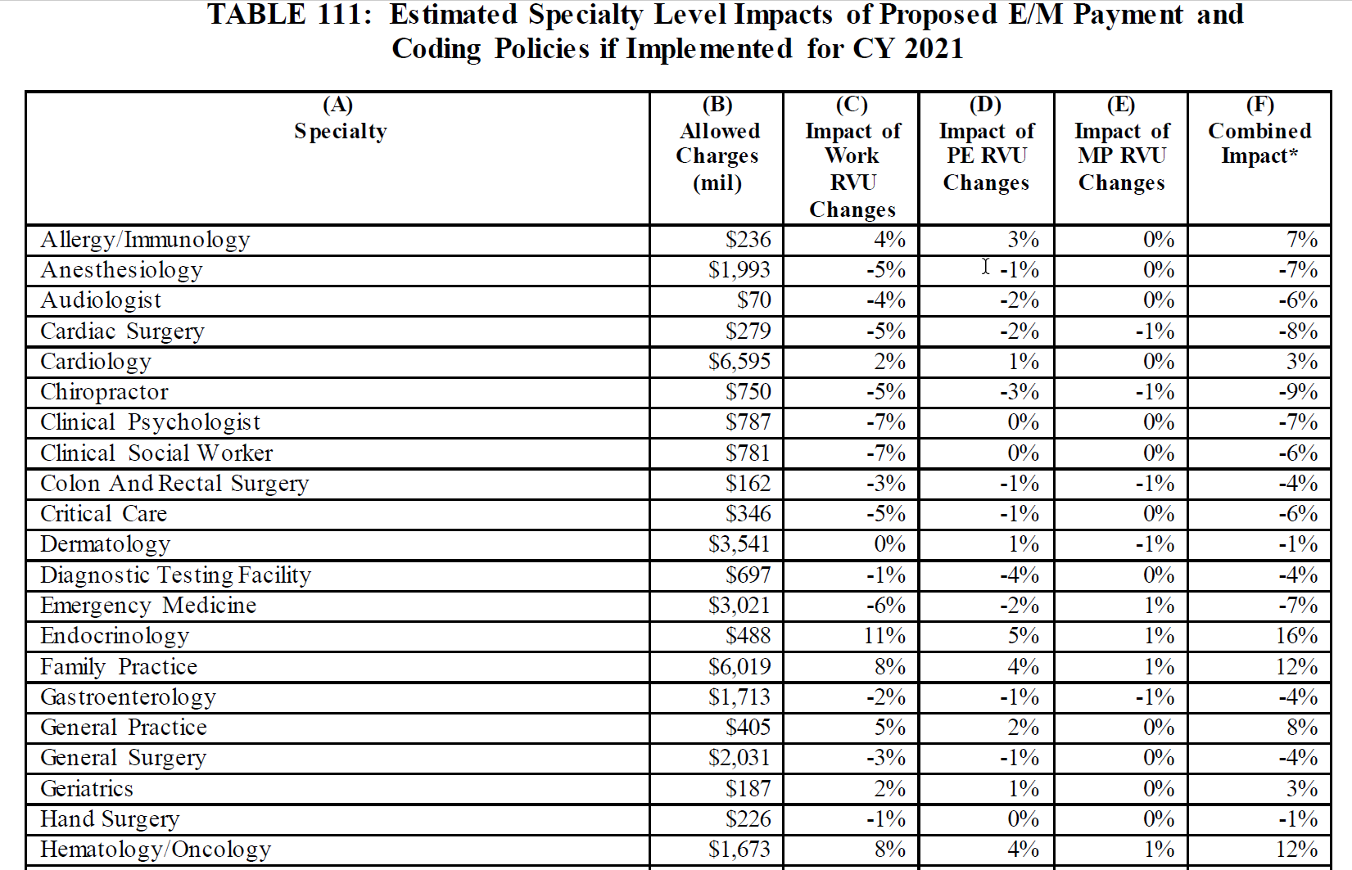
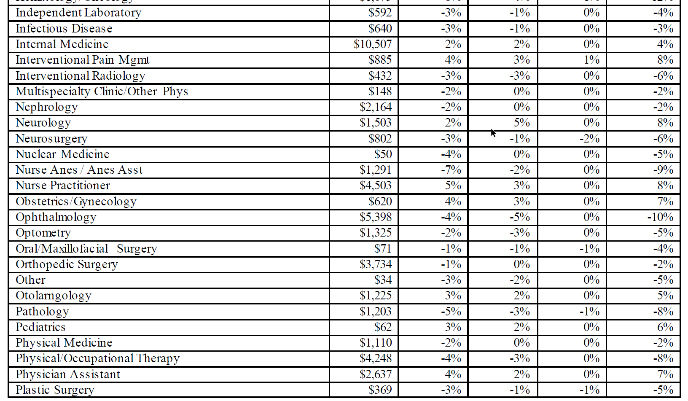
https://s3.amazonaws.com/public-inspection.federalregister.gov/2019-16041.pdf Page 1187, Table 111

Slide 43
CMS 2020 FINALIZED FEE SCHEDULE
Finalized Policy, Payment, and Quality Provisions Changes to the Medicare Physician Fee Schedule for Calendar Year 2020
  https://www.cms.gov/newsroom/fact-sheets/finalized-policy-payment-and-quality-provisions-changes-medicare-physician-fee-schedule-calendar
CY 2020 Medicare Hospital Outpatient Prospective Payment System and Ambulatory Surgical Center Payment System Final Rule (CMS-1717-FC)
  https://www.cms.gov/newsroom/fact-sheets/cy-2020-medicare-hospital-outpatient-prospective-payment-system-and-ambulatory-surgical-center-0
CY2020 End-Stage Renal Disease/Durable Medical Equipment Final Rule (CMS 1713-F)
  https://www.cms.gov/newsroom/fact-sheets/cy2020-end-stage-renal-diseasedurable-medical-equipment-final-rule-cms-1713-f
To see all 2475 pages of the federal register: https://federalregister.gov/d/2019-24086,

Slide 44
APPROPRIATE USE CRITERIA: AUC
The Protecting Access to Medicare Act (PAMA) of 2014, Section 218(b), established a new program to increase the rate of appropriate advanced diagnostic imaging services provided to Medicare beneficiaries. Examples of such advanced imaging services include:
  Computed tomography (CT)
  Positron emission tomography (PET)
  Nuclear medicine, and
  Magnetic resonance imaging (MRI)
When a practitioner orders an advanced diagnostic imaging service for a Medicare beneficiary, he/she, or clinical staff acting under his/her direction, will be required to consult a qualified Clinical Decision Support Mechanism (CDSM).
CDSMs are electronic portals through which appropriate use criteria (AUC) is accessed
  CDSM provides a determination of whether the order adheres to AUC, or if the AUC consulted was not applicable
  A consultation must take place at the time of the order for imaging services furnished in one of the settings and paid for under one of the below payment systems. Ultimately, practitioners whose ordering patterns are considered outliers will be subject to prior authorization.

Slide 45
APPROPRIATE USE CRITERIA
This program impacts all physicians & practitioners that order advanced diagnostic imaging services and physicians, practitioners and facilities that furnish advanced diagnostic imaging services in a physician’s office, hospital outpatient department (including the ED), an ambulatory surgical center or an independent diagnostic testing facility (IDTF) and whose claims are paid under the physician fee schedule, hospital outpatient prospective payment system or ambulatory surgical center payment system
  Currently, the program is set to be fully implemented on January 1, 2021 which means AUC consultations with qualified CDSMs are required to occur along with reporting of consultation information on the furnishing professional and furnishing facility claim for the advanced diagnostic imaging service. Claims failing to append this information will not be paid.
  The program will operate in an Education and Operations Testing Period starting January 1, 2020 during which claims will not be denied for failing to include proper AUC consultation information. Currently a voluntary program is underway since July 2018

Slide 46
PRIORITY CLINICAL AREAS
AUC consultation is required for all advanced diagnostic imaging services, not just those within the priority clinical areas
Current Priority Clinical Areas
  Coronary artery disease (suspected or diagnosed)
  Suspected pulmonary embolism
  Headache (traumatic and non-traumatic)
  Hip pain
  Low back pain
  Shoulder pain (to include suspected rotator cuff injury)
  Lung cancer(primary / metastatic, suspected or diagnosed)
  Cervical or neck pain
When program is implemented, a consultation must take place for any applicable imaging service ordered by an ordering professional that would be furnished in an applicable setting and paid under an applicable payment system, e.g., office, hospital outpatient departments (including ED, ambulatory surgical centers (ASCs), and IDTFs… for payment in PFS, OPPS, ASCs

Slide 47
2020: VOLUNTARY PARTICIPATION
Voluntary participation from July 1, 2018 through January 1, 2020.
During CY 2020 we expect ordering professionals to begin consulting qualified CDSMs and providing information to the furnishing practitioners and providers for reporting on their claims.
  Situations in which furnishing practitioners and providers do not receive AUC-related information from the ordering professional can be reported by modifier MH.
  Even though claims will not be denied during this Educational and Operations Testing Period inclusion is encouraged as it is important for CMS to track this information.
Full program implementation is expected Jan. 1, 2021. At that time, information regarding the ordering professional’s consultation with CDSM, or exception to such consultation, must be appended to the furnishing professional’s claim in order for that claim to be paid
HCPCS modifiers have been established for this program for placement on the same line as CPT code

Slide 48
EXCEPTIONS AND CONSEQUENCES
Exceptions to consulting CDSMs include:
  Ordering professional has significant hardship exception
  Patient has an emergency medical condition
  An applicable imaging service ordered for an inpatient and for which payment made under Part A
PAMA requires that the program result in prior authorization for ordering professionals that are identified as having outlier ordering patterns. Before the prior authorization component of this program begins there will be notice and comment rulemaking to develop the outlier methodology
HCPCS modifiers have been established for this program for placement on the same line as CPT code
Additionally a G code is needed to report which qualified CDSM was consulted.

Slide 49
HCPCS MODIFIERS TO USE
MA: Ordering professional not required to consult a clinical decision support mechanism due to service rendered to a patient with a suspected or confirmed emergency medical condition
MB: Ordering professional is not required to consult a clinical decision support mechanism due to the significant hardship exception of insufficient internet access
MC: Ordering professional is not required to consult a clinical decision support mechanism due to the significant hardship exception of electronic health record or clinical decision support mechanism vendor issues
MD: Ordering professional is not required to consult a clinical decision support mechanism due to the significant hardship exception of extreme and uncontrollable circumstances

Slide 50
HCPCS MODIFIERS TO USE
ME: The order for this service adheres to the appropriate use criteria in the clinical decision support mechanism consulted by the ordering professional
MF: The order for this service does not adhere to the appropriate use criteria in the qualified clinical decision support mechanism consulted by the ordering professional
MG: The order for this service does not have appropriate use criteria in the clinical decision support mechanism consulted by the ordering professional
MH: Unknown if ordering professional consulted a clinical decision support mechanism for this service, related information was not provided to the furnishing professional or provider
And you have to select a specific clinical decision support company…

Slide 51
ADDITIONAL G CODES NEEDED
G1000: Clinical Decision Support Mechanism Applied Pathways, as defined by the Medicare Appropriate Use Criteria Program
G1001: Clinical Decision Support Mechanism eviCore, as defined by the Medicare Appropriate Use Criteria Program
G1002: Clinical Decision Support Mechanism MedCurrent, as defined by the Medicare Appropriate Use Criteria Program
G1003: Clinical Decision Support Mechanism Medicalis, as defined by the Medicare Appropriate Use Criteria Program
G1004: Clinical Decision Support Mechanism National Decision Support Company, as defined by the Medicare Appropriate Use Criteria Program
G1005: Clinical Decision Support Mechanism National Imaging Associates, as defined by the Medicare Appropriate Use Criteria Program

Slide 52
ADDITIONAL G CODES NEEDED
G1006: Clinical Decision Support Mechanism Test Appropriate, as defined by the Medicare Appropriate Use Criteria Program
G1007: Clinical Decision Support Mechanism AIM Specialty Health, as defined by the Medicare Appropriate Use Criteria Program
G1008: Clinical Decision Support Mechanism Cranberry Peak, as defined by the Medicare Appropriate Use Criteria Program
G1009: Clinical Decision Support Mechanism Sage Health Management Solutions, as defined by the Medicare Appropriate Use Criteria Program
G1010: Clinical Decision Support Mechanism Stanson, as defined by the Medicare Appropriate Use Criteria Program
G1011: Clinical Decision Support Mechanism, qualified tool not otherwise specified, as defined by the Medicare Appropriate Use Criteria Program

Slide 53
SOME FUTURE THOUGHT
Newer pharmaceuticals for cancer, inflammatory disease, infections, etc. arriving in the market
New less invasive surgical techniques developing
Artificial intelligence assisting diagnoses
Changes in medical school programs and teaching methods across the country
More virtual and telemedicine visits everywhere
More gadgets for self monitoring by patients
Sub, sub, subspecialties emerging
Increase in NPPs and various medical jobs: scribes, assistants, therapists, coders, etc.
Non physicians running / owning practices
But before banging your head, everything is still subject to change by law or regulation

Slide 54

CAT GOT YOUR TONGUE?
Ask all your questions---maybe I can answer some

