Slide 1
MEDICARE FOR ONCOLOGISTS DURING THE COVID CRISIS AND IN 2021
Medical Oncology Association of Southern California
Via Webinar; December 2, 2020
5:30-6:30 PM Pacific Standard Time

Slide 2

TONIGHT WE WILL DISCUSS
Brief Look at COVID-19
  Noridian Hot Line, CMS emergency page
  Very Brief Telemedicine Update
  Many audits and TPE stopped for now
Some Things Don’t Change 2020
  Clear Documentation Still Important
  Amending Medical Records;
  Off Label Meds--and “Evidence Based” data
Looking at Changes 2021
  Documentation Simplification / Write less but be succinct/ Sign and date notes
  Appropriate Utilization Criteria / Delayed until 2022 and Radiation Oncology Model / Delayed until 7/2021
  Evaluation and Management Changes start 1-1-21
Q&A

Slide 3
NORIDIAN HOT LINE
To support our providers in JE and JF, a COVID-19 Hotline has been established to help with COVID-19 related inquiries. The hotline number is: 866-575-4067. Customer services reps will be available Monday-Friday from 8 a.m.-6 p.m. CDT. The hotline will answer questions on provisional billing privileges and enrollment flexibilities afforded by the COVID-19 waiver for health care facilities and providers, as well as Part A, B, and DME payments related to COVID-19 emergency
CMS ON LINE EMERGENCY PAGE: https://www.cms.gov/About-CMS/Agency-Information/Emergency/EPRO/Current-Emergencies/Current-Emergencies-page

Slide 4

https://www.cmadocs.org/Portals/CMA/files/public/ CMA%20COVID-19%20Telehealth%20Overview.pdf

Slide 5

CMS TELEHEALTH VIDEO-RELATED TO COVID-19
https://www.youtube.com/watch?v=Bsp5tIFnYHk&feature=youtu.be
FLASH, COVID-19 emergency continued for 90 days; currently CMS says telehealth waivers will continue until end of year that COVID-19 emergency ends!!!

Slide 6
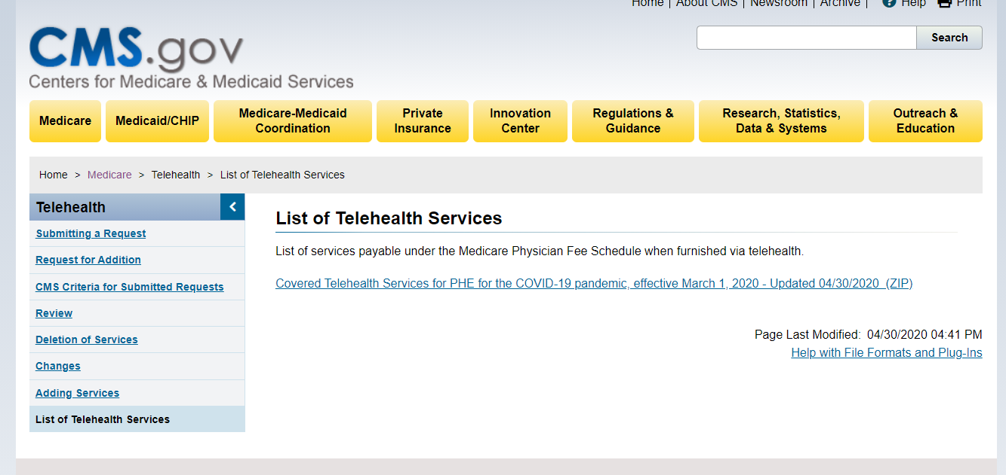
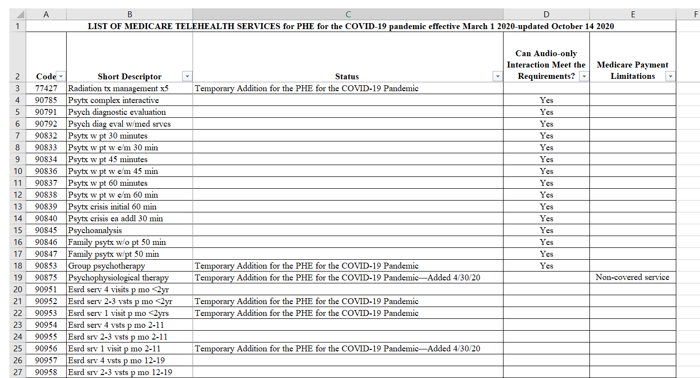
TELEHEALTH DURING COVID-19
“Telehealth” visits conducted between a provider and patient using two-way telecommunication systems with audio and video capabilities.
Two-way, real-time interactive audio/video telecommunication capability is needed.
Bill professional claims for all telehealth services with DOS on and after March 1, 2020, and for the duration of the PHE to Medicare with:
  Place of service (POS) equal to what it would have been had the service been furnished in-person (example: POS 11 for office)
  Modifier 95 should be applied to most claim lines for services furnished via telehealth
The complete list of all Medicare telehealth services can be found here
You will get a spread sheet of all telehealth codes, which were prior to the COVID-19 emergency and which were added for the emergency and updated 10/14/20
https://www.cms.gov/Medicare/Medicare-General-Information/Telehealth/Telehealth-Codes

Slide 7
TELEHEALTH TAKEAWAY
Effective for services March 6, 2020 and for duration of the COVID-19 Public Health Emergency, Medicare will make payment for Medicare telehealth services to patients in broader circumstances.
These visits are considered the same as in-person visits and are paid at the same rate as regular, in-person visits.
Starting March 6, 2020 and for duration of COVID-19 Public Health Emergency, Medicare will make payment for professional services furnished to beneficiaries in all areas of the country in all settings.
While they must generally travel to or be located in certain types of originating sites such as a physician’s office, skilled nursing facility or hospital for the visit, effective for services starting March 6, 2020 and for the duration of the COVID-19 Public Health Emergency, Medicare will make payment for Medicare telehealth services furnished to beneficiaries in any healthcare facility and their home.
The Medicare coinsurance and deductible would generally apply to these services. However, HHS Office of Inspector General is pro-viding flexibility for healthcare providers to reduce or waive cost-sharing for telehealth visits paid by federal healthcare programs.
To the extent the 1135 waiver requires an established relationship, HHS will not conduct audits to ensure that such a prior relationship existed for claims submitted during this public health emergency.

Slide 8
E-VISITS
In all locations including the patient’s home, and in all areas, established Medicare patients may have non-face-to-face patient-initiated communications with their doctors without going to the doctor’s office by using online patient portals. These services can only be reported when the billing practice has an established relationship with the patient…
Medicare Part B pays for E-visits or patient-initiated online E&M conducted via a patient portal. Practitioners who may independently bill Medicare for evaluation and management visits (for instance, physicians and nurse practitioners) can bill the following codes
  99421: Online digital evaluation and management service, for an established patient, for up to 7 days, cumulative time during the 7 days; 5–10 minutes
  94222: Online digital evaluation and management service, for an established patient, for up to 7 days cumulative time during the 7 days; 11– 20 minutes
  99423: Online digital evaluation and management service, for an established patient, for up to 7 days, cumulative time during the 7 days; 21 or more minutes.
An online patient portal: A patient portal is a secure online website that gives patients convenient, 24-hour access to personal health information from anywhere with an Internet connection. Using a secure username and password, patients can view health information
https://www.healthit.gov/faq/what-patient-portal

Slide 9
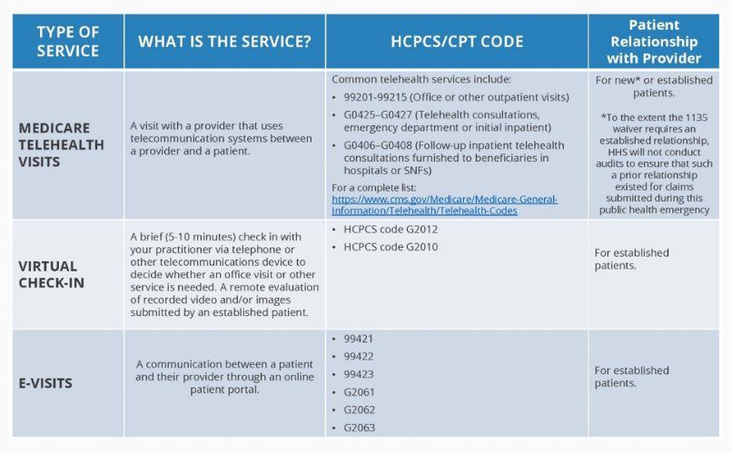
SUMMARY OF VARIOUS NON-FACE TO FACE VISITS
https://www.cms.gov/newsroom/fact-sheets/medicare-telemedicine-health-care-provider-fact-sheet

Slide 10
TELEPHONE ONLY SERVICES
Non-face-to-face E&M services provided using telephone audio only.
Current Procedural Terminology® (CPT®) codes include:
  98966-98968 (Non-face-to-face non-physician telephone services)
  99441-99443 (Non-face-to-face physician telephone services)
Bill appropriate code with the POS where the service would normally take place.
No modifier is required. If you submit these services with modifier 95, the claim may deny.
https://www.cms.gov/newsroom/fact-sheets/medicare-telemedicine-health-care-provider-fact-sheet

Slide 11
OFFICE TELEHEALTH CODING / DOCUMENTATION UNDER COVID-19 EMERGENCY
On an interim basis, we are revising our policy to specify that the office/outpatient E/M level selection for these services when furnished via telehealth can be based on MDM or time, with time defined as all of the time associated with the E/M on the day of the encounter;
And to remove any requirements regarding documentation of history and/or physical exam in the medical record.
This policy is similar to policy that will apply to all office/outpatient E&M services beginning in 2021under policies finalized in the CY 2020 PFS final rule.
Federal Register / Vol. 85, No. 66 / Monday, April 6, 2020 / Rules and Regulations 19269 …CMS Interim Final Rule COVID

Slide 12
DOCUMENTING REASONABLE & NECESSARY:
Only the actual physician who is treating the patient knows what is reasonable and necessary for that patient being evaluated and treated.
The only way a Noridian reviewer can determine if something is (was) reasonable and necessary on a claim is to review the complete documentation submitted

Slide 13
TARGETED PROBE AND EDUCATION
CURRENT MEDICAL REVIEW AUDIT PROCESS
CMS authorized Medicare Contractors to conduct the Targeted Probe and Educate (TPE) review process. The TPE review process includes three rounds of a prepayment probe review with education.
If there are continued high denials after three rounds, the Medicare Contractor will refer the provider/supplier to CMS for additional action, which may include 100% prepay review, extrapolation, referral to a Recovery Auditor, etc.
Note, discontinuation of review may occur at any time if appropriate improvement is achieved during the review process.
PROGRAM HELD DURING COVID-19 EMERGENCY---Some Post Pay Review has restarted

Slide 14
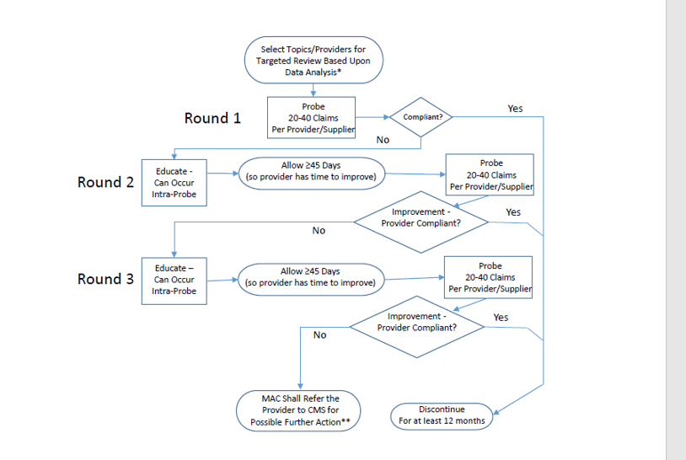
TARGETED PROBE
AND EDUCATION

Slide 15
FIGHTING BACK: RESPONDING TO ANY REQUEST FOR RECORDS
Have a set office process for dealing with all ADRs (Additional Record Requests)
Have one individual responsible for sending all records as part of the set office process
  Experienced office person, or clinical person, or both
Have a check off sheet that involves
  Legibility (can add typed / printed addendum)
  Correct name, date, physician listed in request
  Signature (signature sheet or attestation if needed)
  Correct address to send records
  Timeliness of records being sent
Know how and where to get hospital records
Send by certified mail (or equivalent)

Slide 16
MEDICATION USE AND THE FDA
The FDA allows physicians to use any medication approved by the FDA for labeled uses but also any other use
However, Medicare and Medicare contractors do not have to approve all FDA approved drugs / devices, but usually do approve labeled uses
Medicare has specific rules for use of off-label use of chemotherapy medications
Some non-chemotherapy medications can also be used off-label, and for oncologists that often means biologic drugs used for malignant diseases

Slide 17
OFF LABEL USE OF MEDICINES, CHEMOTHERAPY OR BIOLOGICS
What is Also Considered Off-Label by Noridian:
  Unusual dose (high / low), or frequency given, or time between doses is not as described by FDA
  Unusual combination of meds--- as required by FDA insert
  Unusual sequence (1st, 2nd, 3rd line)
What You Need to Document For These Situations
  Failure of initial treatment of accepted med / combination
  Intolerance to dose, to combination, to frequency
  Underlying medical conditions causing problems
Give Us Data for Off Label Acceptance on Appeal
  Follow information in CMS Manuals for off-label
  NCCN guidelines listed 2A or higher…or other guidelines
  Literature support in quality peer reviewed journals
SHOW ME THE DATA!!

Slide 18
CMS BENEFIT POLICY MANUAL 102: Chapter 15 Sec 15.50.4.5
Off-label, medically accepted indications of Food and Drug Administration-(FDA) approved drugs and biologicals used in an anti-cancer chemotherapeutic regimen are identified below:
  A regimen is a combination of anti-cancer agents recognized for treatment of a specific type of cancer.
  Off-label, medically accepted indications must be supported in either one or more of the compendia or in peer-reviewed medical literature.
The contractor may determine the medically accepted indication of drugs or biologicals used off-label in anti-cancer chemotherapeutic regimen.
Compendia documentation or peer-reviewed literature supporting off-label use by the treating physician may be requested of the physician by the contractor.

Slide 19
CURRENT CMS APPROVED COMPENDIA
American Hospital Formulary Service-Drug Information (AHFS-DI)
National Comprehensive Cancer Network (NCCN) Drugs and Biologics Compendium
  This is often the first place we look
  We usually accept category 2A or higher
Micromedex DrugDex
Clinical Pharmacology
Lexi-Drugs
We are looking for “evidence-based medicine”

Slide 20
SIX SETS OF LEVELS OF EVIDENCE/ GUIDELINES COMMONLY USED
United States Preventive Services Task Force (USPSTF)
Grading of Recommendations, Assessment, Development and Evaluations (GRADE) Working Group
National Comprehensive Cancer Network (NCCN) Categories of Evidence and Consensus
NEATS, from National Academy of Sciences for clinical guidelines
Cochrane Reviews
ECRI Trust (https://guidelines.ecri.org)

Slide 21
AMENDED RECORDS
Late entries, addendums, or corrections to a medical record are legitimate occurrences in documentation of clinical services. A late entry, addendum or correction to the medical record, bears the current date of that entry and is signed by the person making the addition or change.
  Late Entry: supplies additional information that was omitted from original entry. The late entry bears the current date, is added as soon as possible, is written only if the person documenting has total recall of the omitted information and signs the late entry.
  Addendum: An addendum is used to provide information that was not available at the time of the original entry. The addendum should be timely and bear the current date and reason for the addition or clarification of information being added to the medical record and be signed by the person making the addendum.

Slide 22
CORRECTIONS TO MEDICAL RECORD
When making a correction to the medical record, never write over, or otherwise obliterate the passage when an entry to a medical record is made in error. Draw a single line through the erroneous information, keeping the original entry legible. Sign or initial and date the deletion, stating the reason for correction above or in the margin. Document correct information on the next line or space with the current date & time, making reference back to the original entry.
Correction of electronic records should follow same principles of tracking both the original entry and the correction with the current date, time, reason for the change and initials of person making the correction. When a hard copy is generated from an electronic record, both records must show the correction. Any corrected record submitted must make clear the specific change made, the date of the change, and the identity of the person making that entry.

Slide 23
DOCUMENTATION SIMPLIFICATION
E&M office/outpatient visits: for new and / or established patients, physicians need not re-enter in medical record information on patient’s chief complaint and history that has already been entered by ancillary staff or beneficiary.
The physician may simply indicate in the medical record that he or she reviewed and verified this information; and
Removal of potentially duplicative requirements for notations in medical records that may have previously been included medical records by residents / other members of the medical team for E/M visits performed by teaching physicians. Physicians should sign and date (and add any additional) material entered by others

Slide 24
SUMMARY OF AMA CPT REVISIONS: FOR OUTPATIENT OFFICE: 2021
Effective January 2021- for office-based E&M reporting…here are the changes:
Eliminate history and physical as elements for code section:
  While the physician’s work in capturing the patient’s pertinent history and performing a relevant physical exam contributes to both the time and medical decision making, these elements alone should not determine the appropriate code level.
  The Workgroup revised the code descriptors to state providers should perform a “medically appropriate history and/or examination”
24

Slide 25
SUMMARY OF REVISIONS
Allow physicians to choose whether their documentation is based on Medical Decision Making (MDM) or Total Time:
  MDM: The Workgroup did not materially change the three current MDM sub-components but did provide extensive edits to the elements for code selection and revised/created numerous clarifying definitions in the E/M guidelines. (See below for additional discussion.)
  Time: The definition of time is minimum time, not typical time, and represents total physician/qualified health care professional (QHP) time on the date of service. The use of date-of-service time builds on the movement over the last several years by Medicare to better recognize the work involved in non-face-to-face services like care coordination. These definitions only apply when code selection is primarily based on time and not MDM.

Slide 26
SUMMARY OF REVISIONS
Modifications to the criteria for Medical Disease Management: The Panel used the current CMS Table of Risk as a foundation for designing the revised required elements for MDM. Current CMS Contractor audit tools were also consulted to minimize disruption in MDM level criteria.
  Removed ambiguous terms (e.g. “mild”) and defined previously ambiguous concepts (e.g. “acute or chronic illness with systemic symptoms”).
  Also defined important terms, such as “Independent historian.”
  Re-defined the data element to move away from simply adding up tasks to focusing on tasks that affect the management of the patient (e.g. independent interpretation of a test performed by another provider and/or discussion of test interpretation with an external physician/QHP).

Slide 27
SUMMARY OF E&M REVISIONS
Deletion of CPT code 99201: The Panel agreed to eliminate 99201 as 99201 and 99202 are both straightforward MDM and only differentiated by history and exam elements.
Creation of a shorter Prolonged Services code:
  The Panel created a shorter prolonged services code that would capture physician/QHP time in 15-minute increments.
  This code would only be reported with 99205 and 99215 and be used when time was the primary basis for code selection.

Slide 28
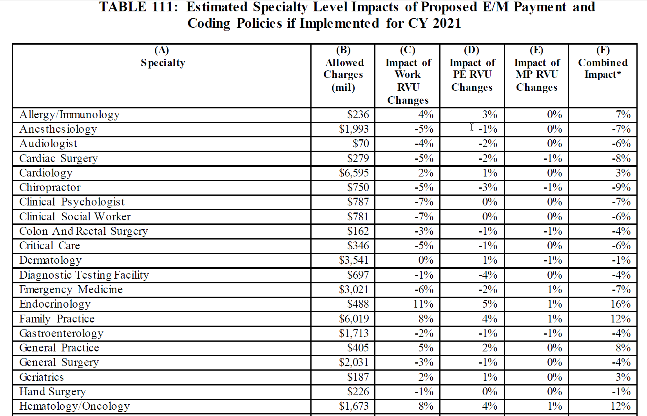
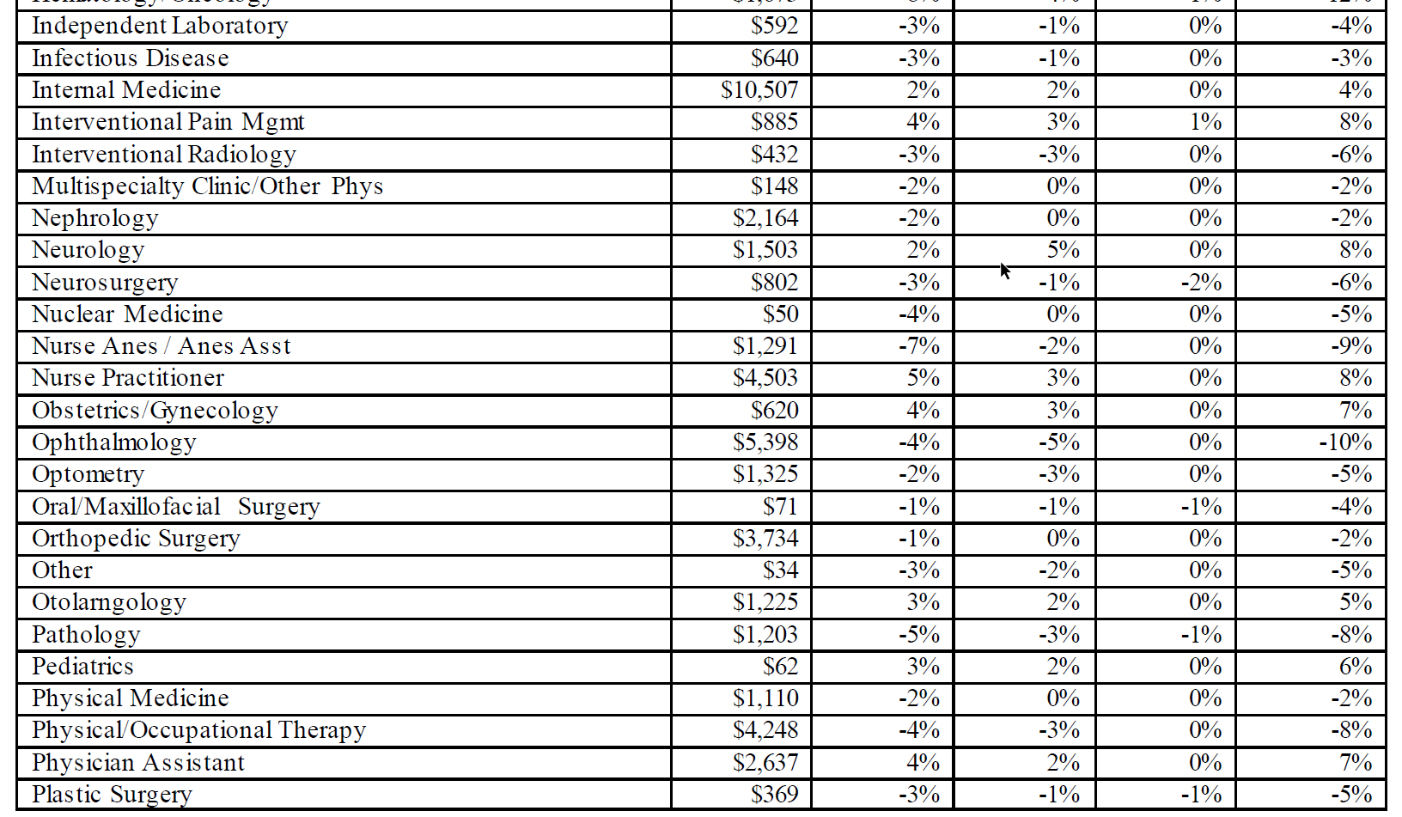
HOW CHANGES WOULD AFFECT MEDICARE PAYMENT
28
https://s3.amazonaws.com/public-inspection.federalregister.gov/2019-16041.pdf Page 1187, Table 111

Slide 29
LEVEL OF OFFICE/OUTPATIENT E&M
E/M level of service for office or other outpatient services can be based on:
  MDM: Extensive clarifications provided in the guidelines to define the elements of MDM
  Time: Total time spent on the date of the encounter Including non-face-to-face services Clear time ranges for each code
Addition of a shorter 15-minute prolonged service code (99XXX)o
  To be reported only when the visit is based on time and
  After the threshold total time of the highest-level service (i.e., 99205 or 99215) has been exceeded
Clinical examples to be added at later time

Slide 30
MEDICAL DECISION MAKING
Modifications to the criteria for MDM:
CMS Table of Risk used as foundation to create the Level of Medical Decision-Making Table
Removed ambiguous terms (e.g., “mild”) and defined previously ambiguous concepts (e.g., “acute or chronic illness with systemic symptoms”)
Guide to assist in selecting the level of MDM Used for office or other outpatient E/M services only Includes four levels of MDM (unchanged from current levels of MDM)
  Straightforward
  Low
  Moderate
  High

Slide 31
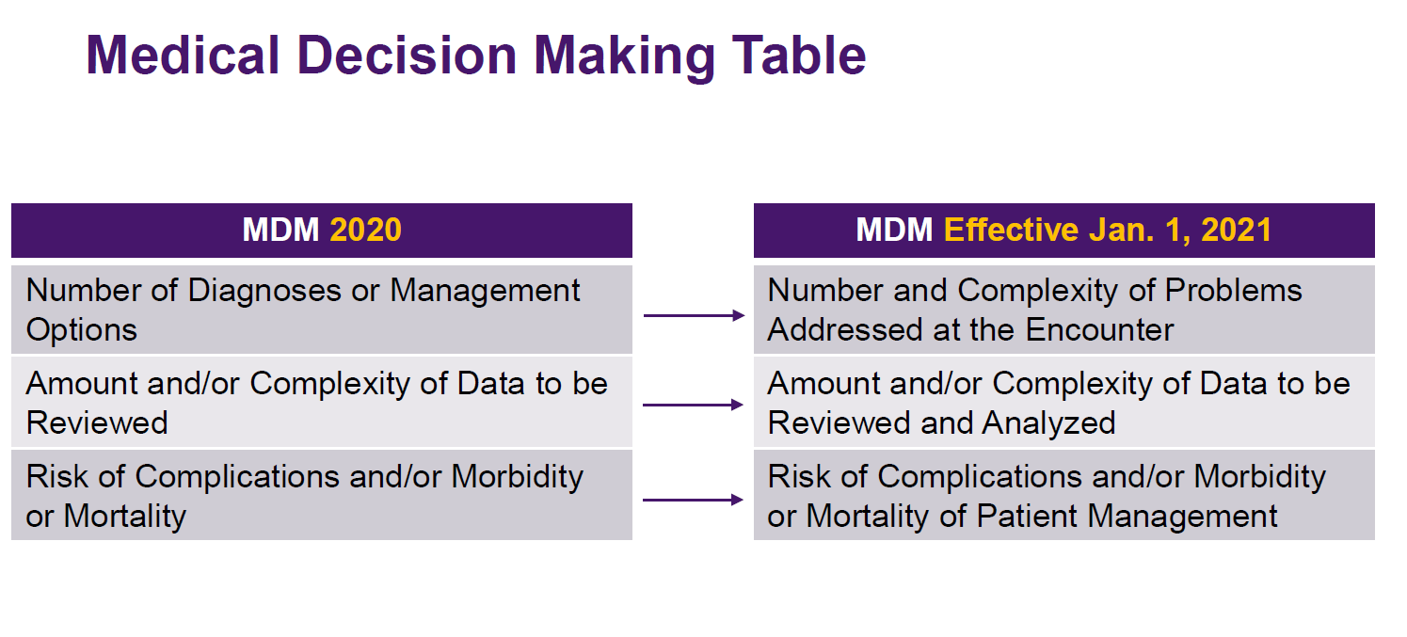
2020 and 2021

Slide 32
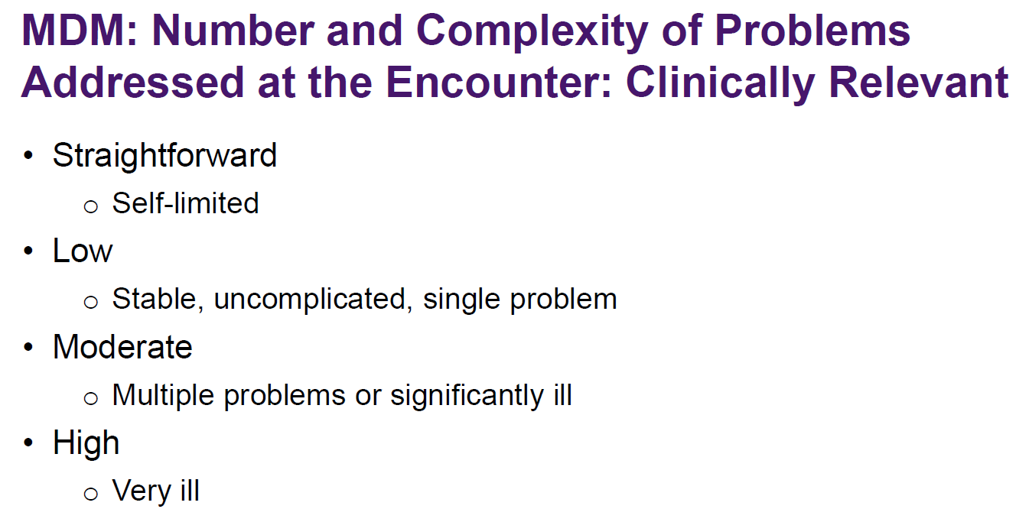
Clinically Relevant

Slide 33
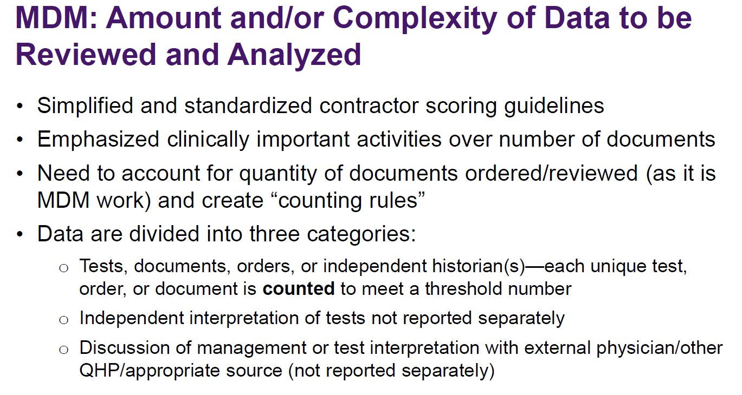

Slide 34
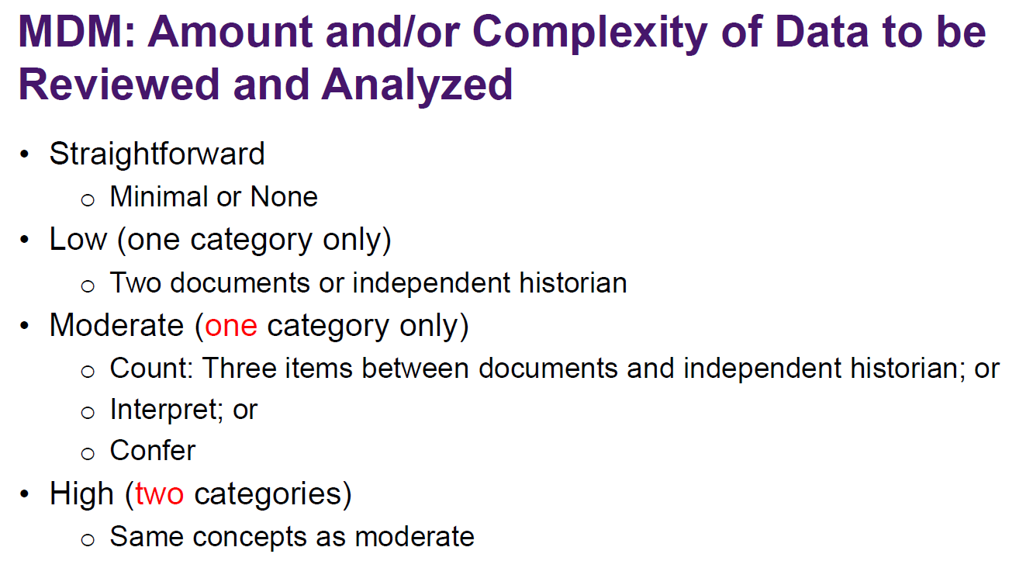

Slide 35
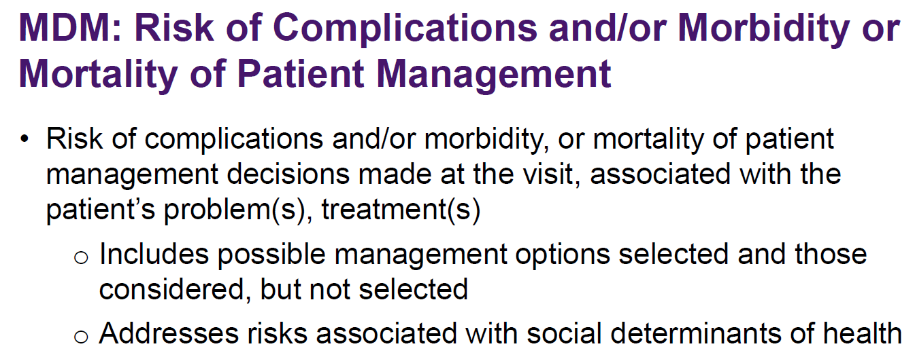

Slide 36
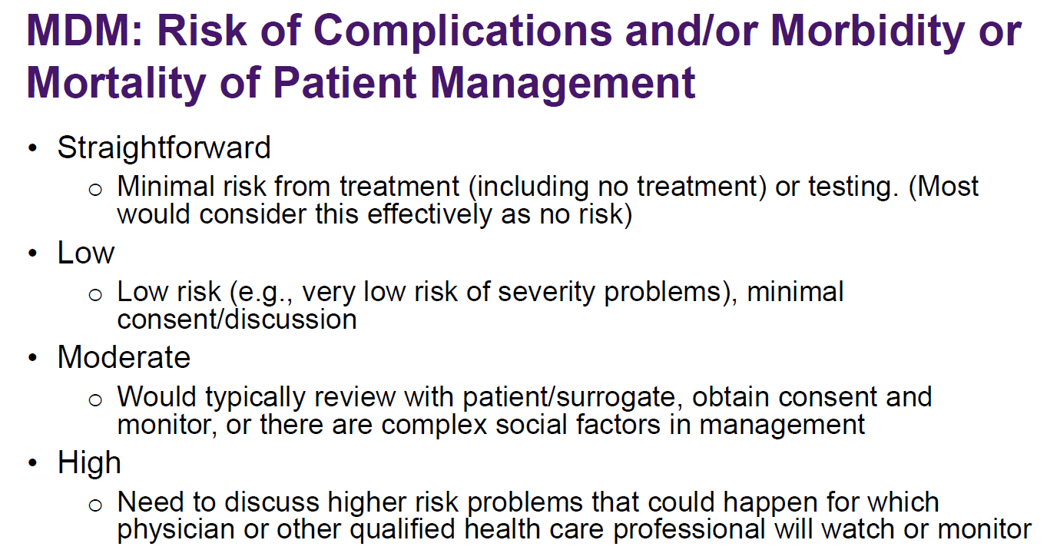

Slide 37
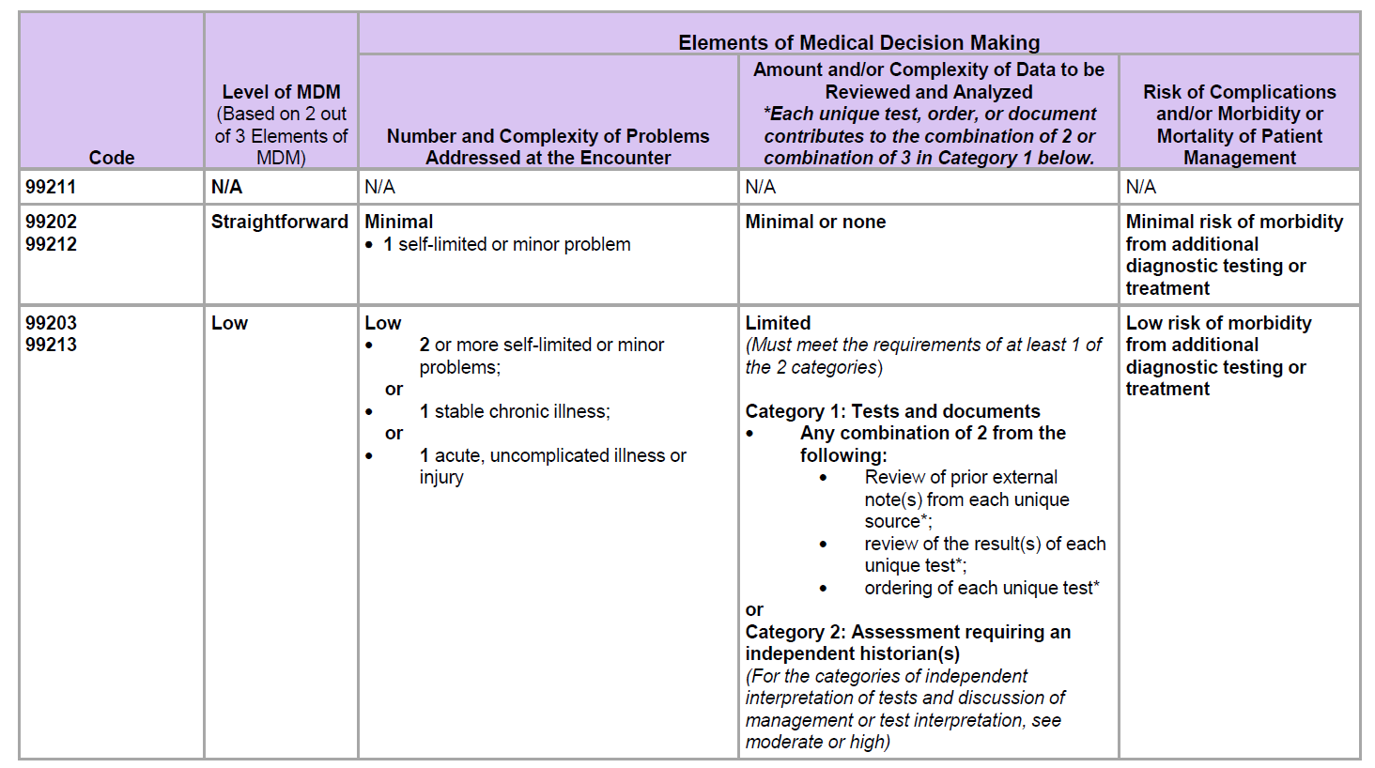
SELECTING E&M LEVEL

Slide 38
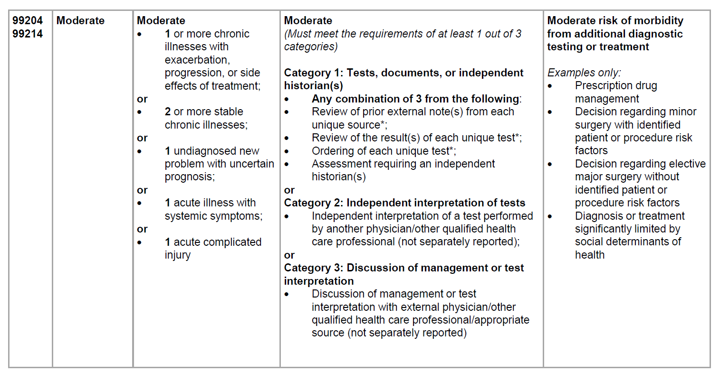
SELECTING E&M LEVEL

Slide 39
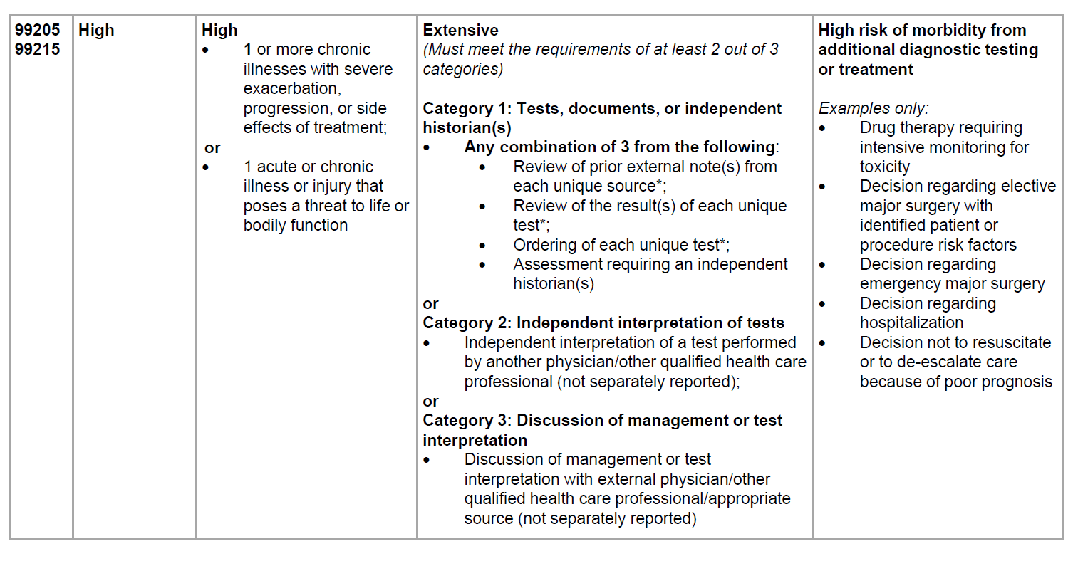
SELECTING E&M LEVEL

Slide 40
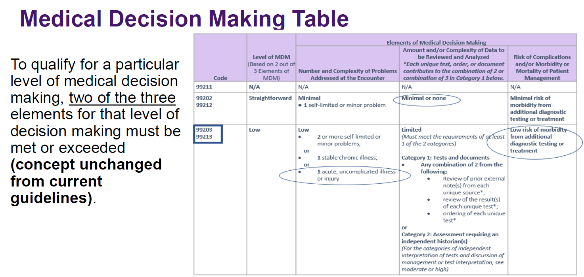

Slide 41
TIME: OFFICE and OTHER OUTPATIENT E/M SERVICES
Time may be used to select a code level in office or other outpatient services whether or not counseling and/or coordination of care dominates the service
(In the past, time was only be used for selecting the level of the other E/M services when counseling and/or coordination of care dominates the service)
Total Time on the date of the encounter
  Includes physician/other QHP face-to-face and non-face-to-face time (Time spent by clinical staff is not included)
  More than one clinician addressed (count only 1 person per minute of time)
  Recognizes the important non-face-to-face activities
  Uses easy to remember increments based on time data of past valuations
  Removes “closest” vs “threshold” by giving exact ranges
  Is for Code Selection When Using Time, Not a required minimum amount when using MDM
Use the algorithm TTT: TOTAL TIME TODAY

Slide 42
Physician/other QHP Time Includes The Following Activities (When Performed)
Preparing to see the patient (e.g., review of tests/chart)
Obtaining / reviewing separately obtained history
Performing a medically necessary appropriate examination and/or evaluation
Counseling / educating the patient, family, or caregiver
Ordering medications, tests, or procedures
Referring and communicating with other health care professionals (when not reported separately)
Documenting clinical information in the electronic or other health record
Independently interpreting results (not reported separately) and communicating results to the patient / family / caregiver
Care coordination (not reported separately)

Slide 43
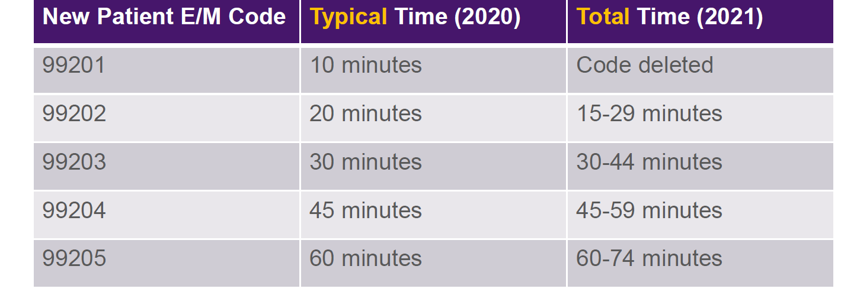
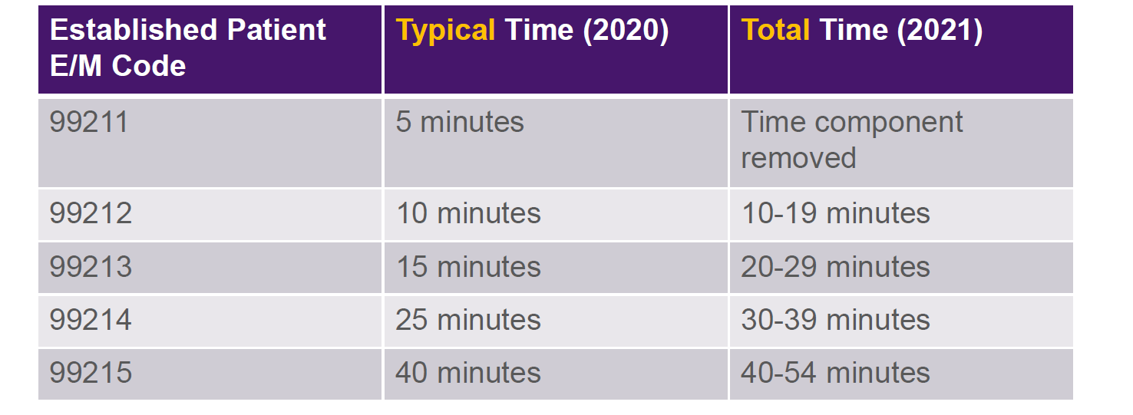
TOTAL TIME OF VISIT 2020 & 2021

Slide 44
PROLONGED SERVICES: 99417
Prolonged Services/Prolonged Service With or Without Direct Patient Contact on the Date of an Office or Other Outpatient Service
99XXX Prolonged office or other outpatient evaluation and management service(s) beyond the minimum required time of the primary procedure which has been selected using total time, requiring total time with or without direct patient contact beyond the usual service, on the date of the primary service, each 15 minutes of total time
  (List separately in addition to codes 99205, 99215 for office or other outpatient Evaluation and Management services)
  (Use 99417 in conjunction with 99205, 99215)
  (Do not report 99417 on the same date of service as 99354, 99355, 99358, 99359, 99415, 99416)
  (Do not report 99417 for any time unit less than 15 minutes)

Slide 45
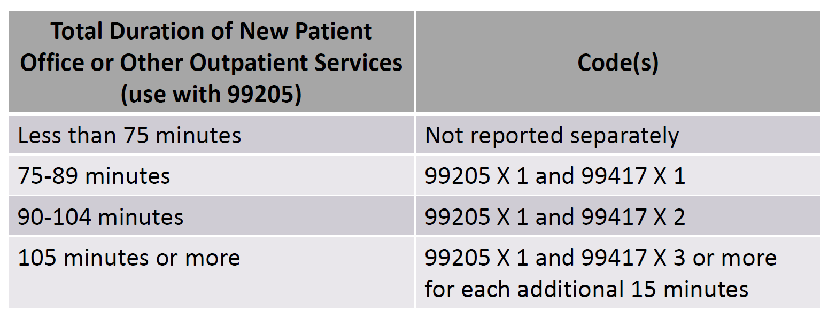
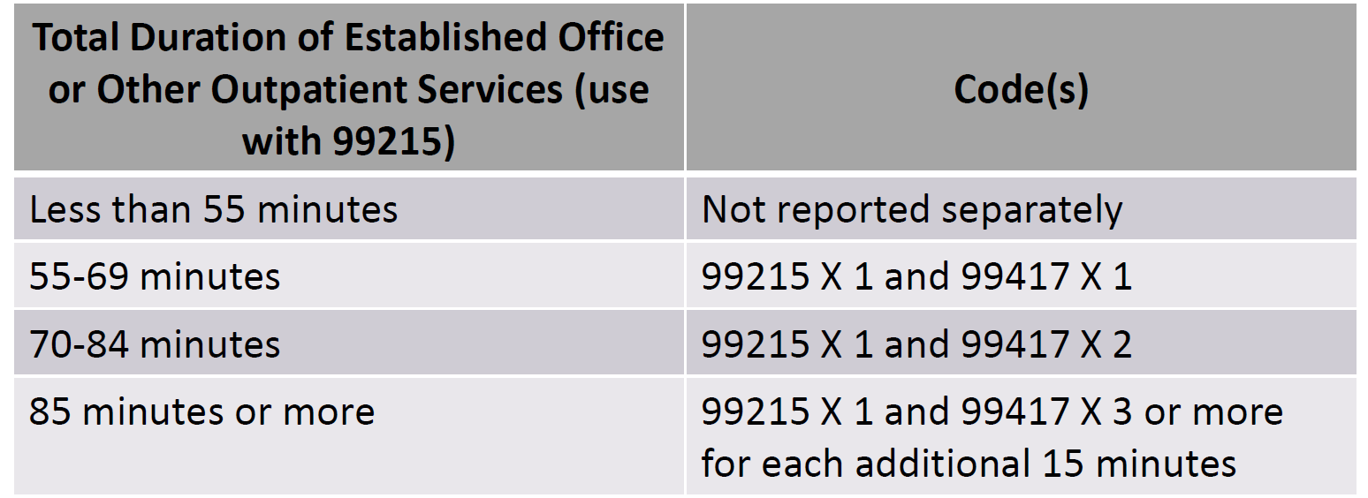
PROLONGED SERVICES 99417

Slide 46
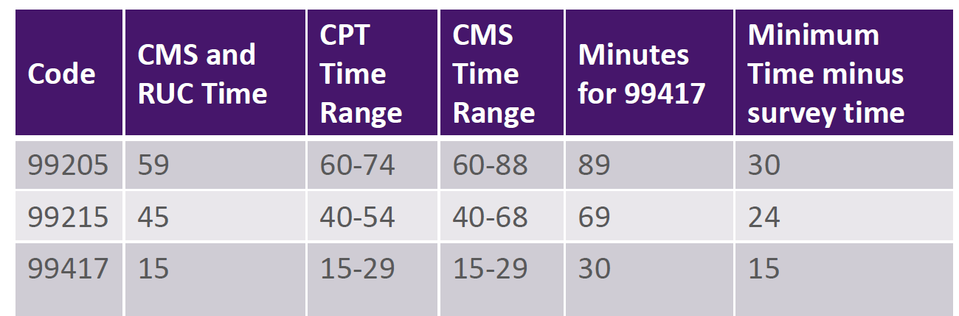
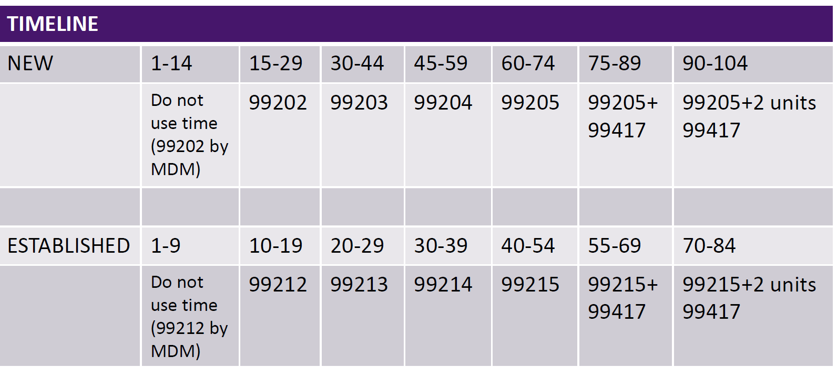
CMS RECALCULATION OF TIME
Issue resolved when CMS Publishes final rule in a few weeks

Slide 47
EVALUATION AND MANAGEMENT PRIMER FROM AMA
Below is a 51 page primer from the AMA to assist in understanding the changes
E/M Office Visit Primer

Slide 48
More Essential Tools & Resources
CPT® E/M Office or Other Outpatient and Prolonged Services Code and Guideline Changes
CPT® E/M Office Revisions Level of Medical Decision Making (MDM)
Review RUC recommendations on CPT E/M office visit codes
Revisions to reporting CPT E/M office visits: Time
Revisions to reporting CPT E/M office visits: MDM

Slide 49
SOME FUTURE THOUGHT
Newer biologic pharmaceuticals for cancer therapy and diagnostic tests arriving in the market
New less invasive surgical techniques developing
Artificial intelligence assisting diagnoses via mathematic algorithms or literature searches
Changes in medical school programs and teaching methods across the country
More virtual and telemedicine likely to continue
More gadgets for self monitoring by patients
Sub, sub, subspecialties emerging
Increase in NPPs and various medical jobs: scribes, assistants, therapists, coders, etc.
Non physicians running / owning practices
But before banging your head, everything is still subject to change by law or custom

Slide 50

CAT GOT YOUR TONGUE?
Ask all your questions---maybe I can answer some
Arthur.Lurvey@Noridian.com

