Slide 1
CALIFORNIA’S COMPREHENSIVE CANCER CONTROL PLAN, 2021-2015 California Dialogue on Cancer Stakeholder Meeting
Sacramento, CA
April 24, 2019
Kenneth W. Kizer, MD, MPH
Distinguished Professor, UC Davis School of Medicine and
Betty Irene Moore School of Nursing
Director, Institute for Population Health Improvement
Director, California Cancer Reporting and Epidemiologic
Surveillance Program

Slide 2
On behalf of UC Davis and the Institute for Population Health Improvement,
welcome to the California Dialogue on Cancer’s Northern California Regional Stakeholder Meeting

Slide 3
Presentation Objectives
Introduce the UC Davis Institute for Population Health Improvement
Share a few data points about cancer on California
Note the role of cancer registries in combatting cancer
Mention some of the work CalCARES is doing

Slide 4

Institute for Population Health Improvement

Slide 5
  Since being established as an independent operating unit in the UC Davis Health System in mid-2011, the Institute for Population Health Improvement has:
  Developed a diverse portfolio of activities in 5 overlapping thematic areas:
  Health care quality improvement
  Data analytics and health intelligence
  Health leadership development
  Health policy assessment
  Public health practice
  Focused primarily on assisting health-related government agencies and philanthropies design, implement, administer and/or evaluate programs
Accrued approximately $130M in >40 projects and programs

Slide 6
Selected IPHI Activities
Provide technical assistance and thought leadership in quality improvement to the Department of Health Care Services and the Medi-Cal Program(California’s $100B/yr Medicaid program)
California Cancer Reporting and Epidemiologic Surveillance (CalCARES) Program which manages the day-to-day operations of the California Cancer Registry in partnership with the CDPH
  Support the California Tobacco Control Program
  Managed the California Health eQuality (CHeQ) Program - California’s federally funded Health Information Exchange Development Program
  Provide technical assistance and support for multiple CDPH chronic disease prevention and surveillance programs
  Conduct a statewide assessment of surgical adverse events and lead a surgical quality improvement collaborative
Investigated the feasibility of developing Community Paramedicine in California

Slide 7
Selected IPHI Activities
Managed the California Health Policy Forum and Sacramento Policy Briefings Programs funded by the CHCF and others
Developed and supported QI training programs in CDPH and DHCS
Work with the Hospital Quality Institute (CHA) to support the CA portion of the CMS-funded American Hospital Engagement Network
Supported the California Health & Human Services Agency in developing a CMMI-funded State Innovation Model payment reform project for California
Assisted CDPH achieve national accreditation
Support the UCD Integrative Medicine Program
Conduct population health research projects
  Use of the Oncotype Dx Assay in women with breast cancer
  Assess quality of care for cancer patients
  Chronic disease management
  Other

Slide 8
Cancer in California (2016)
163, 321 new cases of cancer diagnosed in CA (381.6 cases per 100K – 15.4% lower than in 1988)
59,531 deaths from cancer in CA (140.1 deaths per 100K, 31.8% lower than in 1988)
Cancer will soon be the leading cause of death in California and the nation.
The cost of cancer care has risen disproportionately more than the rest of health care costs.
Cancer will soon become the most expensive health care condition.
P
8

Slide 9
The Critical Role of Cancer Registries in Combatting Cancer
Cancer registries collect detailed information about cancer patients and the treatments they receive.
Registries provide the data-driven foundation for comprehensive cancer control efforts.
9

Slide 10

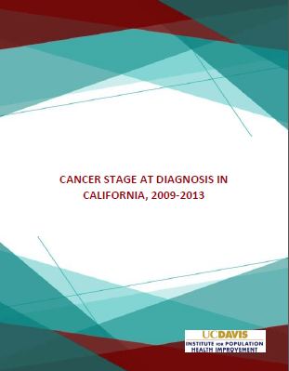

Slide 11

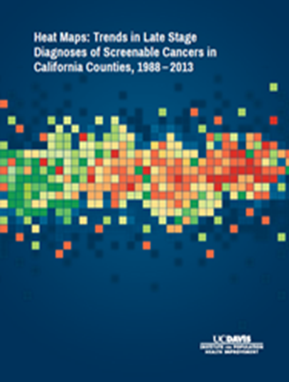
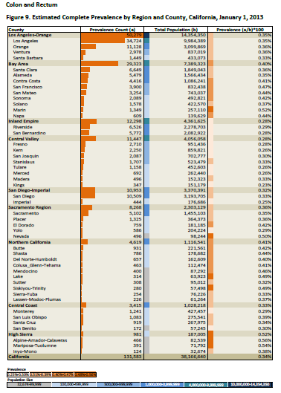

Slide 12
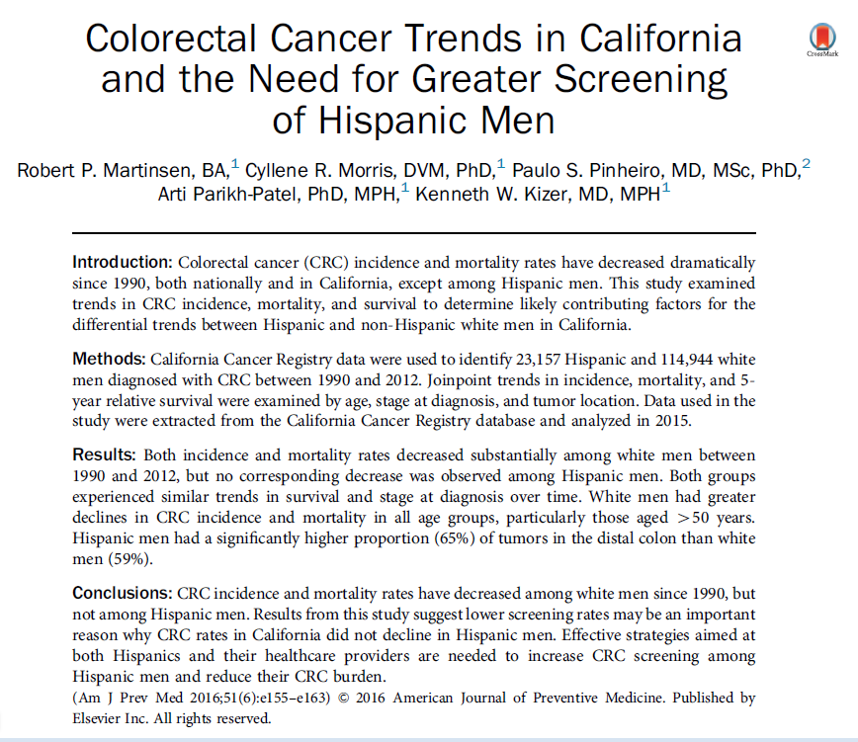

Slide 13
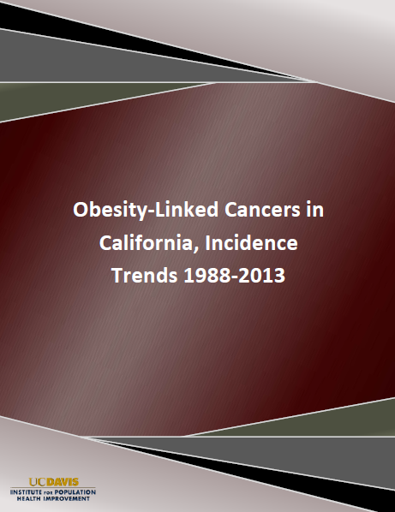
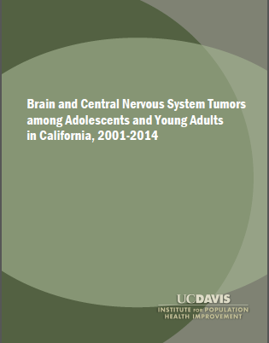

Slide 14
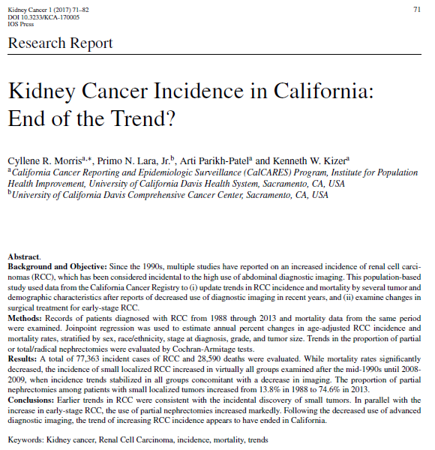

Slide 15

Using data contained in the California Cancer Registry, this study evaluated stage at diagnosis, survival, and quality of care for 698,025 Californians with breast, colon, rectal, lung and prostate cancer from 2004 through 2012.
Payer source was assigned to one of 7 payer categories according to primary payer codes:
  Medicare
  Medi-Cal
  Medicare-Medi-Cal dual eligibles
  Private
  DOD
  VA
  Uninsured
  These CCR data need to be linked with Medi-Cal paid claims and other data bases to better understand the findings

Slide 16
Use of the Oncotype Dx Assay Among Medi-Cal Members With Breast Cancer – Preliminary Results
23,789 breast cancer patients diagnosed during the 3-year study period were eligible for the ODX assay; 8.5% of these were enrolled in Medi-Cal for at least one month (65% were enrolled for the entire period;13% were enrolled for 6 months or less)
About one-quarter (26.7%) of eligible breast cancer patients in California receive the ODX assay
Medi-Cal members are less likely to receive the ODX assay than non-Medi-Cal members - 17.7% vs 27.5%
Breast cancer patients older than 65 yrs are much less likely to receive the ODX assay than women younger than 50 (15% v 41%)
Breast cancer patients residing in low SES census tracts are least likely to receive the ODX assay; use of the assay increased with higher SES status

Slide 17
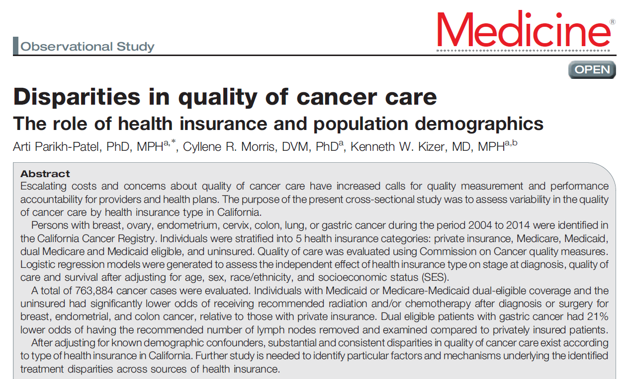

Slide 18
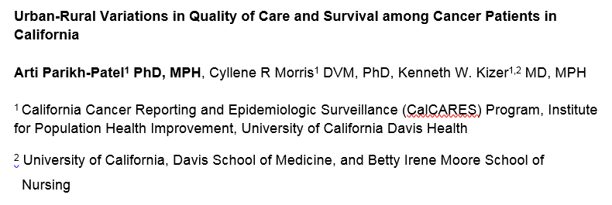
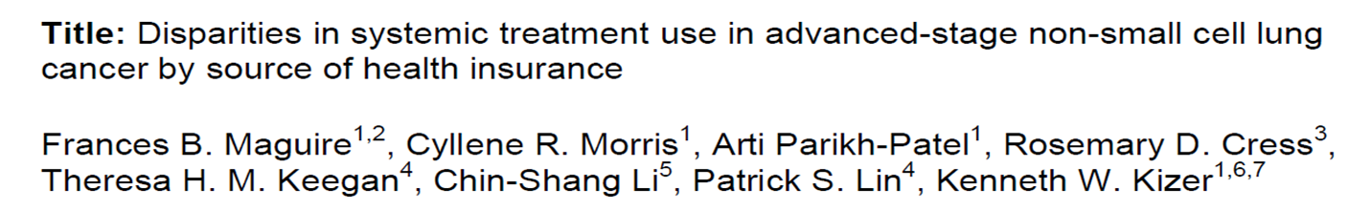

Slide 19

Comprehensive Cancer Control Plan, 2021-2025
The CalCARES Program and IPHI are a resource that can assist your cancer control efforts.
19

Slide 20

QUESTIONS?

