Slide 1
USF HEALTH MERCH
CLASS OF 2026

Slide 2
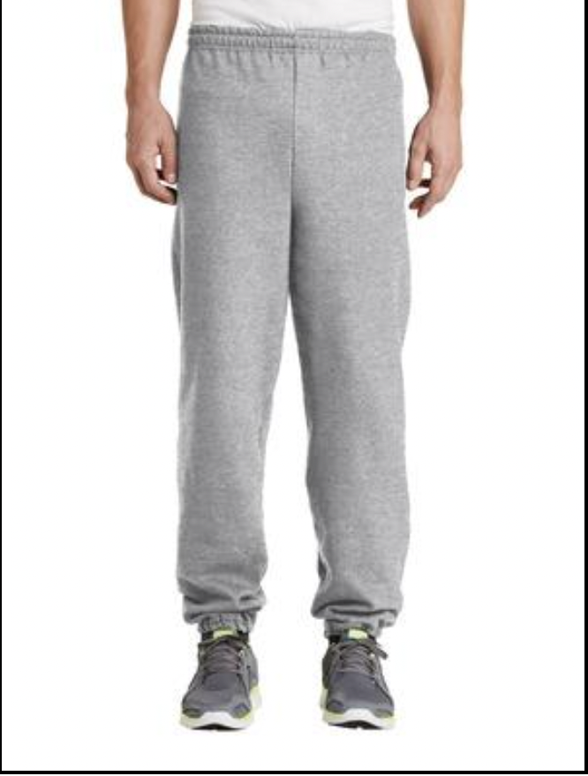

Sweatpants
Gray sweatpants with a Dark Green Logo going down the side of the leg
$16
S-2XL
The logo design will be as pictured below

Slide 3
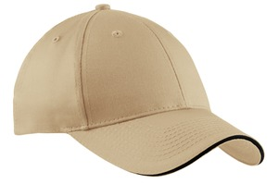

Baseball Cap
Stone Baseball Cap with Black Embroidery, the design will be centered along the front of the cap
The price will vary depending on how many people order: 5- $24, 10-$21.50, 25-$20
So we’ll charge $25 and refund accordingly
The logo design will be as pictured below

Slide 4
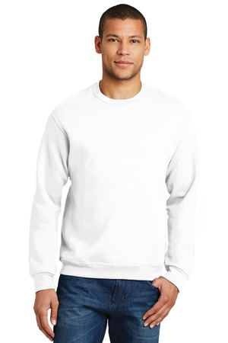
Sweatshirt
White Sweatshirt with Dark Green Embroidery
The logo will be a darker green than pictured here
$20
S-4XL
The logo design will be as pictured below

Slide 5
To order: https://forms.gle/vydjsCwPf2xTnLWX6 Please
Venmo- @jessica-singh-15 ☺

