Slide 1
FY 2023 INITIAL BUDGET PRESENTATION
May 10, 2022

Slide 2
FY 2023 BUDGET HIGHLIGHTS AT A GLANCE

Slide 3
GENERAL FUND OVERVIEW

Slide 4
EXPENDITURES BY FUNCTION

Slide 5
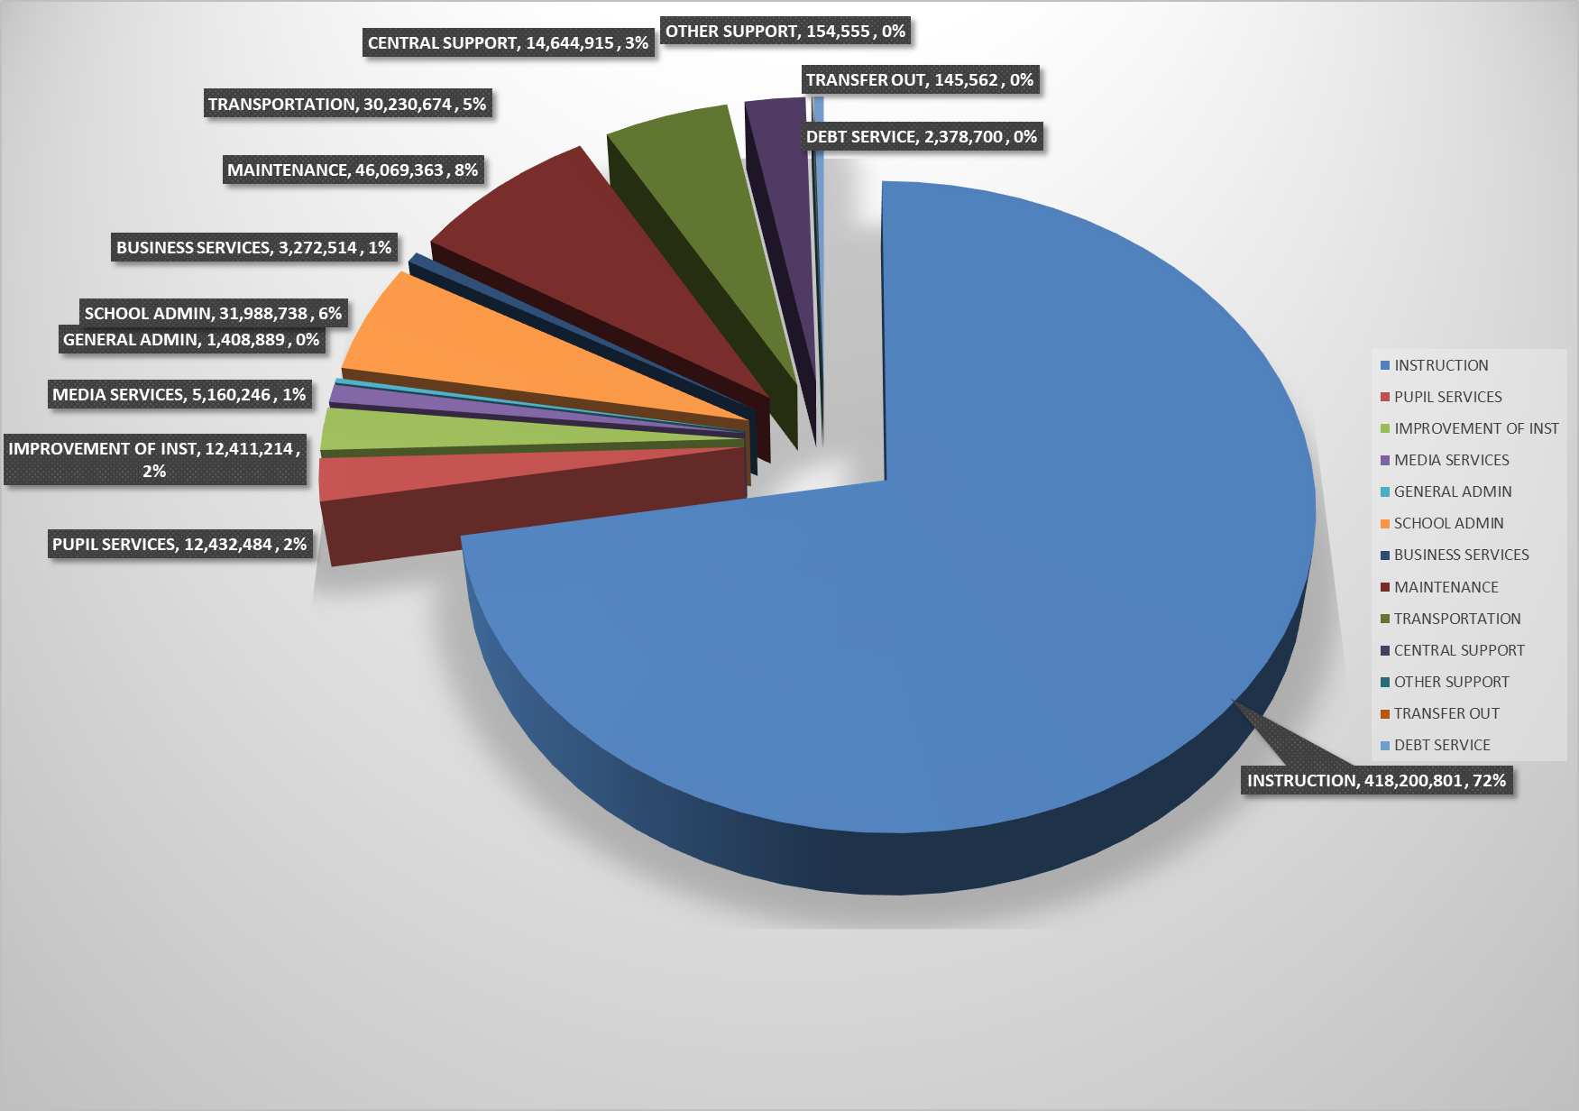
EXPENDITURE COMPARISON

Slide 6
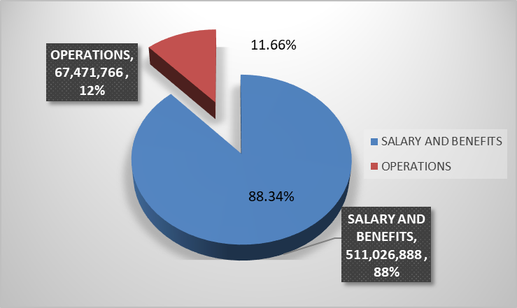
SALARY COMPARED TO OPERATIONS

Slide 7
SALARY AND BENEFIT CHANGES

Slide 8
GENERAL FUND REVENUES

Slide 9
REVENUE COMPARISON

Slide 10
MILLAGE RATE HISTORY SINCE 2000

Slide 11
COSTS PER FTE

Slide 12
SCHOOL FOOD SERVICES

Slide 13
DEBT SERVICE

Slide 14
Other Budgets

