Slide 1




Virtual Education 2022-2023
Board of Education Meeting
January 18, 2022

Slide 2
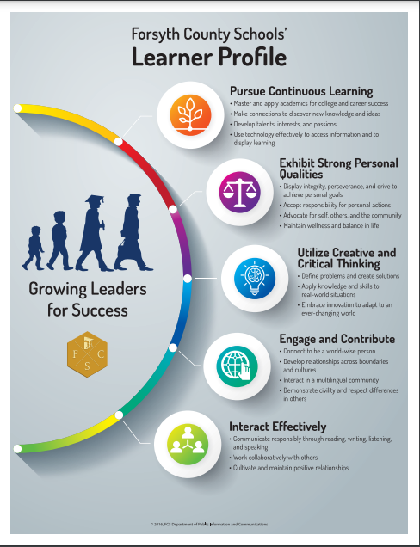
BOE Governance Goals
Goal 1: Safety for Students and Staff
Goal 2: Alignment of Strategies, Initiatives, and Resources to the FCS Learner Profile
Goal 3: Effective and Efficient Financial Planning
Goal 4: Making our Large Schools Feel Small

Slide 3
Forsyth Virtual Academy
K-12
Beginning in the 2022-2023 school year, all kindergarten-12th grade students seeking virtual education in Forsyth County will be served through the Fosyth Virtual Academy.
ELEMENTARY
The elementary program will continue in a similar manner as it has the last two years with SYNCHRONOUS instruction. The teachers will be part of FVA and housed in the ACE building. Students will be full-time virtual students.
MIDDLE
The middle school program will provide core content classes in Mathematics, English Language Arts, Science, and Social Studies along with several elective or connections classes available. It is recommended that students be full-time participants. Instruction will be ASYNCHRONOUS.
HIGH
The high school program offers a robust selection of classes, including the core academic courses, many AP courses, and electives. Students may take classes full-time or part-time. Instruction will be ASYNCHRONOUS.

Slide 4
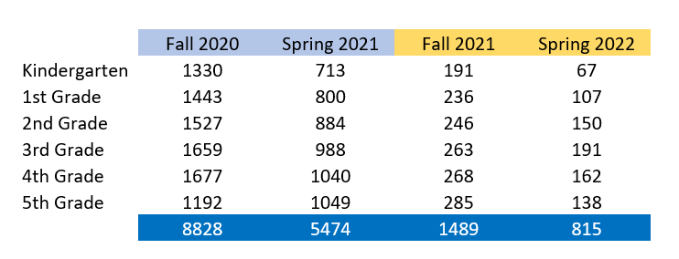
Why are we moving elementary students to FVA?
We started an elementary virtual program in the fall of 2020 in response to the COVID-19 pandemic. Every elementary school has students who are enrolled in the virtual program, but the number of students has dropped significantly over the last two years. We recognize this model serves many of our students, regardless of the pandemic and would like to establish a more permanent opportunity for families.
8,828
>40% of ES in virtual instruction in 2020
815
< 4% of ES in virtual instruction in 2022

Slide 5

Staffing Implications
Teachers will be assigned to Forsyth Virtual Academy to provide online instruction. They will be under the supervision of Principal Drew Hayes at the Academies of Creative Education. In order to allocate staff to FVA, parents will need to reserve a place for their child and commit to a year-long program for the 2022-2023 school year.
Our HR department will review the parent survey data and move teaching allotments based on the number of students who do not attend their regularly assigned (base) school and instead participate as a student at FVA.
Providing a dedicated teaching staff to FVA allows more streamlined communication, consistent instructional expectations, and direct support to students and teachers regarding online instruction.

Slide 6
Next Steps
To be ready for the 2022-2023 school year, we have several tasks to accomplish in a short amount of time. Considerations include staffing, budget, curriculum, instructional resources, professional learning, and facilities.
SURVEY TO K-12 PARENTS
COLLABORATION WITH HR AND T&L
HIRING AND RESOURCES
A survey will be sent to parents through Campus Messenger so they can secure a spot for their child in the virtual program for the 2022-2023 school year. The survey will be open from January 19 – February 7.
Based on the number of students selecting FVA, the HR and T&L departments will collaborate with FVA to allocate staff, prepare a budget, and plan curriculum to meet student and teacher needs.
Interview and hire virtual teachers. Plan for professional learning with new staff. Align instructional resources with the T&L department.

Slide 7
Points to Consider
1
COMMITMENT
2
CLUBS/SPORTS
3
SPECIAL NEEDS
Full-time virtual students are making a YEAR-LONG commitment. There will be no switching of placements at the semester break. This allows us to provide dedicated staff to FVA and ensures consistency throughout the year with students and teachers.
Students in K-12 who attend FVA are eligible to participate in their base school's sports, clubs, and activities. In order to participate, students must meet all requirements set by each respective program at the base school.
We strive to accommodate a variety of student needs no matter which environment students attend. Students with an IEP or with very specialized needs will work with their school-based team and FVA staff to make a decision that is best for the student's success.
4
PARENT COACH/ADVISER
5
STUDENT QUALITIES
For students to be successful in a virtual environment, they benefit from the support of parents or guardians. The elementary students in particular will need someone to help them access materials, log in at assigned times, and interact with the class. Parents can monitor student progress through Campus Portal.
Students who tend to be successful learning in an online environment are organized, self-motivated, meet deadlines, advocate for their needs, ask questions, and work well independently. FVA teachers and students communicate through itslearning Messenger.
Virtual Education is not for everyone. Please make an informed decision.

Slide 8

Further Questions?
We are committed to ensuring a viable, long-term opportunity for virtual education for K-12 students in Forsyth County. Many staff members are working together to meet the needs of this program. For further information, please reach out to the following individuals:
Lee Anne Rice – Associate Superintendent for Teaching and Learning
Amy Bartlett – Director of Elementary Education
Heather Gordy – Director of Secondary Education
Drew Hayes – Principal of ACE, which houses Forsyth Virtual Academy
Phil Lyerly – Assistant Principal at Forsyth Virtual Academy
Kara Hudspeth – Director of Special Education

