Slide 1

FINANCIAL
STATEMENTS
APRIL 2022

Slide 2

Goal 3 – Effective and Efficient Financial Planning – The FCS Governance Team has a responsibility to be very efficient and effective with the financial resources provided by our state, federal and local government and our citizens.
Action – The superintendent will ensure that the FY’21 budget that is presented to the BOE will meet the needs of our students and will maintain, at a minimum, a projected 15% fund balance.

Slide 3
STATEMENT OF CASH RECEIPTS & DISBURSEMENTS
APRIL 30, 2022

Slide 4
YEAR-TO-DATE BUDGET REPORT AS OF 4/30/2022
REVENUE DETAIL

Slide 5
YEAR-TO-DATE BUDGET REPORT
AS OF 4/30/2022

Slide 6
DEBT SERVICES CASH ANALYSIS
APRIL 30, 2022

Slide 7
SPECIAL REVENUE FUNDS
APRIL 2022

Slide 8
CAPITAL PROJECTS & SCHOOL FOOD SERVICES
CASH ANALYSIS
APRIL 30, 2022

Slide 9
INVESTMENT SUMMARY
ACTIVITY ANALYSIS
APRIL 30, 2022

Slide 10
SPLOST V JULY 2017 TO JUNE 2022
LGIP 8972-63321 – APRIL 2022

Slide 11
CASH RECEIPTS & DISBURSEMENTS BY ELEMENTARY SCHOOLS
APRIL 2022

Slide 12
CASH RECEIPTS AND DISBURSEMENTS BY MIDDLE AND HIGH SCHOOLS
APRIL 2022

Slide 13
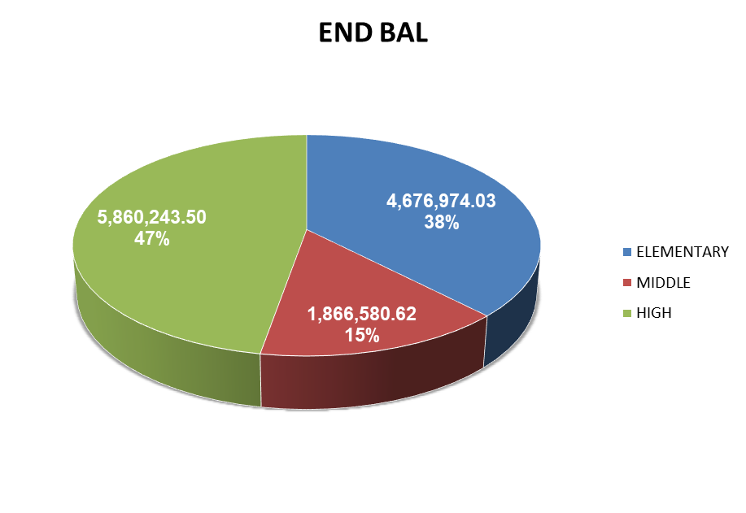
CASH RECEIPTS AND DISBURSEMENTS BY ALL SCHOOLS
APRIL 2022

