Slide 1

Forsyth County Drug Awareness Council Update
Mission Statement
To educate, advocate, and empower the community to prevent substance abuse across the lifespan in Forsyth County, Georgia.

Slide 2
Fentanyl, What is it?
Fentanyl is a synthetic opioid that can be prescribed by a doctor to treat severe pain.
Fentanyl is also illegally made and can be found in all types of street drugs such as heroin and/or cocaine.
Drugs that contain fentanyl cannot be detected by sight or smell and even a small amount can cause an overdose
Today is Fentanyl Awareness Day – Visit fentanylawarenessday.org

Slide 3
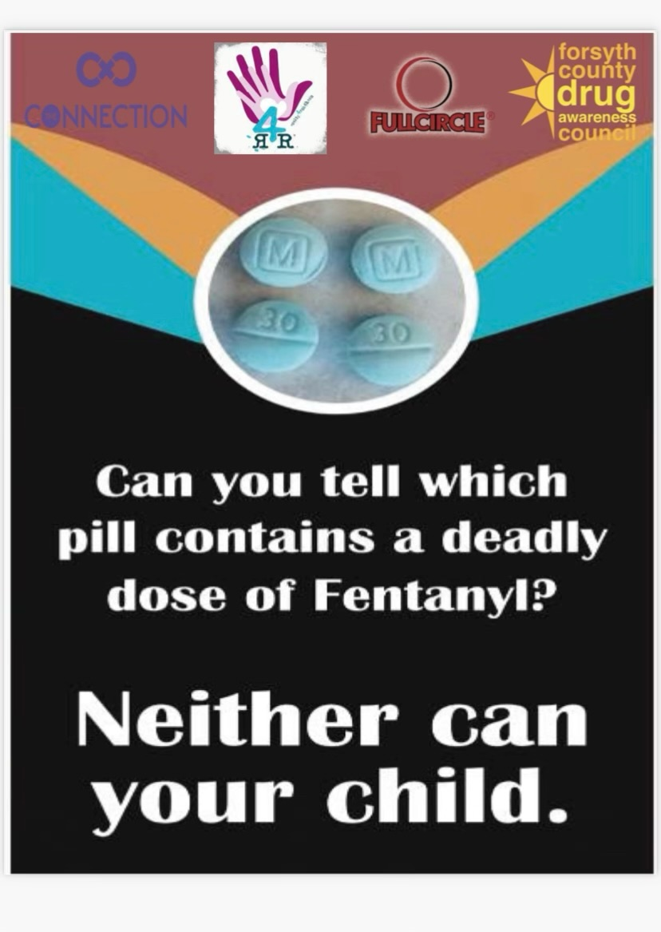
Fentanyl
Deadly and you will not know it!

Slide 4
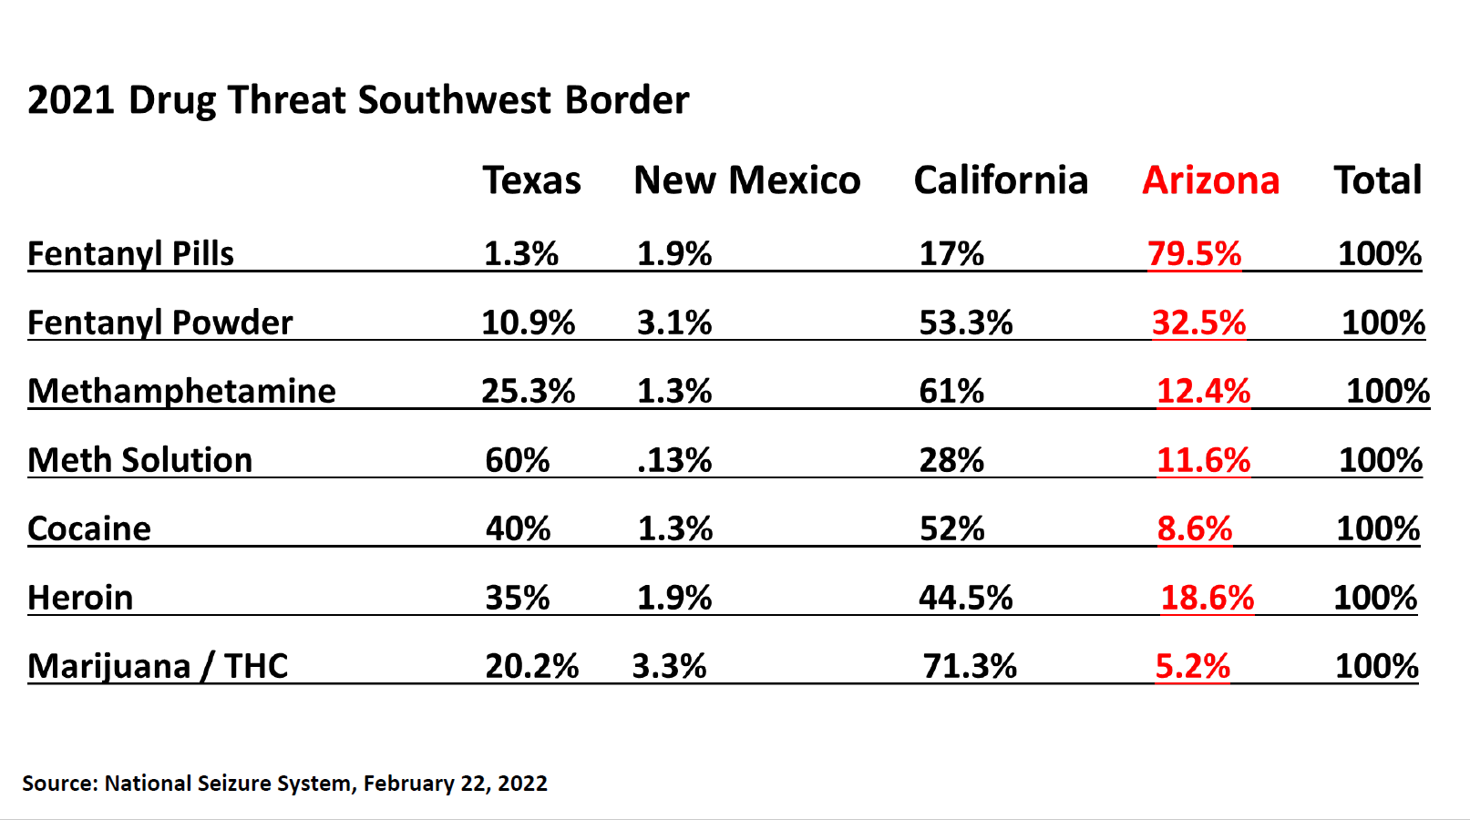

Slide 6
Nurses have naloxone on hand
Elementary 1 dose per school
Middle 4 doses per school
High 12 doses per school thanks to a donation that allowed us to have more doses on hand!
PPE Important when responding!

Slide 7
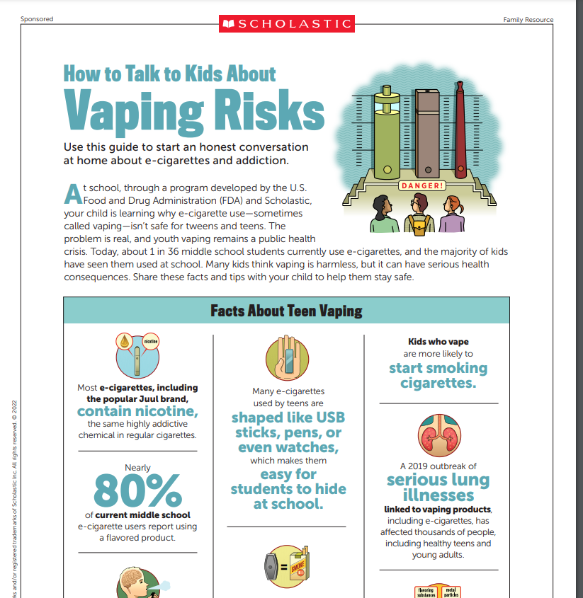
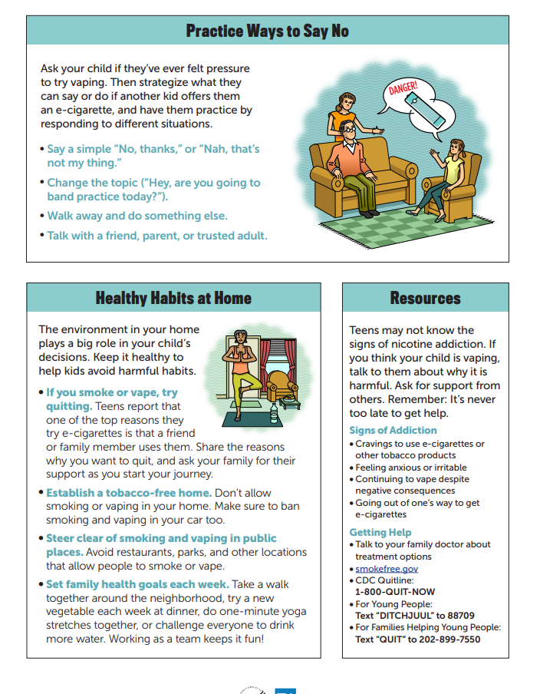
Vaping
Discuss vaping with your youth
https://www.scholastic.com/youthvapingrisks/pdfs/RealCostofVaping2022_MiddleSchool_Family_Resource.pdf
Delivery of potent drugs like THC

Slide 8
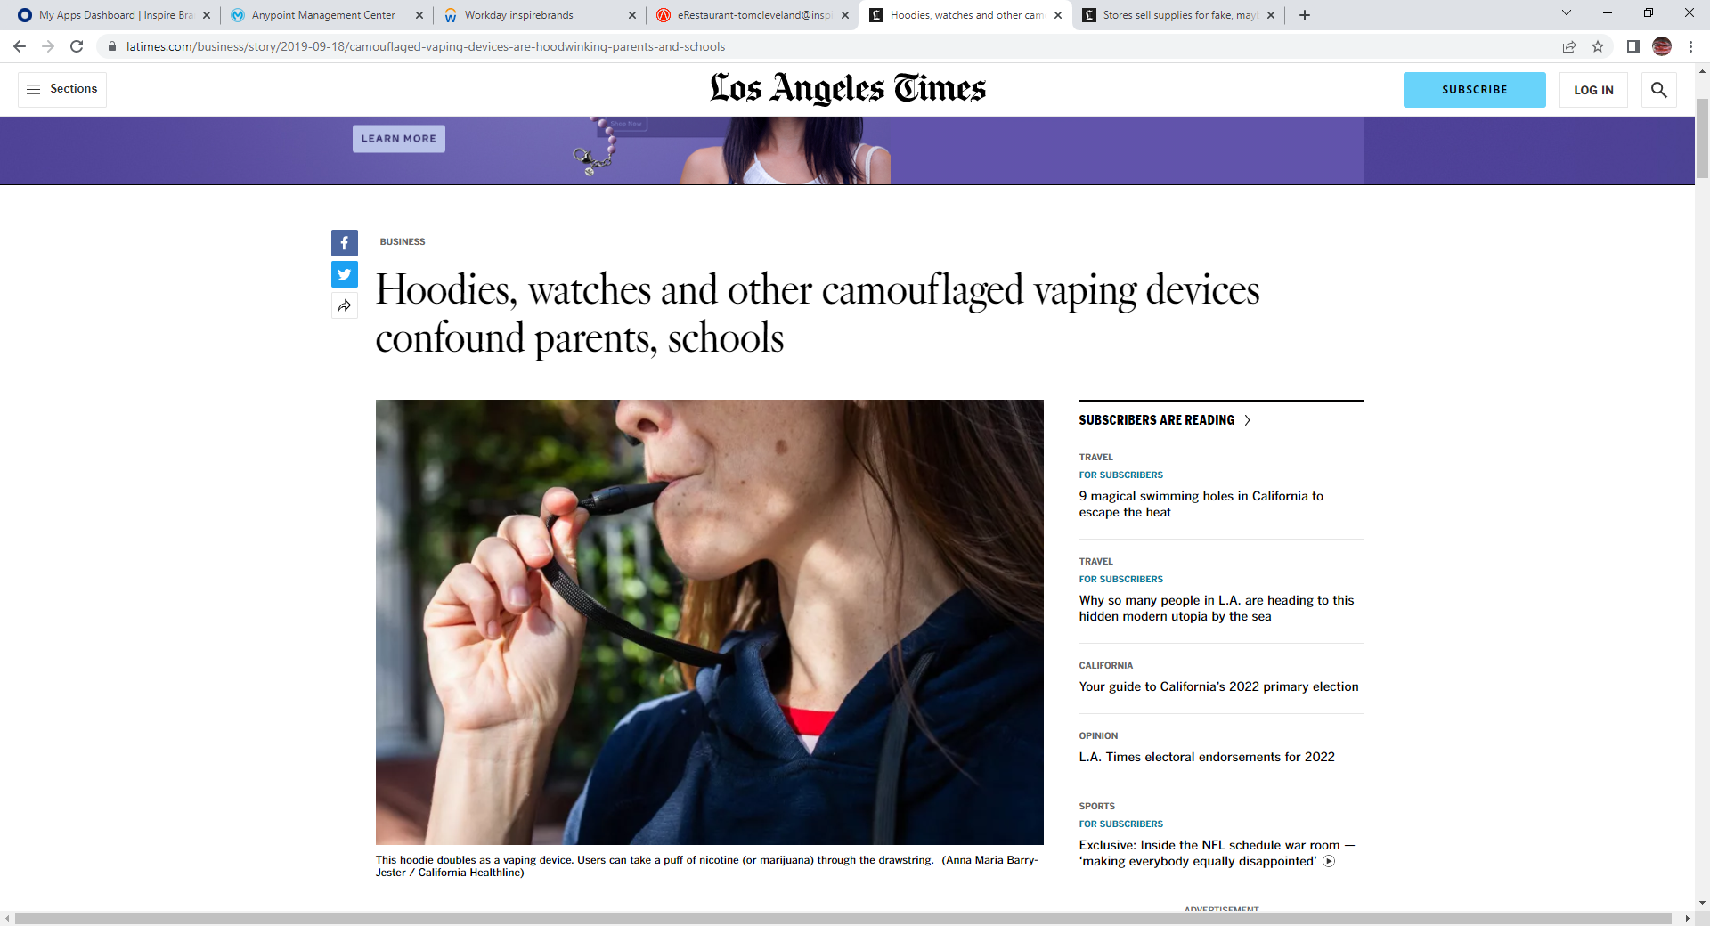

Slide 9
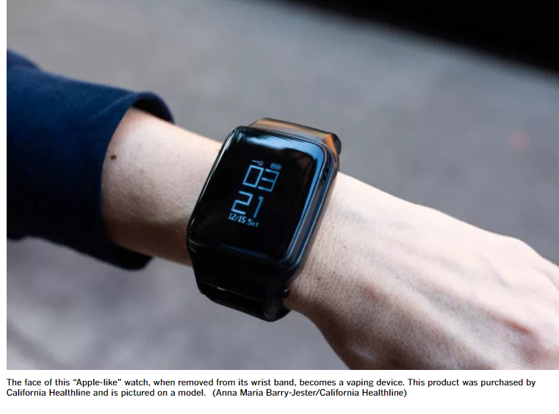
Many formats
Watches
Hoodies
USB Drives
Backpacks
Phone Cases
Computer Mouse

