Slide 1
FINANCIAL
STATEMENTS
FEBRUARY 2025

Slide 2
Goal 3 – Effective and Efficient Financial Planning – The FCS Governance Team has a responsibility to be very efficient and effective with the financial resources provided by our state, federal and local government and our citizens.
Action – The superintendent will ensure that the FY’25 budget that is presented to the BOE will meet the needs of our students and will maintain, at a minimum, a projected 15% fund balance.

Slide 3
STATEMENT OF CASH RECEIPTS & DISBURSEMENTS
FEBRUARY 28, 2025

Slide 4
YEAR-TO-DATE BUDGET REPORT AS OF 2/28/2025
REVENUE DETAIL

Slide 5
YEAR-TO-DATE BUDGET REPORT
AS OF 2/28/2025

Slide 6
DEBT SERVICES CASH ANALYSIS
FEBRUARY 28, 2025

Slide 7
SPECIAL REVENUE FUNDS
FEBRUARY 2025

Slide 8
CAPITAL PROJECTS & SCHOOL FOOD SERVICES
CASH ANALYSIS – FEBRUARY 28, 2025

Slide 9
INVESTMENT SUMMARY
ACTIVITY ANALYSIS – FEBRUARY 28, 2025

Slide 10
SPLOST VI APR 2022 TO MAR 2027
LGIP 8972-72455 – FEBRUARY 2025

Slide 11
CASH RECEIPTS & DISBURSEMENTS BY ELEMENTARY SCHOOLS
FEBRUARY 2025

Slide 12
CASH RECEIPTS AND DISBURSEMENTS BY MIDDLE AND HIGH SCHOOLS
FEBRUARY 2025

Slide 13
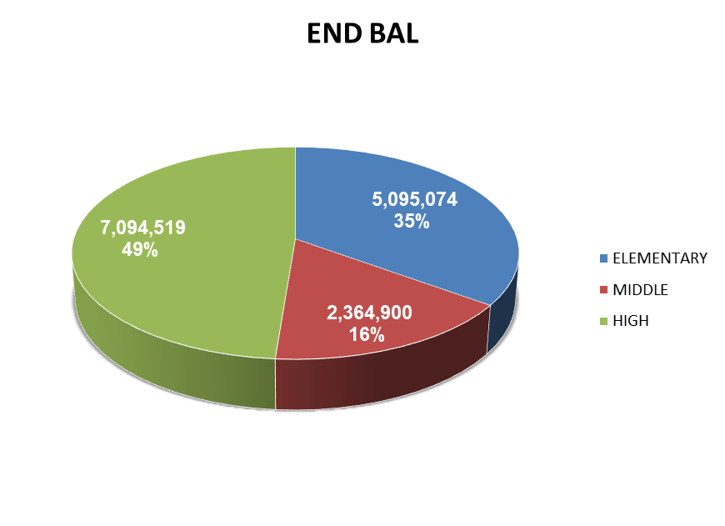
CASH RECEIPTS AND DISBURSEMENTS BY ALL SCHOOLS
FEBRUARY 2025

