Slide 1


YMMS TRAINING
SEPTEMBER 15 , 2024

Slide 2


New or Returning Directors/Secretaries.
Complete / Renew your Sterling Background Check is if needed. www.sterlingvolunteers.com
Update eAdventist status for new Pathfinder / Adventurer Year. Local Church Clerk would be the person to contact. www.eadventist.com

Slide 3
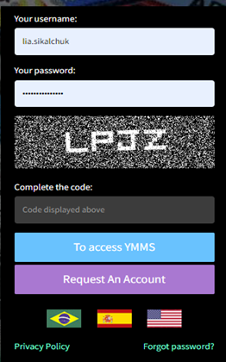
To Request / Reactivate an Account go to www.nadyouth.com Click on Request an account and follow the Steps to Update your personal information / registration After it is completed, it will take 2-3 days for the Conference Secretary to see and release your account When you log into your account make sure the CODE that is displayed is entered in CAPS

Slide 4
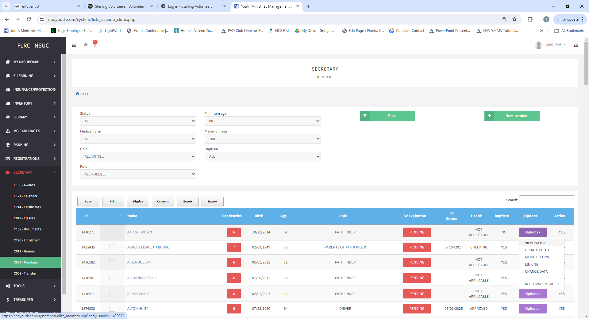
MEMBERS
To add a new member, click on
Secretary Tab
Members Tab
New Member
Fill out the application
Submit
If you need to change/update data for existing member, click on “Options” select “View Profile”

Slide 5
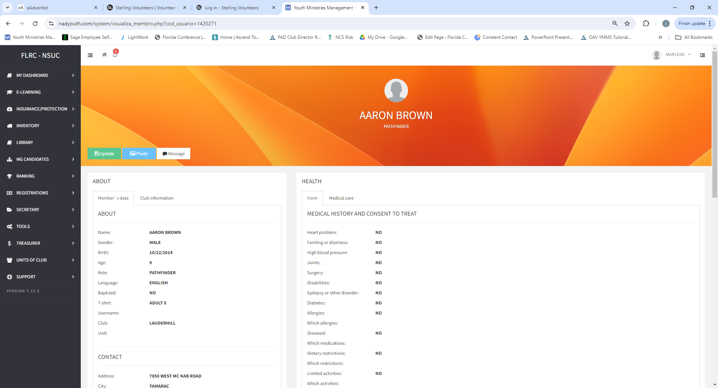
If you need to change / update personal data (DOB, SV date, Name) Click on “Update tab “
When update is completed scroll down and click “Save”

Slide 6
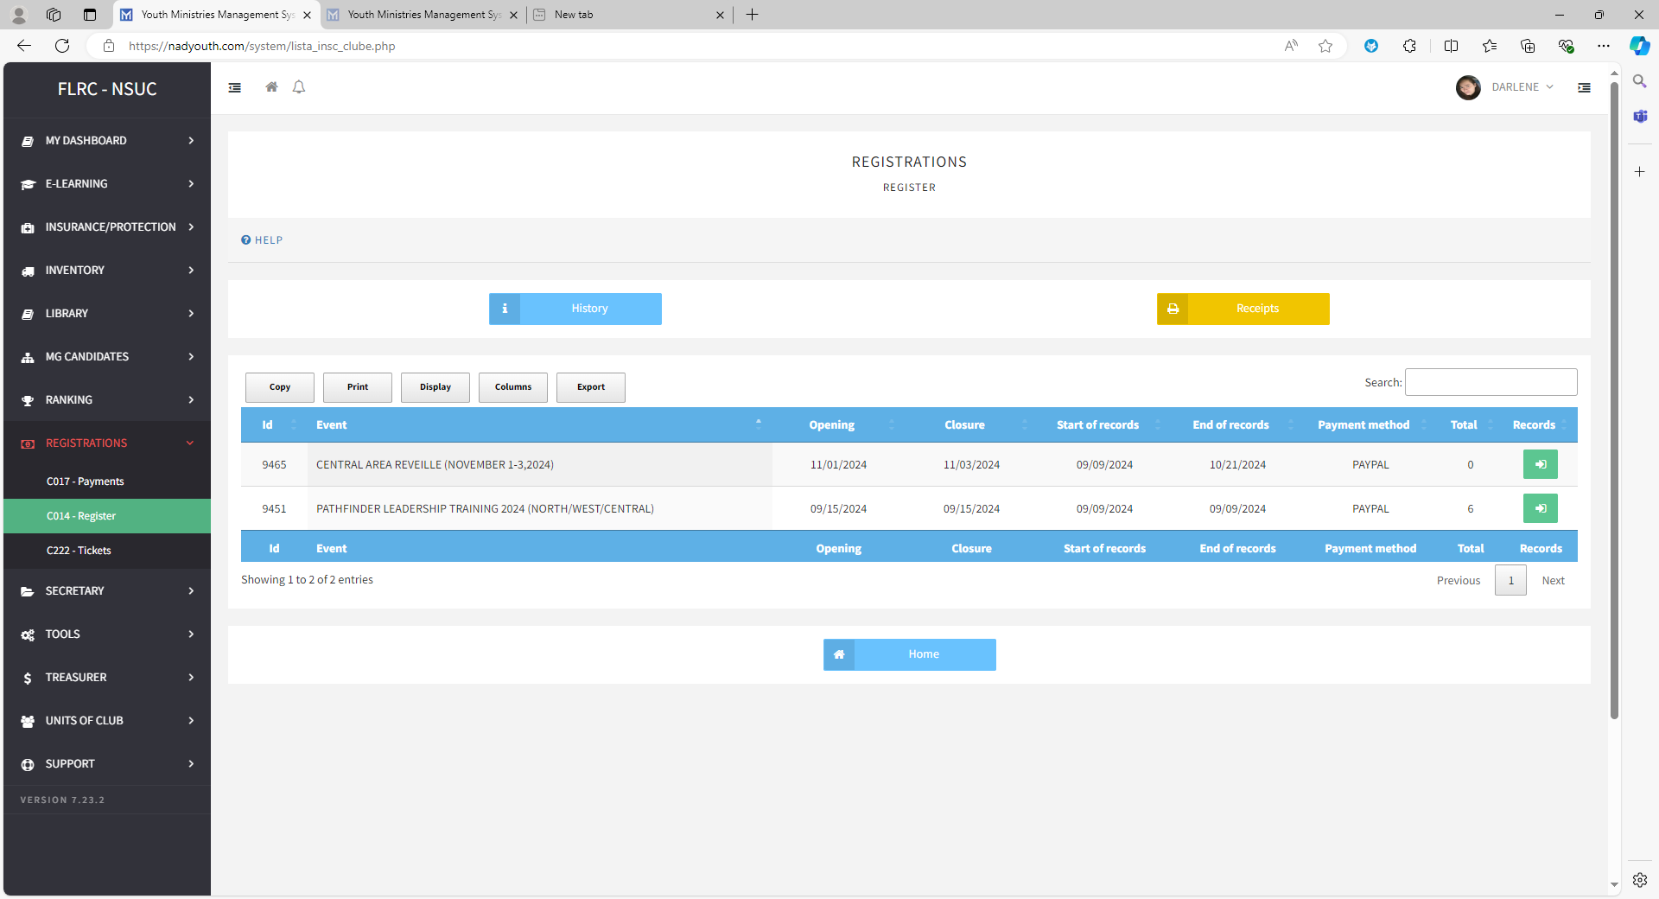
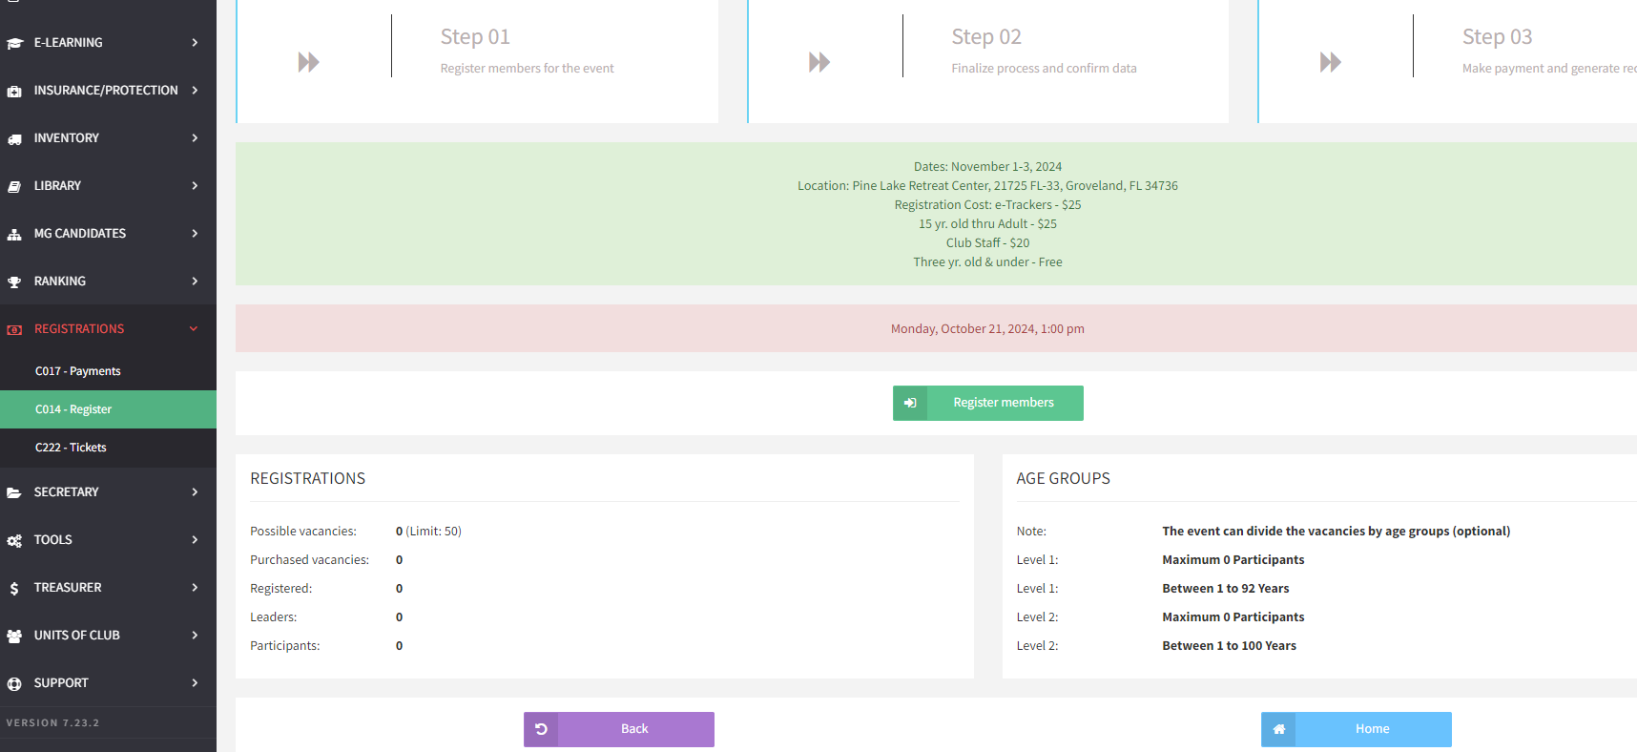
EVENT REGISTRATION 1. Secretary TAB – C014 / Register 2. Records 3. Register Members

Slide 7
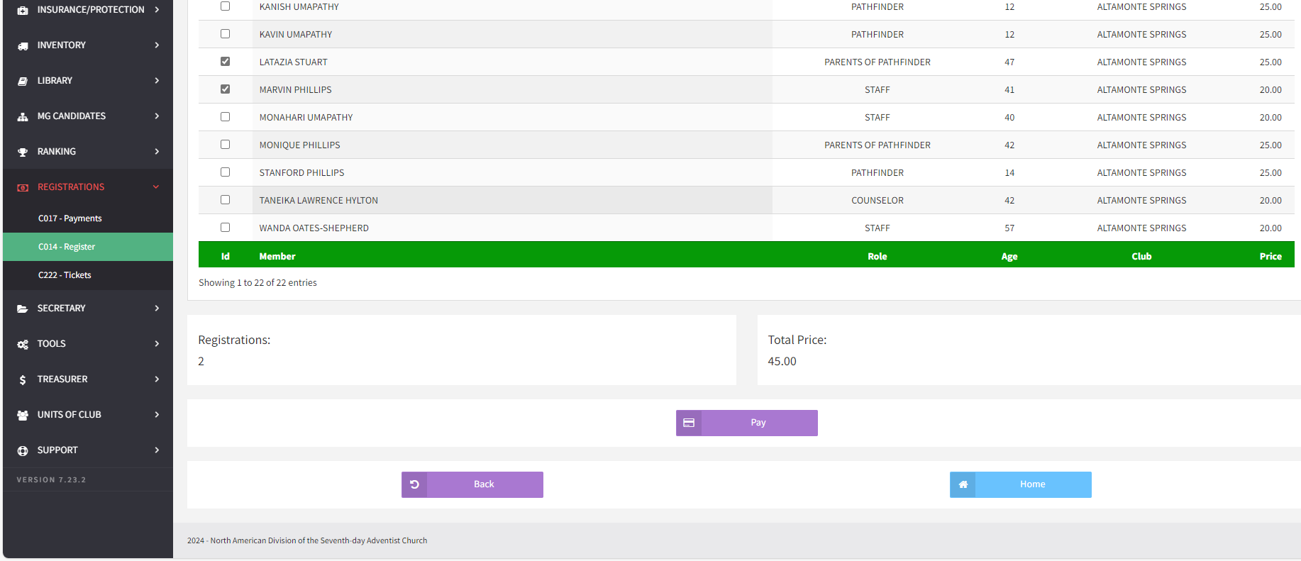
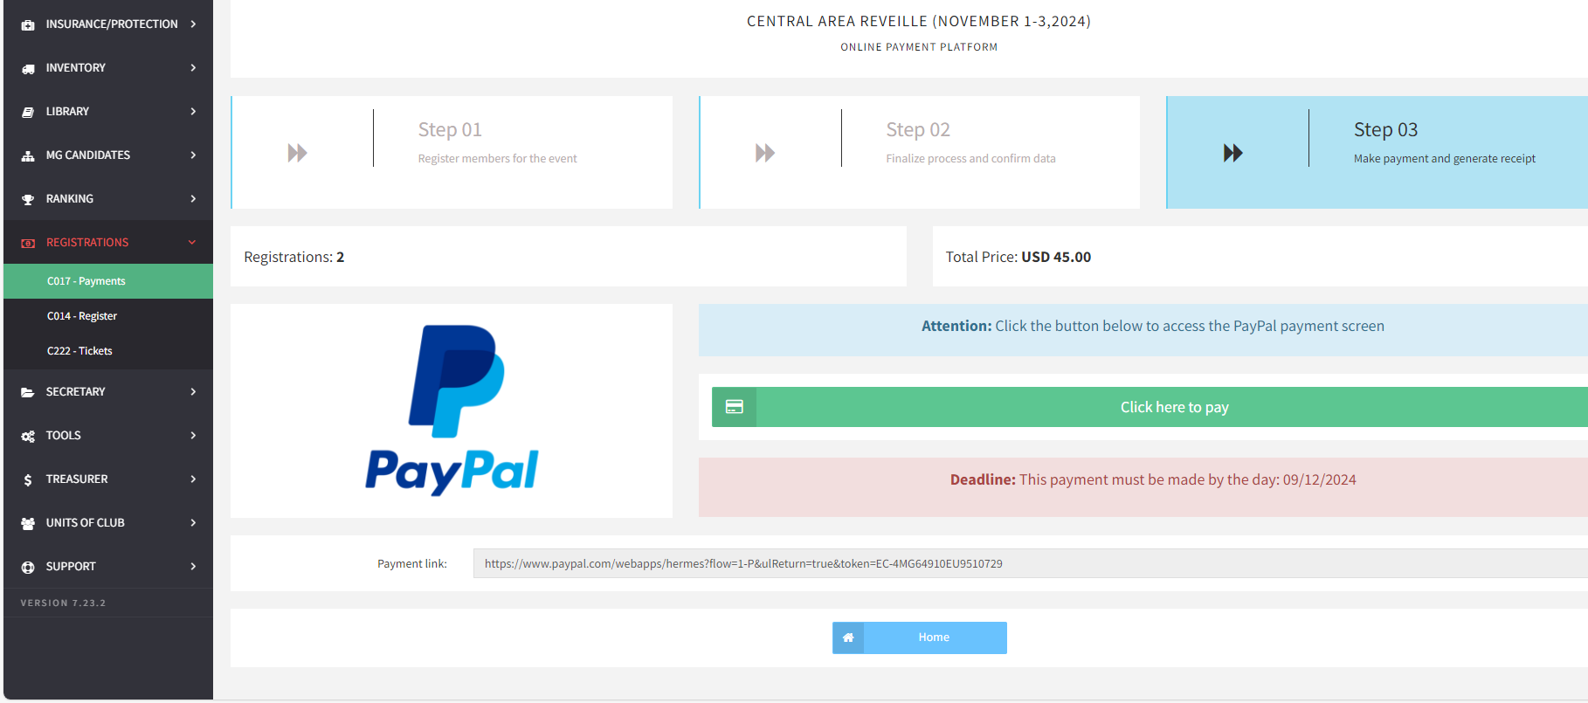
4. Select Members (by clicking the box next to the name) 5.Click on the “PAY” TAB 6. Proceed to a Payment Window ( PayPal / Credit /Debit Card )

Slide 8
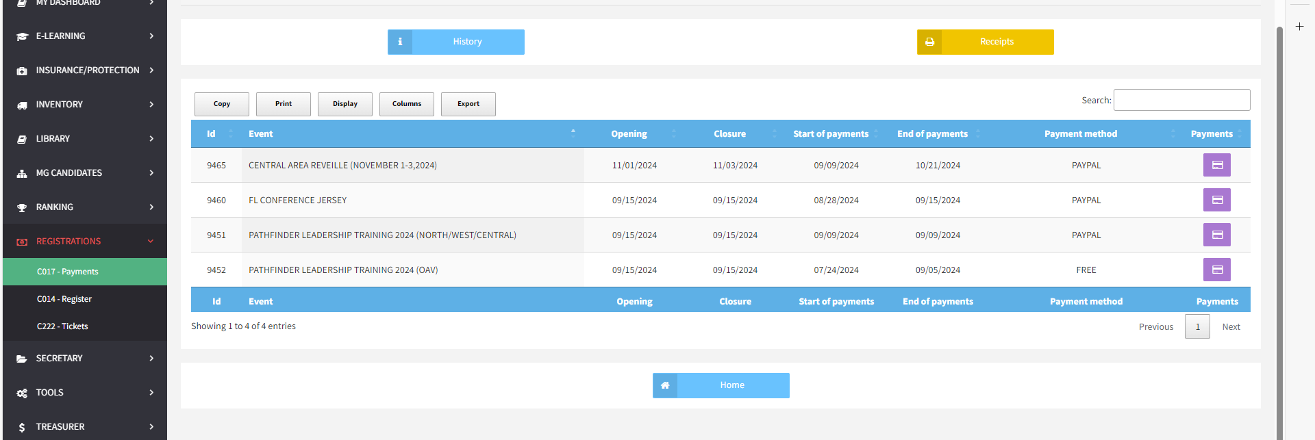
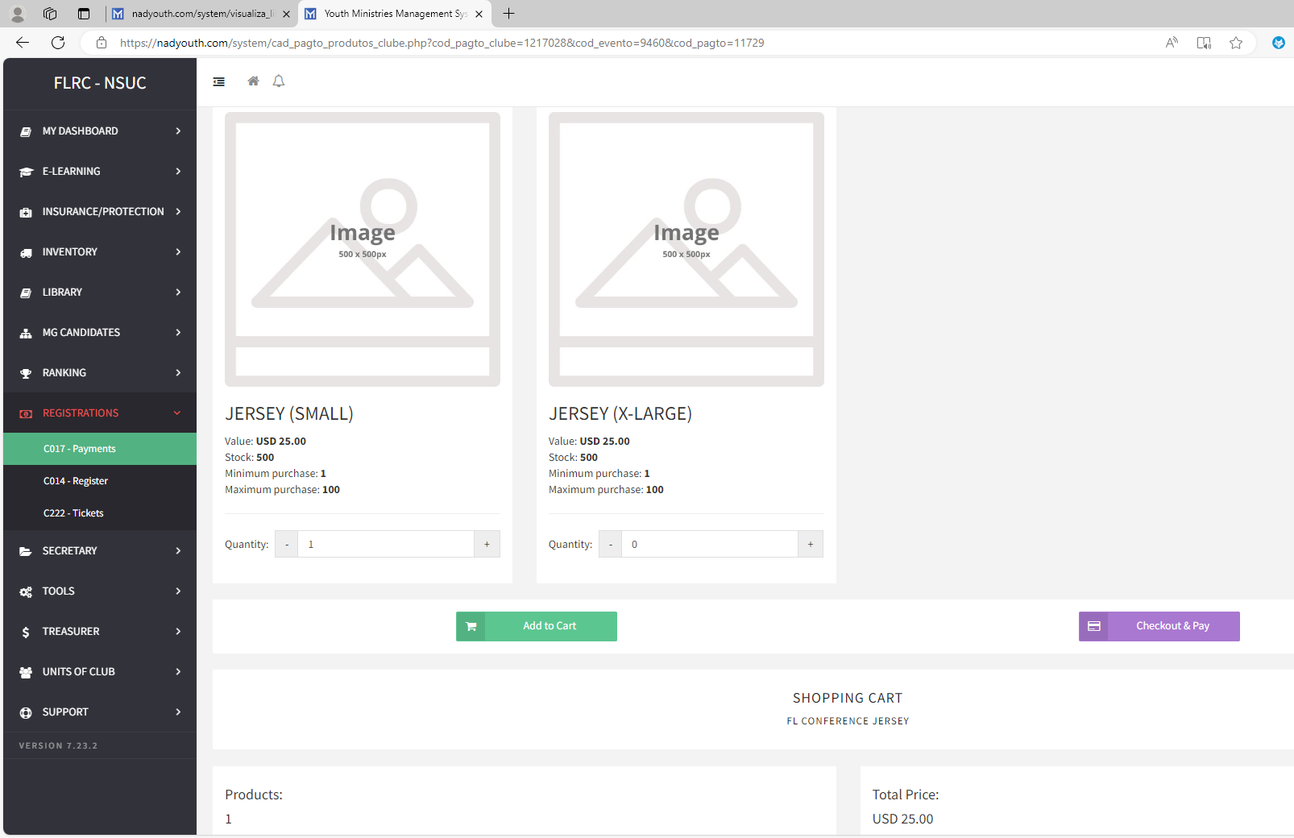
PURCHASING 1.Registration TAB – Payments 2. Payment Icon on the right side 3. Add Quantity – Add to Cart 4. Check out & Pay 5. Proceed to a PayPal Window

Slide 9
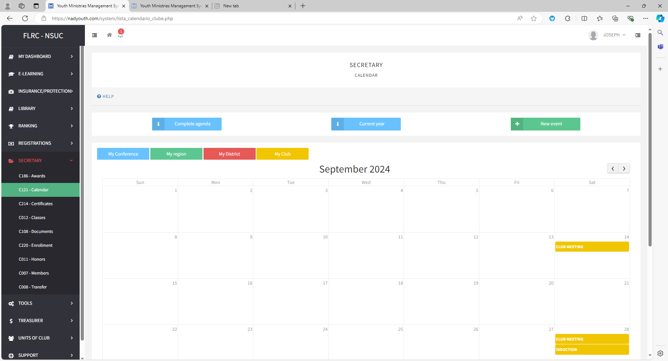
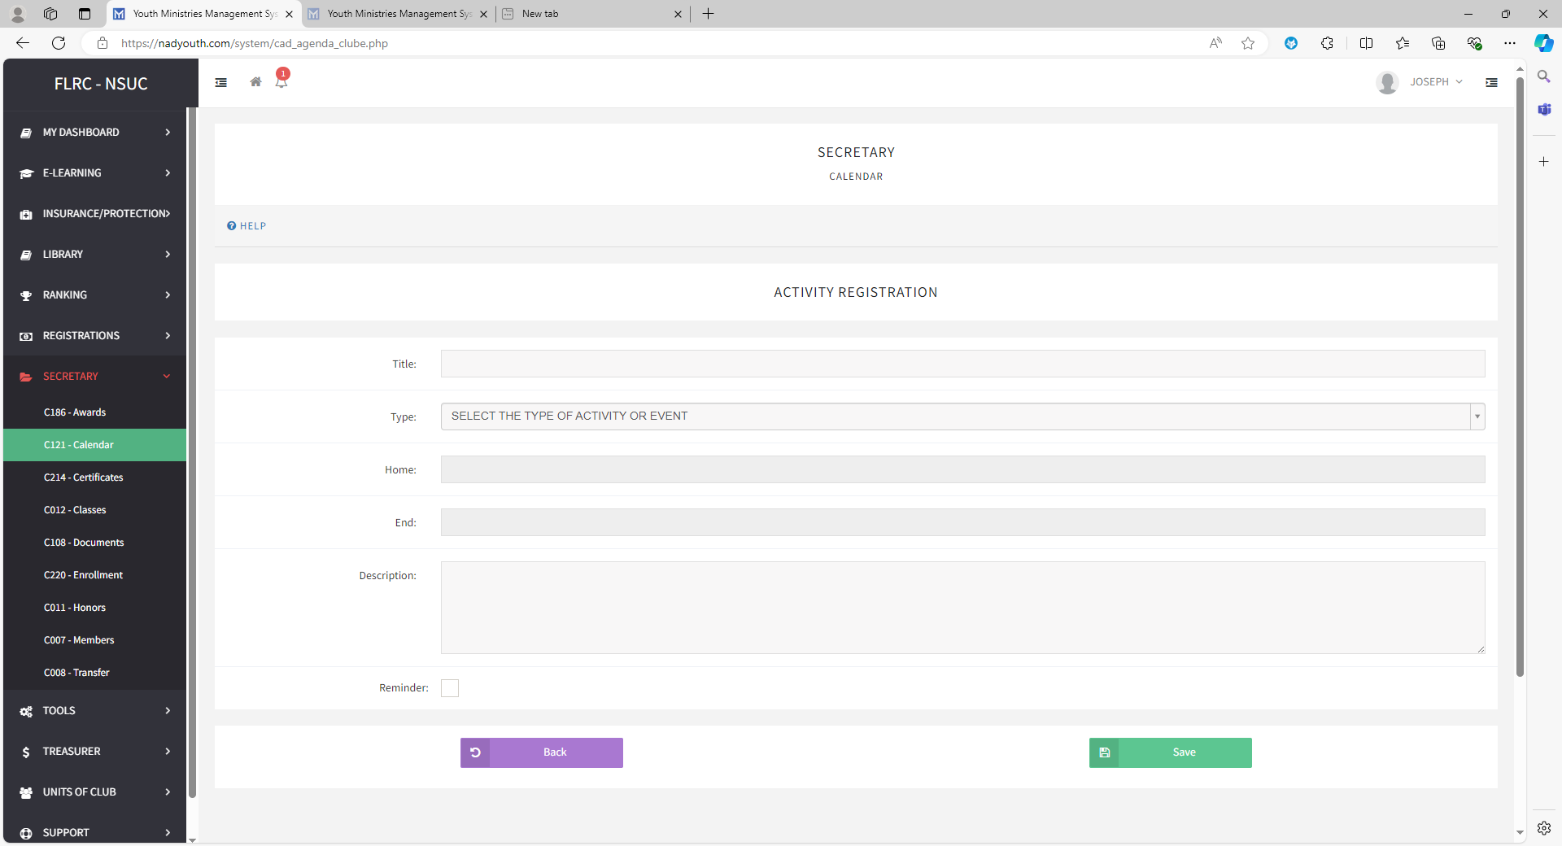
CALENDAR Must be Church Board Approved To add Events / Meetings: 1. Secretary TAB – Calendar – New Event 2.Enter Title – Select type of Event 3. Add a description 4. Set up a reminder ( if needed) 5. Click “Save”

Slide 10
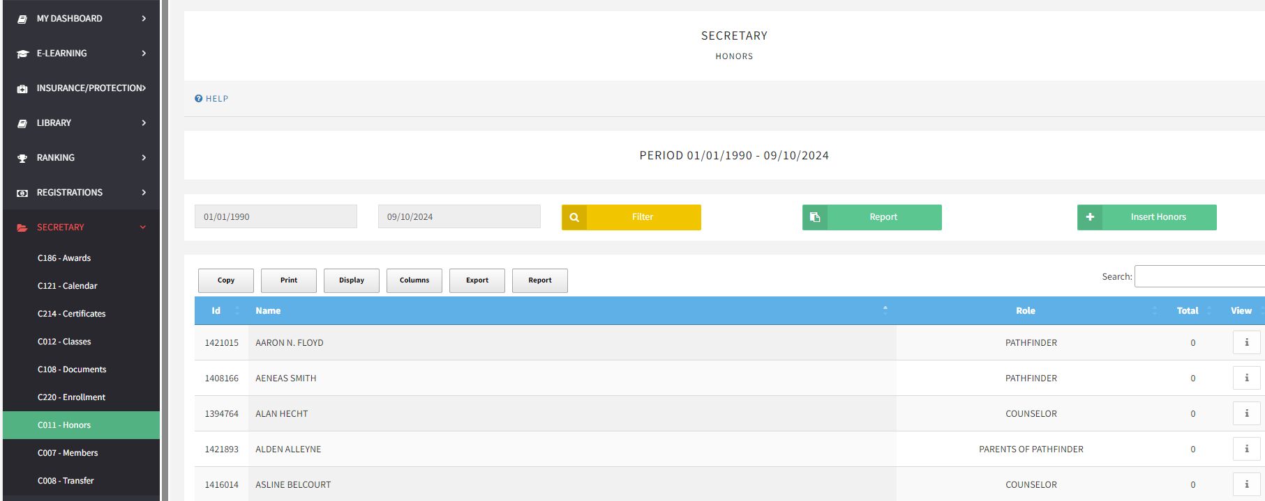
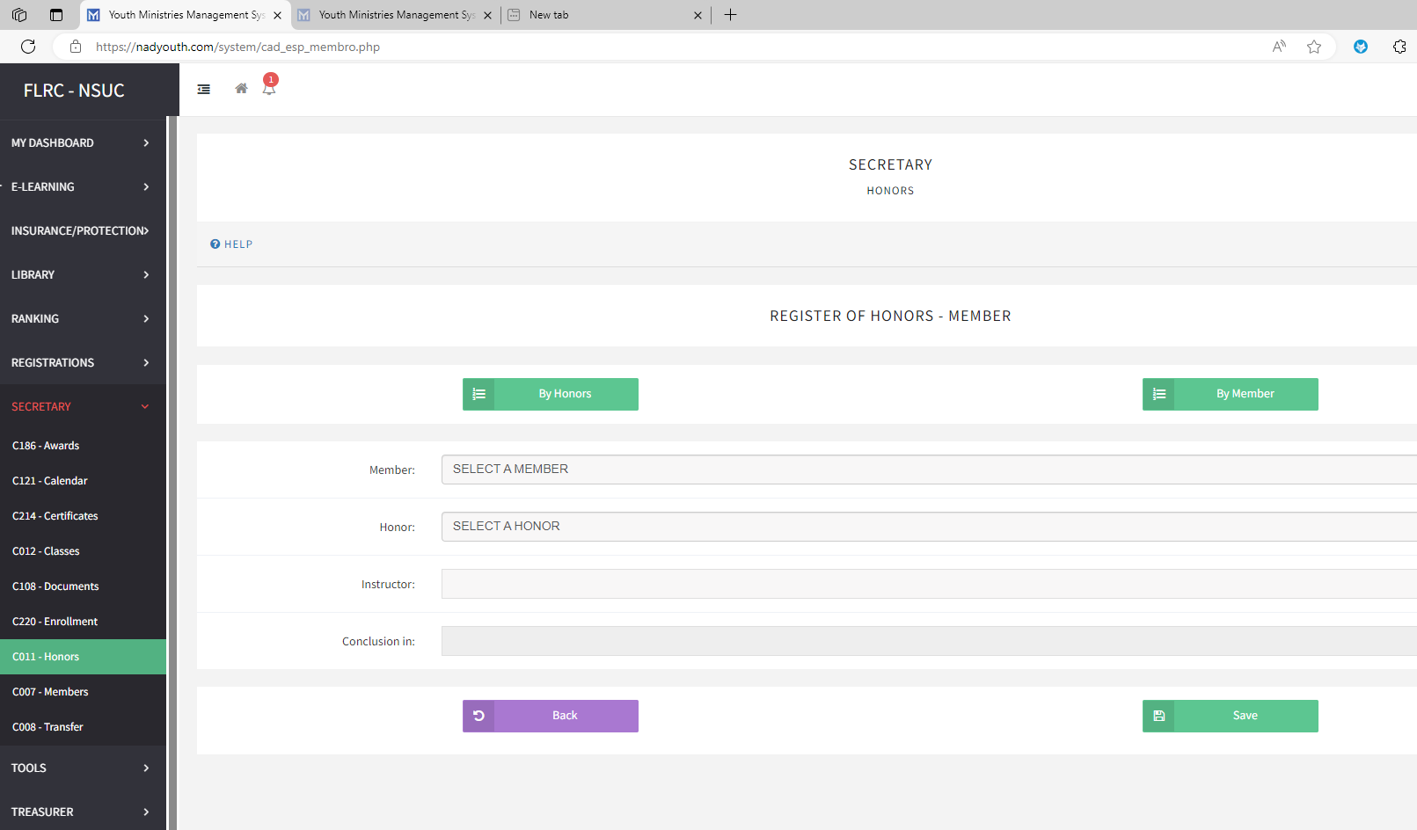
HONORS To Register for Honors: 1. Secretary TAB – C011/Honors 2. Insert Honors – Select a Member name – Select Honor 3. Enter Instructor’s name 4. Click “Save” If you have multiple members for the same Honor, you can select option “ By Honor” and register members by clicking on the box next to their name.

Slide 11
NORTH AREA
Pathfinder Area Administrator | Cherrie Betaudier | cab2da@aol.com
Pathfinder Cluster 3 | Albert Folson | folsonclub@aol.com

Slide 12
WEST AREA
Pathfinder Area Administrator | Yolanda Acevedo | Yolanda.Acevedo@gmail.com
Pathfinder Cluster 1 | Victoria Arnoux | ms_Arnoux@msn.com
Pathfinder Cluster 2 | Derryll Fox | dnfox@gmail.com

Slide 13
CENTRAL AREA
PATH Area Administrator | Lurlet Gordon | tinziela@gmail.com
PATH Zone A Administrator | John Estremera | estremerajohn@yahoo.com
PATH Cluster 1 | Richard Crespo | crespodas@gmail.com
PATH Cluster 2 | Erik Wyand | erikwyand@priserv.com
PATH Cluster 4 | Eric Hernandez | ericshernandez2000@gmail.com
PATH Zone B | Ruben Rodriguez | ruben29@hotmail.com
PATH Cluster 7 | Sai Vidal | vjarillo27@hotmail.com

