Slide 1
Sonoma County Department of Health Services Overview
Impact 100 Redwood circle – October 21, 2020

Slide 2
Mental Health & Substance Use Disorder Treatment in Sonoma County
Private Health Insurance & Providers
Service Sectors with Behavioral Health services
        Schools
        Primary Care inc. FQHCs
        First 5
        Private Non-Profits
        Others
Public Behavioral Health Services

Slide 3
Public Behavioral Health Services
Disaster Response
Crisis Response
        24/7 Crisis Hotlines
        Mobile Support Team
        Crisis Stabilization Unit
Variety of State & Federal Grants
MHSA – Prevention & Early Intervention

Slide 4
Public Behavioral Health Services
Medi-Cal Mental Health Plan
  Medi-Cal Beneficiaries
    Adults with Severe Mental Illness (SMI)
    Children with Serious Emotional Disturbance (SED)
Medi-Cal Substance Use Disorder Services Provider
  Medi-Cal Beneficiaries

Slide 5
Public Behavioral Health Services
Medi-Cal Mental Health Plan
  Serves over 3,500 individuals annually
  Roughly 70,000 service encounters a year
Medi-Cal Substance Use Disorder Services Provider
  Serves over 3,000 individuals annually

Slide 6
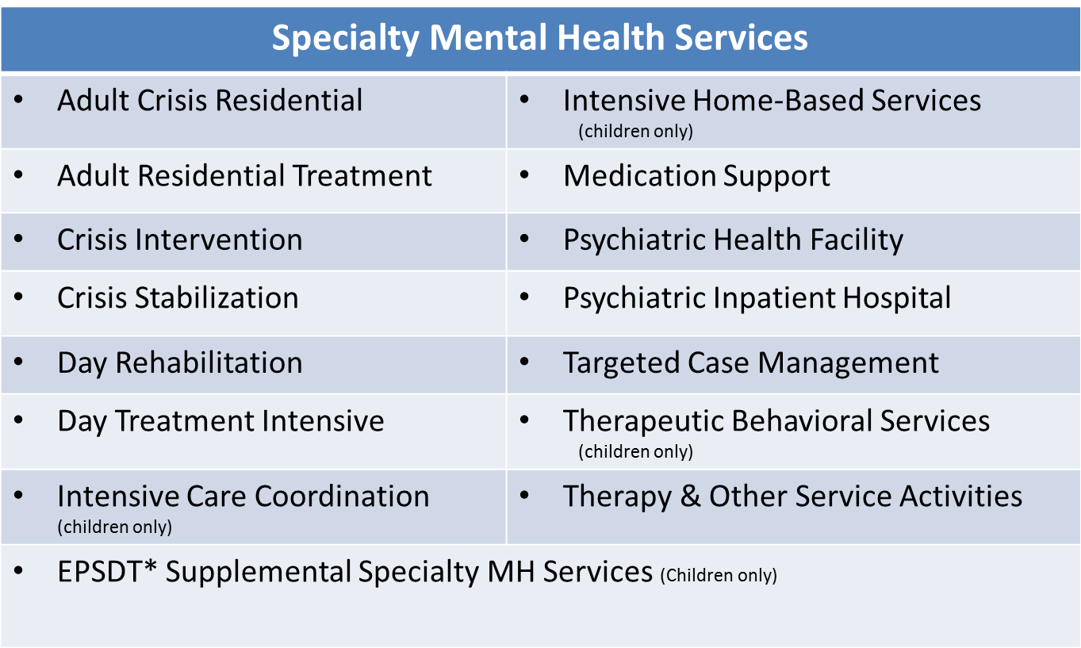
Public Mental Health Services – Types

Slide 7
Public Substance Use Disorder Services – Types
Drug Medi-Cal Services
Detoxification Services – social model | Adult Residential Treatment (30 Days)
Perinatal Residential | Perinatal Intensive Outpatient Services
Drug Court | DUI Program
Narcotic Treatment Program | Intensive Outpatient Services
Adolescent Outpatient Services

Slide 8
Mental Health Service Providers
Sonoma County DHS-BHD Programs
Community-Based Organizations
  Youth Providers
    LifeWorks
    Seneca Family of Agencies
    Social Advocates for Youth (SAY)
  Adult Providers
    Community Support Network (CSN)
    Buckelew
    Progress Foundation
    Telecare
  Crisis Services
    SOS Community Counseling

Slide 9
SUD Service Providers
Sonoma County DHS-BHD Programs
Community-Based Organizations
  Drug Abuse Alternatives Center (DAAC)
  Women’s Resource Center (WRS)
  California Human Development (CHD)
  Santa Rosa Treatment Program (SRTP)

Slide 10
Sonoma County Behavioral Health Special Issues
Fill gaps in crisis continuum
Improve outreach to Latinx population
Expand youth services
Housing & Homeless Services
Expand Forensic Services – Diversion
Local Suicide Prevention
Expand SUD Service System

Slide 11
Sonoma County Behavioral Health Services
  https://sonomacounty.ca.gov/Health/Behavioral-Health/
  https://sonomacounty.ca.gov/Health/Behavioral-Health/Mental-Health-Services-Act/
  Sonoma County Health Data
  https://sonomacounty.ca.gov/Health/Public-Reports/Health-Need-Assessments/Leading-Health-Indicators/

