Slide 1
MHANYS & MHFA
Presented by
Glenn Liebman, Chief Executive Officer
&
Katie Oldakowski, Director of Training

Slide 2
About MHANYS

Slide 3
Mission Statement
Mental Health Association in New York State, Inc. (MHANYS) improves the lives of individuals, families, and communities by raising mental health awareness, ending stigma and discrimination, and promoting wellness and recovery.

Slide 4
Affiliate Network
We are an affiliate of Mental Health America. Across New York State, we have 26 affiliates in 50 counties that offer a unique blend of services and programs focused on meeting the needs of their community.

Slide 5
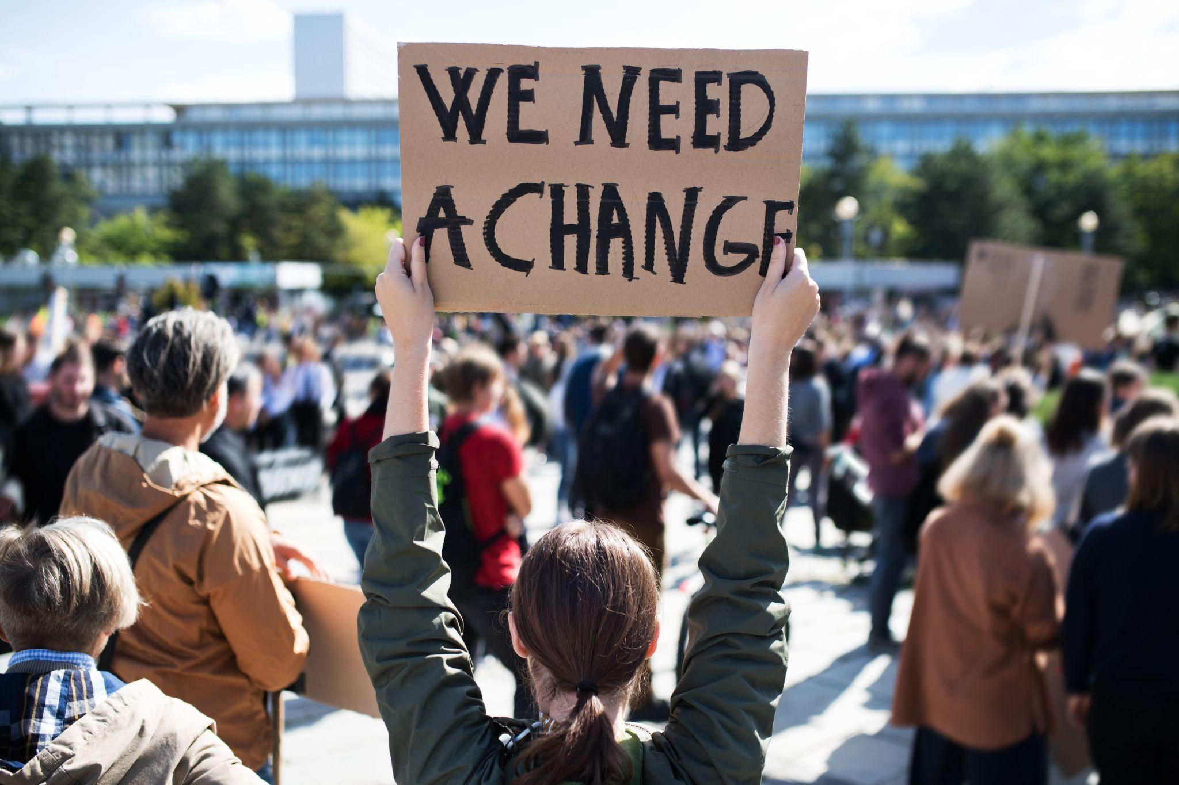
What We Do
Advocacy & Policy
Training & Certification
Support

Slide 6



MHANYS Programs
School Mental Health Resource and Training Center
Mental Health Community
Partners
MHANYS CarePathTM
Mental Health First Aid
And much more!

Slide 7
MHANYS & MHFA

Slide 8

History
Mental Health First Aid began in Australia in 2000
Evolved into a global movement, adopted and delivered in 24 countries
To date, over 6 million people worldwide have been trained
MHANYS MHFA:
Adult in 2010
Youth in 2014
Teen in 2023

Slide 9
What is Mental Health First Aid?
Evidenced based mental health literacy program
Skills based training program that teaches:
  Signs and symptoms of mental health and substance use
  Action plan to identify, support and engage individuals that may be or are struggling with mental health challenge or substance use
  What to do when someone says no
Does not diagnose

Slide 10
The Data
KEY FINDINGS:
Increased mental health literacy among participants after the training
Increased confidence/self-efficacy and likelihood to help an individual in distress
Reduced stigma and increased empathy toward individuals with mental health challenges

Slide 11

Adult MHFA Training Opportunity
Provides Adult MHFA training to 3 populations in the Capital Region (Albany, Saratoga, Schenectady & Rensselaer County):
Military/veterans & families
EMS/fire
Primary & specialty care providers

Slide 12

Teen & Youth MHFA
Youth: Provide yMHFA for adults that work or have contact with youth ages 12-18
Teen: Provide teenMHFA to teens ages 15-18

Slide 13
Thank you!

