Slide 1
COVID-19 Analytics
Hospital resource utilization forecasting
October 12, 2021

Slide 2
The COVID patient census in N.C. hospitals continued to decline this past week

Slide 3
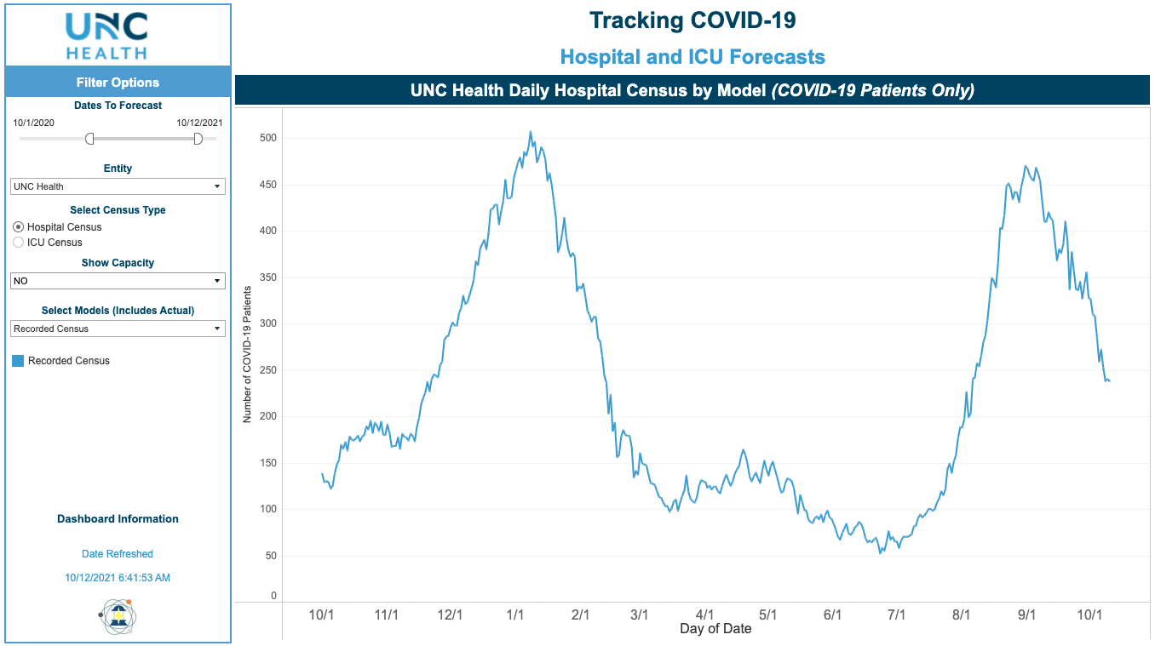
UNC Health hospitals’ COVID patient census also declined over this past week

Slide 4
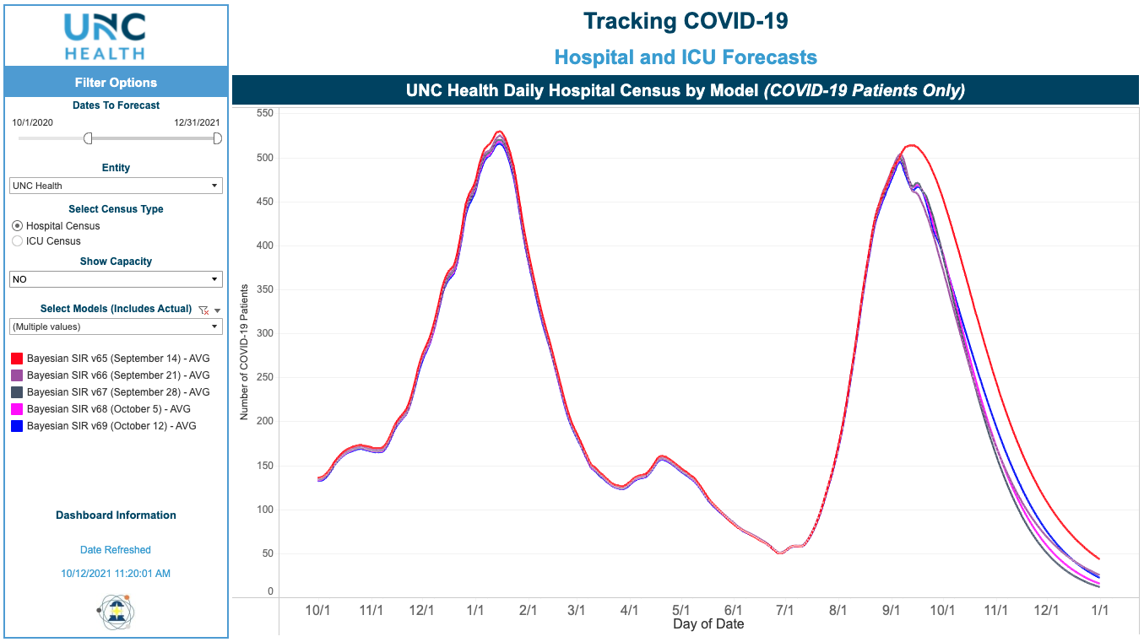
The UNC Health forecast estimates a continued decline The model forecast assumes a continuation of the current rate of person to person transmission

Slide 5
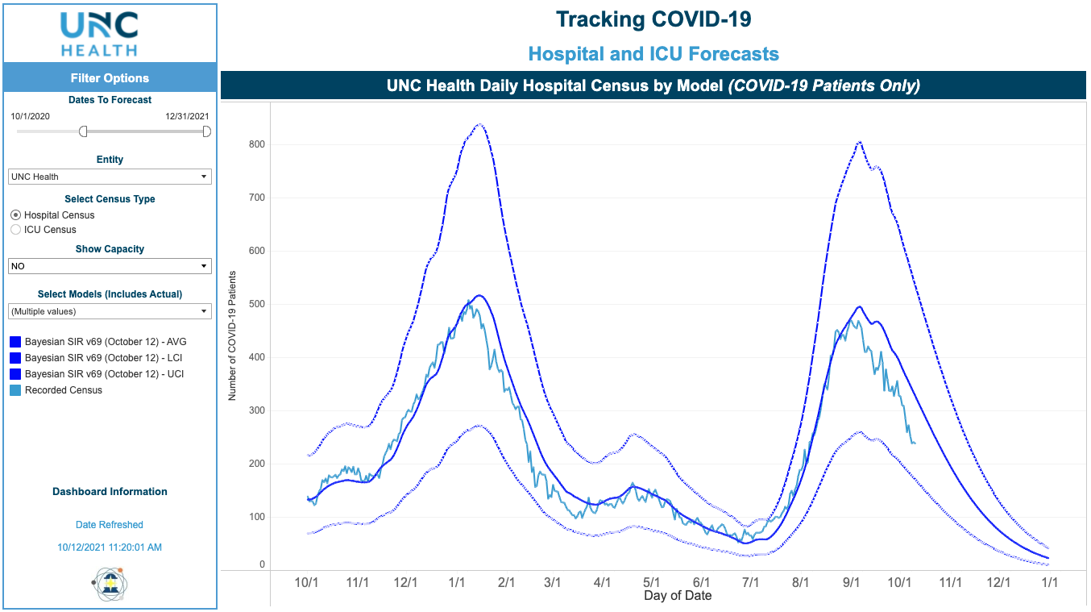
UNC Health observed data and updated forecast range

Slide 6
Modeling Update
The NC & UNC Health COVID hospitals census has continued to decline over the past week.
The forecast this week is very similar to the past three forecasts.
Even with this decline, many NC hospitals are challenged to meet the demand for ICU level care.
The significant effort and teamwork by UNC Health entities is making a real difference for our patients and colleagues.
We need to continue to continue our strong advocacy for vaccination, including boosters for patients (65+ and other high risk) and our colleagues.
The model, including entity specific data (accessed via a dropdown menu in the left margin), is available in the COVID dashboard section of the UNC Health intranet. Please use your entity modeling coupled with the UNC Health and state trends to inform your planning.

