Slide 1
One Sky, One Voice
Las Vegas, NV – NATCA ATX
DEC 12-16, 2022

Slide 2
Objectives of IFATCA
The objectives of the International Federation of Air Traffic Controllers' Associations are:
a. To operate as a non-­profit and non-­political federation of air traffic controllers' associations;
b. To promote safety, efficiency and regularity in International Air Navigation;
c. To assist and advise in the development of safe and orderly systems of Air Traffic Control;
d. To promote and uphold a high standard of knowledge and professional efficiency among Air Traffic Controllers;
e. To protect and safeguard the interests of the Air Traffic Control profession;
f. To make mutual benefit affiliations with other international professional organisations;
g. To strive for a world‐wide Federation of Air Traffic Controllers' Associations.
— Constitution of IFATCA

Slide 3
Who & What is IFATCA?
IFATCA was founded in 1961 by air traffic controllers from 12 European countries. It has since grown to over 130 Member Associations (MA) & represents more than fifty thousand air traffic controllers world-wide.
Today IFATCA is well represented in international forums involving:
  International Civil Aviation Organization (ICAO),
  International Transport Workers’ Federation (ITF),
  International Labour Office (ILO),
  International Federation of Air Line Pilots’ Associations (IFALPA),
  International Air Transport Association (IATA),
  CANSO, IFATSEA and others.

Slide 4

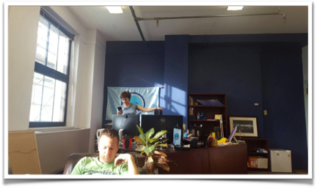
IFATCA Headquarters
360, Rue St. Jacques,
Suite #2002
Montreal, Quebec H2Y 1P5 Canada
Email: office@ifatca.org

Slide 5
IFATCA Executive Board
(Elected to 2-year terms)
PCX, Duncan Auld
DP, Helena Sjöström
EVPF, Mark Taylor
EVPT, Ignacio Baca
EVPP, Peter van Rooyen
EVP EUR, Fred Deleau
EVP AFM, Fateh Behkti
EVP AMA, Trish Gilbert
EVP ASP, Cheryl Chen
(Appointed, non-voting)
Communications Coordinator, Philip Marien (2023 Conference will be Nicola NiRiada)
ICAO ANC, Jean Francois (JF) Lepage
Office Manager, Tatiana Iavorskaia

Slide 6




The Regions
It has been IFATCA’s experience that our general policy, particularly in the technical field, cannot always be uniformly implemented throughout all regions of the world.
To meet these requirements - from 1980 to 1990 there were 12 regions (North and Central America, South America, Caribbean, Pacific, Asia, Middle East, Europe Central, Europe West, Africa East, Africa West, Africa North) and RVPs were not part of the EB.
In 1990 four regions were formed and the EVPs became part of the EB:
AFM
Africa & Middle East
AMA
Americas
ASP
Asia Pacific
EUR
Europe

Slide 7
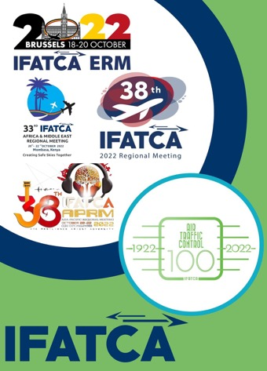
Regional Meetings-Held annually between Sept. & Jan.
To fulfil IFATCA’s objectives to protect & safeguard the interests of air traffic controllers & the profession
To promote & uphold a high standard of knowledge & professionalism among air traffic controllers through the origination of policies & sharing of knowledge
To create, maintain, & enhance the worldwide fellowship of air traffic controllers
While the RMs allow for attendees to learn, share essential information, & provide for a continuous exchange of ideas & experiences. It is also imperative that we teach & encourage our MAs to demonstrate their value by seeking to develop a collaborative & effective relationship w/aviation authorities & ANSPs

Slide 8
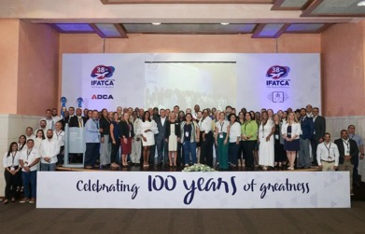
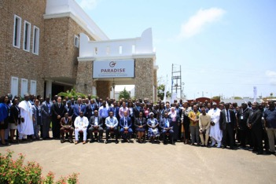
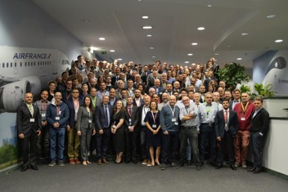
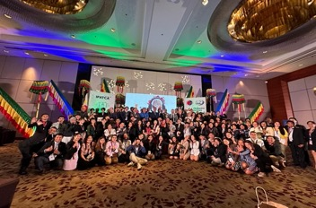
Regional Meetings

Slide 9
Americas Region
MAs : Argentina, Aruba, Bahamas, Barbados, Bermuda, Bolivia, Brazil, Canada, Cayman Islands, Chile, Costa Rica, Curacao, Dominican Republic, El Salvador, Guyana, Haiti, Honduras, Jamaica, Mexico, Panama, Trinidad and Tobago, St. Lucia, United States, Uruguay (24)
RVPs: S. America - Mario Libran, S. Caribbean - Ameer Chattergoon, N. Caribbean - Ramon Armora & C. America - Ronald Vega (elected RM 2021, new term RM 2023)
ICAO Offices: Montreal, Canada, Mexico City, Mexico & Lima, Peru
Regional Involvement Globally: ICAO ANC Liaison – JF Lepage CA, TOC Chair – Jaymi Steinberg USA, TOC member – Betsy Beaumont USA, PLC member – Michelle Trudeau USA, FIC member – Matthew Narine T&T, EDI TF – Ronald Vega CR and Rossana Croci UY, 2030+ TF – Jaymi Steinberg USA & Kendell Peter St. Lucia, Remote Towers – Adam Rhodes USA, ADOP – Bridget Singratanakul USA, METP – Eric Avila USA

Slide 10
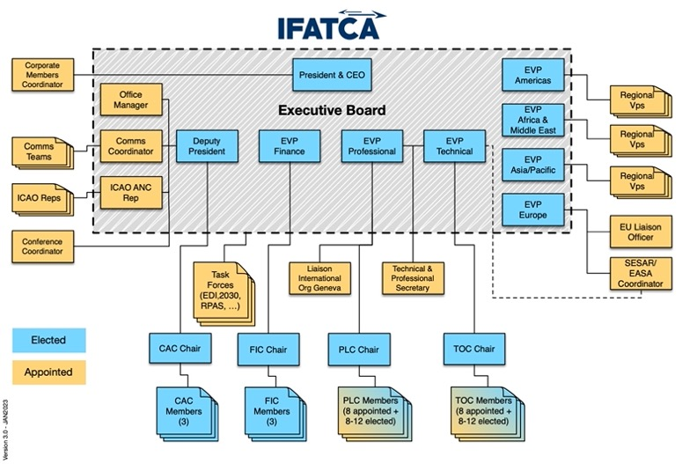

Slide 11
IFATCA Standing Committees
Finance Committee (FIC)
Constitutional and Administrative Committee (CAC)
Technical and Operations Committee (TOC)
Professional and Legal Committee (PLC)

Slide 12
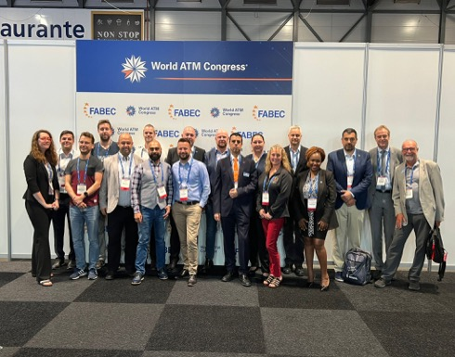
TECHNICAL (TOC) AND PROFESSIONAL (PLC) COMMITTEES
Study of new subjects
Drafting of policies via WPs
Keeping TPM up to date

Slide 13
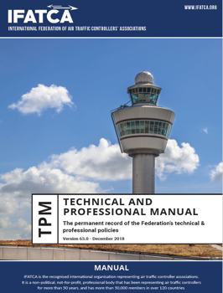
Policy Development
Participation in WG with our partners
IFATCA Standing Committees will produce Working Papers for conference
The Working papers will after discussions lead to either
...Information papers, Recommendations Or Policy
… And will be included in the MANUAL
All WPs are available from the IFATCA website
The Technical & Professional Manual serves as guideline for discussion on regional level and will be updated according to input received

Slide 14
TECHNICAL (TOC) AND PROFESSIONAL (PLC) COMMITTEES
CURRENT WORK PROGRAM
Airspace/Flight Rules ref. UAS Integration
Artificial Intelligence
Very High Altitude Ops.
Truth North vs. Magnetic North
Controller Staffing
Relief from Position after an Occurrence

Slide 15


Air Navigation Commission, ANC - 19 member states plus other organizations, of which IFATCA is one.
The Air Navigation Commission (ANC) considers and recommends Standards and Recommended Practices (SARPs) and Procedures for Air Navigation Services (PANS) for adoption or approval by the ICAO Council.
Every third year – ICAO ASSEMBLY. 193 member states plus all organizations.

Slide 16
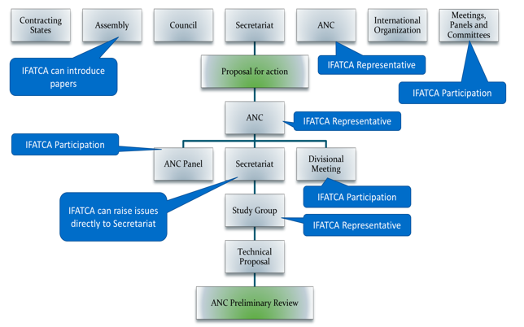
The influence of IFATCA

Slide 17
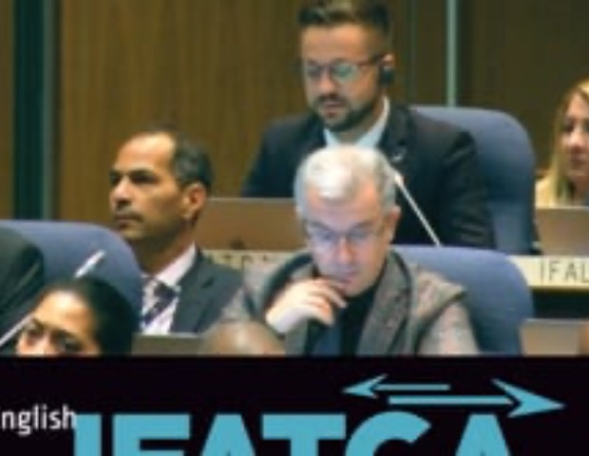
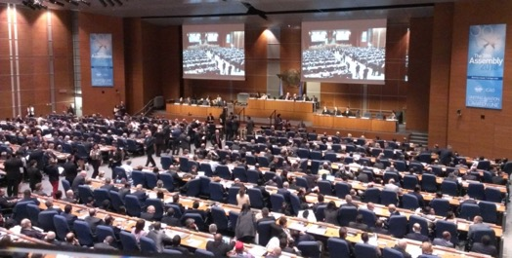
The ICAO Assembly
IFATCA's comments on Working Paper 230 - standardizing of working practices during abnormal traffic levels whilst maintaining training efficiency

Slide 18
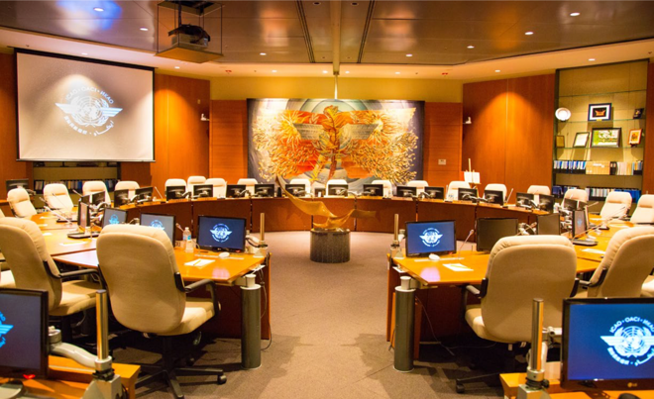
The Air Navigation Commission

Slide 19
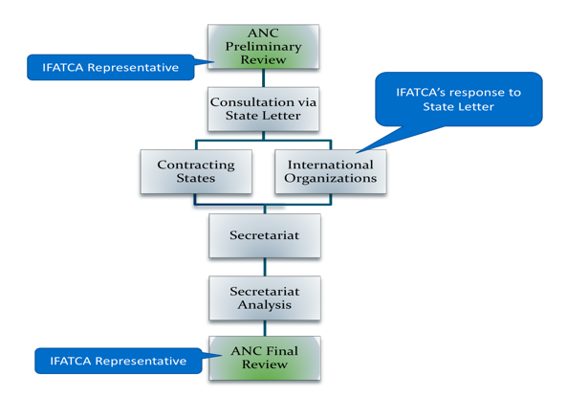
The influence of IFATCA

Slide 20
ICAO Panels with IFATCA Reps.
ADOP (Aerodrome Design and Ops Panel)
ATMOPS (ATM Ops Panel)
ATMRPP (ATM Requirements and Performance panel)
CP-OPDLSGW (Comms Panel, Datalink Specific WG)
FLTOPSP (Flight Ops Panel)
METP (Meteorology Panel)
IFPP (Instrument Flight Procedures Panel)
PTLP (Personnel Training and Licensing Panel)
RPASP (RPAS Panel)
SMP (Safety Management Panel)
SP (Surveillance Panel)
Chair, SASP (Separation and Airspace Safety Panel) David Perks, AUS.

Slide 21
CURRENT IFATCA Task Forces
UASTF
RTTF
IFATCA2030+
EDITF
100YATC

Slide 22
CURRENT IFATCA ADHOC Committees & Work Groups
COMMS
Speak English Program (SEP) Secretariat
??
IFATCA Course Instructors
TRAINING*
* Working to Set-up

Slide 23







We have social media
23

Slide 24


Executive Board
Distributed monthly via
Updates on recent IFATCA activity
MA liaison receives via email (WhatsApp) and forwards
An individual can subscribe, email trish.gilbert@ifatca.org for a link
24

Slide 25
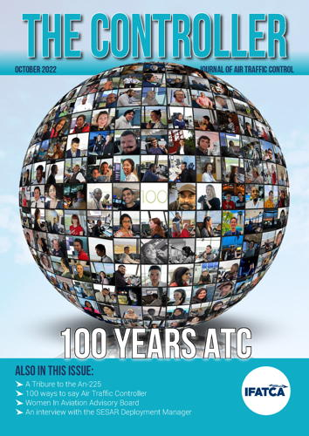
The Controller Magazine
The official journal of IFATCA. The journal addresses all aspects of air traffic control, with an emphasis on human factors and new technology.
The Controller finds its readership amongst Air traffic control personnel, civil and military ATC administrations, national and international aviation organizations, airline management and aircrew, aviation academics, Universities.
The magazine is distributed electronically via different platforms: the IFATCA website, and a downloadable PDF and via issuu.com - where it is also possible to order printed copies.
Visit the controller website on www.the-controller.net

Slide 26
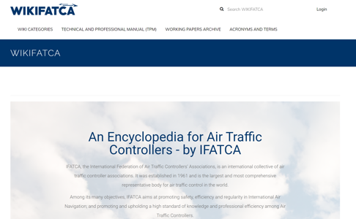
www.ifatca.org | wiki.ifatca.org

Slide 27
Guidance Material
Just Culture
Educational Issues on Distractions
Unstable Approaches
Accident/Incident Investigation
Fatigue (IFATCA and joint w/ ICAO)
Critical Incident Stress Management (CISM)
Crisis Management
Training

Slide 28
Guidance Material
Icing
Remote Tower
ICAO SID/STAR Phraseology
Volcanic Ash
Low level drone ops. near controlled airports
TCAS Procedures
Model of Employment Agreement
Unlawful Seizure of Aircraft and with Civil Aviation & Facilities

Slide 29

Annual World Conference
May 8-12, 2023 in Montego Bay, Jamaica
2024 TBD

Slide 30
Plenary (opening/closing)
Educational Briefings & Panels
Committees A, B and C
A
WPs
FIC/CAC
B
WPs
TOC
C
WPs
PLC
A (maybe B/C)
WPs
MAs or Other Committees

Slide 31
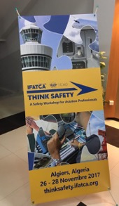
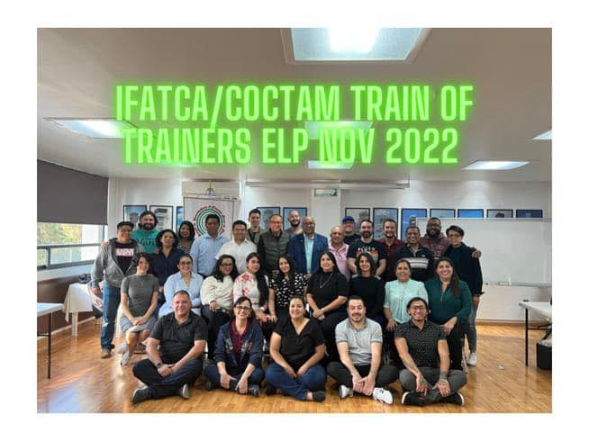
COURSES
THINK SAFETY
ENGLISH PROFICIENCY
PROSECUTOR EXPERT
COMPETENCY BASED TRAINING
CRITICAL INCIDENT STRESS MANAGEMENT (CISM)

Slide 32

Speak English Program
A controller's language & communication skills are critical. As English is the international language requirement for aviation professionals, it is therefore a priority to strengthen the general communication & English language skills of all Controllers.
The program:
To help enhance the English-speaking capabilities of ATC around the region.
To create a welcome & friendly English-speaking environment without any judgement or pressure.
An environment where air traffic controllers can practice plain English language & build up self-confidence in both usual & unusual situations that necessitate departure from standard R/T phraseology.
The IFATCA Speak English Program (SEP) is not only to help the participants improve speaking English, but to help them be able to think in English, thus improving their overall English abilities.

Slide 33
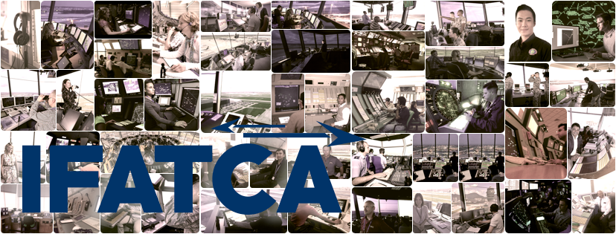
If you are interested in volunteer work with IFATCA,
contact NATCA’s EVP Andrew LeBovidge @ alebovidge@natca.org.

Slide 34
Thank you for your attention!
Questions?

