Slide 1
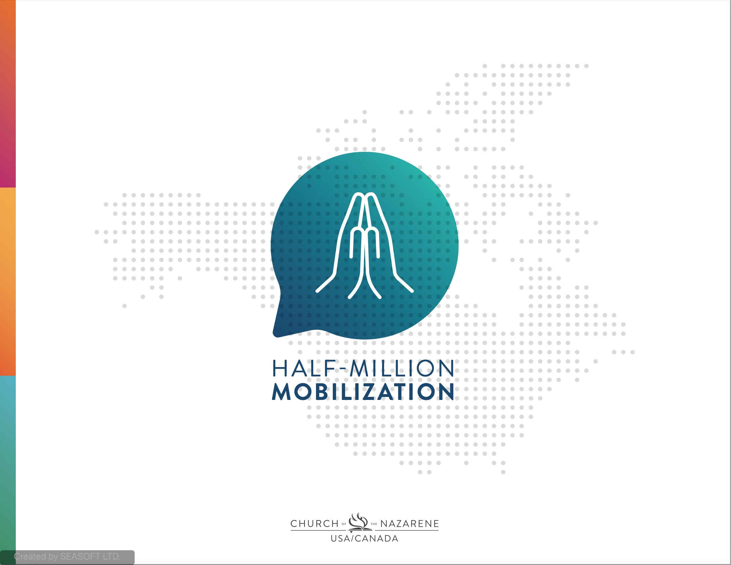

Slide 2

“For I know the plans I have for you,” declares the Lord, “plans to prosper you and not to harm you, plans to give you hope and a future. Then you will call on me and come and pray to me, and I will listen to you. You will seek me and find me when you seek me with all your heart. I will be found by you,” declares the Lord - Jeremiah 29:11-14a
God’s Part - He has a plan…a plan to prosper, to give hope and a future; He will be found; He will listen…He declares it!
Our Part – Believe the declaration, seek Him with all our heart, come and pray to Him

Slide 3
Has two intersecting elements:
THE HALF-MILLION MOBILIZATION…
A Call to PRAYER
A Call to SPEAK

Slide 4
For the Lord’s PROTECTION …
A HALF-MILLION MOBILIZED TO PRAY:
For the Clergy and Lay Leaders
For the People
For unity around our Mission

Slide 5
For the Lord’s DIRECTION …
A HALF-MILLION MOBILIZED TO PRAY:
For His will to be done on earth as it is in heaven
For wisdom and guidance

Slide 6
For the Lord’s REVELATION …
A HALF-MILLION MOBILIZED TO PRAY:
For us to hear His voice
For us to see what He is blessing
For us to know His Vision, His Plan
Join the Prayer Mobilization, Seek and Find the Lord

Slide 7
This is an invitation to be heard:
A HALF-MILLION MOBILIZED TO SPEAK:
A call to share what the Spirit is saying to and doing through the Church
Every voice in our region matters
Our combined voice will unify us
Join the discussion mobilization, take the survey, speak up

Slide 8
We believe we can discover what God is saying to/ doing in the Church and align our vision, values, plans, strategies and resources with His Plan
WHY A HALF-MILLION MOBILIZATION?

Slide 9
We believe God’s desire is to bring RENEWAL and RESURGENCE in the Church of the Nazarene!
WHY A HALF-MILLION MOBILIZATION?
We look forward to a new day, and a fresh wind on our people and Church in USA/Canada!
We look forward to a new day for renewed growth and impact of the Church in USA/Canada!

Slide 10
HOW TO MOBILIZE A HALF-MILLION TO PRAY:
50 - GS’s, DSAC, GMC Exec, Univ Presidents (01/22)
500 – DS/District & SRT Leaders, COK pastors (02/22)
5,000 - Local church pastors (03/22)
50,000 - Local church boards & ministry leaders (04/22)
500,000 - Local church congregations (05/22)
1
2
3
4
5

Slide 11
HOW TO MOBILIZE A HALF-MILLION TO SPEAK:
Immediately after a group prays we will follow-up with having them take a survey
The Survey…
Captures demographics so we know who is speaking
Is primarily quantitative with multiple choice and scale rating
Has one qualitative/narrative question to hear the heartbeat of the respondent
Is short, so it actually gets taken

Slide 12
TIMELINE FOR HALF-MILLION MOBILIZATION:
Build awareness, create prayer group invitations, build survey
June 5th
Present to GS’s & DS’s, create content, create survey & feedback plan
( Year 2022 )
May 1st
Apr (Board)
PENTECOST SUNDAY
Mar 1st
5
Group Prays!
Create plan,
basic messaging
Oct ’21 – Dec ‘21
Feb 1st
4
Group Prays!
Prayer Journal Ends
Jan 11th
3
Sept ‘21
Group Prays!
Prayer Journal Begins
2
Aug ‘21
Group Prays!
1
Group Prays!
Revised March 2021

Slide 13
THE HALF-MILLION MOBILIZATION DREAM:
500,000+ Nazarene’s in the USA/Canada praying for protection, direction, revelation
Excitement for what God is saying to and doing in the Church
A God given plan for our hope and future
A Holy Spirit fueled renewal and resurgence

Slide 14
THE HALF-MILLION MOBILIZATION CONTACTS:
Dr. Stan Reeder, USA/Canada Regional Director
sreeder@usacanadaregion.org
Rev. Jeff Alexander, USA/Canada Director of Strategy
jalexander@usacanadaregion.org

