Slide 1
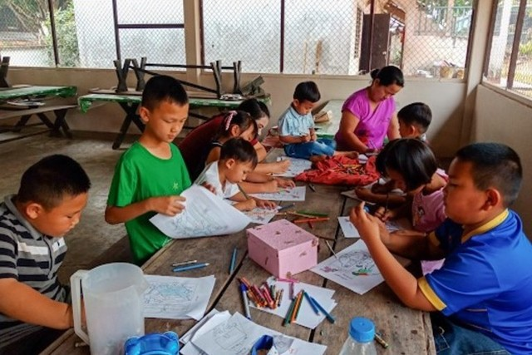
2026-2027 Children’s Mission Project
SEA: Southeast Asia Field Literature Project
Funds for the Literature Project will be used to create videos and books to help kids and adults hear the good news about Jesus.
https://www.youtube.com/watch?v=5b0vlPtg8Pc
“Let the little children come to me,
and do not hinder them,
for the kingdom of heaven belongs to such as these.”
Matthew 19:14
Send Funds for this project through “Funding the Mission”
“Search for Additional Project” and enter # 128559

