Slide 1

MEN’S CENTRAL JAIL CLOSURE PLAN:
MEN’S CENTRAL JAIL CLOSURE PLAN:
MEN’S CENTRAL JAIL CLOSURE PLAN:
ACHIEVING A CARE FIRST VISION ​
Notes:
Peter – 2 minutes / then Bruce:
Speaker introductions:
Peter, Asst Sheriff Bruce Chase, Dr. Bob Ross-TCE, Karen Tamis-DHS consultant, Michelle Parris-Vera Institute, Diana Zuniga-DHS and Reentry Health Advisory Collaborative, Troy Vaughn-LARRP, Herb Hatanaka-SSG, Tracey Whitney-DA, Eunisses Hernandez-La Defensa
Collaboration between ODR and LASD
Tremendous amount of work on heels of ATI, covid releases, to keep population down and continue reductions to close MCJ

Slide 2

INHUMANE FACILITY FOR ALL PEOPLE INVOLVED
2. POOR HEALTH, SOCIAL,
& LEGAL OUTCOMES
WHY CLOSE MCJ?
3. HIGH COST & LIABILITY
4. RACIAL INEQUITY
5. GROWING MENTAL HEALTH
POPULATION
Notes:
Dr. Ross – why close MCJ? 2 minutes
Board and community have long made it clear that MCJ must be closed
Board made the decision not to replace it with a new jail or build a new women’s jail and instead invest in communities – that’s where ATI was born
This is the plan for how to expand reductions, equitably, and finally close MCJ, after years of study and plans and reports

Slide 3

MCJ CLOSURE MOTION: CONTEXT
MARCH
2020
ATI CARE FIRST, JAILS LAST REPORT describing vision for a holistic, decentralized system of care.
APRIL-
MAY
2020
Jail population reduced by 5,000
in response to COVID-19.
JULY
2020
BOS requests 12-month plan to close MCJ.
Notes:
Dr. Ross – share context for MCJ Closure motion – 2 minutes
March 10 ATI report submission, describing road map for healthier, safer communities
COVID hit and health and justice agencies reduced population by 5,000
Releases did not improve racial disparities especially for Black people, or health disparities – mental health population continued to rise as percentage of overall population (now at 40% - more than 6,000 people)
Many of the recommendations on how to do this are consistent with things the Board has already invested in and expressed an interest in doing more on - like de-carcerating women and the mental health population - and we will talk more about that and next steps at the end
The MCJ Closure motion was part of an arc representing a pivot by the county to a ‘care first, jails last’ approach.

Slide 4

MCJ CLOSURE WORK GROUP PARTICIPANTS
ACLU of Southern California (ACLU So Cal) ​
Alternate Public Defender (APD) ​
Auditor Controller ​
California Contract Cities Association ​
Chief Executive Office (CEO) ​
CHS/Addiction Medicine​
CHS/Care Transitions​
Civilian Oversight Commission ​
Community Health Project Los Angeles ​
Correctional Health Services (CHS) ​
County Counsel ​
Department of Mental Health (DMH) ​
Department of Public Health (DPH) ​
Department of Public Health-Substance Abuse and Prevention Control (DPH-SAPC) ​
DHS/ Housing for Health ​
DHS/ Office of Diversion and Reentry (ODR) ​
DHS/Whole Person Care ​
District Attorney (DA) ​
InsideOUT Writers ​
JFA Institute ​
La Defensx ​
Los Angeles City Attorney ​
Los Angeles County Board of Supervisors ​
Los Angeles County Police Chiefs Association (LACPCA) ​
Los Angeles County Prosecutors Association (LACPA) ​
Los Angeles County Superior Court​
Los Angeles Homeless Services Authority (LAHSA) ​
Los Angeles Police Department (LAPD) ​
Los Angeles Regional Reentry Partnership (LARRP) ​
Los Angeles Sheriff’s Department (LASD) ​
​
Million Dollar Hoods ​
National Alliance on Mental Illness (NAMI) Greater Los Angeles County​
Office of the Inspector General ​
Probation Department ​
Public Defender (PD) ​
Reentry Health Advisory Collaborative (RHAC)
Special Service for Groups (SSG) ​
The Bail Project ​
The California Endowment ​
UCLA Bunche Center​
UCLA Criminal Justice Center​
Vera Institute of Justice ​
Notes:
Karen-participants

Slide 5
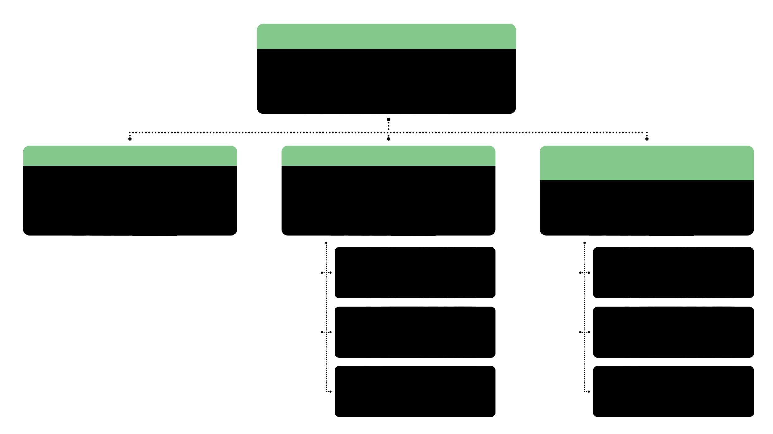
MCJ CLOSURE WORK GROUP
CO-CHAIRS: Peter Espinoza (ODR) and Assistant Sheriff Bruce Chase
DATA & FACILITIES COMMITTEE
SERVICES & PROGRAMS COMMITTEE COMMITTEE
Community Engagement & Racial Equity
(CERE) Advisory Group​
CHAIRPERSONS: Dr. Tim Belavich (CHS), Joan Hubbell (CHS), Commander Hugo Macias (LASD), Michelle Parris
(Vera Institute)
CHAIRPERSONS: Troy Vaughn (LARRP),
Brenda Doyle (CHS),
Captain Roel Garcia (LASD)
Chairpersons: Diana Zuñiga (DHS), Diamond Lee (DHS), Reentry Health Advisory Collaborative (RHAC)
COMMUNITY PATHWAY
SUBCOMMITTEE
COMMUNITY ENGAGEMENT
FEEDBACK
FACILITY PATHWAY
SUBCOMMITTEE
RACIAL EQUITY QUESTIONS AND ACTIONS
FUNDING SUBCOMMITTEE
PARTICIPATING BUDGETING
PROCESSES & PRINCIPLES
Notes:
Karen - process

Slide 6
CERE Advisory Group
To support an infrastructure of community care and systemic accountability, the CERE Advisory Group focused on activities pertaining to racial equity, community engagement, and participatory budgeting. ​
These activities can also impact reassessments of AB109 funding, the Jail Population Review Council, Measure J, and other ATI-related activities.
Participants:
ACLU of Southern California, Advancement Project, Californians for Safety and Justice, Community Coalition, Dignity and Power Now, Drug Policy Alliance, Frontline Wellness Network, InsideOUT Writers, LA County Department of Health Services, LA County Public Defender’s Office, La Defensx, Million Dollar Hoods, NAMI Greater Los Angeles County, Participatory Budgeting Project, Paving the Way Foundation, Reentry Health Advisory Collaborative, Special Services for Groups, St. John’s Well Child and Family Center, The Bail Project, The California Endowment, Timelist Group, Translatin@ Coalition, UCLA Bunche Center, and Vera Institute of Justice​
Notes:
Diana – 1 minute
Define CERE and membership

Slide 7
CERE Advisory Group Contributions
Community Engagement: Phase II: What would you build instead of MCJ?​
​Racial Equity Activities: Data Collection Guidelines; System Disparity Analysis: Early Releases (Pre-Trial, Zero Dollar Bail, Stipulated Releases); and Pre-Trial Memo​
Participatory Budgeting: Goals; Principles; Roles; and Process (Integration of all CERE components)​
Notes:
Diana – 3 minutes
Cover CERE community engagement, racial equity, PB work

Slide 8

POPULATION REDUCTION GOAL
CATEGORY
ESTIMATE
DESCRIPTION (BASED ON FALL 2020)
TOTAL POPULATION
15,000
Estimated number of people in LA County jail. Number fluctuates daily.
POPULATION AWAITING STATE TRANSFER
• 3,000 people awaiting transfer to state facilities due to COVID-19.
• An estimated 2,300 can be transferred post COVID-19.
• Approximately 700 typically awaiting state transfer pre-COVID-19.
2,300
REMAINING
POPULATION
12,700
• Base number of people in jail, excluding the population awaiting state transfer.
• Reduction goal of 4,500 people corresponds approximately to the number
of people in MCJ.
• According to a RAND study, of the mental health population in jail (n=6000)
at least 61% can be diverted out (i.e., 3,660).
• Additional people need to be identified to achieve the 4,500 goal.
POPULATION
REDUCTION
GOAL
4,500
FINAL TOTAL POPULATION
8,200-8,500
• Maximum number of people in the jail after the reduction goal is achieved.
Notes:
Karen – reduction goal
Used these numbers for process
Note on transfers – now almost 4,000 and baseline population down to 11,400 roughly
To close MCJ, need to get to a population of 8200-8500

Slide 9

MCJ CLOSURE PLAN
Facilities
Diversion
Community
Notes:
Karen
So, we developed a plan to reduce the population through a ‘care first’ diversion approach, prioritizing 6 groups.
3 components to plan
A note on the timeline – Board asked for 12-month plan, by end of process stakeholders agreed that 18-24 months was more viable albeit no less urgent or aggressive in terms of decisions and action.

Slide 10
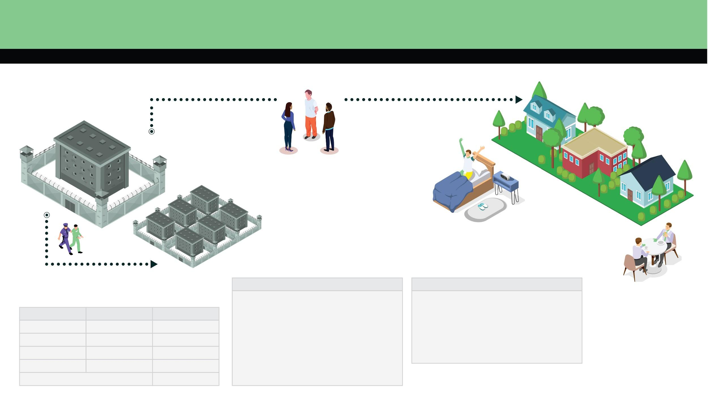
FACILITIES
DIVERSION
COMMUNITY
12,700 PEOPLE IN LA COUNTY JAIL
COST: $443-$654/DAY
(FOR MOH/HOH)
DIVERT 4,500 PEOPLE
COST: $180/DAY
(COMMUNITY-BASED HOUSING & CLINICAL CARE)
COMMUNITY-BASED
SYSTEM OF CARE
DIVERSION TEAM
RESIDENTIAL TREATMENT
FIELD-BASED SERVICES
HOUSING
TARGET GROUPS FOR DIVERSION
PRESUMPTION POLICY
1. Serious Mental Health Population
2. People with Misdemeanors
3. People with Non-Serious/Non-Violent Felonies
4. People with Pretrial-Bail Set
5. People Age 50+
6. Cisgender Women/ LGBTQ+/ Transgender, Gender Non-conforming, and Intersex People
As a general matter, there is a presumption of diversion/release for the selected target groups, unless there is a reason to prevent it.
MONTHS
REDUCTION
SUBTOTAL
0-6
6-12
12-18
18-24
- 800
- 1,250
- 1,500
- 950
11,900
10,650
9,150
8,200
8,200
FINAL POPULATION
Cost Data: The High Observation Housing rates are estimates originally calculated by the Auditor-Controller as part of a 2019 CIO Presentation on Mental Health Population Growth for FY 2017-18 and based on data/information provided by LASD (unaudited).
Notes:
Karen
Provide overview of plan – three main components
The plan involves some logistical changes within the jail system—including some shifting of functions and populations within the remaining 6 facilities, like clearing out space in CRDF and Twin Towers and moving the MOSH (medical services)—but will not rely on overcrowding the other jails or expansions to jails.

Slide 11

DIVERSION COMPONENT
Based on data and case stories, an Ad Hoc Team of the MCJ Workgroup identified SIX TARGET GROUPS for diversion and a POLICY recommendation for substantially increased diversion and healthier, safer long-term outcomes.
TARGET GROUPS FOR DIVERSION
1. Serious Mental Health Population ​
2. People with Misdemeanors ​
3. People with Non-Serious/
Non-Violent Felonies ​
4. People with Pretrial-Bail Set ​
5. People Age 50+​
6. Cisgender Women/ LGBQ/
Transgender, Gender Non-
conforming, and Intersex People
POLICY RECOMMENDATION: As a general matter, there is a presumption of diversion/release from jail custody for the identified target groups, unless there is a specific consideration to prevent it.
Notes:
Karen – describe process and task
Created ad hoc team of legal stakeholders and service providers to review data, discuss case stories, talk through challenges and how to address them
Met also with representatives of the LA City Attorney Office, DA, PD and APD and incorporated feedback/input into final report, secured support from each office

Slide 12
DIVERSION: CRITICAL CONSIDERATIONS
To have the most impact on the jail population, divert people spending more than 30 days in custody.
Include and expand diversion opportunities for people charged with serious/violent felonies—not just those with more minor charges—to decrease the jail population sufficiently.
Proactively center racial equity to decrease the long-standing incarceration disparities.
DIVERT 4,500 PEOPLE
DIVERSION TEAM
Notes:
Michelle P
Estimated how to achieve reduction goal
Describe critical considerations
Mention population reductions in other jurisdictions and timeline for that / how they did it
Describe dashboard idea for accountability – once implemented is population going and staying down

Slide 13

COMMUNITY COMPONENT
Expand existing residential programs by 4,000 beds that serve justice-involved populations to increase service capacity in the community, prioritizing the mental health population.
COMMUNITY COMPONENT
MONTHS | OBJECTIVES
0-24 | Add 3,600 beds for community-based mental health care; and 400 beds for individuals with serious medical, SUD, and/or housing needs.
24-36 | Expand total beds in line with Executive Work Group’s calculations to sustain reductions.
Notes:
Michelle – 1 minute
Connected to focus populations for diversion, many, not all, will need supported releases into residential and high level of services in the community
Turn over to Troy to describe the community expansion recommendations
Troy – 2 minutes
To implement Board’s ‘care first’ approach—especially for the most vulnerable—the county will need to expand existing residential programs by 4,000 beds over the course of 24 months.
Focus on highly vulnerable populations that need residential services at release (1) mental health, (2) chronic medical conditions, (3) SUD / co-occurring disorder, (4) homeless
Providers can and ready to add beds if resourced appropriately
Developing capacity through ATI, Measure J, other sources
No getting around the need to expand the beds for justice population to move people out and stop relying on jail for mental health care
Tracey – 2 minutes
Constantly looking for beds in courtrooms
Prosecutors and judges would use them if they existed
We have programs that work that need expansion

Slide 14

SERVICES EXPANSION – TOTAL ANNUAL COST
Mental Health Services/Intensive Case Management Services/Interim Housing
TOTAL COST | $237,633,132
AVERAGE COST PER CLIENT/PER YEAR | $66,009
AVERAGE COST PER CLIENT/PER DAY | $181
AVERAGE CAPITAL COST PER BED (ONE-TIME EXPENSE) | $3,500-$6,500
Notes:
Herb – 5 minutes
To build this out, the county will need to invest $12-23 million in capital costs and $237 million for treatment for first year.
Once in place, the costs of treatment and housing are reduced, and some are reimbursed by other sources (some programs MediCal, others like DHS/ODR will rely on changes to CalAIM, AB109, etc.)
Ultimately the treatment costs for the MH population are cheaper AND more effective in the community than in the jail.

Slide 15

WHERE TO START
4,000 bed expansion: majority mental health beds for ODR housing.
De-carcerate women in line with ATI recommendations, GRAC, and Get Them Out Campaign.
Build centralized community-based unit for comprehensive assessment & diversion.
Notes:
Eunisses-2 minutes
Important action / implementation steps – this is what the Board can do now, some underway already
The County now has two places where important planning and implementation is happening that connects to MCJ closure - JPRC and ATI, plus GRAC - we envision all bodies will have important roles to play in implementing MCJ closure

Slide 16
KEY TAKEAWAYS
Closing MCJ is as urgent as ever.
Closing MCJ advances the County’s care first vision and equity goals.
Building an equitable system of care is a necessary and cost-effective investment in the long term.
Notes:
Eunisses – 2 minutes
Key takeaways – urgency
Cannot wait for more study

